Slide 1
Problem related to Hydro Electric Power Plant

Slide 2
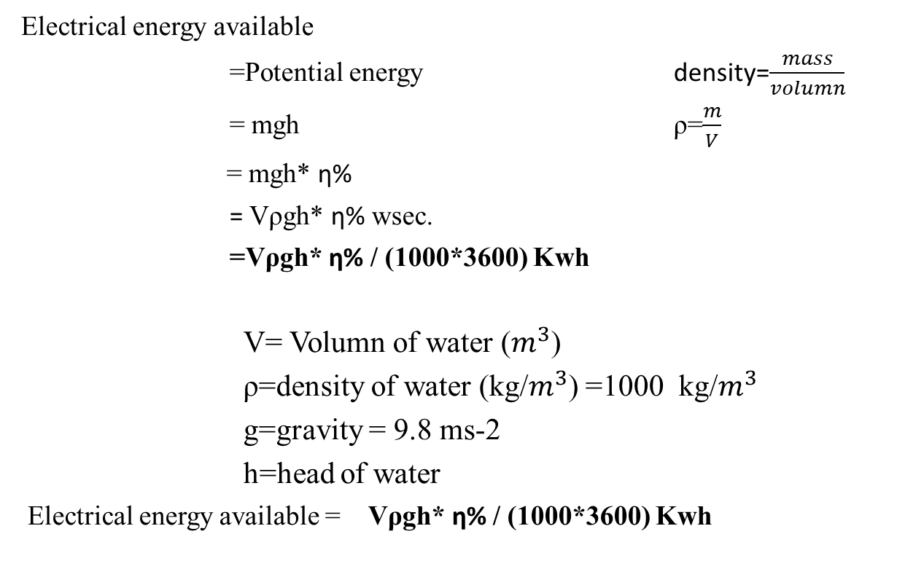
Electrical energy available
=Potential energy density=$\frac{mass}{volumn}$
= mgh ρ=$\frac{m}{V}$
= mgh* ⴄ%
= Vρgh* ⴄ% wsec.
=Vρgh* ⴄ% / (1000*3600) Kwh
V= Volumn of water ($m^{3}$)
ρ=density of water (kg/$m^{3}$) =1000 kg/$m^{3}$
g=gravity = 9.8 ms-2
h=head of water
Electrical energy available = Vρgh* ⴄ% / (1000*3600) Kwh

Slide 3
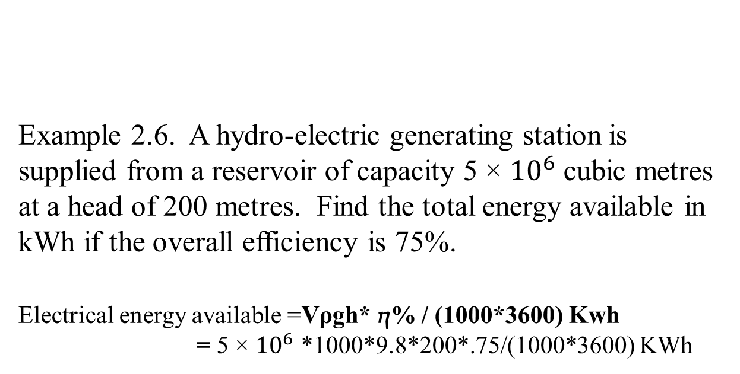
Example 2.6. A hydro-electric generating station is supplied from a reservoir of capacity 5 × ${10}^{6}$ cubic metres at a head of 200 metres. Find the total energy available in kWh if the overall efficiency is 75%. Electrical energy available =Vρgh* ⴄ% / (1000*3600) Kwh = 5 × ${10}^{6}$ *1000*9.8*200*.75/(1000*3600) KWh

Slide 4
Example 2.7. It has been estimated that a minimum run off of approximately 94 m3/sec will be available at a hydraulic project with a head of 39 m. Determine (i) firm capacity (ii) yearly gross output. Assume the efficiency of the plant to be 80%. Electrical energy available =Vρgh* ⴄ% w firm capacity =Vρgh* ⴄ% w =94*1000*9.8*39*0.8 w = M kw yearly gross output= firm capacity * 8760 kwh

Slide 5
Example 2.8. Water for a hydro-electric station is obtained from a reservoir with a head of 100 metres. Calculate the electrical energy generated per hour per cubic metre of water if the hydraulic efficiency be 0·86 and electrical efficiency 0·92.
Electrical energy available =Vρgh* ⴄ%
= 1*1000*9.8*100*.86*.92 kwh

Slide 6
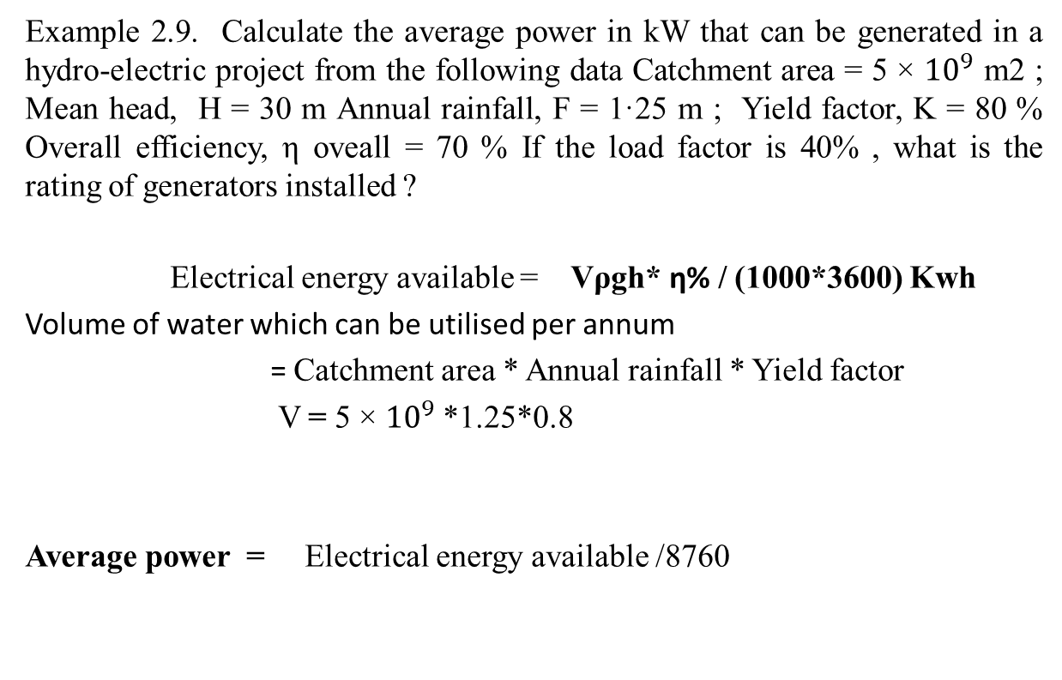
Example 2.9. Calculate the average power in kW that can be generated in a hydro-electric project from the following data Catchment area = 5 × ${10}^{9}$ m2 ; Mean head, H = 30 m Annual rainfall, F = 1·25 m ; Yield factor, K = 80 % Overall efficiency, η oveall = 70 % If the load factor is 40% , what is the rating of generators installed ?
Electrical energy available = Vρgh* ⴄ% / (1000*3600) Kwh
Volume of water which can be utilised per annum
= Catchment area * Annual rainfall * Yield factor
V = 5 × ${10}^{9}$ *1.25*0.8
Average power = Electrical energy available /8760

Slide 7
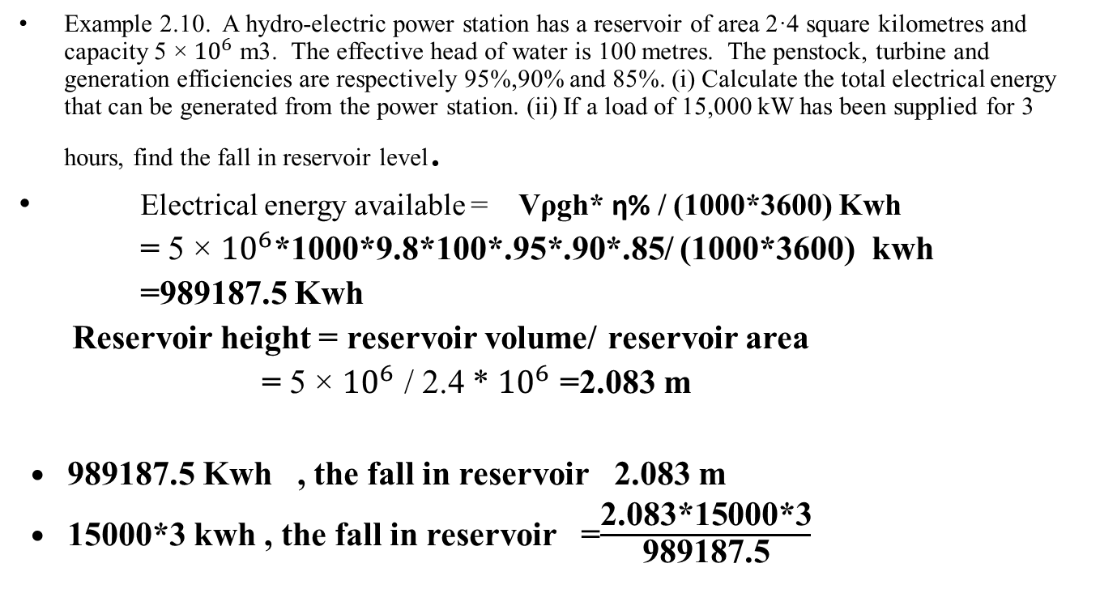
Example 2.10. A hydro-electric power station has a reservoir of area 2·4 square kilometres and capacity 5 × ${10}^{6}$ m3. The effective head of water is 100 metres. The penstock, turbine and generation efficiencies are respectively 95%,90% and 85%. (i) Calculate the total electrical energy that can be generated from the power station. (ii) If a load of 15,000 kW has been supplied for 3 hours, find the fall in reservoir level.
Electrical energy available = Vρgh* ⴄ% / (1000*3600) Kwh
= 5 × ${10}^{6}$*1000*9.8*100*.95*.90*.85/ (1000*3600) kwh
=989187.5 Kwh
Reservoir height = reservoir volume/ reservoir area
= 5 × ${10}^{6}$ / 2.4 * ${10}^{6}$ =2.083 m
989187.5 Kwh , the fall in reservoir 2.083 m
15000*3 kwh , the fall in reservoir =$\frac{\text{2.083}\text{*}\text{15000*3}}{\text{989187.5}}$

Slide 8
Example 2.11. A factory is located near a water fall where the usable head for power generation is 25 m. The factory requires continuous power of 400 kW throughout the year. The river flow in a year is (a) 10 m3/sec for 4 months, (b) 6 m3/sec for 2 months and (c) 1·5 m3/sec for 6 months.
(i) If the site is developed as a run-of-river type of plant, without storage, determine the standby capacity to be provided. Assume that overall efficiency of the plant is 80%.
(ii) If a reservoir is arranged upstream, will any standby unit be necessary ? What will be the excess power available ?

