Slide 1
Modulation
Course Name : Communication Engineering
Course Title : ICE 237

Slide 2
Amplitude-Modulation System
Modulation:
In electronics and telecommunications, modulation is the process of varying one or more properties of a periodic waveform, called the carrier signal (high frequency signal), with a modulating signal that typically contains information to be transmitted.
In telecommunications, modulation is the process of conveying a message signal, for example a digital bit stream or an analog audio signal, inside another signal that can be physically transmitted. Modulation of a sine waveform transforms a baseband message signal into a pass band signal.

Slide 3
Frequency Translation
Some advantages of frequency translation are given below
Frequency Multiplexing:
Suppose that we have several different signals, all of which encompass the same spectral range. Let it be required that all these signals be transmitted along a single communication channel in such a manner that, at the receiving end, the signals be separately recoverable and distinguishable from each other. For that one signal is translated to the frequency range f₁’ to f₂’, the second to the range f₁” to f₂” and so on . if these new frequency ranges do not overlap, then the signal may be separated at the receiving end by appropriate bandpass filters.

Slide 4
Practicability of Antennas
When free space is the communication channel, antennas radiate and receive the signal. It turns out that antennas operate effectively only when their dimensions are of the order of magnitude of the wavelength of the signal being transmitted. A signal frequency of frequency 1 kHz corresponds to a wavelength of 300,000 m, an entirely impractical length. The required length may be reduced to the point of practicability by translating the audio tone to a higher frequency.
Narrowbanding
Let us assume that the audio range extends from, say, 50 to 10²⁴
Hz. The ratio of the highest audio frequency to the lowest is 200. Therefore, an antenna suitable for use at one end of the range would be entirely too short or too long for the other end.

Slide 5
Suppose, however, that the audio spectrum were translated so that it occupied the range, say, from (10⁶ + 50) to (10⁶ + 10⁴ ) Hz. Then the ratio of highest to lowest frequency would be only 1.01. Thus the process of frequency translation may be used to change a wideband signal into a narrowband signal which may well be more conveniently processed.
Common Processing
It may happen that we may have to process, in turn, a number of signals similar in general character but occupying different spectral ranges. It will then be necessary, as we go from signal to signal, to adjust the frequency range of the signal to be processed.

Slide 6
Frequency Translation
A signal may be translated to a new spectral range by multiplying the signal with an auxiliary sinusoidal signal.
The pattern consists of two lines, each of amplitude A_{m}/2 located at f = f_{m} and f =-f_{m} .Consider next the result of the multiplication of v_{m}(t) with an auxiliary sinusoidal signal

Slide 7
Using the trigonometric identity as
We have for the product
Now the two original spectral lines have been translated, both in positive frequency direction by amount f_{c} and also in negative direction by the same amount. So there are four spectral components resulting in two sinusoidal waveforms, one of frequency f_{c} + f_{m} and the other of frequency f_{c} – f_{m} .
Each of amplitude
The auxiliary signal of frequency is variously referred to as the local oscillator signal, the mixing signal, the heterodyning signal or carrier signal.

Slide 8
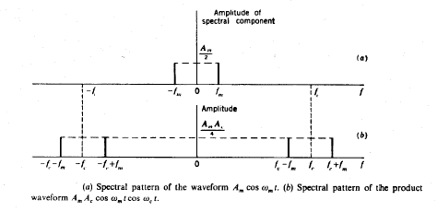
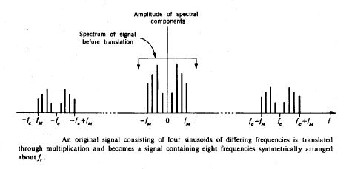

Slide 9
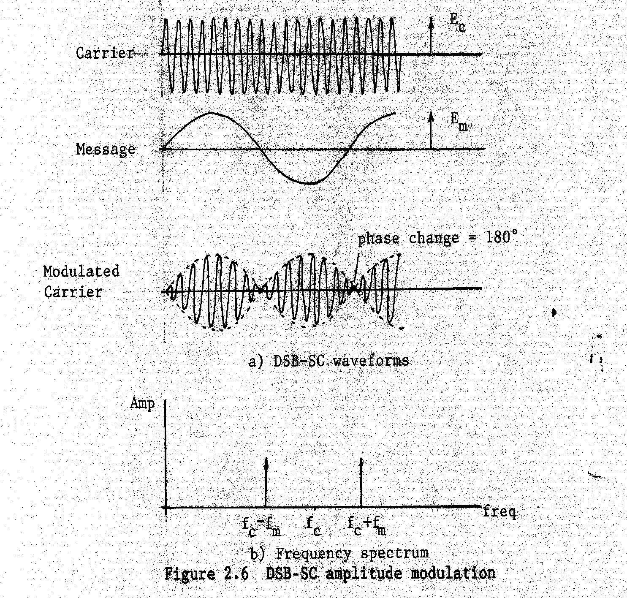
Notice: No carrier frequency

Slide 10
Recovery of the Baseband Signal
Suppose a signal m(t) has been translated out of its baseband through multiplication with cosω_{c}t. The recovery may be achieved by a reverse translation, which is accomplished simply by multiplying the translated signal with cosω_{c}t.
So the recovered baseband signal spectral range extends from 2f_{c} + f_{m} and 2f_{c} - f_{m} . Therefore the double frequency signal is easily removed by a low pass filter.

Slide 11
DSB-SC Detection
Synchronous detection
Low pass
filter
DSB-SC
Multiplier
Message signal
Local oscillator
c(t) = cos ω_{c}t
Condition:
Local oscillator has the same frequency and phase as that of the carrier signal at the transmitter.
high frequency
information
Low pass filter
ω_{m}
2ω_{c}-ω_{m}
2ω_{c}+ω_{m}

Slide 12
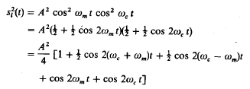
DSB-SC - Synchronous Detection
Suppose that the auxiliary signal used for recovery differs in phase from auxiliary signal.

Slide 13
Case 1 - Phase error
Low pass
filter
DSB-SC
Multiplier
Message signal
Local oscillator
c(t) = cos(ω_{c}t+θ)
Condition:
Local oscillator has the same frequency but different phase compared to carrier signal at the
transmitter.
high frequency
information
Low pass filter
ω_{m}
13
2ω_{c}-ω_{m}
2ω_{c}+ω_{m}

Slide 14
Amplitude Modulation
The amplitude modulated signal is given by
Here m(t) represents the modulation waveform which may be A cos ω_{m}t where A is the amplitude of the modulation. We shall insists that m(t)<1 so that (1+m(t)) is always positive. So the carrier is modulated in amplitude. The process of generating such a waveform is called amplitude modulation and a communication system which employs such a method of frequency translation is called an amplitude modulation system or AM system.

Slide 15
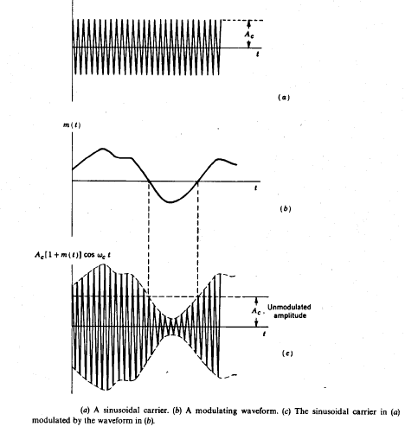

Slide 16
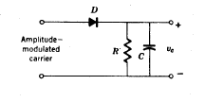
Demodulation
The very great merit of the amplitude modulated carrier signal is the ease with which the baseband signal can be recovered. The recovery of the baseband signal, a process which is referred to as demodulation or detection, is accomplished with the simple circuit consists of a diode D and the resistor capacitor RC combination.
For simplicity we assume that, the amplitude modulated carrier wave is applied at the input terminals with zero impedance and the diode is ideal.
If the input is of fixed amplitude and that the resistor R is not present.

Slide 17
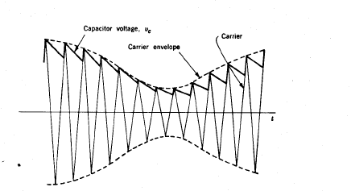
In this case the capacitor charges to the peak positive voltage of the carrier, holds this peak charge and would not again conduct. Suppose now the input carrier amplitude is increased. Then the diode again conducts and the capacitor charges to new higher carrier peak. But when the amplitude decreases, it is necessary to include the resistor R, so that the capacitor may discharge.

Slide 18
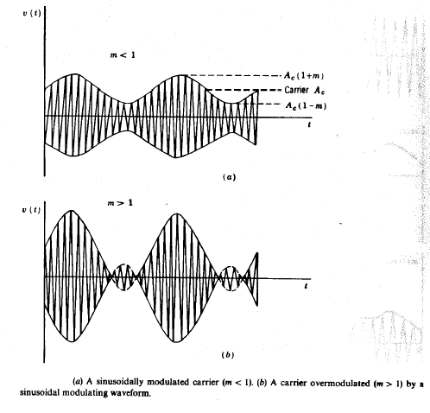
Maximum Allowable Modulation
m(t) = m cos ω_{m}t
And v(t)= A_{c} (1+m cos ω_{m}t)cos ω_{c}t

Slide 19
The percentage modulation is defined as
In case of a sinusoidal modulation,
P=m X 100

Slide 20
The Square Law Demodulator
An alternative method of recovering the baseband signal which has been superimposed as an amplitude modulation on a carrier is to pass the AM signal through a nonlinear device. We assume here for simplicity that the device has a square-law relationship between input signal x (current or voltage) and the output signal y. Thus y=kx² , with k a constant. Because of the nonlinearity of the transfer characteristics of the device, the output response is different for positive and for negative excursions of the carrier away from the quiescent operating point O of the device.
The output of the squaring circuit is

Slide 21
Squaring and dropping dc terms as well as terms whose spectral components are located near ω_{c} and 2ω_{c .} So the low pass filter output is
Observe that the modulation m(t) is indeed recovered but that m²(t) appears as well. So the total recovered signal is distorted version of the original modulation. The distortion is small, however, if 0.5 m²<<Im(t)I or Im(t)I<<2

Slide 22
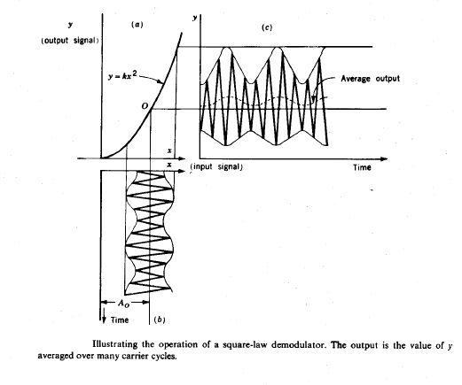

Slide 23
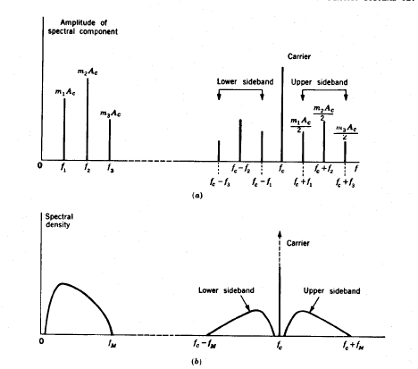
Spectrum of an AM signal

Slide 24
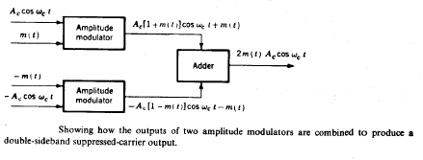
Balanced Modulator
Here two physical multipliers are used as amplitude modulators. The carrier inputs to the two modulators are of reverse polarity. The modulator outputs are added with consequent suppression of the carrier. The baseband signal is easily eliminated by a filter.

Slide 25
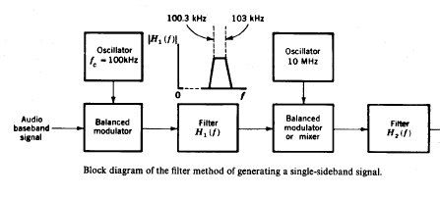
Methods of generating an SSB signal

Slide 26
Thank you All

