Slide 1
Impression Management

Slide 2
Working Attitude

Slide 3
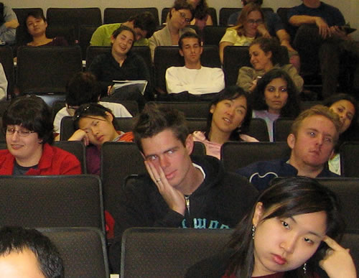
Classroom Attitude

Slide 4
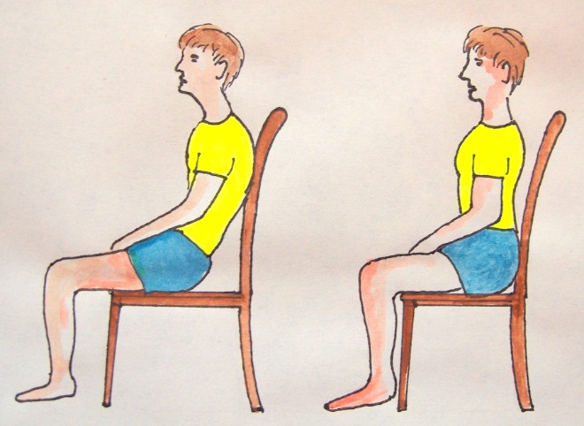
Classroom Sitting

Slide 5
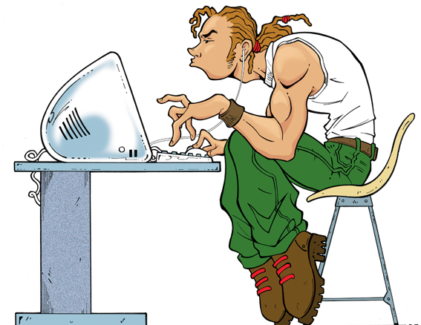
Office Sitting

Slide 6
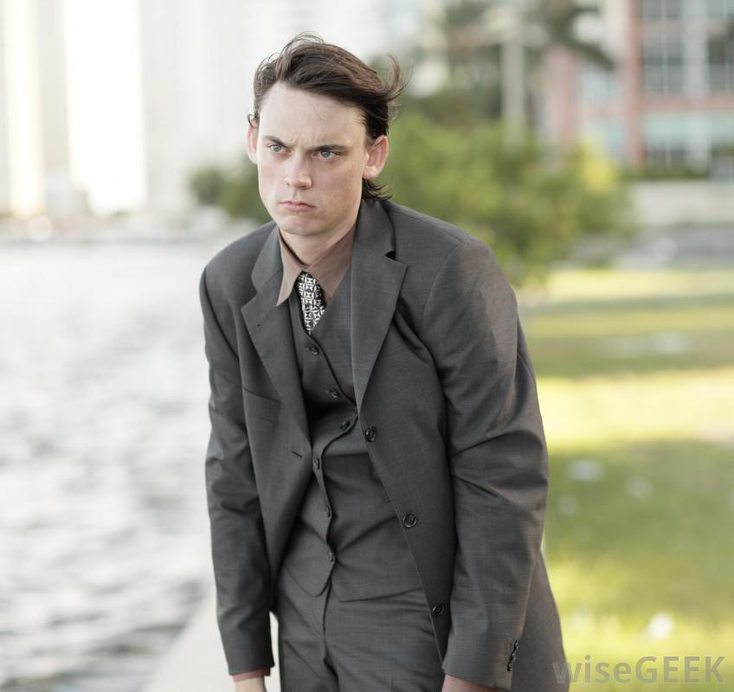
Standing
Attitude

Slide 7
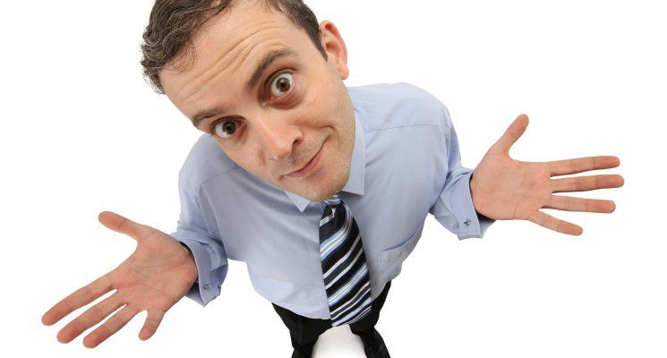
What is Impression Management?

Slide 8
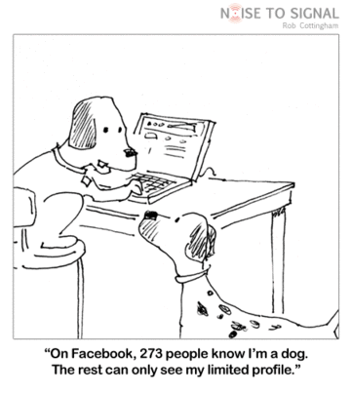
Impression Management
The process of portraying yourself to others in a manner that creates a desired impression.

Slide 9
Need of Impression Management

Slide 10
You will not get second chance to make your first impression

Slide 11
Within seconds of seeing a person for the first time we decide their:

Slide 12
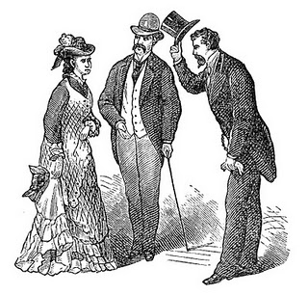

Slide 16
We evaluate others on the basis of

Slide 17
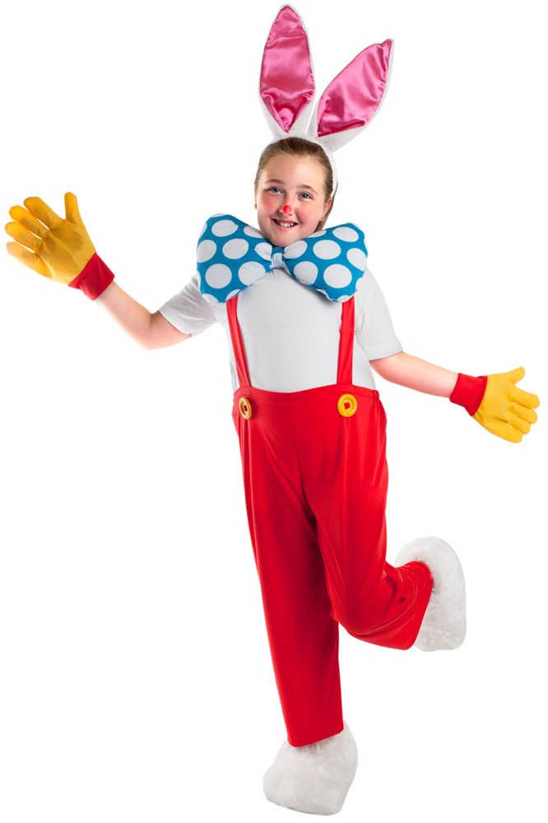
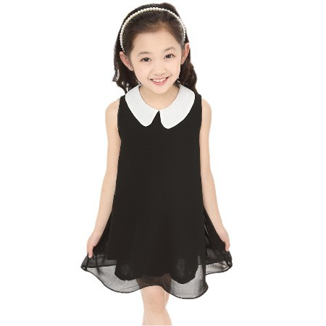
Dress

Slide 18
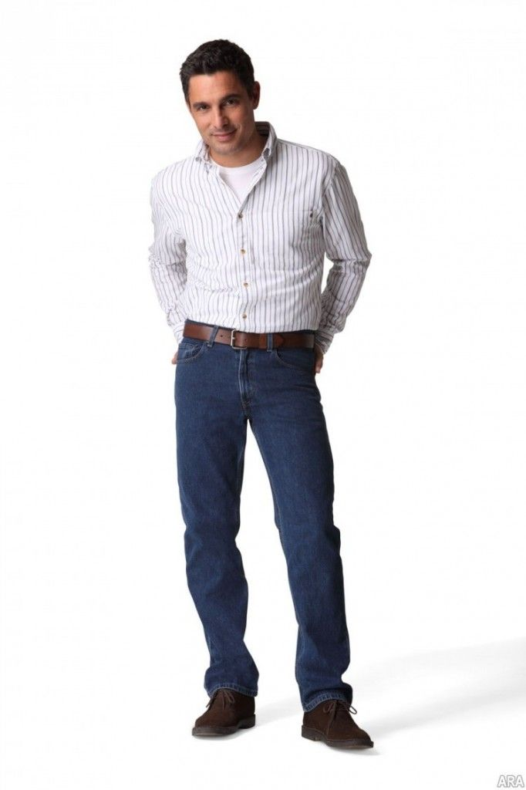
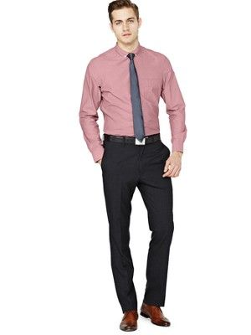
Formal Dress

Slide 19
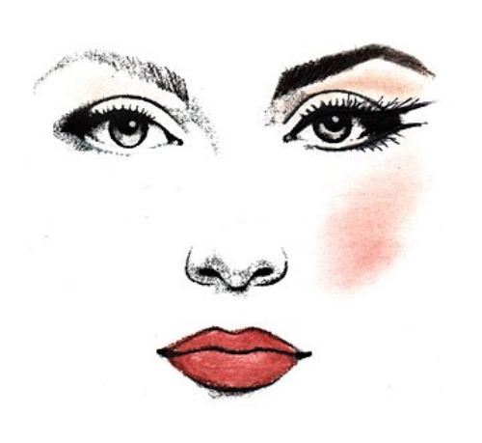
Makeup

Slide 20
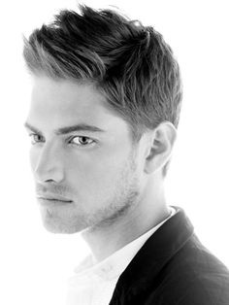
Hair Style

Slide 21
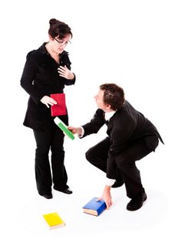
Manner and general behavior

Slide 22
Body language

Slide 23
Working
Attitude

Slide 24
Classroom
Attitude

Slide 25
Classroom
Sitting

Slide 26
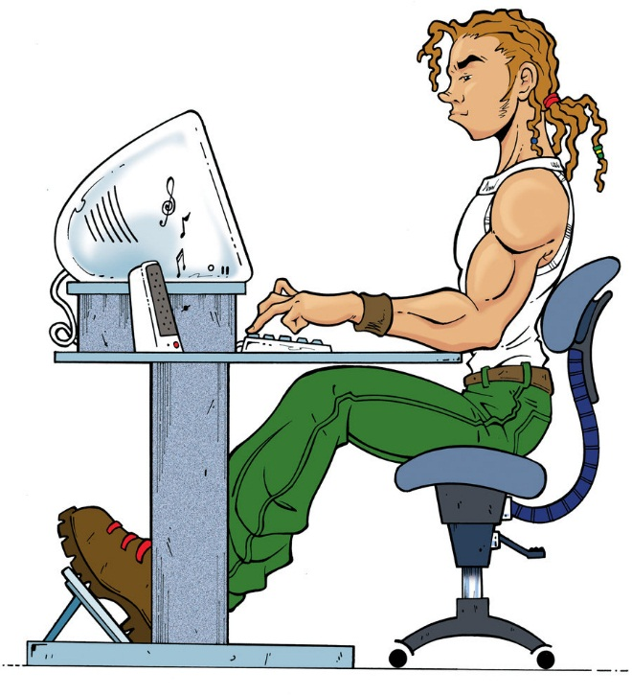
Office Sitting

Slide 27
Standing
Attitude

Slide 28
First impressions: 93% rule
38% tone, pitch & pace of your voice
55% appearance & body language
7% what you say

Slide 29
IM Techniques
Sweet talk
Favors
Verbal Self- Presentation
Apologies
Excuse

Slide 30
Good Impression vs. Bad Impression

Slide 31
How To Improve Impression Management :-
Set goals.
Commit to the change you want to create.
Dress appropriately
Learn to shake hands
Keep your body language open
Keep smiling and feel confident

Slide 33
