Slide 2
Lecture Outcome
Basic conception regarding GAD
Gender Empowerment Measurement
International Conferences
Four Major Theories
Research on Gender Issues
SDG, Health and Gender
Key Principles and Challenges

Slide 3
what is Gender and Development?
a globally - recognized development perspective; acknowledges that development affects people differently
women’s roles are important and should be maximized
women and men should be assisted in attaining their full potentials
advocates that planning deliberately address the unique needs and situations of women

Slide 4
GAD is about recognizing that gender biases IMPEDE development because:
they prevent people from attaining their full potentials
they worsen social inequity
they mislead understanding of social realities and limit the impacts of development efforts

Slide 5
GAD is about being faithful to the principle that:
Development is for all!

Slide 6
Gender and Development
WID/GAD
HEALTH
SHD
Notes:
WID/GAD - Women In Development/Gender and Development - forms an inseparable bond with Health and SHD - Sustainable Human Development.
The learning objectives for this course include:
a history of the development of WID/GAD and a discussion of the connection between gender and development.
a discussion of health issues that are pertinent to the continuing evolution of WID/GAD
and a discussion of a strategy for obtaining sustainable human development.
This lecture features
Gender and Development
The other two lectures on the topic are
Sustainable Human Development (SHD)
Interactions between GAD, SHD and women’s health

Slide 7
Gender and Development
What is the connection?
Why is it important?
Notes:
What is the connection between gender and development?
In the 1960s and 1970s, two international concerns emerged:
1. Women’s movements for equal rights
2. Criticisms of development processes.

Slide 9
Equal Rights for Women
Notes:
Women’s organizations, especially in North America and western Europe, mobilized to demand:
equal legal rights
expanded access to jobs and other economic resources
a voice in government policies
shared responsibility by men for household work and child care

Slide 10
Development Processes Criticized
Economists, governments and international organizations (IOs) defined development primarily in terms of traditional measures, such as increased Gross National Product (GNP) and the degree of industrialization.
Notes:
Even when the GNP went up, millions of people remained poor, and gaps between urban and rural people and men and women often widened. Also, although GNP measures the sum of all goods and services produced by a country’s nationals, the statistics used often do not reflect productive activities that are especially important for women, who may work, for example, primarily in subsistence agriculture.

Slide 11
“Women in Development”
The convergence of Women’s issues and Development problems led to the growth of the “Women in Development” (WID) field of study and policy advocacy.
WID advocates argued that:
the benefits of development had not reached women;
in some economic sectors women’s position was undermined;
women should be integrated into the design and implementation of development programs through legal and administrative changes.
Notes:
WID advocates argued that:
the benefits of development had not reached women;
in some economic sectors women’s position was undermined;
women should be integrated into the design and implementation of development programs through legal and administrative changes.

Slide 12
WID advocates sought change:
WID advocates sought to change development practices by pushing governments and international organizations to:
include women in development projects
respond to specific concerns and problems of women,
Notes:
The momentum to integrate women into development programs emerged from the priorities and interests of two different groups of women in the 1970s:
. The UN Commission of the Status of Women http://www.un.org/womenwatch/daw/csw/
. And national women’s movements, particularly in the US.
Some of the specific concerns addressed were
Nutrition
Health
Education
Access to resources, such as land and credit
These needs are now referred to as practical needs…the basics for survival.

Slide 13
Critique and Limits of WID
The mobilization of women as scholars, policy-makers, activists and practitioners of development led to criticisms of the WID policies of the 1970s.
The limits of the WID approach were emphasized.
Notes:
Limits of WID
1. Accepted traditional liberal economic theory about the nature of development;
2. Assumed women were not already integrated into economic production;
3. Influenced by American feminism: accepted existing social and political structures;
4. Assumed women all had common problems and interests;
5. De-emphasized the family and community contexts affecting women’s activities; 6. Often resulted in separate projects for women apart from broad development programs; 7. Non-confrontational, thus failed to transform the fundamental status of women.

Slide 14
Emergence of GAD Approaches
Criticism of the limits of WID led to new ways of thinking about development in the 1980s and 1990s. The theories and policies that emerged from this rethinking became known as “Gender and Development” (GAD).
Notes:
GAD approaches argued that:
1. Development processes in poor countries or less-developed countries (LDCs) were deeply influenced by the inequitable structures of the international economic system.
2. Women have always been integrated into development processes, but those processes essentially flawed.
3. Men, as well as women, are hurt by development programs that do not alter repressive class, ethnic, and racial structures.
4. One cannot assume women’s solidarity across class and racial lines, but patriarchal values and institutions may oppress women in every social-economic category.
5. Development policies should not isolate women’s productive or reproductive roles: they are intertwined in women’s lives.
6. Women are agents of change and must organize politically.
7. Successful development does not “target” women, it empowers them.

Slide 15
Empowerment
“Empowerment” is a relatively new term for the long-standing recognition that women and disadvantaged men must be organized to make a difference in the structures of power that confine them to secondary status.
Notes:
Empowerment may be defined as:
A process through which women and men in disadvantaged positions increase their access to knowledge, resources, decision-making power, and raise their awareness of participation in their communities, in order to reach a level of control over their own environment.
Source: World Food Programme,
Gender Glossary, n.d. (1998?)

Slide 16
Gender Empowerment Measure
Power over economic resources
Participation in economic decision making
Access to political opportunities
Notes:
This is an index developed by the U.N. Development Programme. It quantitatively measures the empowerment of women on a country-by-country basis, by using these three indicators:

Slide 17
Major International Conferences
Rio Conference 1992
Vienna Conference 1993
Cairo Conference 1994
Beijing Conference 1995
Notes:
The Rio de Janeiro conference on the environment and development (1992) acknowledged women’s roles in protecting the environment, and the special impact of environmental degradation on women.
The Vienna conference on human rights (1993) included “women’s rights as human rights”.
The Cairo conference on population and development (1994) addressed women’s needs for access to health, maternal care, and family planning facilities.
The Fourth World Conference on Women in Beijing (1995) built on earlier international conferences, national government efforts, and lobbying by NGOs to develop gender-sensitive strategies in its Platform for Action.

Slide 18
When is Gender Identity acquired by children?
By the age of 3, children know if they are male or female
Gender Role Development begins . . .
at birth

Slide 19
Four Major Theories
Psychoanalytic Theories
Freud
Erikson
Social-Learning Theory
Cognitive - Developmental Theory
Gender-Schema Theory

Slide 20
Psychoanalytic Theories
Freud
Ages 3 to 5, children feel sexually attracted to their other-sex parent
Ages 5 to 6, children feel guilt and anxiety over their attraction
Connection with same sex parent is crucial to long-term mental health and sex drive.

Slide 21
Psychoanalytic Theories
Erikson
An extension of Freud’s Theory
Based on sexual differences between men and women to explain psychological differences
Due to differing genital structures, males more intrusive and aggressive, and females more inclusive and passive

Slide 22
Social-Learning Theory
Emphasis on the power of the immediate situation and observable behaviors
Two ways children learn their gender roles:
They receive rewards or punishments for specific gender role behaviors
They watch and imitate the behavior of others
Belief that children imitate the same-sex parent
Socialization of children is one of the major causes of gender differences between boys and girls.

Slide 23
Social-Learning Theory continued
Children are encouraged to do the appropriate sex-typed activities by the following:
Parents
traditional roles feed to children in traditional families
Media
shows traditional roles for females and males; female is still placed in the traditional domestic role
Schools
transmit the information of gender role stereotypes to children

Slide 24
Cognitive-Developmental Theory
Children’s own cognitions are primarily responsible for gender role development
Kohlberg
children identify with and imitate same-sex parents, and others of their same gender
after children label themselves as male or female, the development of gender related interests and behavior quickly follow
Stages:
Gender Identity: children develop a concept of what sex category they belong to
Gender Consistency: children realize that their gender and that of other do not change with age, dress, or behavior

Slide 25
Cognitive-Developmental Theory continued
Appropriate female or male activities identified and imitated, once gender consistency established
External world rewards or punishes them for their choices

Slide 26
Gender-Schema Theory
Theory suggests that children
use gender as a schema to organize and guide their view of the world
acquire gender-specific behaviors through social-learning
own thought processes encourage gender development
A combination of the social-learning and cognitive-developmental approaches

Slide 27
Research on Gender Role Development
Fagot
Stone and Church
Hemmer and Klieber
Golombok and Fivush
Sadker and Sadker
Condry and Condry
Goldberg and Lewis

Slide 28
Research on Gender Differences
Infants
Studies have shown that most infant behaviors do not show gender differences
Gender similarity is rule for most infant behaviors
Activity Level
male infants have a greater activity level (more kicking, arm movements, fussing, and crying) than girls
later in life boys are still seen as more active
Aggression
one of the most consistently documented psychological gender differences
male children more aggressive than female children

Slide 29
Research on Gender Differences continued
differences hold true for the variety of aggressions, such as verbal and physical
differences tend to disappear later in life around the college years
gender roles are the cause of gender differences
girls realize that they should be passive and boys realize they must be aggressive
prosocial or justified to be aggressive for male children
rewards are give to boys who are aggressive and girls are punished for being aggressive

Slide 30
Research on Gender Differences continued
possibly explains why 80% of boys are classified as hyperactive compared to girls who are seen as passive
Anxiety
studies have shown that girls display more anxiety and fear than boys
biased interpretation of emotions
boys’ anxiety is likely to be seen as anger
girls’ anxiety is likely to be seen as fear
Academic Ability
boys outperform girls in math and spatial tasks

Slide 31
Research on Gender Differences continued
girls outperform boys in language and arts (reading & writing)
Expectations of teachers and parents influence girls and boys academic performance
Language Ability
females read earlier than males
females continue to outperform males through high school

Slide 32
Research on Gender Differences continued
females more encouraged to engage in passive activity (reading)
parents work harder to engage girls in mutual social interaction
Play and Friendship Patterns
Play
between 2 &3 years of age, girls begin to prefer playing with other girls and boys with other boys
children reinforced by adults and possibly by other children for selecting same-gender playmates and gender-typed play
children also prefer same-gender playmates because females and males have different play styles.

Slide 33
Research on Gender Differences continued
Friendship
Long-lasting friendships with peers do not occur until elementary school
Girls
spend more time conversing with each other, sharing secrets, and talking about mutual interests than boys
more likely to have a single best friend
Boys
play in groups and tend not to have a single best friend
activities revolve around rule-governed games
do not engage in long or intimate conversations with friends

Slide 34
KEY PRINCIPLES
Development planning and practice should:
deliberately ADDRESS OBSTACLES to
women’s effective participation and enjoyment f benefits
EXPAND women’s range of CHOICES
and OPPORTUNITIES
STRENGTHEN their capabilities to attain a full and satisfying life
BRIDGE the gender gap
PROMOTE gender equality

Slide 35
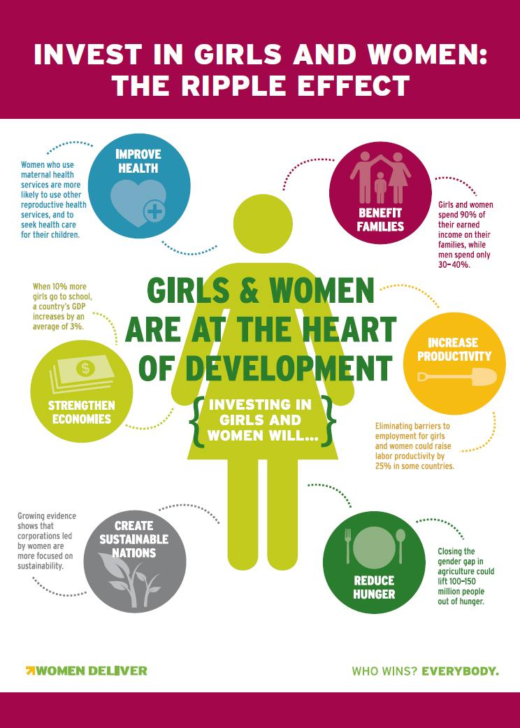

Slide 36
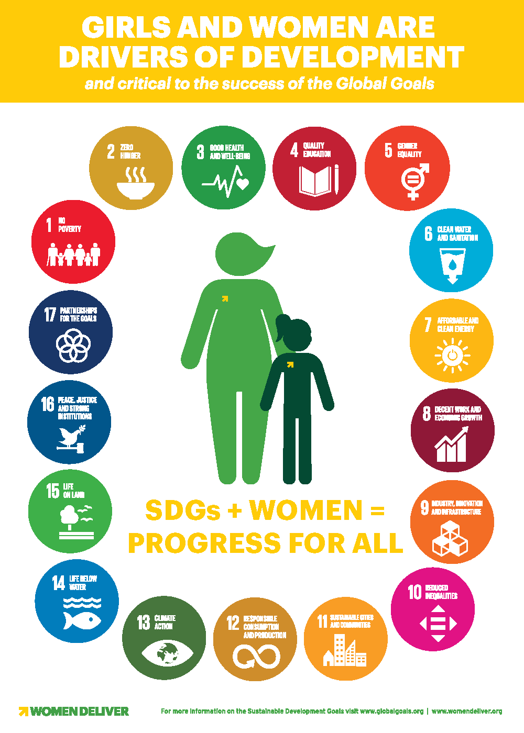

Slide 37
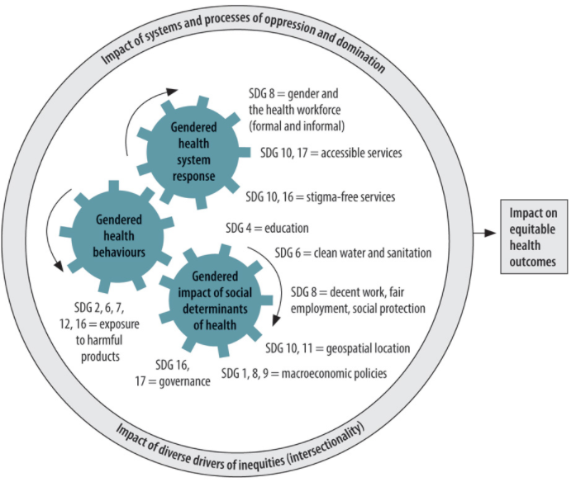
Conceptual framework to show interactions between sustainable development goals 3 (health) and 5 (gender) with other global goals across three domains of gender and health (WHO)

Slide 38
What are the challenges in doing GAD plan?

Slide 39
CHALLENGES
GAD plans submitted only for compliance
Lack of sex-disaggregated data crucial for gender analysis and GAD planning
Weak political and popular support
Limited technical capabilities and expertise of agencies and LGUs on gender planning and budgeting
Inability to influence mainstream macro policies and programs and total budget
Lack of mechanisms to track progress and measure impact; monitoring

Slide 40
Some Important Abbreviations
CGA = Country Gender Assessment
GAP= Gender Action Plan
GDI = Gender-Related Development Index
HDI = Human Development Index
M&E = Monitoring and evaluation
MDG = Millennium Development Goal
SDG = Sustainable Development Goal
UNIFEM= UN Development Fund for Women
UNFPA= United Nations Population Fund
UNAIDS= Joint United Nations Programme on HIV/AIDS
ICPD= International Conference on Population and Development

