Slide 1
Variable Load on Power Plants

Slide 2
Economics of power generation
The art of determining the per unit (i.e., one kWh) cost of production of electrical energy is known as economics of power generation.
Cost of Electrical Energy: Total cost of electrical energy generated can be divided into three parts;
Fixed cost
Semi-fixed cost
Running or operating cost.
(i) Fixed cost. It is the cost which is independent of maximum demand and units generated. The fixed cost is due to the annual cost of central organization, interest on capital cost of land and salaries of high officials.

Slide 3
Economics of power generation
(ii) Semi-fixed cost: It is the cost which depends upon maximum demand but is independent of units generated. The semi-fixed cost is directly proportional to the maximum demand on power station
(iii) Running cost. It is the cost which depends only upon the number of units generated. The running cost is on account of annual cost of fuel, lubricating oil, maintenance, repairs and salaries of operating staff. Since these charges depend upon the energy output, the running cost is directly proportional to the number of units generated by the station.

Slide 4
Economics of power generation
Expressions for Cost of Electrical Energy
The overall annual cost of electrical energy generated by a power station can be expressed in two forms viz three part form and two part form.
(i) Three part form: In this method, the overall annual cost of electrical energy generated is divided into three parts viz fixed cost, semi-fixed cost and running cost i.e.
Total annual cost of energy = Fixed cost + Semi-fixed cost + Running cost
= Constant + Proportional to max. demand + Proportional to kWh generated.
= Rs (a + b kW + c kWh)

Slide 5
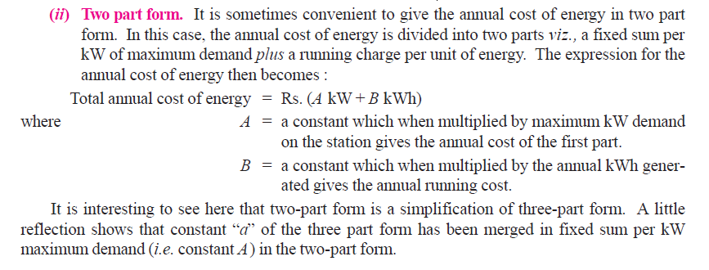
Economics of power generation

Slide 6
Economics of power generation
Methods of Determining Depreciation
There is reduction in the value of the equipment and other property of the plant every year due to depreciation.
The following are the commonly used methods for determining the annual depreciation charge:
(i) Straight line method
(ii) Diminishing value method
(iii) Sinking fund method.

Slide 7
Economics of power generation
Straight line method. In this method, a constant depreciation charge is made every year on the basis of total depreciation and the useful life of the property. Obviously, annual depreciation charge will be equal to the total depreciation divided by the useful life of the property. Thus, if the initial cost of equipment is Rs 1,00,000 and its scrap value is Rs 10,000 after a useful life of 20 years, then,

Slide 8
Economics of power generation
Diminishing value method to determine depreciation:
In this method, charge is made every year at a fixed rate on the diminished value of the equipment.
Suppose the initial cost of equipment is BDT 10,000 and its scrap value after the useful life is zero.
If the annual rate of depreciation is 10%, then depreciation charge for the first year will be 0·1 × 10,000 = BDT 1,000. The value of the equipment is diminished by BDT 1,000 and becomes BDT 9,000.
For the second year, the depreciation charge will be made on the diminished value (i.e. BDT 9,000) and becomes 0·1 × 9,000 = BDT 900. The value of the equipment now becomes 9000 − 900 = BDT 8100. For the third year, the depreciation charge will be 0·1 × 8100 = BDT 810 and so on.

Slide 9
Economics of power generation
Diminishing value method to determine depreciation:

Slide 10
Economics of power generation
Diminishing value method (Cont.)

Slide 11
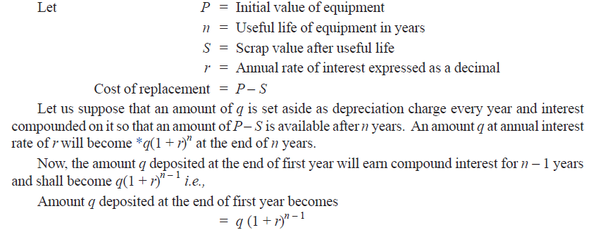
Economics of power generation
Sinking fund method. In this method, a fixed depreciation charge is made every year and interest compounded on it annually. The constant depreciation charge is such that total of annual instalments plus the interest accumulations equal to the cost of replacement of equipment after its useful life.

Slide 12
Economics of power generation
Sinking fund method (cont.)

Slide 13
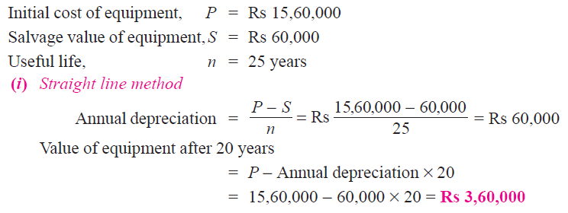
Economics of power generation

Slide 14
Economics of power generation

Slide 15
Economics of power generation

Slide 16
Economics of power generation

Slide 17
Importance of High Load factor
The load factor plays a vital role in determining the cost of energy.
Reduces cost per unit generated: A high load factor reduces the overall cost per unit generated. The higher the load factor, the lower is the generation cost. It is because higher load factor means that for a given maximum demand, the number of units generated is more. This reduces the cost of generation.
Reduces variable load problems: A high load factor reduces the variable load problems on the power station. A higher load factor means comparatively less variations in the load demands at various times. This avoids the frequent use of regulating devices installed to meet the variable load on the station.

Slide 18
Economics of power generation

Slide 19
Economics of power generation

Slide 20
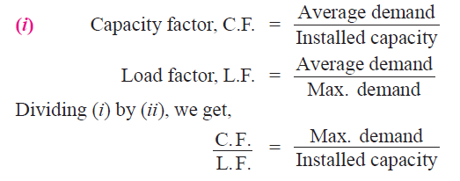
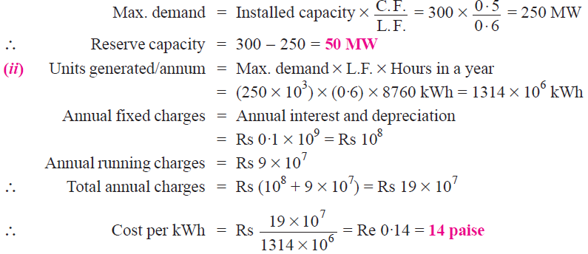
Economics of power generation

Slide 21
Economics of power generation

Slide 22
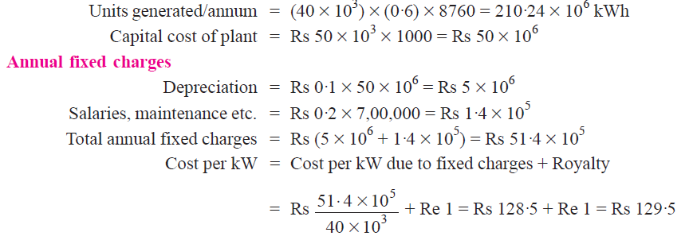
Economics of power generation

Slide 23
Economics of power generation

Slide 24
Thank You
Contact: dralam.eee@diu.edu.bd

