Slide 1
Gas Turbine and Diesel Power Plant

Slide 2
Diesel Power Station
A generating station in which diesel engine is used as the prime mover for the generation of electrical energy is known as diesel power station.
Advantages
The design and layout of the plant are quite simple.
It occupies less space
It can be located at any place.
It can be started quickly and can pick up load in a short time.
There are no standby losses.
It requires less quantity of water for cooling.
The overall cost is much less than that of steam power station of the same capacity.
The thermal efficiency of the plant is higher than that of a steam power station.
It requires less operating staff.

Slide 3
Diesel Power Station
Disadvantages
The plant has high running charges as the fuel (i.e., diesel) used is costly.
The plant does not work satisfactorily under overload conditions for a longer period.
The plant can only generate small power.
The cost of lubrication is generally high.
The maintenance charges are generally high.

Slide 4
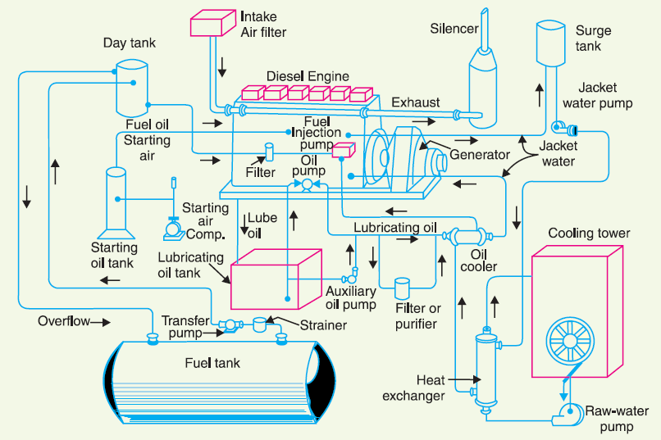
Schematic Arrangement/working principle of Diesel Power Station

Slide 5
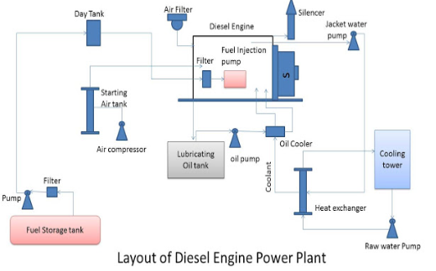
Schematic Arrangement/working principle of Diesel Power Station

Slide 6
Schematic Arrangement/working principle of Diesel Power Station
Diesel power plant has the following auxiliaries:
Fuel Supply Chain
Air intake system
Exhaust system.
Cooling system.
Lubricating system.
Engine starting system.
Fuel supply system. It consists of storage tank, strainers, fuel transfer pump and all day fuel tank. The fuel oil is supplied at the plant site by rail or road. This oil is stored in the storage tank. From the storage tank, oil is pumped to smaller all day tank at daily or short intervals. From this tank, fuel oil is passed through strainers to remove suspended impurities. The clean oil is injected into the engine by fuel injection pump.

Slide 7
Schematic Arrangement of Diesel Power Station
Air intake system: This system supplies necessary air to the engine for fuel combustion. It consists of pipes for the supply of fresh air to the engine manifold. Filters are provided to remove dust particles from air which may act as abrasive in the engine cylinder.
Exhaust system: This system leads the engine exhaust gas outside the building and discharges it into atmosphere. A silencer is usually incorporated in the system to reduce the noise level.

Slide 8
Schematic Arrangement of Diesel Power Station
Cooling system:
The heat released by the burning of fuel in the engine cylinder is partially converted into work. The remainder part of the heat passes through the cylinder walls, piston, rings etc. and may cause damage to the system.
In order to keep the temperature of the engine parts within the safe operating limits, cooling is provided. The cooling system consists of a water source, pump and cooling towers.
The pump circulates water through cylinder and head jacket. The water takes away heat form the engine and itself becomes hot. The hot water is cooled by cooling towers and is recirculated for cooling.

Slide 9
Schematic Arrangement of Diesel Power Station
Lubricating system:
This system minimises the wear of rubbing surfaces of the engine. It comprises of lubricating oil tank, pump, filter and oil cooler.
The lubricating oil is drawn from the lubricating oil tank by the pump and is passed through filters to remove impurities. The clean lubricating oil is delivered to the points which require lubrication. The oil coolers incorporated in the system keep the temperature of the oil low.

Slide 10
Schematic Arrangement of Diesel Power Station
Engine starting system:
This is an arrangement to rotate the engine initially, while starting,
until firing starts and the unit runs with its own power.
Small sets are started manually by handles but for larger units, compressed air is used for starting.
For large units, air at high pressure is admitted to a few of the cylinders, making them to act as reciprocating air motors to turn over the engine shaft. The fuel is admitted to the remaining cylinders which makes the engine to start under its own power.

Slide 11
Examples: Diesel Power Station

Slide 12
Examples: Diesel Power Station

Slide 13
Examples: Diesel Power Station

Slide 14
Examples: Diesel Power Station

Slide 15
Gas Turbine Power Plant
A generating station which employs gas turbine as the prime mover for the generation of electrical energy is known as a gas turbine power plant
Advantages
It is simple in design as compared to steam power station.
It is much smaller in size as compared to steam power station.
The initial and operating costs are much lower
It requires comparatively less water as no condenser is used.
The maintenance charges are quite small.
Gas turbines are much simpler in construction and operation.
It can be started quickly form cold conditions.
There are no standby losses.

Slide 16
Gas Turbine Power Plant
Disadvantages
There is a problem for starting the unit. It is because before starting the turbine, the compressor has to be operated for which power is required from some external source.
Since a greater part of power developed by the turbine is used in driving the compressor, the net output is low.
The overall efficiency of such plants is low (about 20%) because the exhaust gases from the turbine contain sufficient heat.
The temperature of combustion chamber is quite high so that its life is comparatively reduced.

Slide 17
Working principle/Schematic Arrangement of Gas Turbine Power Plant
The main components of gas turbine plant are:
Compressor
Regenerator
(iii) Combustion chamber
(iv) Gas turbine
(v) Alternator and
(vi) Starting motor

Slide 18
Working principle/Schematic Arrangement of Gas Turbine Power Plant
Compressor
The compressor used in the plant is generally of rotatory type. The air at atmospheric pressure is drawn by the compressor via the filter which removes the dust from air.
Regenerator
A regenerator is a device which recovers heat from the exhaust gases of the turbine. The exhaust is passed through the regenerator before wasting to atmosphere. A regenerator consists of a nest of tubes contained in a shell.

Slide 19
Working principle/Schematic Arrangement of Gas Turbine Power Plant
Combustion chamber
The air at high pressure from the compressor is led to the combustion chamber via the regenerator. In the combustion chamber, heat is added to the air by burning oil. The oil is injected through the burner into the chamber at high pressure.
Gas turbine
The products of combustion consisting of a mixture of gases at high temperature and pressure are passed to the gas turbine. These gases in passing over the turbine blades expand and thus do the mechanical work. The temperature of the exhaust gases from
the turbine is about 900 degree F.

Slide 20
Working principle/Schematic Arrangement of Gas Turbine Power Plant
Alternator
The gas turbine is coupled to the alternator. The alternator converts mechanical energy of the turbine into electrical energy. The output from the alternator is given to the bus-bars through transformer, circuit breakers and isolators.
Starting motor
Before starting the turbine, compressor has to be started. For this purpose, an electric motor is mounted on the same shaft as that of the turbine. The motor is energized by the batteries. Once the unit starts, a part of mechanical power of the turbine drives the compressor and there is no need of motor now.

Slide 21
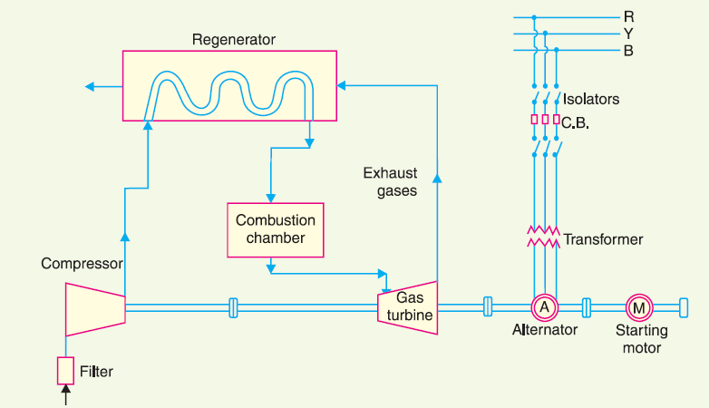
Working principle/Schematic Arrangement of Gas Turbine Power Plant

Slide 22
Thank You
Contact: dralam.eee@diu.edu.bd

