Slide 1
Frictional Properties
Chapter 04

Slide 2
Lecture 01

Slide 3
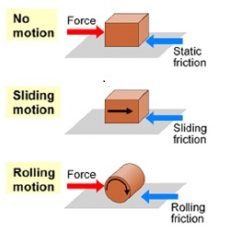
Frictional Properties Of Textile Fibres
Friction is the force that resists the movement of a surface over another surface during sliding.
When fibres are processed in textile industry, friction is developed between them.
Due to the friction, the properties shown by textile fibres are called as frictional properties.

Slide 4
Fibre Friction
It is the surface property of the fibre when two solid surfaces slide against each other.
When we talk about fiber friction then it is very necessary because it is the the force that holds together the fibre in a spun yarn and the interlacing threads in a fabric.
For example, if we rub silk fabric with itself or any other type of material then static charge and heat energy is produced due to fiber friction.

Slide 5
Fibre Friction
There may be two kinds of fiber frictions :
Fiber to Fiber friction that is in between two same or different fibers.
Fiber to Solid friction that is present in between fiber and solid particle or surface.

Slide 6
Types of Friction
Static Friction
Kinetic or Dynamic friction

Slide 7
1. Static Friction
It is the force that must be overcome to begin sliding of two objects or fibers in contact. It is independent of area of contact.

Slide 8
2. Kinetic or Dynamic friction
It is the force that must be overcome to continue sliding. It is independent of sliding speed, however in case of some semi crystalline polymers this behavior is very complex.
Kinetic friction is always less than that of static friction.

Slide 9
Factors Affecting the Frictional Intensity of Textile Materials
Composition of the material (natural/synthetic)
The state of the surface (slippery/rough surface)
Weight of the fibre
Pressure between two surfaces
Area of contact or angle of contact
Speed of sliding of one surface over another

Slide 10
Factors Affecting the Frictional Intensity of Textile Materials
Temperature & Relative humidity (%)
Water absorption of fibre
Cross-sectional area of fibre

Slide 11
Thank You

Slide 12
Lecture 02

Slide 13
Directional Frictional Effect (DFE)
The friction of the wool fibre depends on the direction in which it is pulled. The resistance is greater when it is pulled against the scales than when it is pulled with the scales. This is known as the directional frictional effect.
So, in case of wool fibre it can be said that, less friction takes place between the fibres with the direction of scales and the friction becomes higher between the fibres against the scales.

Slide 14
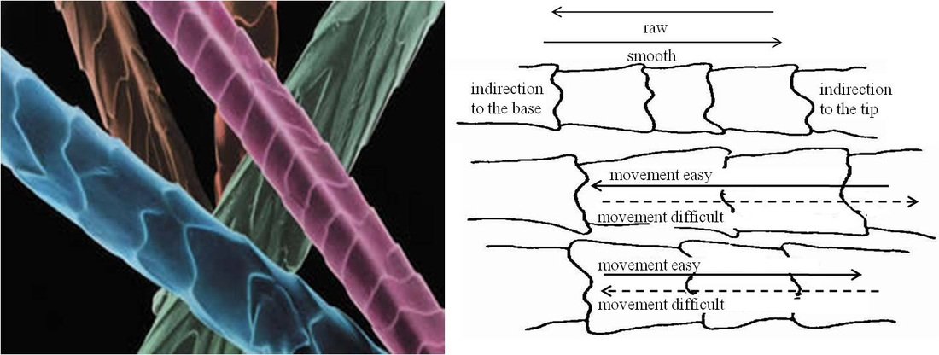
Directional Frictional Effect (DFE)
Wool has greater friction for having scales in its surface. But, cotton also has more friction due to its convolution (natural crimp) and has more friction than wool.

Slide 15
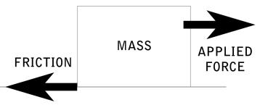
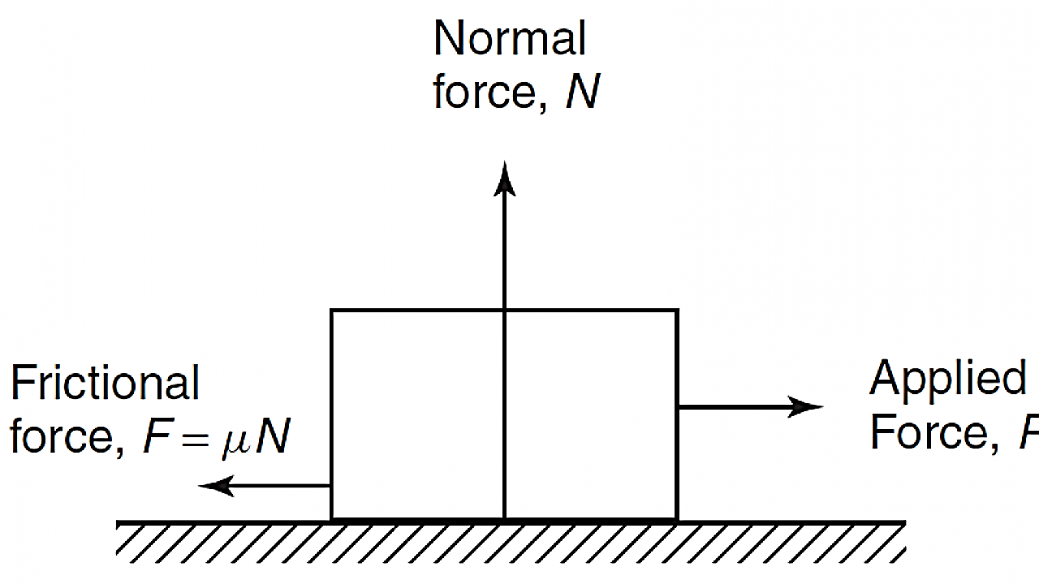
Co-efficient of Friction
Frictional intensity of textile fibres can be determined by measuring co-efficient of friction.
According to Amonton’s basic law (2nd law) of friction,
“Frictional force is proportional to the normal/ perpendicular force between surfaces in contact.”

Slide 16
Co-efficient of Friction
So, F∞ N; where F= Frictional force & N= Normal or perpendicular force
Or, F= µ N Or, µ= F/N
Here, µ is the proportionate constant known as co-efficient of friction. Thus, co-efficient of friction can also be defined as the ratio between frictional force and perpendicular force of a material. (µ= F/N)
Frictional intensity of textile fibres depends on the difference between µs and µk (µs-µk), where µs is always higher than µk. If the difference is high, then the fabric becomes slippery and if the difference is less, then the fabric becomes rough.

Slide 17
Some typical values of µs and µk
Friction between fibre on fibre |  | µs | µk
Rayon on rayon |  | 0.35 | 0.26
Nylon on nylon |  | 0.47 | 0.40
Polyester on polyester |  | 0.15 | 0.12
Cotton on cotton |  | 0.51 | 0.26
Wool on wool | with scale | 0.13 | 0.11
 | against scale | 0.61 | 0.38

Slide 18
Methods of measuring co-efficient of friction
Capstan method is most commonly used to measure co-efficient of friction. Capstan method can be classified into two classes-
Static capstan method
Dynamic capstan method
Other methods-
Buckle & Pollitt’s method
Abboh & Grasberg method
Gutheric & Olivers method

Slide 19
Thank You

Slide 20
Lecture 03

Slide 21
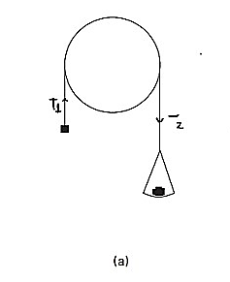
Static capstan method:
A static form of the method is illustrated in Fig. (a). In this method, a loop of yarn is placed over the guide and a small load placed on one side. The load on the other side is then decreased until slippage commences.

Slide 22
Static capstan method:
If the yarn incoming tension (T₁), leaving tension (T₂), angle(θ) of those tension(T₂>T₁) are measured and the coefficient of friction is calculated from the Amonton’s law, according to the following equation:

Slide 23
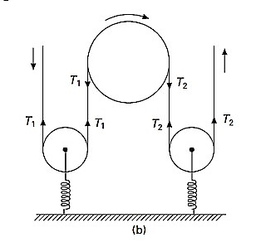
Dynamic capstan method
A dynamic form of the method is illustrated in Fig. (b). In this method, a yarn is running continuously over the guide. If the yarn incoming tension (T₁), leaving tension (T₂), angle (θ) of those tension (T₂>T₁) are measured and the coefficient of friction is calculated the from Amonton’s law, according to the following equation:

Slide 24
Importance of friction in Textile Industry
Friction holds the fibre in a sliver and hence material does not break due to self weight.
Friction helps in drafting and drawing process.
Uniform tension can be maintained in winding and warping because of friction.
Friction helps in twisting during spinning.
Friction modifies the lustre and appearance of a cloth
Friction makes more clean yarn.

Slide 25
Problems of friction in Textile Industry
Fiber friction can lead to damage of fiber surface; it weakens the fibers, even causes breakage of fibers.
Friction causes neps formation.
Over friction causes high breakage of yarn in weaving.
Due to friction handle properties of fabric will be changed.

Slide 26
Problems of friction in Textile Industry
Sometimes, due to friction textile materials may be elongated.
Friction causes yarn and fabric hairiness.
Friction causes static charge formation in textile material and therefore, dust, dirt etc. are attracted by the textile material and it becomes dirty.
Friction worns out different parts of a machine.

Slide 27
Minimization of frictional intensity of textile materials
The following steps may be taken to reduce the frictional intensity in textile materials-
Sizing is done on warp yarn before weaving to reduce friction between adjacent yarns; as a result ends breakage rate during weaving becomes minimized.
Emulsion, oil, lubricants etc. are applied specially on jute in batching section to reduce the stiffness of fibre and thus fibre damage is reduced in processing. Thus, lubrication reduces the effect of friction.

Slide 28
Minimization of frictional intensity of textile materials
Chemical treatment is applied on wool fibre to reduce scale sharpness and thus frictional intensity of fibre is minimized.
By calendaring it is possible to minimize the frictional intensity of cloth.
Sometimes resin finish or anti-crease finish can be applied on cloth to reduce the frictional intensity.
Softener can also be applied on textile material to reduce its frictional intensity.

Slide 29
Thank You

