Slide 1
Topic 9
Correlation Analysis

Slide 2
What Is Correlation Analysis?
A group of techniques to measure the relationship between two variables.
The basic idea of correlation analysis is to report the relationship between two variables. The usual first step is to plot the data in a scatter diagram

Slide 3
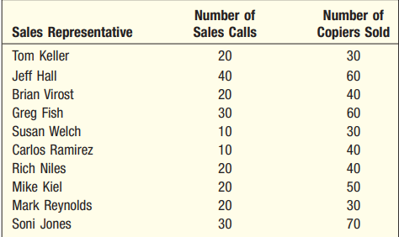
Example
Number of Sales Calls and Copiers Sold for 10 Sales people

Slide 4
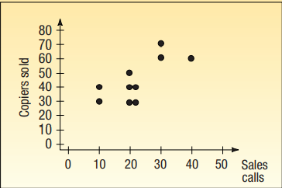
Example
The scatter diagram shows graphically that the sales representatives who make more calls tend to sell more copiers. It is reasonable for the national sales manager at Copier Sales of America, to tell her salespeople that, the more sales calls they make, the more copiers they can expect to sell. Note that, while there appears to be a positive relationship between the two variables, all the points do not fall on a line.

Slide 5
The Coefficient Of Correlation
The correlation coefficient describes the strength of the relationship between two sets of interval-scaled or ratio-scaled variables.
Designated r, it is often referred to as Pearson’s r and as the Pearson product-moment correlation coefficient.
It can assume any value from to 1.00 inclusive. A correlation coefficient of or indicates perfect correlation.

Slide 6
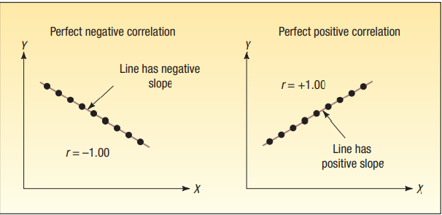
A correlation coefficient for the preceding example computed to be would indicate that the number of sales calls and the number of copiers sold are perfectly related in a positive linear sense.
A computed value of reveals that sales calls and the number of copiers sold are perfectly related in an inverse linear sense.

Slide 7
The Coefficient Of Correlation
If there is absolutely no relationship between the two sets of variables, Pearson’s r is zero.
A correlation coefficient r close to 0 (say, .08) shows that the linear relationship is quite weak.
The same conclusion is drawn if Coefficients of and have equal strength; both indicate very strong correlation between the two variables.
Thus, the strength of the correlation does not depend on the direction (either or ).

Slide 8
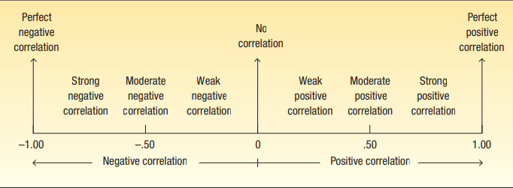
Summarizing the strength and direction of the Correlation Coefficient

Slide 9
Correlation Coefficient
A measure of the strength of the linear relationship between two variables

Slide 10
Correlation Coefficient
CHARACTERISTICS OF THE CORRELATION COEFFICIENT
The sample correlation coefficient is identified by the lowercase letter r
It shows the direction and strength of the linear relationship between two interval- or ratio-scale variables
It ranges from up to and including 1
A value near 0 indicates there is little relationship between the variables
A value near 1 indicates a direct or positive relationship between the variables
A value near 1 indicates inverse or negative relationship between the variables

Slide 11
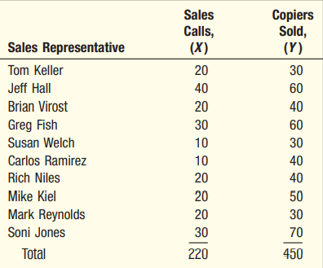
Example
How is the value of the correlation coefficient determined? We will use the Copier Sales of America data as an example. Sales Calls and Copiers Sold for 10 Sales people:

Slide 12
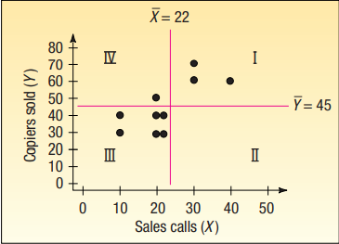
Draw a vertical line through the data values at the mean of the X-values
Horizontal line at the mean of the Y-values.
We’ve added a vertical line at 22.0 calls and a horizontal line at 45.0 copiers
These lines pass through the “center” of the data and divide the scatter diagram into four quadrants.

Slide 13
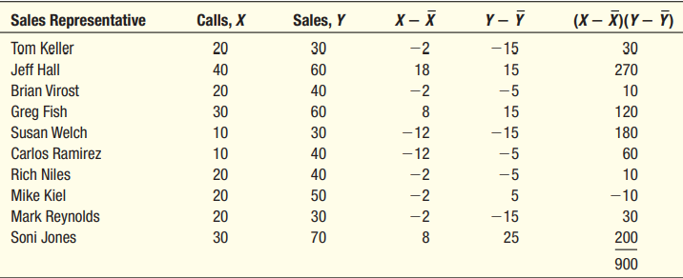

Slide 14
The standard deviation of the number of sales calls is 9.189 and of the number of copiers sold 14.337.

Slide 15
How do we interpret a correlation of 0.759?
First, it is positive, so there is a direct relationship between the number of sales calls and the number of copiers sold.
The value of 0.759 is fairly close to 1.00, so we conclude that the association is strong.

Slide 16
How do we interpret a correlation of 0.759?
The correlation of 0.759 indicates a strong positive association between the variables. It would be correct to encourage the sales personnel to make that extra sales call, because the number of sales calls made is related to the number of copiers sold.
However, does this mean that more sales calls cause more sales? No, we have not demonstrated cause and effect here, only that the two variables—sales calls and copiers sold—are related. If there is a strong relationship (say, .91) between two variables, we are tempted to assume that an increase or decrease in one variable causes a change in the other variable.

Slide 17
Testing The Significance Of The Correlation Coefficient
Could there be zero correlation in the population from which the sample was selected?
To put it another way, did the computed r come from a population of paired observations with zero correlation?
The correlation in the population. It is pronounced “rho.”

Slide 18
Testing The Significance Of The Correlation Coefficient

Slide 21
Thank You!

