Slide 1
Population in Bangladesh 2021

Slide 2
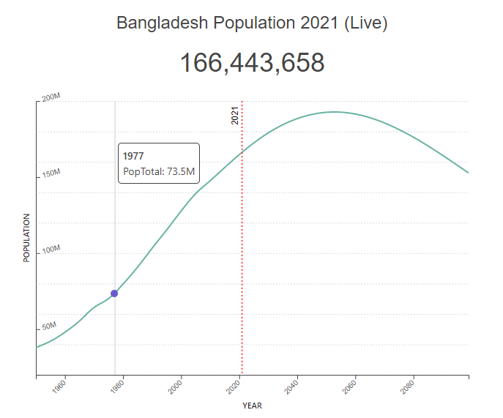
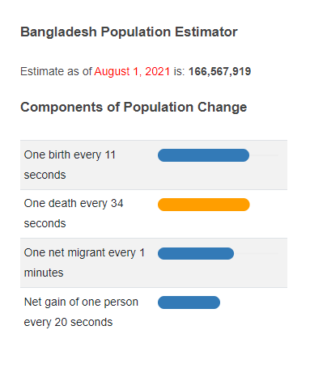
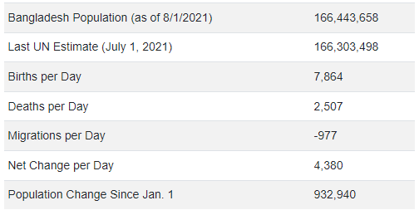

Slide 3
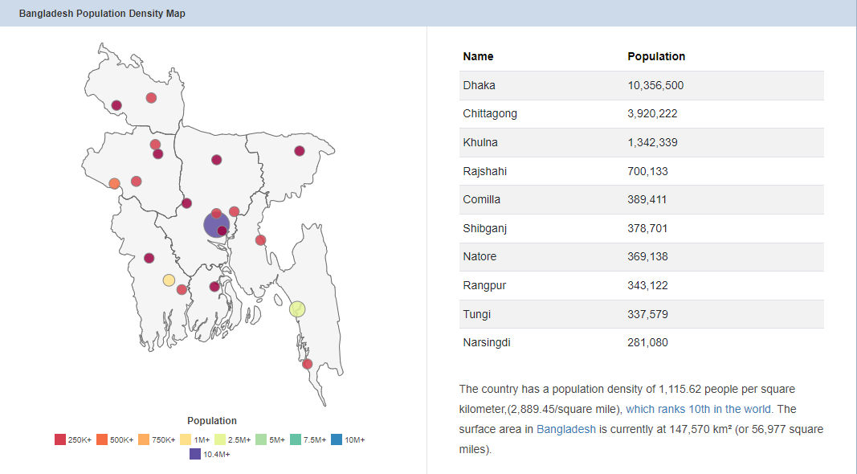

Slide 4
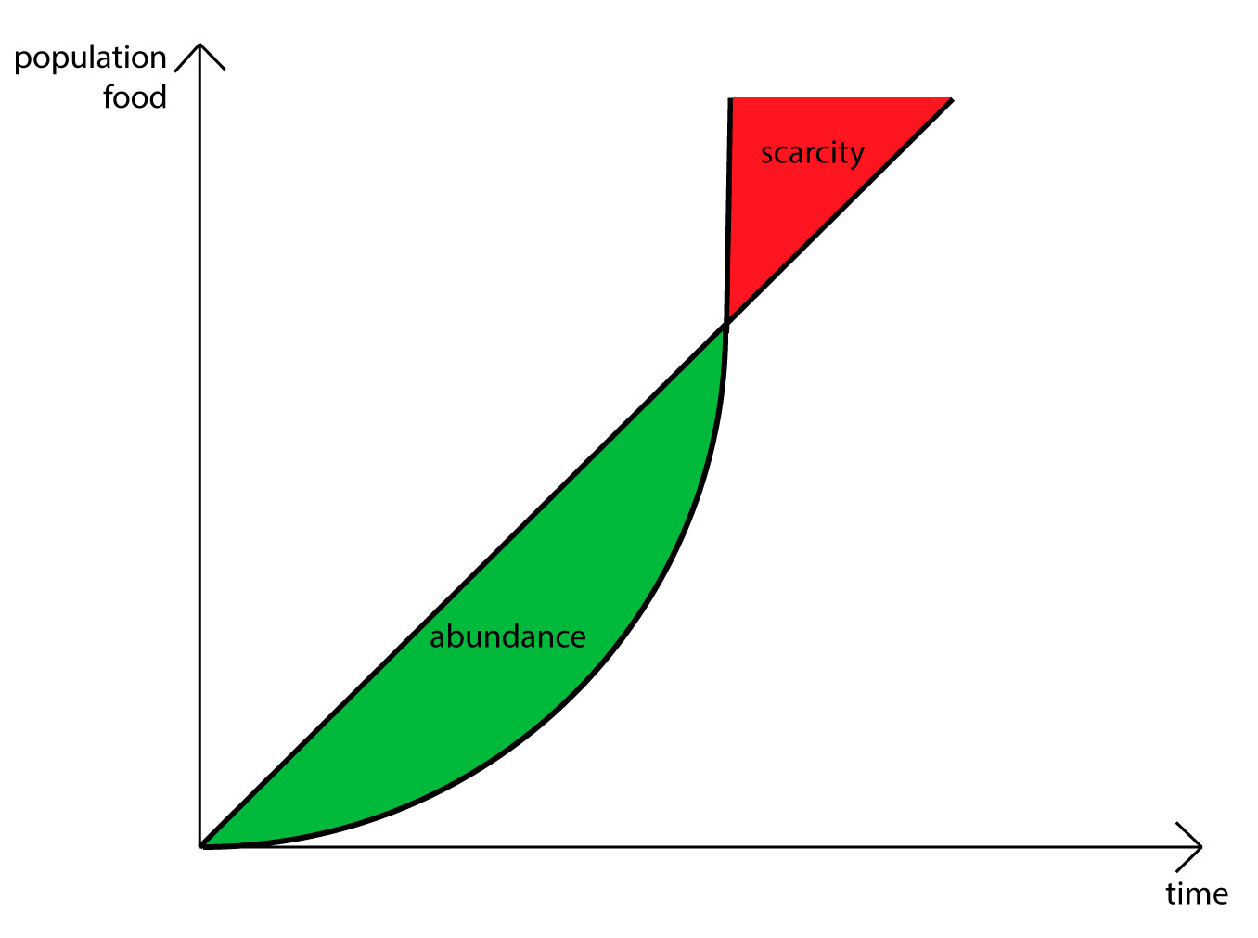
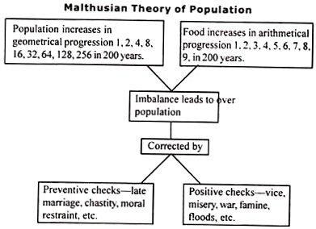
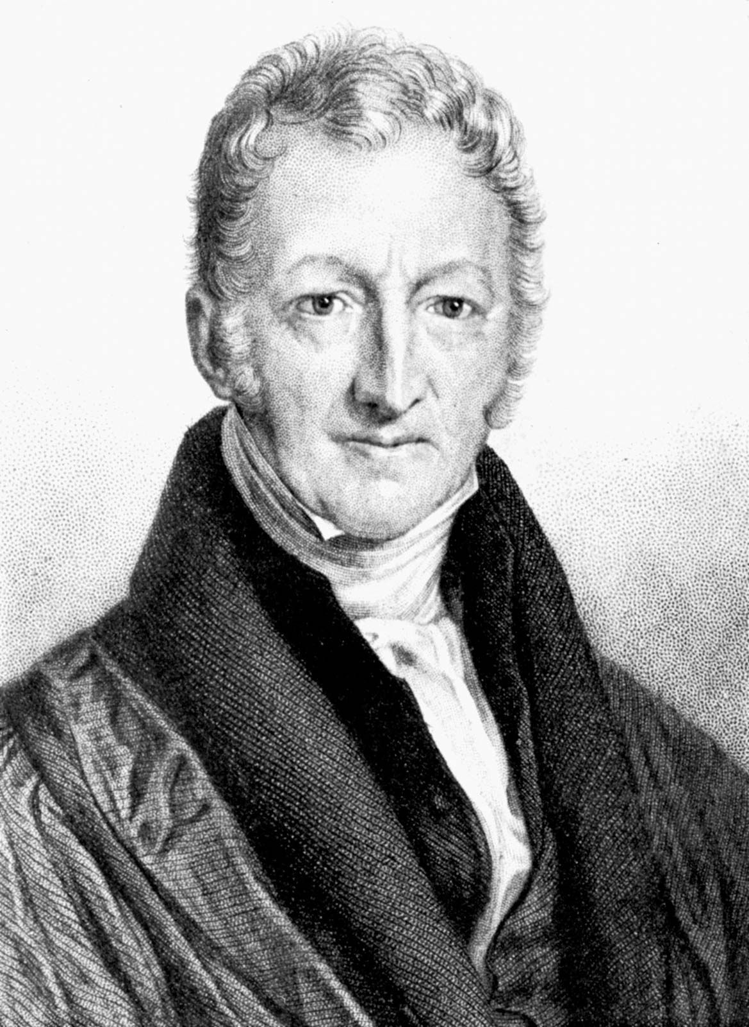
The relationship between population growth and economic growth is of great interest both for demographers and for development economists.

Slide 5
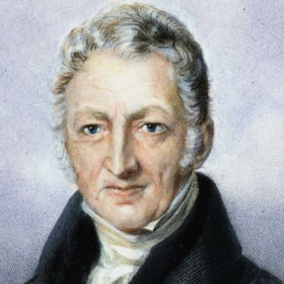

Slide 6
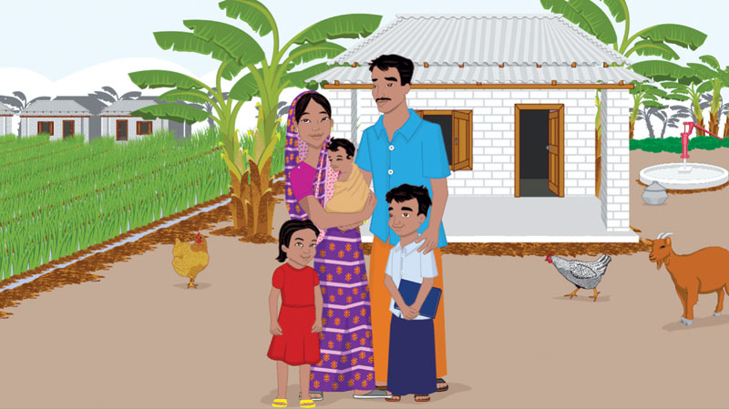
"a small family is a happy family", "boy or girl, two children are enough", "not more than two children, one is better" etc., proliferated in different media outlets, conveying a message regarding the benefits of small families.
Even though the country has taken control of population growth and has achieved considerable success in reducing fertility, it is still adding approximately two million people to its population every year

Slide 7
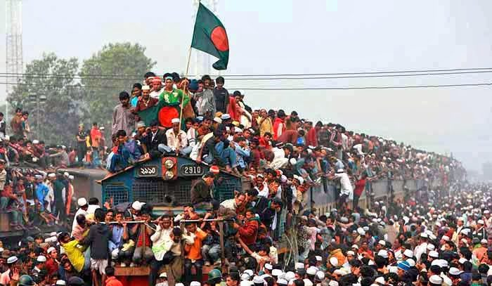
There is no denying the fact that the population of a country is the greatest social capital a nation can have, but unchecked population growth can be detrimental to economic development.
It diminishes the availability of capital per head by limiting access to food, housing, sanitation, healthcare, education and employment, which in turn reduces the productivity of its labour force.

Slide 8
High population density has contributed to the intense use of forests, fisheries and to a certain extent, even soil and water resources. According to a report prepared by the Global Forest Watch, 278,000 acres of forest land in Bangladesh was destroyed from 2001 to 2018. This constitutes almost eight percent of the country's forest land. Recent statistics show that forest area as percent of land area is 10 percent in 2017, but according to the global forest policy, it should be at least 25 percent of the total land area of a country.

Slide 9
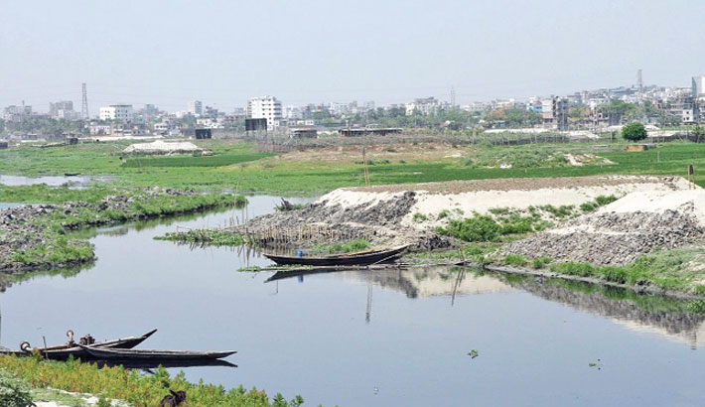
As per a survey of the Bangladesh Water Development Board (BWDB), there are 310 rivers in Bangladesh. Out of these rivers, the condition of 175 is miserable, and 65 are almost dead.

Slide 10
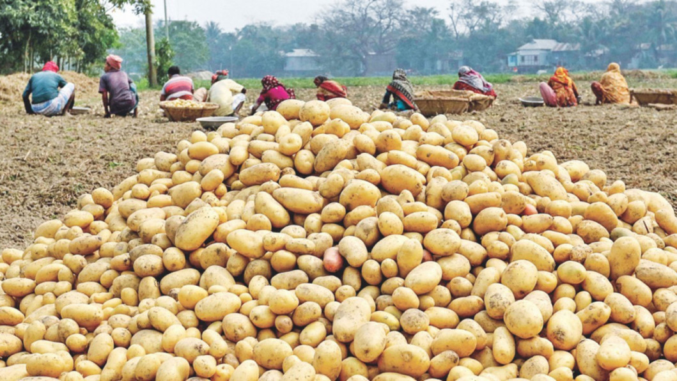
In another report prepared by the Cabinet Division of the Government of Bangladesh and World Food Program (WFP), one in eight, or more than 21 million people, cannot afford a nutritious diet in Bangladesh. According to the Food and Agricultural Organization (FAO), nearly two-thirds of the regular diet includes mostly rice, some vegetables, a little amount of pulses and small quantities of fish if and when available.

Slide 11
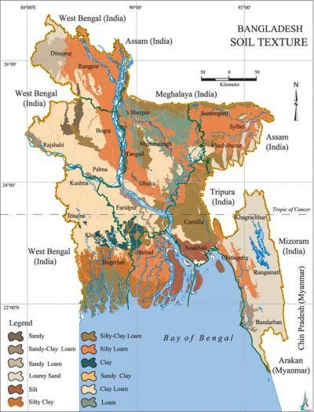
Each year, Bangladesh loses a vast tract of agricultural land due to the extreme pressure of population. A report on the loss of agricultural land based on a study carried out by the Soil Resource Development Institute (SRDI) indicated that nearly 69,000 hectares of agricultural land have been shrinking annually due to rapid industrialization, unplanned urbanization and increase in rural settlements.

Slide 12
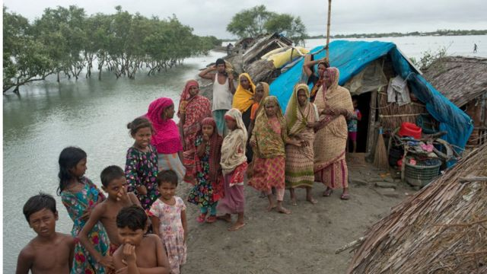
Ways to Reduce Population in Bangladesh
1. Campaigns to spread the message
2. Counseling for citizens
3. Schemes to motivate people to use birth control options
4. Creating options for child adoption
5. Reducing infant mortality
6. Benefits to those who are staying within the suggested limit in terms of number of children
7. Creating rules to penalize couples with more than the suggested limit of children
8. Controlling illegal immigration
9. Controlling movement of population
10. Improve awareness about problems related to high population growth
11. Empowering women
12. Improving Maternal Health

Slide 13
Thank You

