Slide 1
Daffodil International University Dept. of CSE Information Security
Chapter 3
Security Risk Management

Slide 2
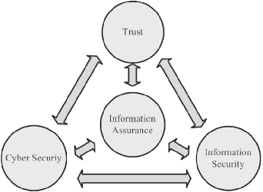
Information Assurance
Information assurance is the practice of assuring information and managing risks related to the use, processing, storage, and transmission of information.
Information assurance includes protection of the integrity, availability, authenticity, non-repudiation and confidentiality of user data.

Slide 3
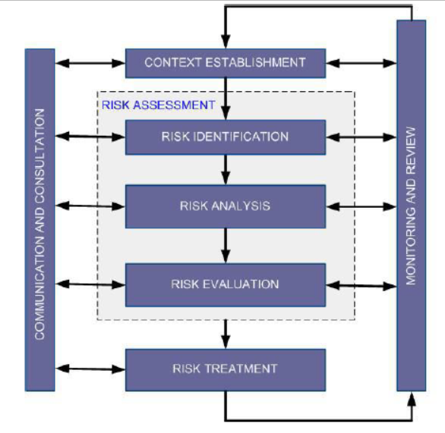
What is Risk, Purpose and Risk Level
Risk is the potential for loss, damage or
destruction of assets or data.
It comprises the impacts to an organization and its
stakeholders that could occur due to the threats and vulnerabilities associated with
the operation and use of IS and the environments in
which those systems operate.
Purpose of Risk Management:
to identify potential problems before they occur
to ensure the desired business outcomes are
achieved
Fig: Risk Management Process

Slide 4
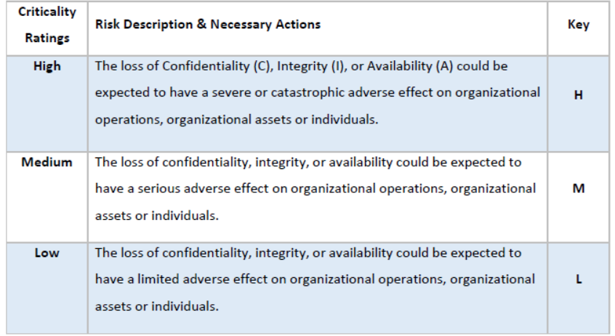
What is Risk, Purpose and Risk Level
Risk Level: Three distinct levels are used for risk assessment:
Fig: Risk Levels

Slide 5
Identification of Assets
A Risk management strategy requires that information security professionals know their organizations’ information assets—that is, identify, classify, and prioritize them.
Asset Type / Category | Particulars | Criticality
Core Application Software | Core Banking Systems Card issuing, Authorizations & Switching Systems Call Center Management | H H M
Intranet Applications | ANYORG Document Management System HR Management System Employee information PortalS | H M M
Database | CBS Database (Customer data and Financial Data) | H
Information (Data) | Sensitive data of different devices (Passwords, configurations) Source code Network infrastructure design Strategic plans | H H H M
Human Resources (People) | Decision Makers End Users Operation/Maintenance Staff Subject Matter Experts | H H H M
Fig: Example of Assets of a Banking System

Slide 6
Identification of Key Risk Indicators (KRIs)
A key risk indicator (KRI) is a measure used in management to indicate how risky an activity is. KRI’s are metrics used by organizations to provide an early signal of increasing risk exposures in various areas.
Identification of Risk-Scenarios
Any event that triggers an undesired scenario alternative is identified as Risk.
Threat Category | Threat Sources | Risk Scenarios
Human | Acts of human error or failure | Accidents, Disclosure of password
Technical | Technical software failures or errors Technical hardware failures or errors Deviation in quality of service from service providers | Software failure (System, OS, database etc.) Hardware/ Disk malfunction, failure, damages Communications link down, Damage caused by service provider
Cyber-attack activities | Deliberate cyber-attack activities | Malicious code inject by insider or outsider, DDOS, Social Engineering, Corruption Data, Data Theft
Natural Forces | Natural Disaster | Flood, Fire, Power Failure, Supply Shortage
Fig: Example of Risk Scenarios of an IS System

Slide 7
Relationship between Vulnerabilities and Risk Scenarios based on Assets
Vulnerability is the weakness of assets which can be exploited by a threat Actor, such as an attacker, to perform unauthorized actions within a computer system. This unauthorized actions are the Risk Scenarios that an organization might face.
Asset Type / Category | Vulnerabilities | Risk Scenarios
Core Application Software | Well-known flaws in the software. 2. Unauthorized system changes Due to Unauthorized software, users are not aware of safe browsing policy. Application weakness, No input validation | Software failure Compromising confidential information Malicious code inject by insider or outsider
Database | Power failure, No redundant on storage media, No high Availability. Application weakness, No input validation,unwanted open ports,Internet access from server | Database System failure Malicious code inject by insider or outsider
Information (Data) | Due to Unauthorized software, Users are not aware of safe browsing policy, Operating System and security patch is not updated, Due to Unauthorized software, Antivirus not updated 6. Unrestricted remote access | Cyber Crime / Attack
Human Resources (People) | Aggressive, Anger and resentment, Arrogant, Insecurity, Naïve, Short-sighted, Low Employee Morale | Disgruntled Employee Political Spying human intervention - Pandemic Flu - Dengue Fever
Fig: Relation Between Vulnerabilities and Risk Scenarios based on Assets

Slide 8
Risk Frequency Evaluation
Risk frequency may be defined in terms of the chance (likelihood).
Measure of risk frequency evaluation:
likelihood – chance of the risk happening
Likelihood Scale
Rating Likelihood Likelihood of Occurrence
0.1 Low Not expected, but there's a slight possibility it
may occur at some time.
0.5 Moderate The event might occur at some time as there is a
history of casual occurrence.
1 High There is a strong possibility the event will occur as
there is a history of frequent occurrence.

Slide 9
Thank You

