Slide 1
Transistors

Slide 2
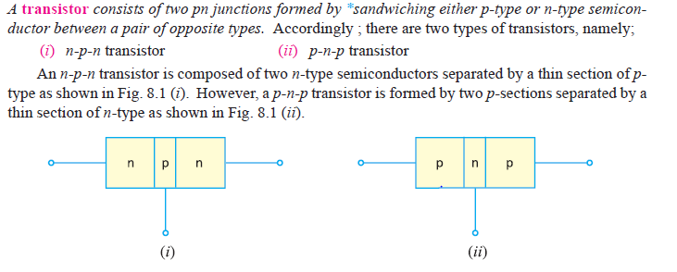

Slide 3
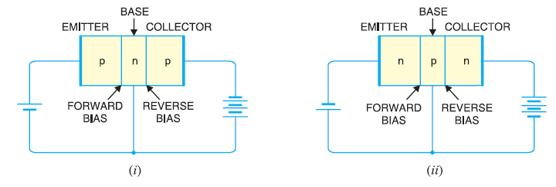
Different Terminal of Transistor

Slide 4
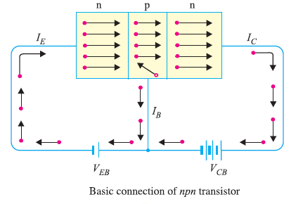
Operation of npn Transistor

Slide 5
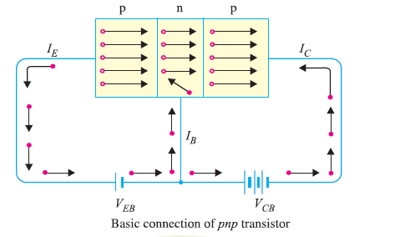
Operation of pnp Transistor

Slide 6
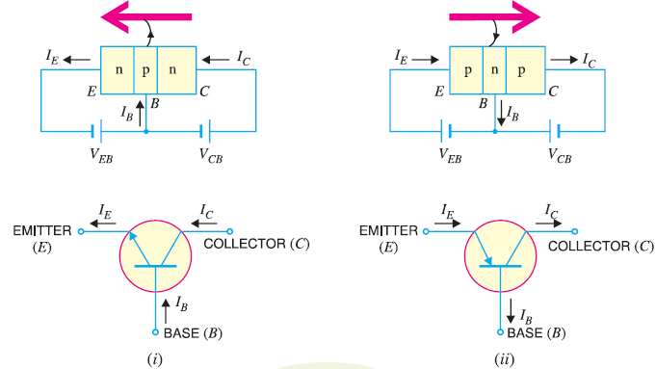
Symbol

Slide 7
Transistor works as a amplifier

Slide 8
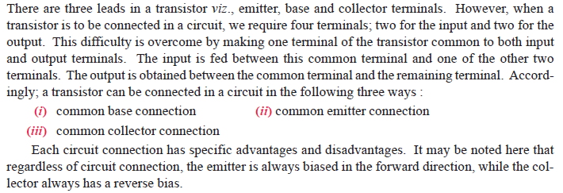
Combinations of Transistor

Slide 9
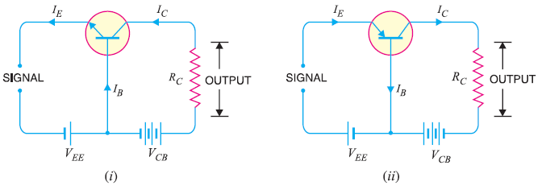
Common base Transistor

Slide 11
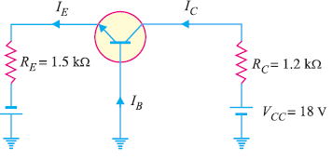
exercise

