Slide 1
Professional Grooming
Prepared by
Emran Khan
Lecturer
Department of English
Daffodil International University

Slide 2
What does it mean?
Corporate grooming is about ensuring that an employees grooming, including dressing, personal hygiene and personality reflect a positive and professional image about himself, and thereby ensures that he is able to represent his business in a professional manner.

Slide 3
Smile

Slide 4
Body Language

Slide 5
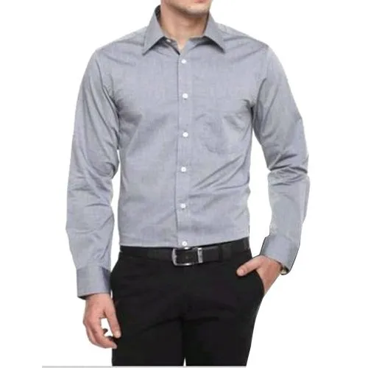
Dress Up

Slide 6
Personal Hygiene

Slide 7
Dining Etiquette

