Slide 1
Chapter 3: Vector Differentiation
Ordinary Derivative
Partial Derivative
Gradient
Divergence
Curl

Slide 2
Ordinary Derivative
Let $R(u)$ be a vector depending on a single scalar variable $u.$
Then the Derivative of $R(u)$ is defined as
$\frac{dR}{du}=\lim_{Δu→0}{\frac{ΔR}{Δu}}=\lim_{Δu→0}\frac{R\left(u+Δu\right)−R(u)}{Δu}$ if the limit exists.

Slide 3
Space curves
If in particular $R(u)$ is the position vector $r(u)$ joining the origin O of a coordinate system and any point $(x,y,z)$, then
$$r\left(u\right)=x\left(u\right)i+y\left(u\right)j+z\left(u\right)k$$
$$\frac{dr}{du}=\frac{dx}{du}i+\frac{dy}{du}j+\frac{dz}{du}k$$
$x\left(u\right)$, $y\left(u\right)$, $z\left(u\right)$ are parametric functions and $u$ is a parameter

Slide 4
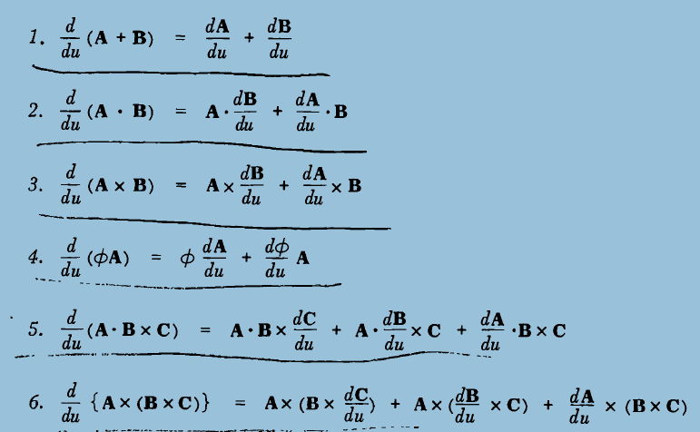

Slide 5
Differentiation Formulae
1. $\frac{d}{du}\left(A±B\right)=\frac{dA}{du}±\frac{dB}{du}$
2. $\frac{d}{du}\left(A∙B\right)=A∙\frac{dB}{du}+\frac{dA}{du}∙B$
3. $\frac{d}{du}\left(A×B\right)=A×\frac{dB}{du}+\frac{dA}{du}×B$
4. $\frac{d}{du}\left(φA\right)=φ\frac{dA}{du}+\frac{dφ}{du}∙A$

Slide 6
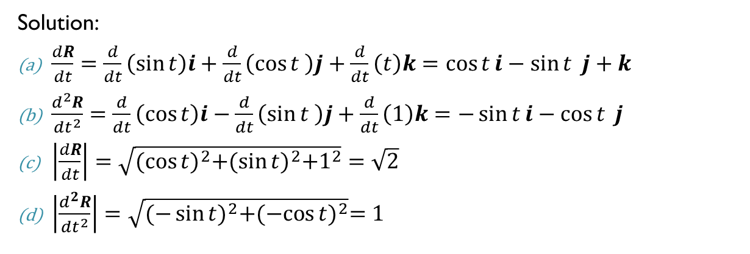
Example1. Given $R=\sin{t}i+\cos{t} j+tk$, find (a) $\frac{dR}{dt}$ (b) $\frac{d^{2}R}{dt^{2}}$ (c) $\left|\frac{dR}{dt}\right|$ (d) $\left|\frac{d^{2}R}{dt^{2}}\right|$
Solution:
$\frac{dR}{dt}=\frac{d}{dt}\left(\sin{t}\right)i+\frac{d}{dt}\left(\cos{t} \right)j+\frac{d}{dt}\left(t\right)k=\cos{t}i−\sin{t} j+k$
$\frac{d^{2}R}{dt^{2}}=\frac{d}{dt}\left(\cos{t}\right)i−\frac{d}{dt}\left(\sin{t} \right)j+\frac{d}{dt}\left(1\right)k=−\sin{t}i−\cos{t} j$
$\left|\frac{dR}{dt}\right|=\sqrt{{(\cos{t)}}^{2}+{(\sin{t)}}^{2}+1^{2}}=\sqrt{2}$
$\left|\frac{d^{2}R}{dt^{2}}\right|=\sqrt{{(−\sin{t)}}^{2}+{(−cos{t)}}^{2}}=1$

Slide 7
Example 2. Given $A=5t^{2}i+t j−t^{3}k$ and $B=\sin{t}i−\cos{t} j$find (a) $\frac{d}{dt}(A∙B)$, (b) $\frac{d}{dt}\left(A×B\right)$, (c) $\frac{d}{dt}(A∙A)$
(a) $\frac{d}{dt}(A∙B)$= $A∙\frac{dB}{dt}+\frac{dA}{dt}∙B$
$$=\left(5t^{2}i+t j−t^{3}k \right)∙\left(\cos{t}i+\sin{t} j\right)+\left(10t i+ j−{3t}^{2}k \right)∙\left(\sin{t}i−\cos{t} j\right)$$
$$=\left(5t^{2}\cos{t}+t\sin{t}+10t\sin{t} −cos t\right)$$
$=(5t^{2}−1)\cos{t}+11t\sin{t}$

Slide 8
(b) $\frac{d}{dt}\left(A×B\right)=\frac{d}{dt}\left|\begin{matrix}i & j & k \\ 5t^{2} & t & −t^{3} \\ \sin{t} & −cos{t} & 0\end{matrix}\right|$
$$=\frac{d}{dt}\left\{i\left(0−t^{3}\cos{t}\right)−j\left(0+t^{3}\sin{t}\right)+k\left(−5t^{2}\cos{t}−t\sin{t}\right)\right\}$$
$=\frac{d}{dt}\left\{−t^{3}\cos{t}i−t^{3}\sin{t}j+\left(−5t^{2}\cos{t}−t\sin{t}\right)k\right\}$
$=\frac{d}{dt}\{−t^{3}\cos{t}\} i−\frac{d}{dt}\{t^{3}\sin{t}\} j+\frac{d}{dt}\left(−5t^{2}\cos{t}−t\sin{t}\right)k$
$=\left(t^{3}\sin{t}−3t^{2}\cos{t}\right) i−\left(t^{3}\cos{t}+3t^{2}\sin{t}\right) j$
$+\left(5t^{2}\sin{t}−11t\cos{t}−\sin{t}\right)k$
(c) $\frac{d}{dt}(A∙A)$=$\frac{d}{dt}\left\{\left(5t^{2}i+t j−t^{3}k\right).\left(5t^{2}i+t j−t^{3}k\right)\right\}$
=$\frac{d}{dt}\left(25t^{4}+t^{2}+t^{6}\right)$
=$100t^{3}+2t+6t^{5}$

Slide 9
Partial Derivative of Vectors
If $A$ is vector depending on more than one scalar variable say $x,y,z$. then we write $A=A(x,y, z)$
The partial derivative of $A$ with respect to $x$ is defined as
$$\frac{∂A}{∂x}=\lim_{Δx→0}{\frac{A\left(x+Δx,y,z\right)−A(x,y,z)}{Δx}}⁡$$
If limit exists
Similarly,
$$\frac{∂A}{∂y}=\lim_{Δy→0}{\frac{A\left(x,y+Δy,z\right)−A(x,y,z)}{Δy}}⁡$$
$$\frac{∂A}{∂z}=\lim_{Δz→0}{\frac{A\left(x,y,z+Δz\right)−A(x,y,z)}{Δz}}⁡$$
are the partial derivatives of $A$ with respect to $y$ and $z$ respectively if limits exist.

Slide 10
Remark!
1. You can not write, $\frac{d^{2}A}{dxdy}=\frac{d}{dx}\left(\frac{dA}{dy}\right)$
2. You have to write, $\frac{∂^{2}A}{∂x∂y}=\frac{∂}{∂x}\left(\frac{∂A}{∂y}\right)$
3. $\frac{∂^{2}A}{∂x∂y}=\frac{∂^{2}A}{∂y∂x}$

Slide 11
Example 3. If $A=\left(2x^{2}y−x^{4}\right)i+\left(e^{xy}−y\sin{x}\right)j+\left(x^{2}\cos{y}\right)k$. Find: $\frac{∂A}{∂x}$, $\frac{∂A}{∂y}$, $\frac{∂^{2}A}{∂x^{2}}$, $\frac{∂^{2}A}{∂y^{2}}$, $\frac{∂^{2}A}{∂x∂y}, \frac{∂^{2}A}{∂y∂x}$
$$\frac{∂A}{∂x}=\frac{∂}{∂x}\left\{\left(2x^{2}y−x^{4}\right)i+\left(e^{xy}−y\sin{x}\right)j+\left(x^{2}\cos{y}\right)k\right\}$$
$$=\frac{∂}{∂x}\left(2x^{2}y−x^{4}\right)i+\frac{∂}{∂x}\left(e^{xy}−y\sin{x}\right)j+\frac{∂}{∂x}\left(x^{2}\cos{y}\right)k$$
$$=\left(4xy−4x^{3}\right)i+\left({ye}^{xy}−y\cos{x}\right)j+\left(2x\cos{y}\right)k$$
$$\frac{∂A}{∂y}=\frac{∂}{∂y}\left\{\left(2x^{2}y−x^{4}\right)i+\left(e^{xy}−y\sin{x}\right)j+\left(x^{2}\cos{y}\right)k\right\}$$
$$=\frac{∂}{∂y}\left(2x^{2}y−x^{4}\right)i+\frac{∂}{∂y}\left(e^{xy}−y\sin{x}\right)j+\frac{∂}{∂y}\left(x^{2}\cos{y}\right)k$$
$$=2x^{2}i+\left({xe}^{xy}−\sin{x}\right)j−x^{2}\sin{y}k$$

Slide 12
Example. If $A=\left(2x^{2}y−x^{4}\right)i+\left(e^{xy}−y\sin{x}\right)j+\left(x^{2}\cos{y}\right)k$. Find: $\frac{∂^{2}A}{∂x^{2}}$, $\frac{∂^{2}A}{∂y^{2}}$, $\frac{∂^{2}A}{∂x∂y}, \frac{∂^{2}A}{∂y∂x}$
$$\frac{∂^{2}A}{∂x^{2}}=\frac{∂}{∂x}\left(\frac{∂A}{∂x}\right)=\frac{∂}{∂x}\left\{\left(4xy−4x^{3}\right)i+\left({ye}^{xy}−y\cos{x}\right)j+\left(2x\cos{y}\right)k\right\}$$
$$=\frac{∂}{∂x}\left(4xy−4x^{3}\right)i+\frac{∂}{∂x}\left({ye}^{xy}−y\cos{x}\right)j+\frac{∂}{∂x}\left(2x\cos{y}\right)k$$
$$=\left(4y−12x^{2}\right)i+\left({y^{2}e}^{xy}+y\sin{x}\right)j+\left(2\cos{y}\right)k$$
$$\frac{∂^{2}A}{∂y^{2}}=\frac{∂}{∂y}\left(\frac{∂A}{∂y}\right)=\frac{∂}{∂y}\left\{2x^{2}i+\left({xe}^{xy}−\sin{x}\right)j−x^{2}\sin{y}k\right\}$$
$$=\frac{∂}{∂y}\left(2x^{2}\right)i+\frac{∂}{∂y}\left({xe}^{xy}−\sin{x}\right)j−\frac{∂}{∂y}\left(x^{2}\sin{y}\right)k$$
$$=0+\left({x^{2}e}^{xy}\right)j−\left(x^{2}\cos{y}\right)k$$
$$={x^{2}e}^{xy}j−x^{2}\cos{y}k$$

Slide 13
Example. If $A=\left(2x^{2}y−x^{4}\right)i+\left(e^{xy}−y\sin{x}\right)j+\left(x^{2}\cos{y}\right)k$. Find: $\frac{∂^{2}A}{∂x^{2}}$, $\frac{∂^{2}A}{∂y^{2}}$, $\frac{∂^{2}A}{∂x∂y}, \frac{∂^{2}A}{∂y∂x}$
$$\frac{∂^{2}A}{∂x∂y}=\frac{∂}{∂x}\left(\frac{∂A}{∂y}\right)=\frac{∂}{∂x}\left\{2x^{2}i+\left({xe}^{xy}−\sin{x}\right)j−x^{2}\sin{y}k\right\}$$
$$=\frac{∂}{∂x}\left(2x^{2}\right)i+\frac{∂}{∂x}\left({xe}^{xy}−\sin{x}\right)j−\frac{∂}{∂x}\left(x^{2}\sin{y}\right)k$$
$$=4xi+\left({xye}^{xy}+e^{xy}−\cos{x}\right)j−\left(2x\sin{y}\right)k$$
$$\frac{∂^{2}A}{∂y∂x}=\frac{∂}{∂y}\left(\frac{∂A}{∂x}\right)=\frac{∂}{∂y}\left\{\left(4xy−4x^{3}\right)i+\left({ye}^{xy}−y\cos{x}\right)j+\left(2x\cos{y}\right)k\right\}$$
$$=\frac{∂}{∂y}\left(4xy−4x^{3}\right)i+\frac{∂}{∂y}\left({ye}^{xy}−y\cos{x}\right)j+\frac{∂}{∂y}\left(2x\cos{y}\right)k$$
$$=4xi+\left({xye}^{xy}+e^{xy}−\cos{x}\right)j−\left(2x\sin{y}\right)k$$
Note that: $\frac{∂^{2}A}{∂x∂y}=\frac{∂^{2}A}{∂y∂x}$

Slide 14
Exercise
1. If $R=e^{−t}i+\ln\left(t^{2}+1\right)j+\tan{t}k$, find (a) $\frac{dR}{dt}$ (b) $\frac{d^{2}R}{dt^{2}}$ (c) $\left|\frac{dR}{dt}\right|$ (d) $\left|\frac{d^{2}R}{dt^{2}}\right|$
2. If $A=t^{2}i−t j+(2t+1)k$ and $B=\left(2t−3\right)i+j−t k$find (a) $\frac{d}{dt}(A∙B)$, (b) $\frac{d}{dt}\left(A×B\right)$, (c) $\frac{d}{dt}(A+B)$ $at$ $t=1$
3. If $A=\cos{xy}i+\left(3xy−2x^{2}\right)j−\left(3x+2y\right)k$. Find: $\frac{∂^{2}A}{∂x^{2}}$, $\frac{∂^{2}A}{∂y^{2}}$, $\frac{∂^{2}A}{∂x∂y}, \frac{∂^{2}A}{∂y∂x}$

