Slide 1
Flexural Properties
Chapter 02

Slide 2
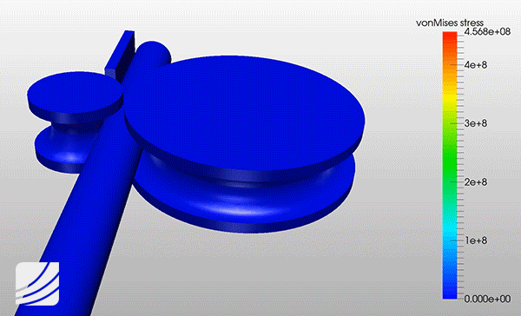
What is Flexural Properties?
The behaviors shown by textile materials (fibre, yarn and fabric), when it is subjected to bending, are known as flexural properties.

Slide 3
Flexural rigidity
Flexural rigidity is the resistance of a textile fibre against bending.
The unit of flexural rigidity is N-mm², N-m² etc.
Mathematically, Flexural rigidity, Rf = $\frac{1}{4Π}$ x $\frac{\text{η}\text{Е}\text{T}\text{2} }{\text{ρ}}$
Where,
η = Shape factor
Е = Specific shear modulus (in N/tex)
T = Linear density (in tex)
ρ = Density (in gram/cm³)

Slide 4
Specific Flexural rigidity
The specific flexural rigidity is the flexural rigidity of a textile fibre of unit linear density. Specific flexural rigidity is usually expressed as N-mm²/tex, N-m²/tex etc.
Mathematically, Specific Flexural rigidity = $\frac{1}{4Π}$ x $\frac{\text{η}\text{Е(1)2 }}{\text{ρ}}$
Where,
η = Shape factor
Е = Specific shear modulus (in N/tex)
T = Linear density (in tex)
ρ = Density (in gram/cm³)

Slide 5
Bending recovery
The power of recovery from an immediate curvature of textile fibre is known as bending recovery.
For example, nylon of 15 denier shows 100% recovery from a small curvature, whereas only 20% recovery is obtained from a large curvature

Slide 6
Bending modulus
Bending modulus can be defined as the ratio between bending stress and bending strain. Here, bending strain is usually expressed as degree or radian.
So, Bending modulus = $\frac{\text{Bending} \text{stress}}{\text{Bending} \text{strain}}$

Slide 7
Shape factor
Shape factor is a quantity or number that indicates the thickness or cross-section of a fibre. Shape factor is usually expressed by η.
If η =1, then the fibre is round shaped.
If η >1, then the fibre thickness is increased.
If η <1, then the fibre thickness is reduced.

Slide 8
Shape factor of different fibres
Fibre | Shape factor | Fibre | Shape factor
Viscose | 0.74 | Acetate | 0.67
Wool | 0.80 | Nylon | 0.91
Silk | 0.59 | Glass | 1.0

Slide 9
Thank You

