Slide 1
Computer Networks
GAA
Global Access Asia
VLAN
Professor Dr. A.K.M Fazlul Haque
Electronics and Telecommunication Engineering
(ETE)
Daffodil International University

Slide 2
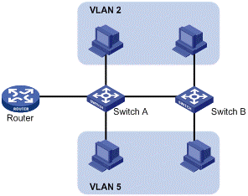
What is VLAN
A virtual local area network (virtual LAN) is the logical grouping of network nodes. A virtual LAN allows geographically dispersed network nodes to communicate as if they were physically on the same network.

Slide 3
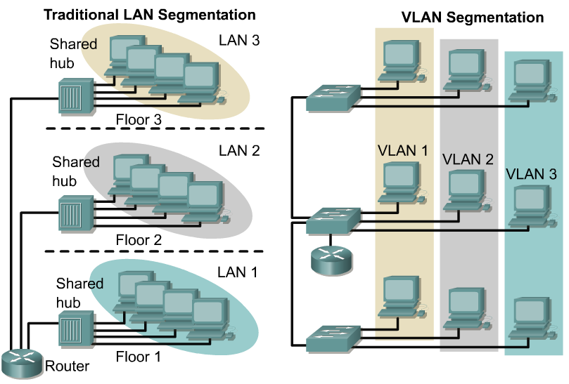
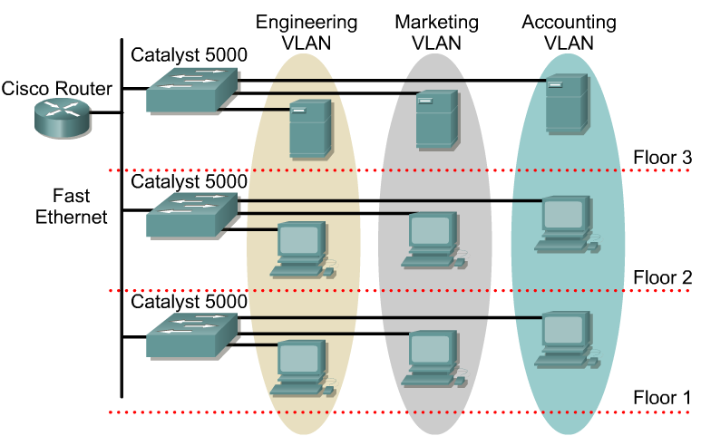
VLAN Introduction(Cont.)
VLANs provide segmentation based on broadcast domains.
VLANs logically segment switched networks based on the functions, project teams, or applications of the organization regardless of the physical location or connections to the network.
All workstations and servers used by a particular workgroup share the same VLAN, regardless of the physical connection or location.

Slide 4
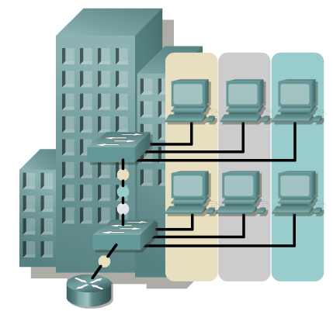
VLAN Introduction(Cont.)
VLANs are created to provide segmentation services traditionally provided by physical routers in LAN configurations.
VLANs address scalability, security, and network management. Routers in VLAN topologies provide broadcast filtering, security, and traffic flow management.
Switches may not bridge any traffic between VLANs, as this would violate the integrity of the VLAN broadcast domain.
Traffic should only be routed between VLANs.

Slide 5
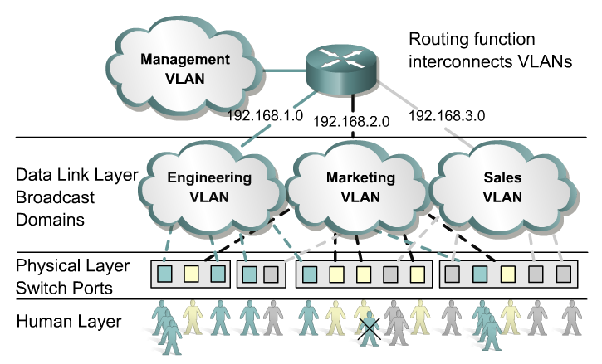
Benefits of VLANs
The key benefit of VLANs is that they permit the network administrator to organize the LAN logically instead of physically.
This means that an administrator is able to do all of the following:
Easily move workstations on the LAN.
Easily add workstations to the LAN.
Easily change the LAN configuration.
Easily control network traffic.
Improve security.
If a hub is connected to VLAN port on a switch, all devices on that hub must belong to the same VLAN.

Slide 6
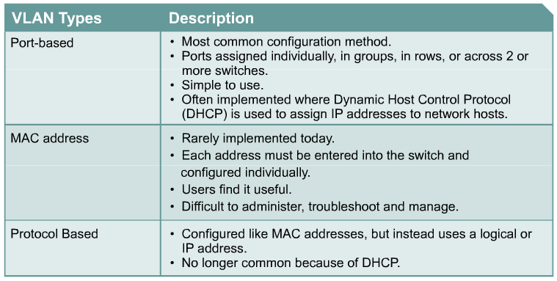
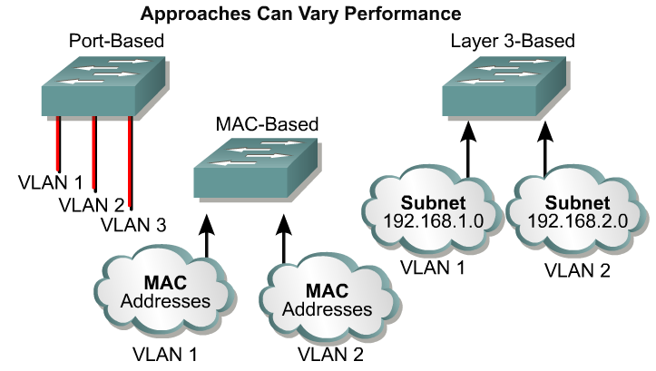
VLAN Types
2 types of VLAN
End-to-End or Campus-wide VLANs
Geographic or Local VLANs

Slide 7
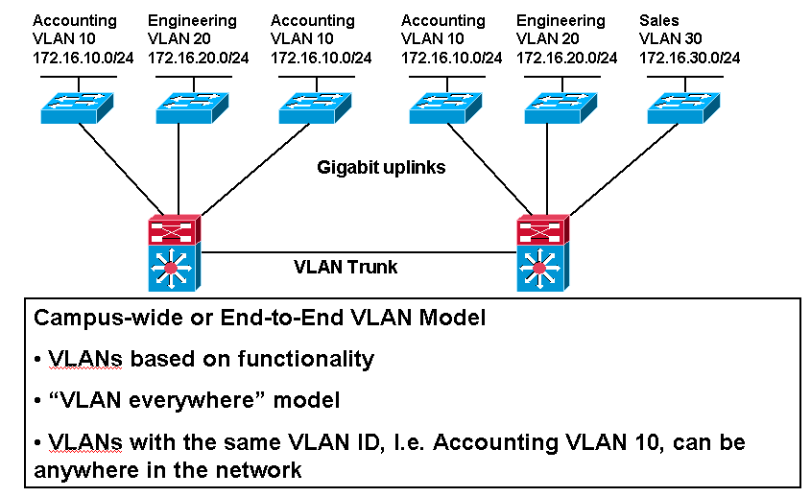
End-to-End or Campus-wide VLANs

Slide 8
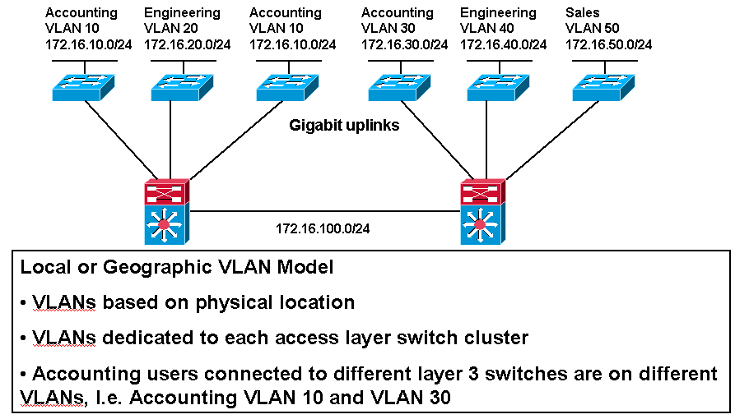
Geographic or Local VLANs

Slide 9
Static VLANs
Static membership VLANs are called port-based and port-centric membership VLANs.
This is the most common method of assigning ports to VLANs.
As a device enters the network, it automatically assumes the VLAN membership of the port to which it is attached.
There is a default VLAN, on Cisco switches that is VLAN 1.

Slide 10
Dynamic VLANs
Dynamic VLAN works with MAC address.
Administrator adds only MAC address in VLAN.
By using VMPS dynamic VLAN will work.

Slide 11
VLANs Connection Links
Access link: An access link is a link that is part of only one VLAN, and normally access links are for end devices.
Trunk link: A Trunk link can carry multiple VLAN traffic and normally a trunk link is used to connect switches to other switches or to routers.

Slide 12
VLAN Techniques
Two techniques
Frame Filtering: Examines particular information about each frame (MAC address or layer 3 protocol type)
Frame Tagging: Places a unique identifier in the header of each frame as it is forwarded throughout the network backbone.

Slide 13
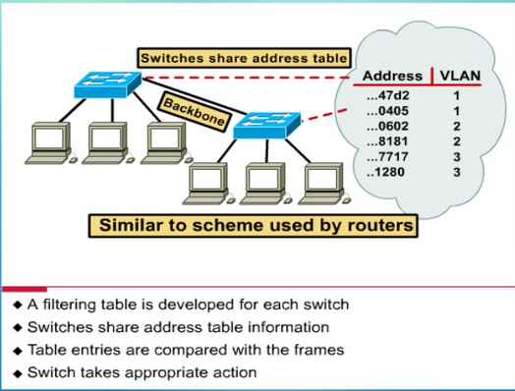
Frame Filtering
User can be logically group via software based on:
Port number
MAC address
IP subnet
Protocol being used

Slide 14
Frame Tagging
Frame tagging was specifically developed for switched communication
Frame tagging places a unique identifier in the header of each frame as it is forwarded throughout the network backbone.

Slide 15
VLAN Trunking/Tagging Protocol
VLAN Tagging is used when a link needs to carry traffic for more than one VLAN.
Trunk link: As packets are received by the switch from any attached end-station device, a unique packet identifier is added within each header.
This header information designates the VLAN membership of each packet.

Slide 16
VLAN Trunking/Tagging Protocol (Cont.)
The packet is then forwarded to the appropriate switches or routers based on the VLAN identifier and MAC address.
Packet tagging provides a mechanism for controlling the flow of broadcasts and applications while not interfering with the network and applications.
This is known as a trunk link or VLAN trunking.

Slide 17
VLAN Trunking/Tagging Protocol (Cont.)
VLAN Tagging is used when a single link needs to carry traffic for more than one VLAN.
No VLAN Tagging
VLAN Trunking/Tagging

Slide 18
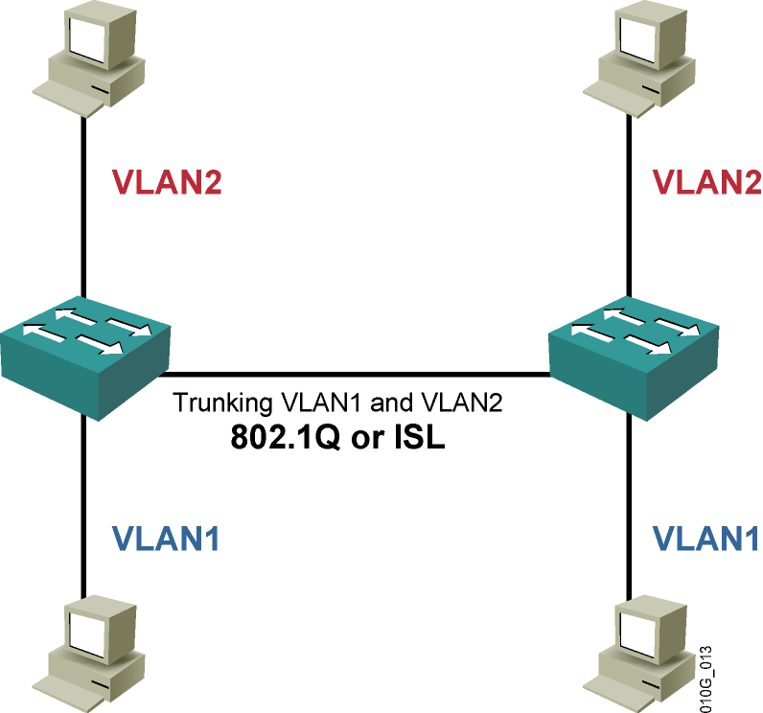
VLAN Trunking/Tagging Protocol (Cont.)
There are two major methods of frame tagging, Cisco proprietary Inter-Switch Link (ISL) and IEEE 802.1Q.
ISL used to be the most common, but is now being replaced by 802.1Q frame tagging.
Cisco recommends using 802.1Q.
VLAN Tagging and Trunking will be discussed in the next chapter.

Slide 19
Broadcast Domains With VLANs & Routers
Port 1 VLAN 10
Port 4 VLAN 20
Port 9 VLAN 10
Port 12 VLAN 20
10.1.0.10/16 DG: 10.1.0.1
10.2.0.20/16 DG: 10.2.0.1
10.1.0.30/16 DG: 10.1.0.1
10.2.0.40/16 DG: 10.2.0.1
A VLAN is a broadcast domain created by one or more switches.
VLANs are assigned on the switch and correspond with the host IP address.
Each switch port can be assigned to a different VLAN.

Slide 20
Broadcast Domains With VLANs & Routers(Cont.)
Port 1 VLAN 10
Port 4 VLAN 20
Port 9 VLAN 10
Port 12 VLAN 20
ARP Request
10.1.0.10/16 DG: 10.1.0.1
10.2.0.20/16 DG: 10.2.0.1
10.1.0.30/16 DG: 10.1.0.1
10.2.0.40/16 DG: 10.2.0.1
Ports assigned to the same VLAN share the same broadcast domain.
Ports in different VLANs do not share the same broadcast domain.

Slide 21
END

