Slide 1
Countable & Uncountable Nouns

Slide 2
Types of Nouns
Common nouns: Common nouns are words that refer to undefined or generic people, places, or things.
Proper nouns: Proper nouns help distinguish a specific person, place, or thing. These words should be capitalized.
Concrete nouns: A concrete noun is something that can be perceived through the five senses. If you can see, hear, touch, taste, or smell something, it uses a concrete noun.
Abstract nouns: Abstract nouns are intangible ideas that can’t be perceived with the five senses, such as social concepts, political theories, and character traits. Abstract nouns are also uncountable nouns.
Collective nouns: A collective noun is a noun that functions as a singular noun while referring to a group of people or things.
Compound nouns: A compound noun combines two or more words into one. Compound nouns can appear as a single word, multiple words used separately, or words connected by hyphens.
Countable nouns: A countable noun (also known as a count noun) is one that you can count.
Uncountable nouns: An uncountable noun (also known as a mass noun) is one that cannot be counted.

Slide 3
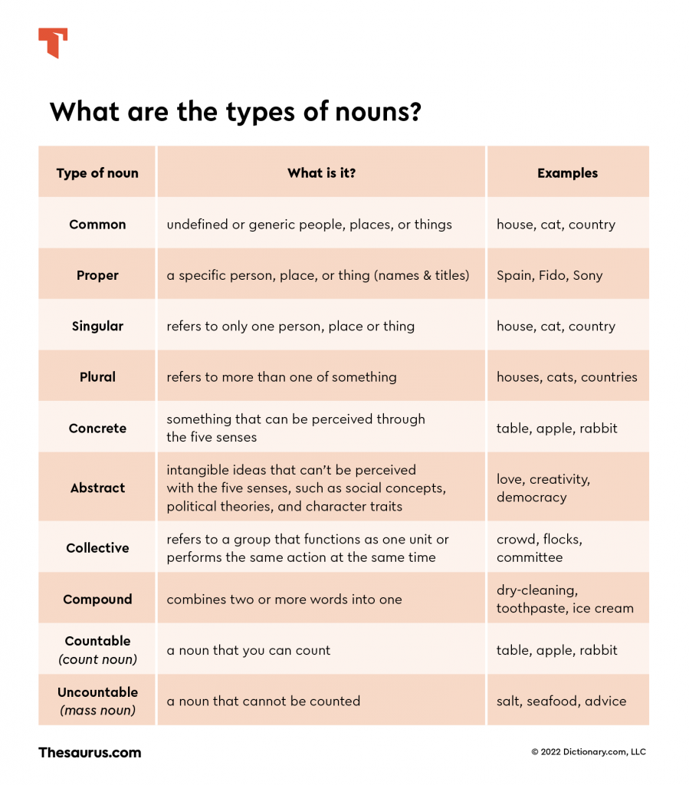

Slide 4
Definition
Nouns that can be counted and – banana, monkey, phone etc.
Ex: He ate two bananas for breakfast. Mother gave me two dollars. The train will be 10 minutes late. The trip to Singapore will be expensive. The burger I had for dinner was soggy. You need to take two tablets very day.
Nouns that cannot be counted – money, rice, water, etc.
Ex: She ate rice for dinner. Mother gave me money. I hate delay. Travelling is a good hobby. The dinner was getting cold. The medicine works slowly.

Slide 5
Countable
Uncountable
Countable nouns can be singular or plural. Ex: one banana (singular), two bananas (plural)
She was listening to a song. (one song)
Articles a/an are used with countable nouns to define numbers. Ex: A boy (one boy) was stalking me.
Many and Few: used with countable noun. Ex: He sold many books today.
Uncountable nouns do not have singular or plural forms. The plural for ‘rice’ is rice.
He was listening to music. (no numbers)
Articles are not used with uncountable nouns. Ex: father gave me a money. (wrong)
Much and little: used with uncountable noun. Ex. The soup need a little salt.

Slide 6
Some nouns are used as both countable and uncountable nouns.
Ex: Noise, room, paper, coffee, juice, etc.
I heard a noise. / They are making too much noise.
The room is spacious. / I need some room. (space or privacy)
Some nouns are Uncountable and always used with singular to be verbs.
Ex: News furniture information accommodation behaviour damage luck permission traffic advice bread luggage progress weather baggage chaos scenery work
But some of them can be used with other modifiers to indicate numbers. Ex: a loaf of bread, the piece of advice,

