Slide 1
Yarn
Mousumi Rahaman Hashi
Senior Lecturer
Dept. of Textile Engineering
Faculty of Engineering

Slide 2
Yarn
Yarn may be defined as the long fine structure capable of being assembled or interlocked into such intermediate product as like fabric, woven fabric, ropes & cords.

Slide 3
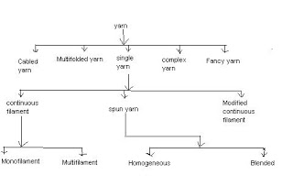
Classification of yarn:

Slide 4
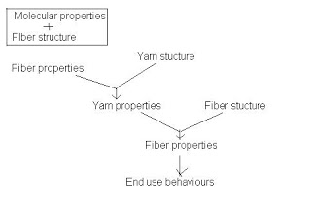
Interaction between fiber, yarn & fabric:

Slide 5
Yarn Geometry
Assumption of an ideal yarn geometry/ Properties of an ideal Yarn:
The following yarn properties should have a textile yarn if it is said as a ideal yarn- 1. The yarn is circular in cross-section and is uniform along its length. 2. Each fibre follows a uniform helical path around one of the concentric cylinder so that its distance from yarn axis remains constant. 3. A fibre at the centre will follow a straight line of the axis. 4. The number of filaments or fibres crossing the unit area is constant; that is the density of packing. Fibres in the yarn are constant throughout the model. 5. Every filament in the yarn will have the same amount of twist per unit length. 6. The yarn consists of very large number of filaments.

Slide 6
If the above mentioned yarn properties is absent on any yarn than the yarn should not be allowed on weaving to make fabric. Because it will not be able to give you a perfect weaving combination where the warp and weft yarn’s parameter is mandatory to be maintained.

Slide 7
Yarn Designation
The factors or parameters which are required to express the yarn structure and properties are called yarn designation. The factors are-
Yarn count
No. of filaments
No. of components in folding
Direction and amount of twist
No. of components in cabling
Fibre components
By yarn designation it is possible to express the identities of single, folded yarn.

Slide 8
Thanks All

