Slide 1
Lecture 19-20
NGOs provisions on Basic Education:
Alternative or Complementary?
Mohammad Faisal Akber
Lecturer
Department of Development Studies
Daffodil International University

Slide 2
What Are Your Thoughts on Education?

Slide 3
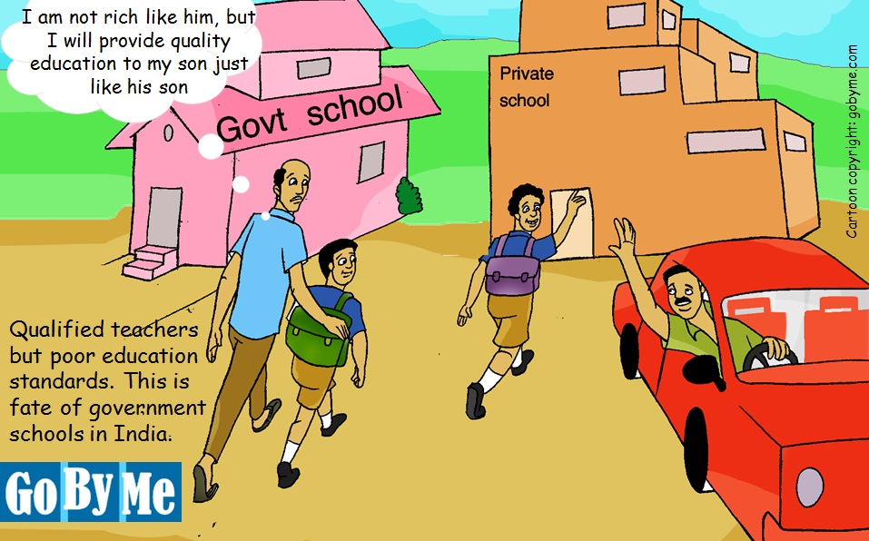

Slide 4
NGO roles as Education Provider
NGOs play a variety of roles in supporting education service delivery.
A few NGOs try to put pressure on Governments through advocacy to fulfill the commitment to education for all. Some NGOs provide support to develop the quality of Government Provision through “School Adoption” programs.
But there are some specific NGOs which are directly involved in education provision. These directly involved NGOs aim to provide educational opportunities to those children who are excluded from government schooling.
NGOs can respond to this kind of educational exclusion in many forms. Educational exclusion is associated with being “hard to reach” in terms of where children live and who they are-

Slide 5
Who are “Hard to Reach”?
Street Children
Orphans
Child Soldiers
Demobilized children in post-conflict areas
Pastoralists
Indigenous Groups
Ethnic, Religious and Language Minority Groups
The disabled
Refugees
Child Laborers

Slide 6
Education Provision by NGOs: Alternative or Complementary
International agency and NGO reports often suggest that students in NGO schools receive a better quality education compared with their counterparts in government schools, and that such provision is more cost-effective.
However, little is known about how access to NGO provision affects access to higher levels of education, or how it influences employment opportunities.
In order to reach the excluded, NGO provision is often viewed as aiming to develop an ‘alternative’ approach to education from the formal ‘conventional’ state system.
The ‘alternative’ associated with NGO provision is often related to ‘non-formal’ approaches.

Slide 7
What is Non-Formal Provision?
Coombs and Ahmed’s analysis of non-formal education programs (1974) articulated a now much-cited definition for non-formal education. Their approach started from the premise that ‘education can no longer be seen as a time-bound, place-bound process confined to schools and measured by years of exposure’, and so equated education with learning, regardless of where, how or when learning occurs.
Their definition is concerned with how education is provided, not with who provides the different forms of education.
There may be similarities between formal and non-formal education in as much as they are organized to augment and improve the informal learning process.
There may also be differences with respect to their institutional activities, educational objectives and the groups they serve.

Slide 8
What is Non-Formal Provision?
Over time, the term non-formal education has become closely associated with NGO provision, while formal schooling is seen to refer to government (or private) provision.
The term non-formal education has gained common currency, with the definitions coined by Coombs and Ahmed continuing to be adopted by international agencies.
However, debates amongst researchers and NGO practitioners about terminology have become intense in recent years for two reasons.
Firstly, there is a concern that, where the term ‘non-formal’ is associated with being an ‘alternative’ to formal schooling, this implies that it is second-best.
Secondly, given the diversity in non-formal programs, as well as some changes in the way that formal schooling is delivered, the boundaries between formal and non-formal education have become increasingly fuzzy.

Slide 9
Terms Commonly Associated With Formal Approaches
State Provided
Conventional
Mainstream
Accountable to Ministry of Education
Teacher-centered
Homogeneous
Rigid
Top-down
Over-crowded curriculum
Curriculum associated with modernization
Hidden curriculum promoted silent exclusion
Exam-driven
Large Class size
Centrally Recruited Teachers
Inefficient

Slide 10
Terms Commonly Associated With Non-Formal Approaches
NGO provided
Alternative/Complementary
Compensatory/supplementary
Accountable to civil society/community
Child-centered
Heterogeneous
Flexible/participatory
Bottom-up
Accelerated Learning
Locally Relevant Curriculum
Girl-friendly
On-going, formative assessment
Small class sizes
Locally recruited teachers

Slide 11
Education Provision by NGOs
The dilemma of Cost
NGO programs are more cost-effective in terms of the amount of completion and learning for the resources spent. Even so, in some programs (for example, the School for Life program in Ghana) the annual unit costs are higher than for government schools – partly because of the increased costs required in educating those who are most difficult to reach.
Poor Salary of the Teachers
A key reason for the lower costs of NGO provision is due to inferior pay of ‘voluntary’ teachers, supported by community contributions. For example, in Bangladesh estimates indicate that teachers in government schools receive around $70 per month, compared with $9 for those working in NGO centers.
The possibility of the government finding voluntary teachers on a nationwide scale able to work at a rate of pay considerably below the $1 per day poverty line seems unlikely.

Slide 12
Education Provision by NGOs:
Social Mobilization is not possible
Government provision could be attributed with a more professionally developed, regulated system aimed at providing children with access to jobs in the formal labor market.
By contrast, non-formal, NGO-provided education often involves little external monitoring, with learning limited to basic literacy and numeracy.
This provision could therefore lead to children unable to move beyond their existing environment and status.
However, these views of formal and non-formal provision are rarely portrayed in recent literature. It appears that there is almost a fear of being critical about an approach that has gained exemplary status in the eyes of some international agencies.

Slide 13
Education Provision by NGOs:
Standard Package or Flexible Approaches
In practice, NGO programs are often offered in the form of a standard package, rather than through a wide variation of ‘flexible’ approaches as implied in much of the non-formal education literature.
An assessment of NGOs education programs in Ethiopia, Guinea, Malawi and Mali argues that the approaches of the programs are similar across the four countries.
A small number of programs like School for Life in Ghana, and BRAC in Bangladesh were successful.

Slide 14
Education Provision by NGOs:
From Second Best to Complementary?
Despite the almost universal positive image of NGO non-formal education programs, as noted, it is paradoxically often also viewed as a second-best alternative to government provision.
In an attempt to shift the focus from this conventional perspective, USAID has recently adopted the terminology of ‘complementary’ approaches in its study of eight NGO programs.
The study notes that these programs are ‘not meant to serve as non-formal alternatives to primary education’ even though some were known as non-formal programs at the time when they were established.

Slide 15
Education Provision by NGOs
Mainstreaming Children is Crucial
This shift in terms from alternative towards complementary programs is partly associated with a trend of seeing NGO provision as part of a process of ‘mainstreaming’ children into the formal system.
For example, an equivalency system is currently being devised in Bangladesh to allow graduates from NGO programs to join the formal system.
Transition requires Similarity
A consequence of moving towards equivalency and mainstreaming is that there are increasingly similarities between (formal) government and (complementary) NGO approaches in terms of the curriculum followed in order to prepare for higher levels of education.
Complementary programs are therefore converging towards government formal approaches to ensure children can transit from one system to another.

Slide 16
Education Provision by NGOs:
Accelerated Learning
The move towards complementary NGO provision is commonly associated with a version of ‘accelerated learning’.
In this context, accelerated learning is used to refer to approaches which support a reduced curriculum compared with the state system, usually focusing on basic literacy and numeracy.
The intention is that students learn the basic requirements in a short period of time to allow them to gain access to a later stage of formal schooling.
Examples of complementary, accelerated learning approaches of this kind include Ghana’s School for Life and Ethiopia’s Alternative Basic Education programs, both of which are modelled on the BRAC approach in Bangladesh.

Slide 17
Education Provision by NGOs:
Failure After Transition
Integrating graduates from these NGO programs into the formal system remains a challenge in reality.
In Bangladesh, while the vast majority of BRAC graduates gain access to formal secondary schools (over 90%), their survival rates in school are low, and below rates for those who continue from formal primary schools.
Reasons for their dropout in secondary school are related to differences in learning styles and social background of students which can result in them being excluded within the formal school system.

Slide 18
Education Provision by NGOs:
Insufficient Supply of Secondary Schools
Insufficient supply of secondary schools is another reason for problems in the transition between non-formal and formal systems.
In Ghana’s School for Life program, it is estimated that one-third of graduates have been unable to join the formal school system, with reasons for not doing so mainly due to lack of availability of a school in the locality rather than lack of interest.

Slide 19
Influence of International Commitments and Goals on NGO Provision
1970s: Attention to non-formal approaches
Basic Needs Approach to Development
Concern of achieving universal primary education by 1980
Criticisms of Formal Schooling
1980s to 1990s: swing back to formal, with ‘alternatives’
Structural Adjustment Conditionalities resulting in a decline in resources towards state schooling
Non-formal seen as “band-aid” and second best
2000s: emphasis on complementary approaches.
Education’s role prioritized in the context of emerging democracies with emphasis on state provision.
Concern for achieving MDG/EFA by 2015
Complementarities between state and non-state approaches – search for alignment.

Slide 20
NGO provision in Government Plans
Bangladesh
Since mid 1980s
Grown out of locally based relief NGOs (BRAC particularly influential)
Autonomous from Government Plans
Alternative
Ghana
Since 1990s
Donor-supported
For example, BRAC Model supported by International NGOs
Included in Government Plans
Complementary
Ethiopia
Since 1990s
Donor-supported
For example, BRAC Model supported by International NGOs
Included in Government Plans
Complementary

Slide 21
BRAC’s Evolution in the Education
Sector of Bangladesh
BRAC, an international development organization in Bangladesh, is the largest NGOs in the world; established by Sir Fazle Hasan Abed in 1972. BRAC is present in all districts of Bangladesh and 13 other countries.
1985: BRAC’s Non-Formal Primary Education Program is started
1994: Non-Formal Primary Education is Replicated in Africa
1997: BRAC Pre-Primary Schools commence operation
2002: BRAC commences development work in Afghanistan
2003: The Continuing Education and Post Primary Basic Education Programs are integrated into a single Program called Post Primary Basic and Continuing Education (PACE) Program
2006: BRAC’s development programs in Africa commence
2008: BRAC’s education program initiates capacity building of government and registered non-government primary schools.

Slide 22
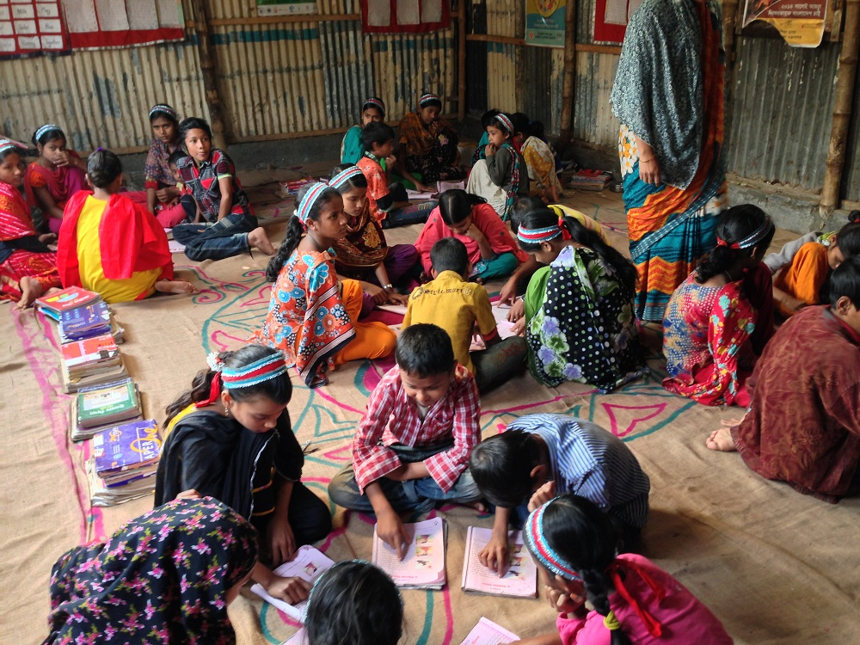
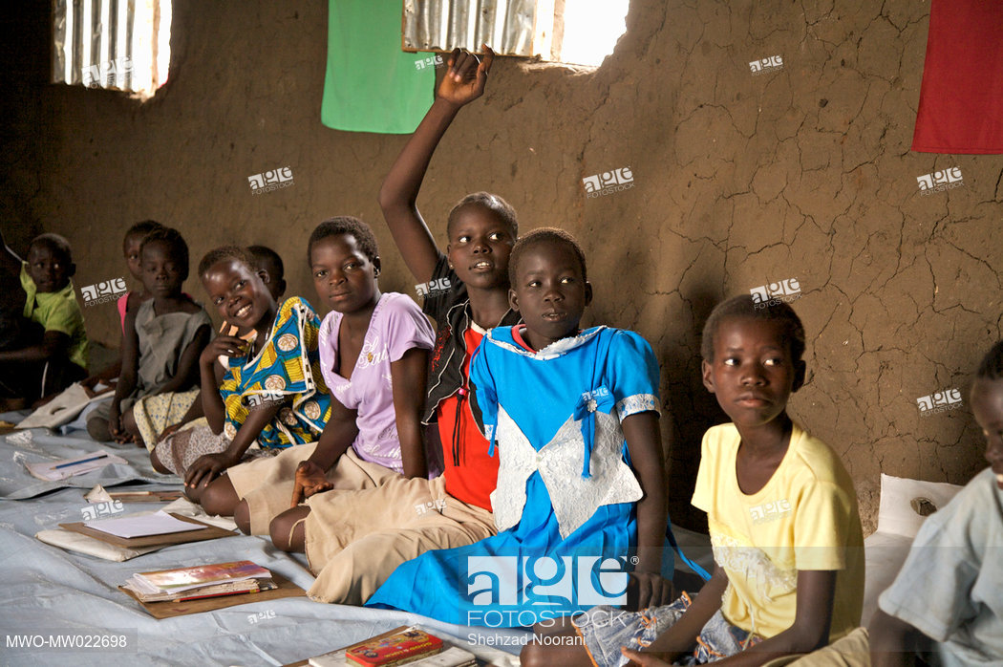

Slide 23
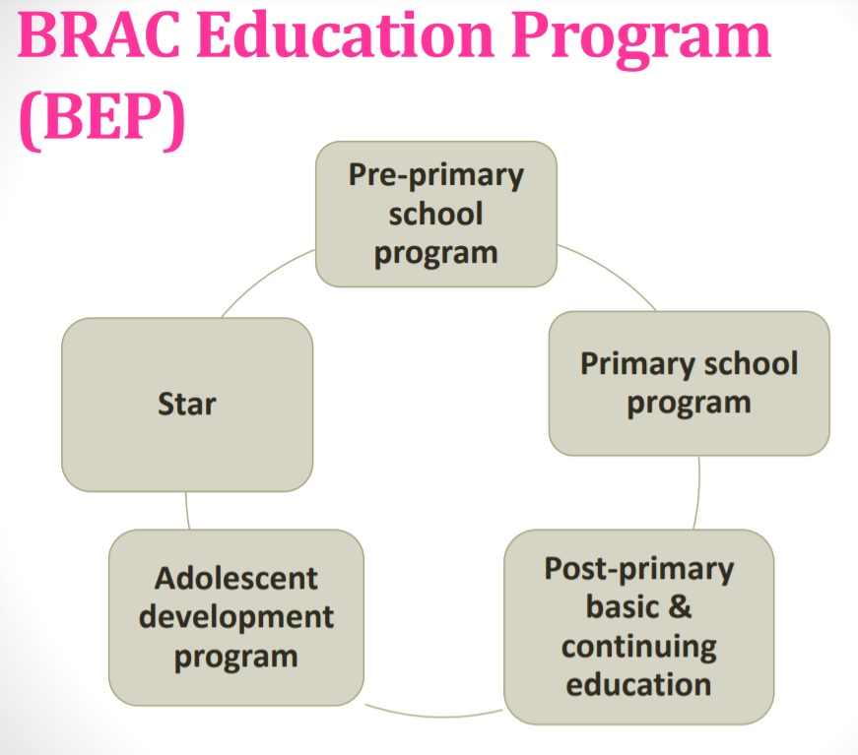
BRAC’s Education Program
BRAC is one of the largest NGOs involved in primary education in Bangladesh. As of the end of 2012, it had more than 22,700 non-formal primary schools with a combined enrolment of 670,000 children.
BRAC's education program provides non-formal primary education to those left out of the formal education system, especially rural, or disadvantaged children, and drop-outs. Its schools are typically one room with one teacher and no more than 33 students.
BRAC Education Program has been operating in 6 countries. There are 7,00,000+ students (8 to 14 years).

Slide 24
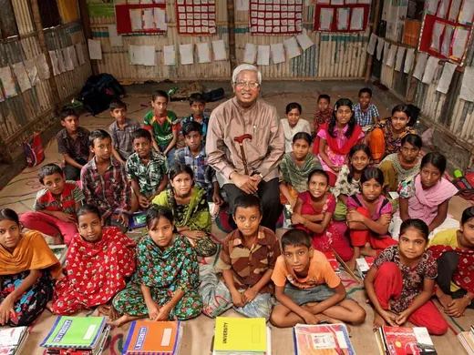
BRAC’s Education Program
Other Education Projects
Children with Special Needs
Education for Ethnic Children (EEC)
Projects:
a. Education Support Program (ESP)
b. Formal & Community School
c. TBS (Tracking of BRAC Graduates at secondary schools)
d. Shishu Niketan: Home for Children
e. Shikkha Tari: Boat School

Slide 25
Facilities of NGOs Schools
Spending on Education: It costs about 20 US dollar for a year of schooling in a BRAC school. This cost is paid for by the school.
Access to Education: NGOs is flexible and accommodating to make it possible for as many children as possible to attend school.
Curriculum: The Curriculum for NGOs schools has been adjusted to meet the needs of children from rural lifestyles.
Teacher Training and Supervision: 97% of teachers in NGOs schools are women who are married, but 100
Flexible hours: Children in rural areas are often needed by their parents for labor purposes, especially during peak harvesting seasons.
Incentives: NGOs offer some sort of incentive to come to school.
Classroom management: The classroom has a range of furniture and this is placed in a corner of the classroom. There is a mat on the floor of the classroom

Slide 26
References
Akyeampong, K. (2004). Aid for self help effort? A sustainable alternative route to basic education in Northern Ghana. Journal of International Cooperation in Education, 7(1), 41-52.
Coombs, P. H., & Ahmed, M. (1974). Attacking Rural Poverty: How Nonformal Education Can Help. A Research Report for the World Bank Prepared by the International Council for Educational Development.
DeStefano, J., Schuh Moore, A., Hartwell, A., & Balwanz, D. (2006). Reaching the underserved through complementary models of effective schooling. Washington, DC: EQUIP2, AED, and USAID.

