Slide 1
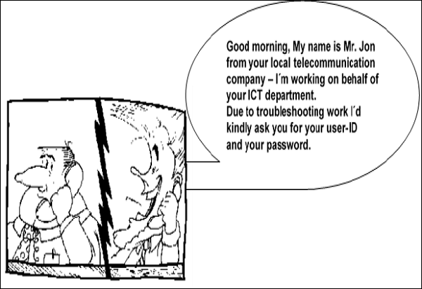
Computer Security Overview

Slide 2
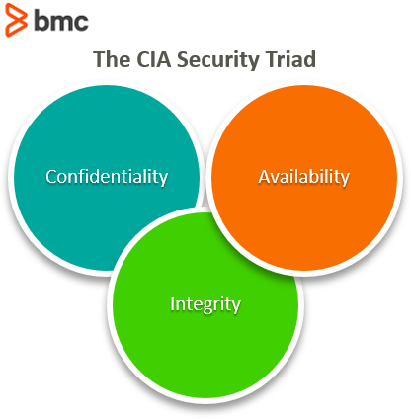
Different Elements in Computer Security

Slide 3
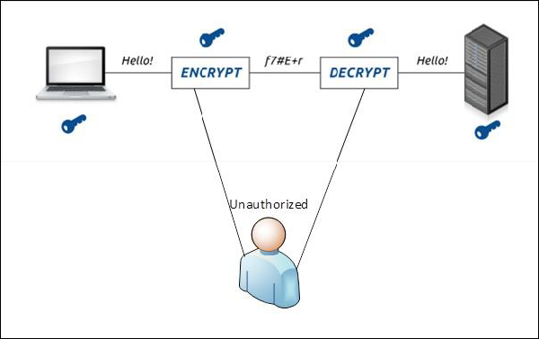
Confidentiality
Confidentiality is the concealment of information or resources. Also, there is a need to keep information secret from other third parties that want to have access to it, so just the right people can access it.
Example in real life − Let’s say there are two people communicating via an encrypted email they know the decryption keys of each other and they read the email by entering these keys into the email program. If someone else can read these decryption keys when they are entered into the program, then the confidentiality of that email is compromised.

Slide 4
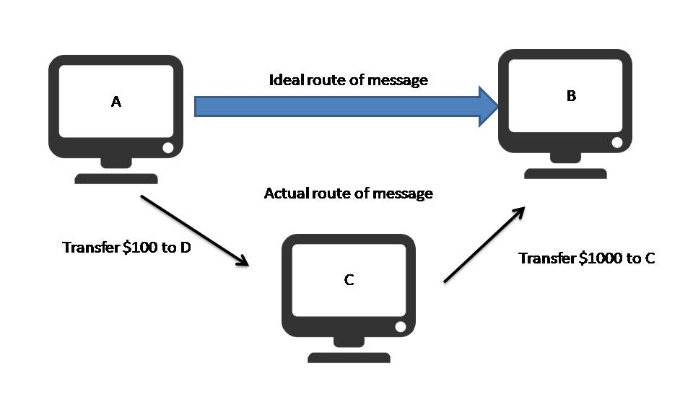
Integrity
Integrity refers to the accuracy and completeness of data. Integrity involves maintaining the consistency and trustworthiness of data over its entire life cycle. Data must not be changed in transit, and precautionary steps must be taken to ensure that data cannot be altered by unauthorized people.
Example in real life − Let’s say you are doing an online payment of 100 USD, but your information is tampered without your knowledge in a way by sending to the seller 1000 USD, this would cost you too much.

Slide 5
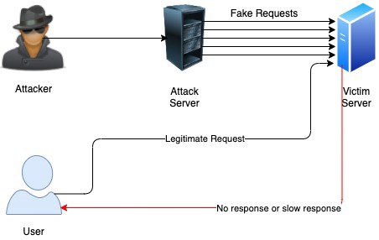
Availability
Availability means that information is accessible to authorized users. It provides an assurance that your system and data can be accessed by authenticated users whenever they’re needed. Similar to confidentiality and integrity, availability also holds great value.
Example in real life − Let’s say a hacker has compromised a webserver of a bank and put it down. You as an authenticated user want to do an e-banking transfer but it is impossible to access it, the undone transfer is a money lost for the bank.

Slide 6
Attacks
Attacks on computer systems
break-in to destroy information
break-in to steal information
blocking to operate properly
malicious software
wide spectrum of problems
6

Slide 7
Services, Mechanisms, Attacks
3 aspects of information security:
security attacks (and threats)
actions that (may) compromise security
security services
services counter to attacks
security mechanisms
used by services
e.g. secrecy is a service, encryption (a.k.a. encipherment) is a mechanism
7

Slide 8
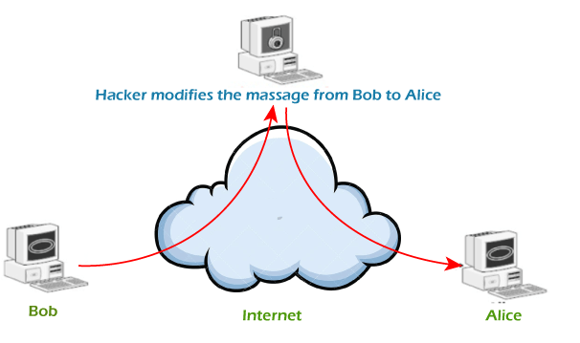
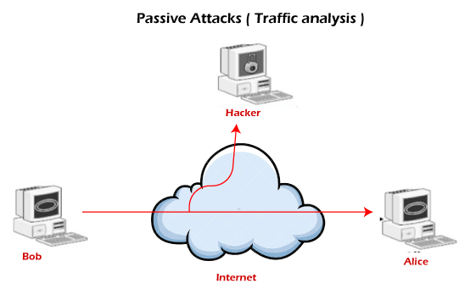
Attacks
Network Security
Active attacks
Passive attacks
8

Slide 9
Attacks
Passive attacks
An attacker observes the messages and copies them
victims do not get informed about the attack
It is difficult to detect as there is no alteration in the message.
Passive attacks can be prevented by using some encryption techniques.
9

Slide 10
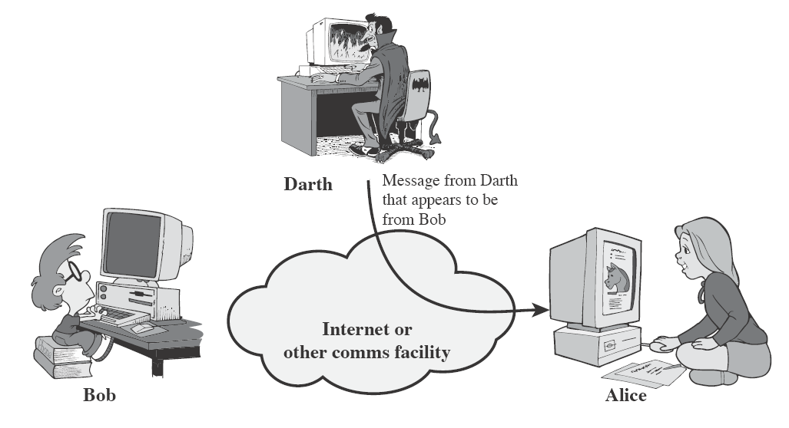
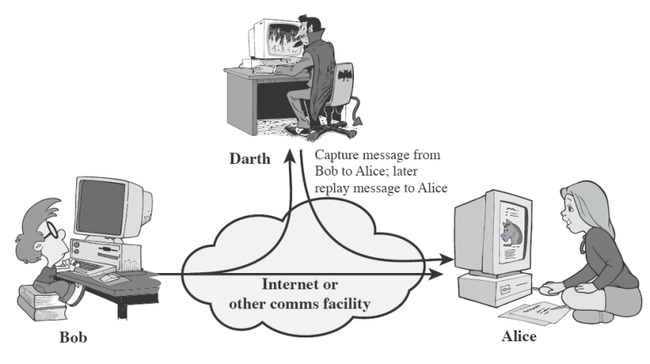
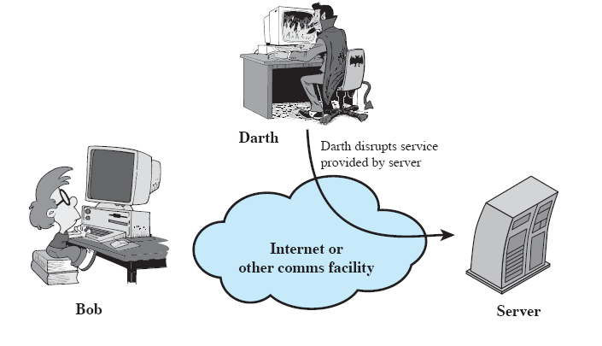
Attacks
Active attacks
Attacker actively manipulates the communication
Masquerade
pretend as someone else
possibly to get more privileges
Replay
passively capture data and send later
Denial-of-service
prevention the normal use of servers, end users, or network itself
10

Slide 11
Security Services
to prevent or detect attacks
to enhance the security
replicate functions of physical documents
e.g.
have signatures, dates
need protection from disclosure, tampering, or destruction
notarize
record
11

Slide 12
Basic Security Services
Authentication
assurance that the communicating entity is the one it claims to be
Access Control
prevention of the unauthorized use of a resource
to achieve this, each entity trying to gain access must first be identified and authenticated, so that access rights can be tailored to the individual
12

Slide 13
Basic Security Services
Data Confidentiality
Confidentiality means that only authorized individuals/systems can view sensitive or classified information.
Data Integrity
assurance that data received are exactly as sent by an authorized sender
i.e. no modification, insertion, deletion, or replay
13

Slide 14
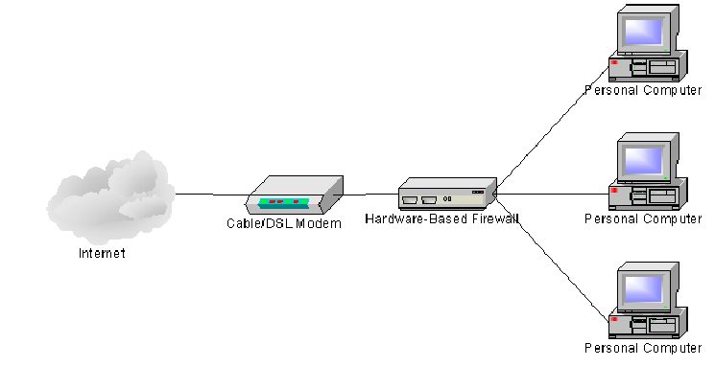
Security Mechanisms
Cryptographic Techniques
will see next
Software and hardware for access limitations
Firewalls
Traffic Padding
A continuous random data
stream is generated.
Hardware for authentication
Smartcards, security tokens.
Physical security
Keep it in a safe place with
limited and authorized physical access
14

Slide 15
Common Types of Networking Attacks
Malware
Computer Virus
Computer Worm
Phishing
DoS (Denial of Service) and DDoS
Man-in-the-middle
Ransomware
SQL Injection Attacks

Slide 16
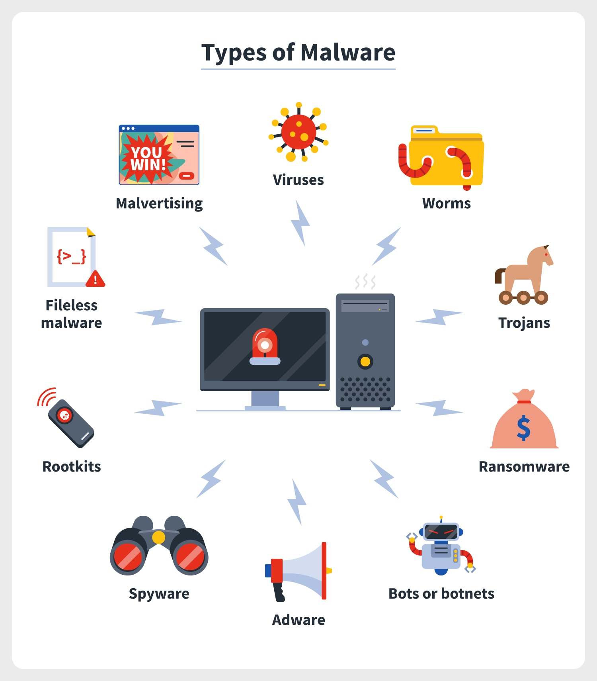
Malware
Malware is a catch-all term for any type of malicious software, regardless of how it works, its intent, or how it's distributed
Hackers attempt to gain unauthorized access into the target system and disrupt or corrupt the files and data through malicious codes called malware.

Slide 17
Computer Virus
A type of malware, they are unique pieces of code that can wreak havoc and spread from computer to computer.
If you click on an email with a malicious link or download links from infected websites, these viruses can corrupt your files, infect other computers from your list and steal your personal information.

Slide 18
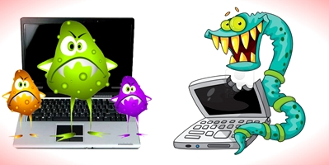
Computer Worm
Worms replicate itself to cause slow down the computer system.
Worms are also replicates itself.
The main objective of worms to eat the system resources.

Slide 19
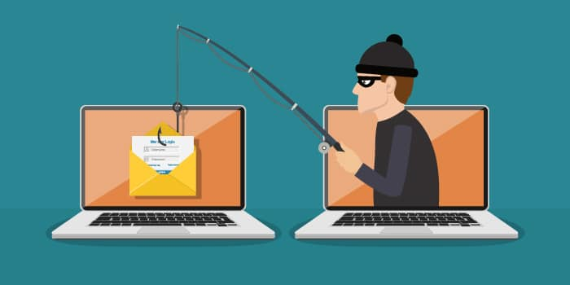
Phishing
Phishing is a type of social engineering where an attacker sends a fraudulent (e.g., spoofed, fake, or otherwise deceptive) message designed to trick a person into revealing sensitive information to the attacker

Slide 20
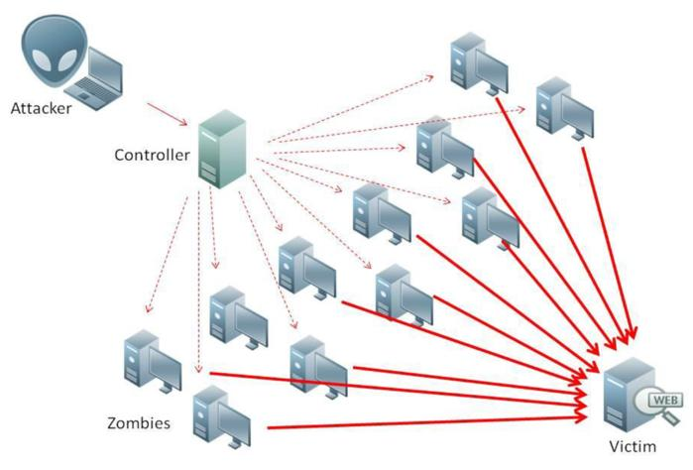
DoS (Denial of Service) and DDoS
A Denial-of-Service (DoS) attack is an attack meant to shut down a machine or network, making it inaccessible to its intended users. DoS attacks accomplish this by flooding the target with traffic, or sending it information that triggers a crash.

Slide 21
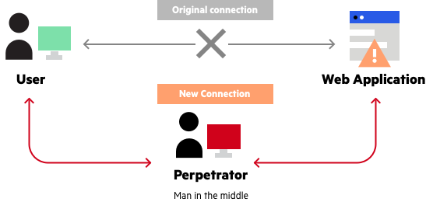
Man-in-the-middle
A man-in-the-middle (MiTM) attack is a cyberattack where the attacker secretly relays and possibly alters the communications between two parties who believe that they are directly communicating with each other, as the attacker has inserted themselves between the two parties.

Slide 22
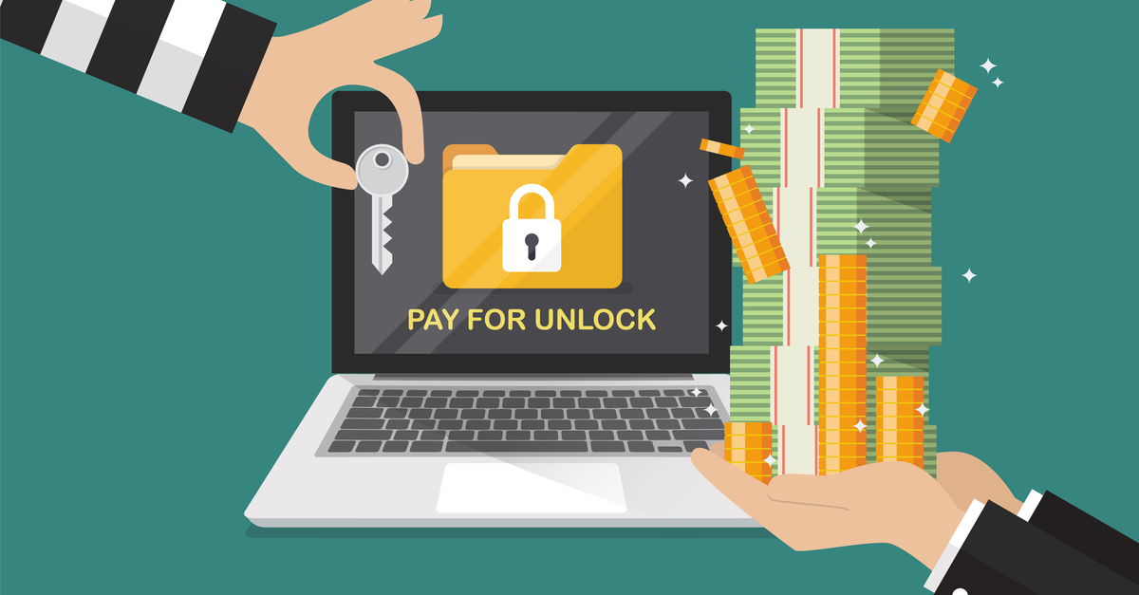
Ransomware
Ransomware is a type of malware that threatens to publish the victim's personal data or block access to it unless a ransom is paid.
While some simple ransomware may lock the system without damaging any files.
Advanced malware uses a technique called cryptoviral extortion. It encrypts the victim's files, making them inaccessible, and demands a ransom payment to decrypt them

Slide 23
SQL Injection Attacks
SQL injection, also known as SQLI, is a common attack vector that uses malicious SQL code for backend database manipulation to access information that was not intended to be displayed. This information may include any number of items, including sensitive company data, user lists or private customer details.

