Slide 1
COLORENT CHEMICALS

Slide 2
Colorants are used in many industries - to colour clothes, paints, plastics, photographs, prints, and ceramics. Colorants are also now being used in novel applications and are termed functional (high technology) as they are not just included in the product for aesthetic reasons but for specific purposes, for example in surgery.
Colorants can be either dyes or pigments. Dyes are soluble coloured organic compounds that are usually applied to textiles from a solution in water. They are designed to bond strongly to the polymer molecules that make up the textile fibre.
Pigments are insoluble compounds used in paints, printing inks, ceramics and plastics. They are applied by using a dispersion in a suitable medium. Most pigments used are also organic compounds.

Slide 3
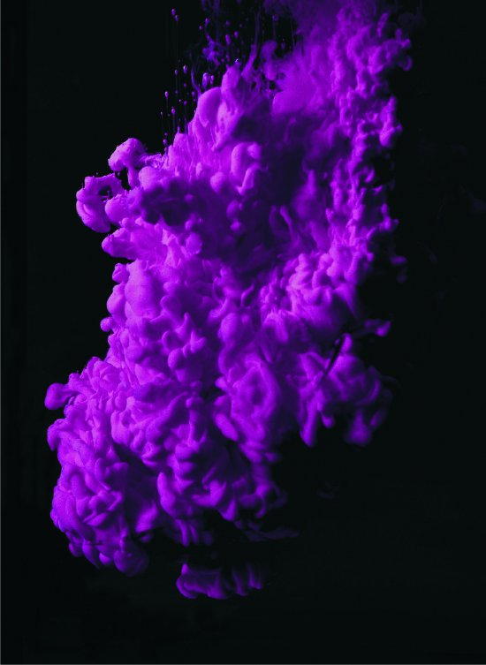
Manipulating the colour and application of dyes
This section considers some of the chemistry behind the colour of dyes and how the target material, for example a fibre, influences the method of dyeing and the dye used.
A dye in solution is coloured because of the selective absorption of certain wavelengths of light by specific bonds in the molecule. The light that is transmitted is seen by the observer and appears coloured because some of the wavelengths of the visible spectrum are now missing.

Slide 4
The absorption of visible light energy by the compound promotes electrons in the molecule from a low energy state, the ground state, to a higher energy state, the excited state. The molecule is said to have undergone an electronic transition during this excitation process. Particular excitation energies correspond to particular wavelengths of visible light.

Slide 5

It is a n electron (an electron in a double or triple bond) that is promoted to the excited state. Even less energy required for this transition if alternate single and double bonds (i.e. conjugated double bonds) exist in the same molecule. The excitation of the electron is made even easier by the presence of aromatic rings because of th enhanced delocalisation of the n electrons.
By altering the structure of the compound, colour chemists can alter the wavelength of visible light absorbed and therefore the colour of the compound.
The molecules of most coloured organic compounds contain two parts:
(i) a single aryl (aromatic) ring such as benzene or a benzene ring with a substituent. Alternatively there may be a fused ring system such a naphthalene (two rings fused together) or anthracene (three rings fused together).

