Slide 1
Human Resources and Economic Aspects of Bangladesh
Dr. Md. Golam Rahman
Professor

Slide 2
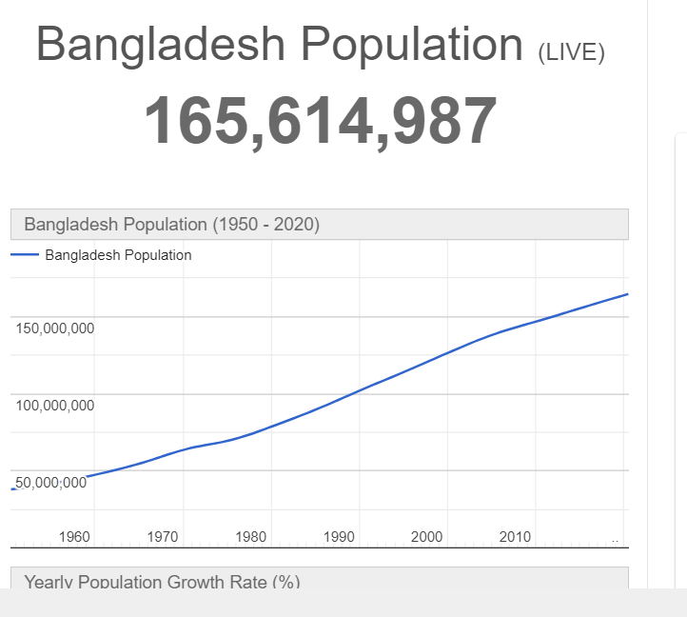
https://www.worldometers.info/world-population/bangladesh-population... (20-01-2021)

Slide 3
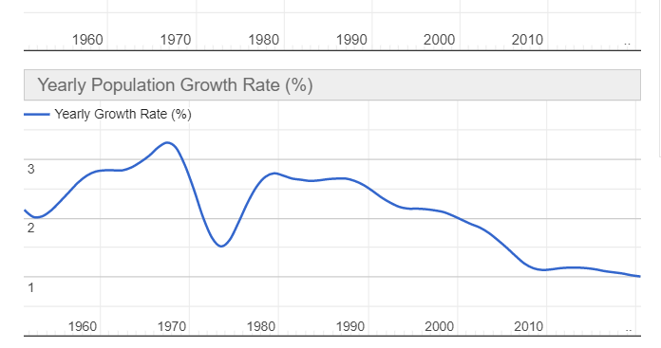
Bangladesh Population growth

Slide 4
Population https://www.worldometers.info/world-population/bangladesh-population/#:~:text=Bangladesh%202020%20population%20is%20estimated,(and%20dependencies)%20by%20population. (19-01-2021)
The current population of Bangladesh is 165,590,520 as of Tuesday, January 19, 2021, based on Worldometer elaboration of the latest United Nations data.
Bangladesh 2020 population is estimated at 164,689,383 people at mid year according to UN data.

Slide 5
Population..2
Bangladesh population is equivalent to 2.11% of the total world population.
Bangladesh ranks number 8 in the list of countries by population.
The population density in Bangladesh is 1265 per Km² (3,277 people per mi²).
The total land area is 130,170 Km2 (50,259 sq. miles)
39.4 % of the population is urban (64,814,953 people in 2020)

Slide 6
Population..3
Bangladesh Population reached 167.6 million people in Jun 2020, compared with the previously reported figure of 165.6 million people in Jun 2019. Bangladesh population data is updated yearly, available from Jun 1990 to Jun 2020.
The data reached an all-time high of 167.6 million people in Jun 2020 and a record low of 108.7 million people in Jun 1990. CEIC extends history for annual Population.
[https://www.ceicdata.com/en/indicator/bangla desh/population (19-01-2021)]

Slide 7
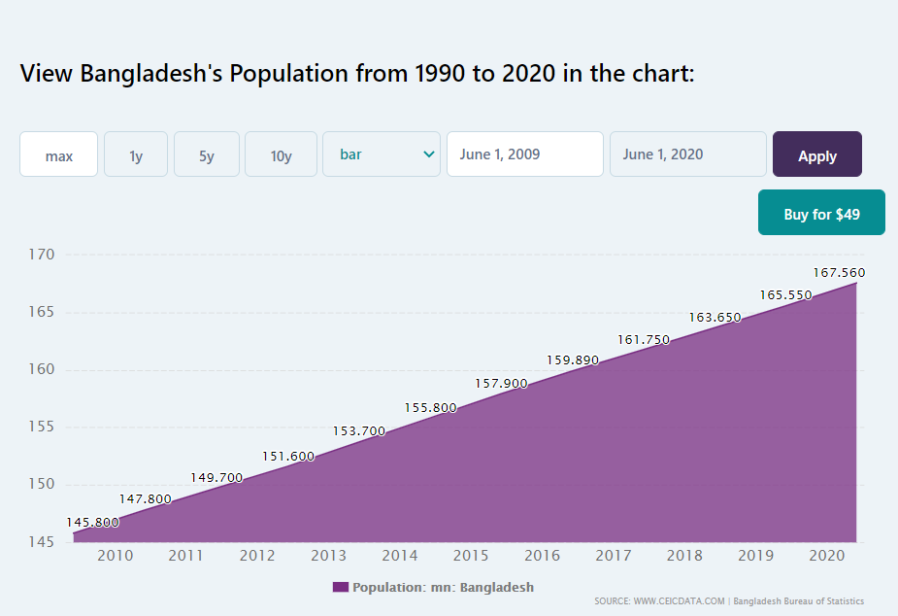
https://www.ceicdata.com/en/indicator/bangladesh/population (20-01-2021)

Slide 8
Human Resource
Human resources are the people who make up the workforce of an organization, business sector, or economy. "Human capital" is sometimes used synonymously with "human resources", although human capital typically refers to a more narrow view.
Likewise, other terms sometimes used include "manpower", "talent", "labor", "personnel", or simply "people".

Slide 9
Statistics of the Population
Population : 16,35,20,333(27.10.16)
2.19% to total world population
Population density: 1252/square KM
Total land : 130,172 sq. KM
Median Age : 26 years
Birth rate : 21.14 births /1000 populations
Death rate : 5.61 deaths/1000 populations
Life Expectancy Rate:70.94 years
Fertility rate : 2.4 children/women
IMR : 44.09 deaths/1000 live births
Sex ratio Rate: 0.95 male/female

Slide 10
HRM in Bangladesh - A Few Highlights..1
• About 33 per cent of organizations used internal referral and word of mouth in the employee recruitment process. Use of social media and mobile applications are very limited (i.e., less than 10 per cent) in the recruitment process.
• Around 40 per cent of the organizations use formal background or reference check in the selection process.
• About one-third of the organizations indicated outsourcing recruitment process sometimes in the past to recruitment managerial employees.

Slide 11
HRM in Bangladesh - A Few Highlights..2
More than 25 per cent of the organizations do not conduct training need analysis and do not provide training to employees on regular basis.
• Performance appraisals indicators include mostly functional achievements rather than behavioural aspects of the jobs. However, IT and telecommunications sectors are leading to introduce structured performance appraisal system and employee training need identification process.

Slide 12
HRM in Bangladesh - A Few Highlights..3
More than 55 per cent of the organizations do not have any defined employee reward and recognition programme. However, 66 per cent organizations of first moving consumer goods, pharmaceuticals sectors and telecommunications sectors reported to have short-term incentive programmes.
• About 95 per cent of the organizations do not provide long-term incentives to retain employees.

Slide 13
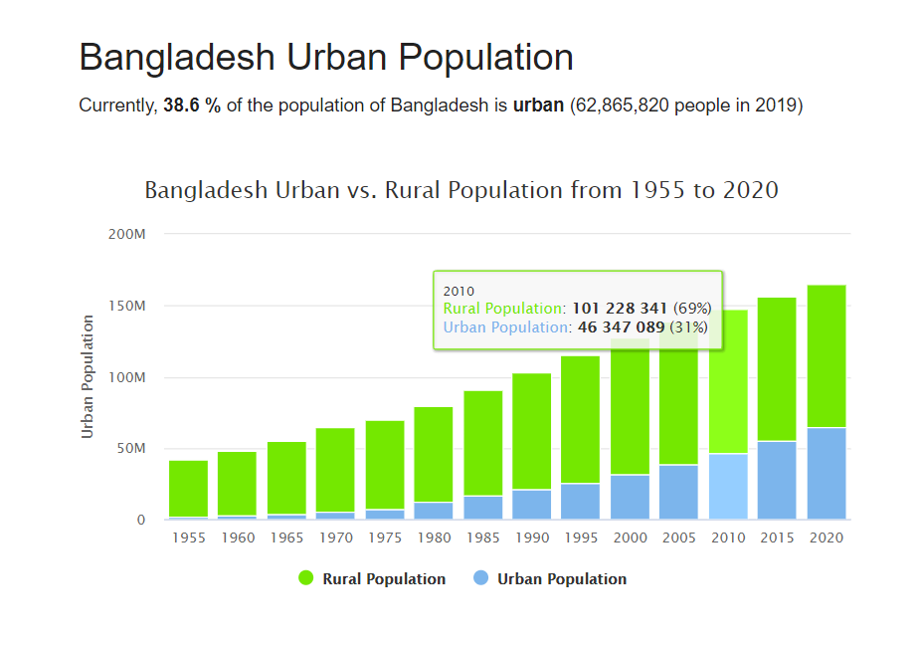
Bangladesh Urban Population
Currently 61% of the population is rural & 39% is urban

Slide 14
Largest Cities in Bangladesh
# | CITY NAME | POPULATION | # | CITY NAME | POPULATION
1 | Dhaka | 10,356,500 | 11 | Bagerhat | 266,388
2 | Chittagong | 3,920,222 | 12 | Cox's Bazar | 253,788
3 | Khulna | 1,342,339 | 13 | Jessore | 243,987
4 | Rajshahi | 700,133 | 14 | Nagarpur | 238,422
5 | Comilla | 389,411 | 15 | Sylhet | 237,000
6 | Shibganj | 378,701 | 16 | Mymensingh | 225,126
7 | Natore | 369,138 | 17 | Narayanganj | 223,622
8 | Rangpur | 343,122 | 18 | Bogra | 210,000
9 | Tungi | 337,579 | 19 | Dinajpur | 206,234
10 | Narsingdi | 281,080 | 20 | Barisal | 202,242

Slide 15
Population Density
Based on United Nations Data 2020 figures for population (164,689,383) and land area (130,170 km²), Bangladesh has the highest population density among large countries, 1265 persons per square kilometre, and 10th overall, when small countries and city-states are included.
  [ Wikipedia, Bangladesh Population 2020 (Live). Retrieved July2020]

Slide 16
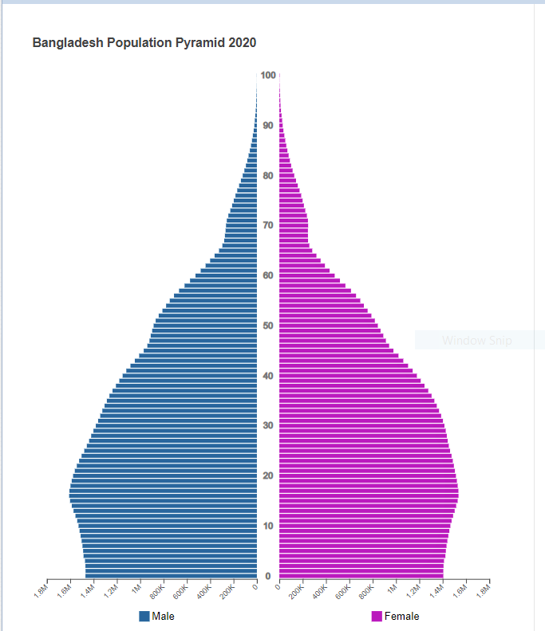
Bangladesh Population Pyramid

Slide 17
Age-Sex Pyramid
Population Pyramid
A Population pyramid (also called "Age-Sex Pyramid") is a graphical representation of the age and sex of a population. (Follow…)

Slide 18
Types:
Expansive - pyramid with a wide base (larger percentage of people in younger age groups, indicating high birth rates and high fertility rates) and narrow top (high death rate and lower life expectancies). It suggests a growing population. Example: Nigeria Population Pyramid
Constrictive - pyramid with a narrow base (lower percentage of younger people, indicating declining birth rates with each succeeding age group getting smaller than the previous one). Example: United States
Stationary - with a somewhat equal proportion of the population in each age group. The population is stable, neither increasing nor decreasing.

Slide 19
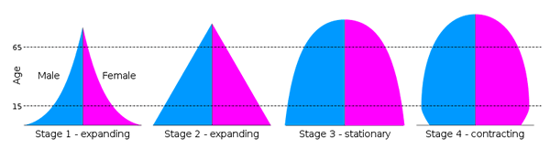
Stages:
NOTE: Dependency Ratio does not take into account labor force participation rates by age group. Some portion of the population counted as "working age" may actually be unemployed or not in the labor force whereas some portion of the "dependent" population may be employed and not necessarily economically dependent.

Slide 20
Dependency Ratio
There are three types of age dependency ratio: Youth, Elderly, and Total. All three ratios are commonly multiplied by 100.
Youth Dependency Ratio
Definition: population ages 0-15 divided by the population ages 16-64.
Formula: ([Population ages 0-15] ÷ [Population ages 16-64]) × 100

Slide 21
Elderly dependency ratio
Definition: population ages 65-plus divided by the population ages 16-64.
Formula: ([Population ages 65-plus] ÷ [Population ages 16-64]) × 100
Total dependency ratio
Definition: sum of the youth and old-age ratios.
Formula: (([Population ages 0-15] + [Population ages 65-plus]) ÷ [Population ages 16-64]) × 100

Slide 22
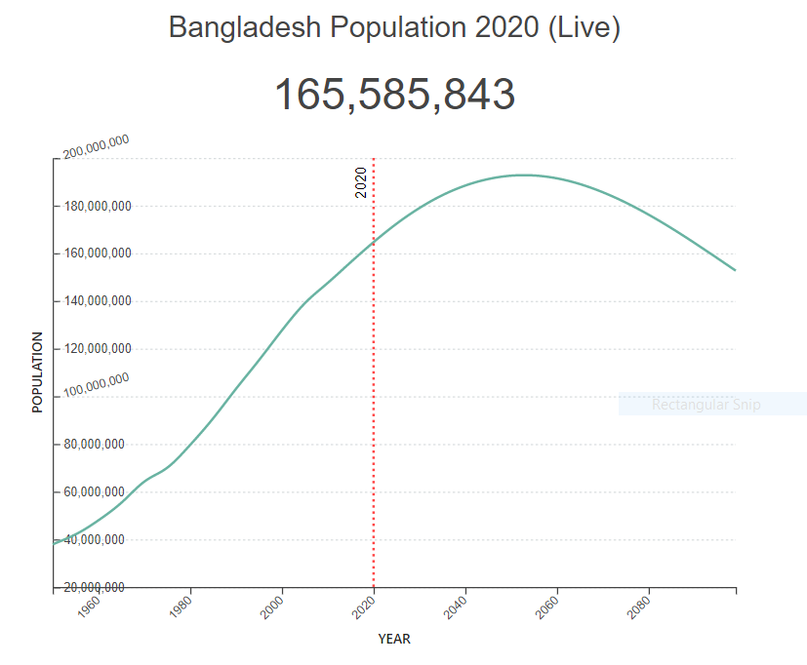
According to current population projections, Bangladesh’s population will reach its peak in 2053 with a population of 192.78.

Slide 23
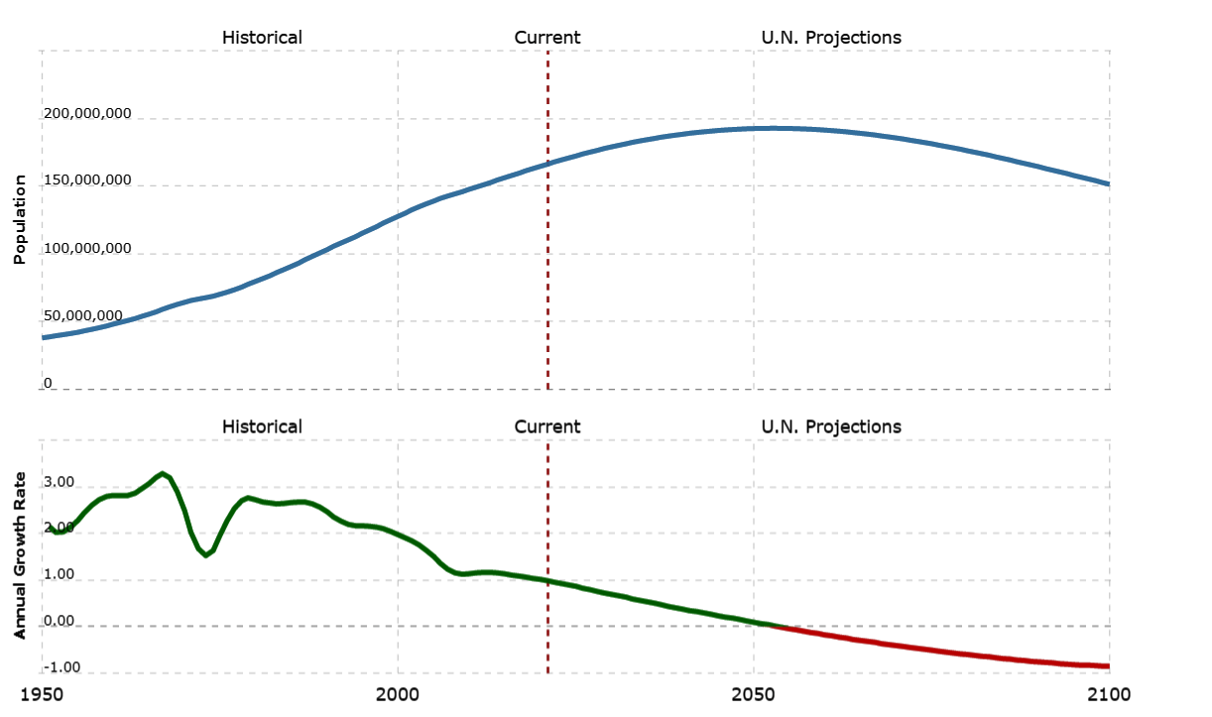
Population and Annual Growth Rate: U.N. Projections

Slide 24
Some Points of Population and Economy

Slide 25
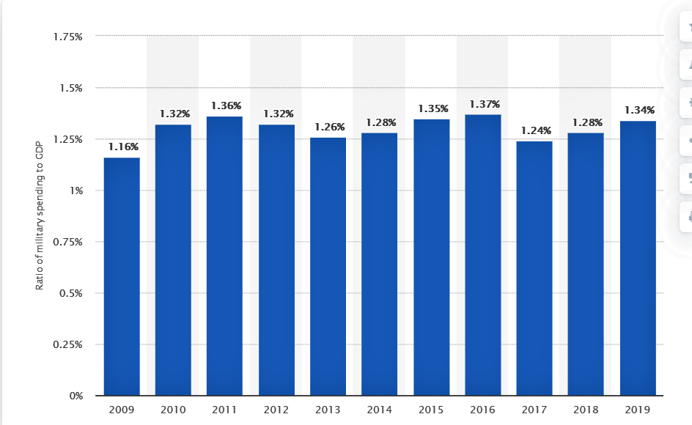
Ratio of military spending to GDP from 2009 to 2019

Slide 26
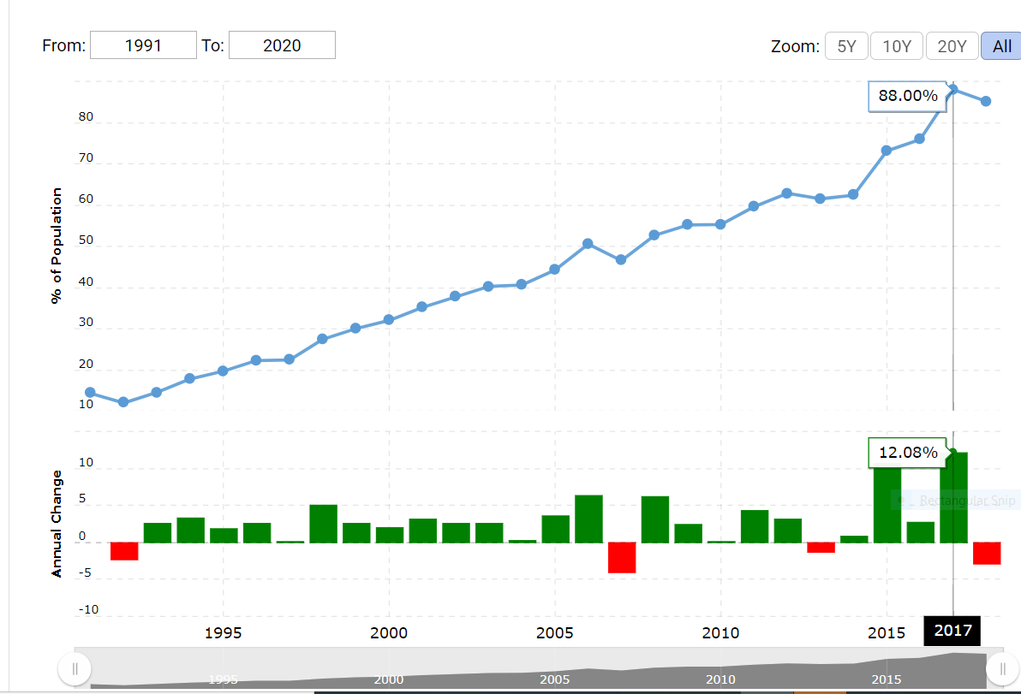
Bangladesh electricity access for 2018 was 85.16%, a 2.84% decline from 2017. https://www.macrotrends.net/countries/BGD/bangladesh/electricity-access-statistics

Slide 27
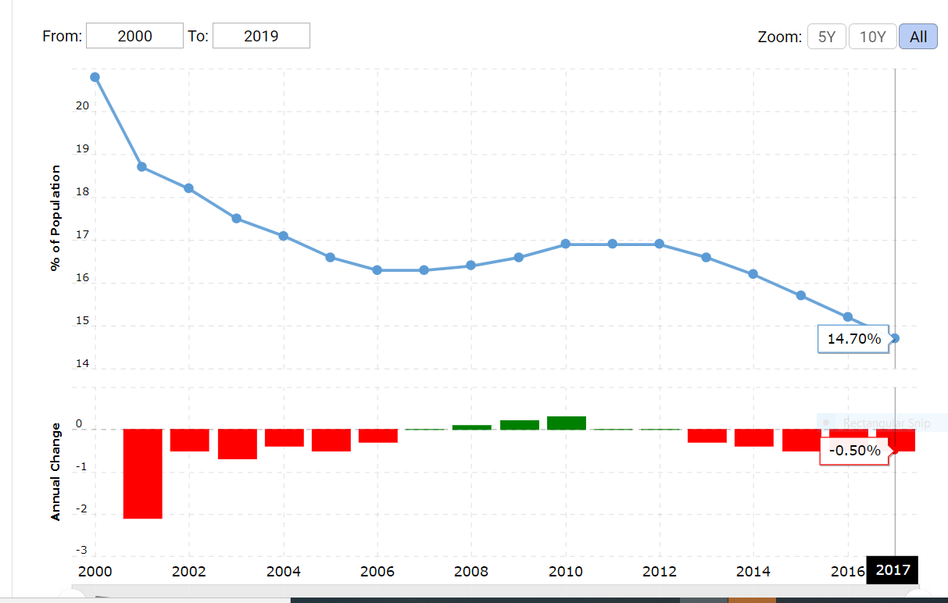
Bangladesh hunger statistics for 2017 was 14.70%, a 0.5% decline from 2016. [macrotrends]

Slide 28
Nourishment
Population below minimum level of dietary energy consumption (also referred to as prevalence of undernourishment) shows the percentage of the population whose food intake is insufficient to meet dietary energy requirements continuously. Data showing as 5 may signify a prevalence of undernourishment below 5%.
    [macrotrends: https://www.macrotrends.net/countries/BGD/bangladesh/hunger-statistics]

Slide 29
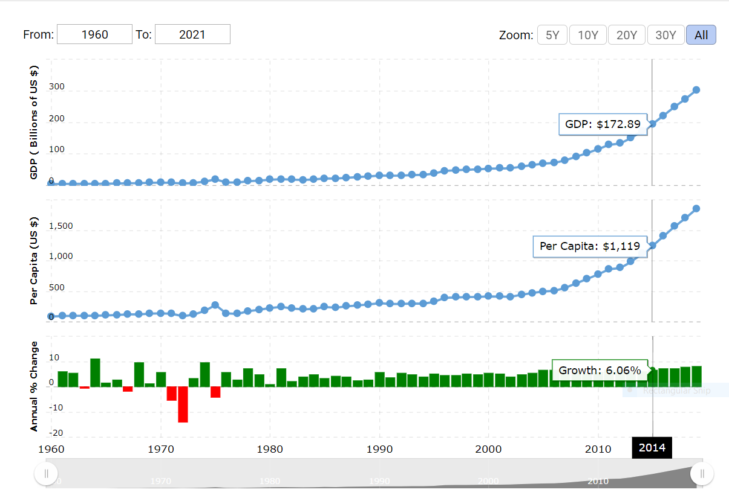
GDP growth:
Bangladesh gdp for 2019 was $302.57B, a 10.41% increase from 2018 [macrotrends]

Slide 30
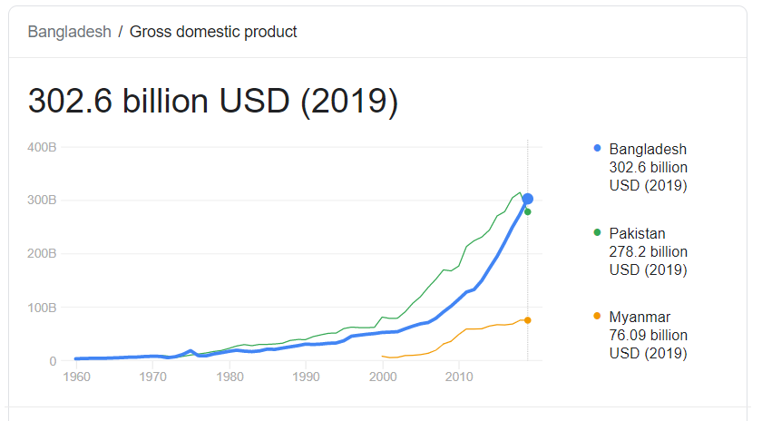
GDP in US $
[World Bank data]

Slide 31
GDP growth (annual %) - Bangladesh
Annual percentage growth rate of GDP at market prices based on constant local currency. Aggregates are based on constant 2010 U.S. dollars. GDP is the sum of gross value added by all resident producers in the economy plus any product taxes and minus any subsidies not included in the value of the products. It is calculated without making deductions for depreciation of fabricated assets or for depletion and degradation of natural resources.

Slide 32
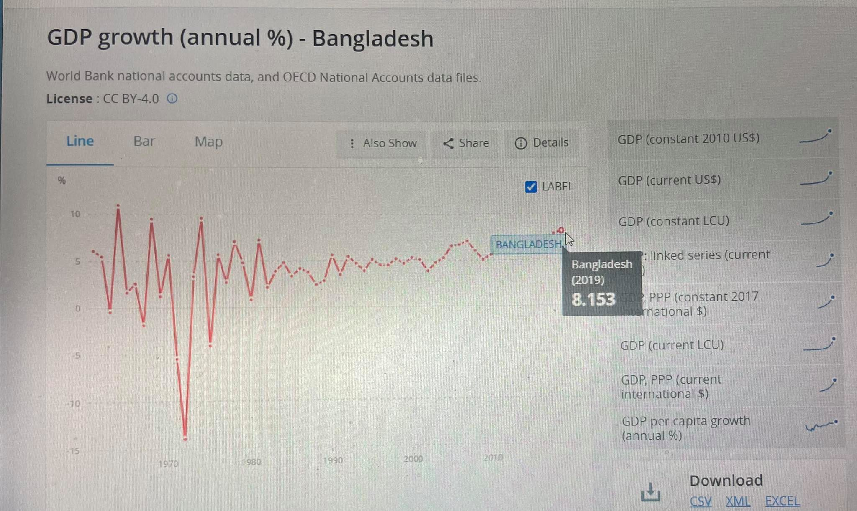
GDP annual % -Bangladesh

Slide 33
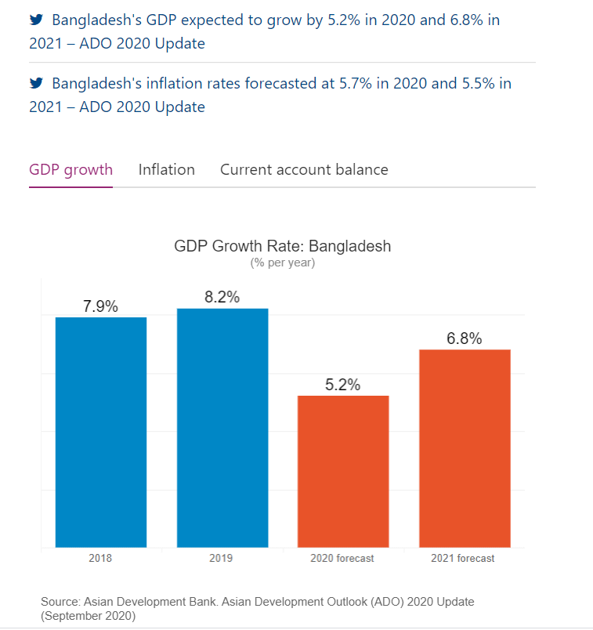
Economic indicators for Bangladesh per year

Slide 34
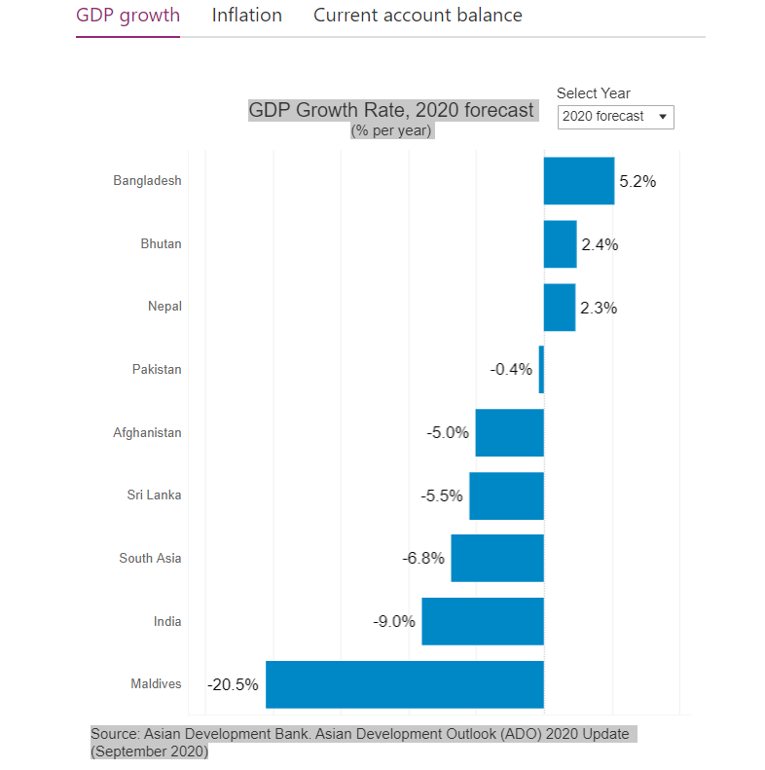
Comparative economic forecast % per year

Slide 35
Bangladesh GDP for 2019 was $302.57B, a 10.41% increase from 2018.
GDP at purchaser's prices is the sum of gross value added by all resident producers in the economy plus any product taxes and minus any subsidies not included in the value of the products. It is calculated without making deductions for depreciation of fabricated assets or for depletion and degradation of natural resources.
  [https://www.macrotrends.net/countries/BGD/bangladesh/gdp-gross-domestic-product (17-01-2021)]

Slide 36
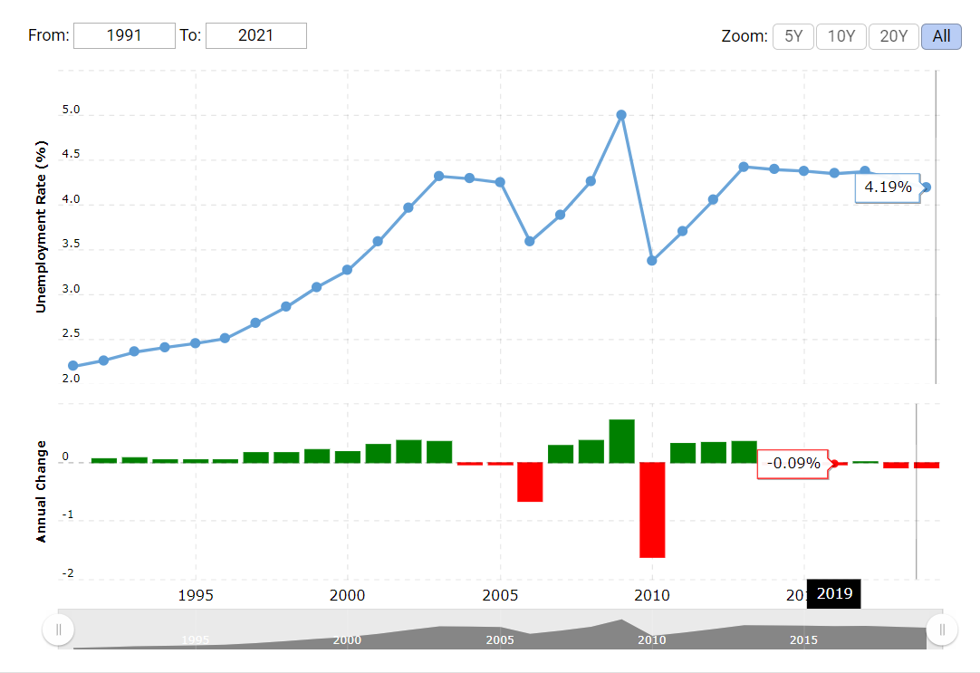
Unemployment refers to the share of the labor force that is without work but available for and seeking employment. Bangladesh unemployment rate for 2019 was 4.19%, a 0.09% decline from 2018.

Slide 37
Poverty in Bangladesh
Poverty headcount ratio at national poverty lines (% of population) – Bangladesh.
Poverty headcount ratio at $1.90 a day (2011PPP) (% of population)
(Data are compiled from official government sources or are computed by World Bank staff using national ( i.e. country- specific (poverty lines.)
2000 48.9%
2005 40
2010 31.5
2016 24.3
[World Bank datahttps://data.worldbank.org/indicator/SI.POV.NAHC?l ocations=BD&most_recent_value_desc=true (20-01-2021)

Slide 38
Although the agriculture sector contributes the least to national GDP, it provides employment to almost half of Bangladesh’s workforce.
Bangladesh operates a thriving textile and clothing export industry and is one of the world’s largest garment exporters.
Garments account for almost 80 percent of its total exports.

Slide 39
Conclusion
Bangladesh has more than halved its incidence of poverty over the past 25 years. The country gained lower middle-income status in 2015 and met the criteria to graduate from least-developed country status in March 2018.
Bangladesh’s economic expansion has been robust over the past decade and in fiscal year (FY) 2019 the economy grew by 8.2%, the highest in the Asia and Pacific region. (ADB)
[https://www.adb.org/countries/bangladesh/overview (20-01-2021)]

Slide 40

Questions…Clarifications…?

Slide 41

Thank you all

