Slide 1
Presented By
MD: Mahmud Hasan
ID: 182-23-5378
Daffodil International University
Sec :- B (L3T2)
Course code:- TE 323
Course title:- Fabric Design and Analysis
Presented To
Engr. Fahmida Siddiqa
Department of Textile Engineering
Daffodil International University

Slide 2
Welcome To
MY
Presentation

Slide 3
My Topic
is
Terms or factors to be conceder during fabric Design & analysis

Slide 4
Formula Number
Formula Number is notation diagram which represent the warp and weft interlacing point. The system of expressing the fabric representation is called formula number. The warp floats coming up are put above the fraction line and the weft floats going down are put above the fraction line and the weft floats down are put under the fraction line.
3
Formula Number of warp =
2
Weft
2 2 1 2
Formula Number of weft =
1 1 2 2 Warp
 | x |  | x
 | x |  | x
x |  | x |  | x
x |  | x |  | x
x |  | x |  | x
x | x |  | x | x |  | x |  |  | x | x

Slide 5
Repeat Number or Repeat Size
It indicates the number of warp and weft yarns in the repeat.
Repeat size ( R.S ) = 4x4
x | x
x | x
 |  | x | x
x | x
x | x
 |  | x | x
 |  | x | x
x | x
x | x

Slide 6
Contact Field:
These are the contact points between warp and weft crossing at right angle.
Interlacing Field:
These are the points where a yarn of one system of threads changes its position in relation to the other system.
There are two types of Interlacing field:
Single Interlacing Field
Double Interlacing Field

Slide 7
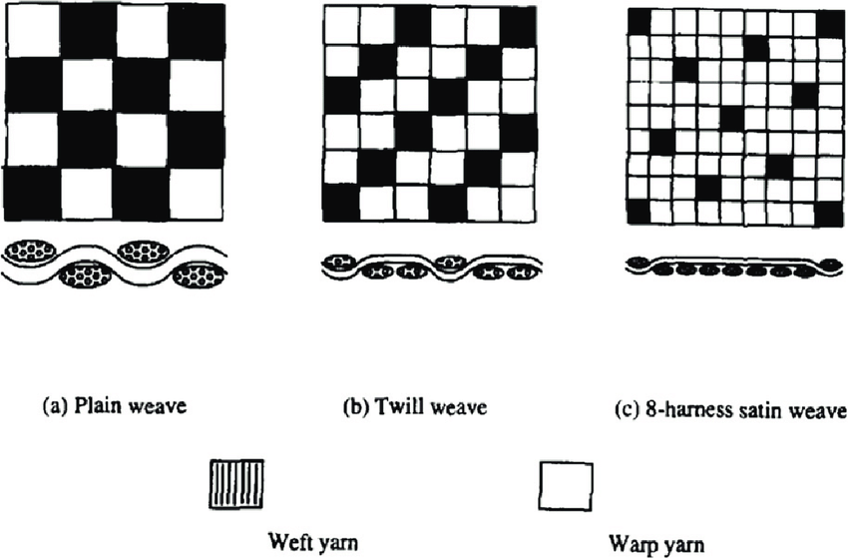
1st picture is called Double Interlacing Field
2nd picture is called Single Interlacing Field

Slide 8
Single Interlacing Field:
The yarn bends from the top of the fabric to the bottom and covers two or more yarns. It is found in Twill weave. Where the number of interlacing is less it is single interlacing.
Double Interlacing Field:
Here the yarn bends and covers a yarn, bends again and reappears at the same fabric side. It is found in plain weave. Where the number of interlacing is more it is double interlacing.
x
x
x
x
x
x

Slide 9
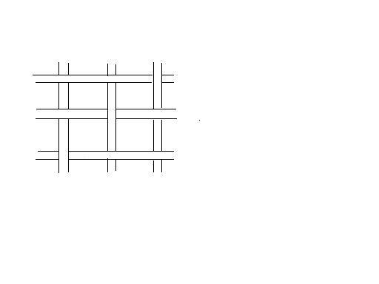
Open Field:
The space between the warp and the weft yarn is called the open field. Like as, Dressing Bandage.
Free Field:
The part of a fabric that has weft yarn and warp yarn but no interlacement is called the part if Free Field.
Contact Field
Double Interlacing Field
Weft
Open Field
Warp

Slide 10
Thank You
Maam
STAY HOME
&
STAY SAFE

