Slide 1

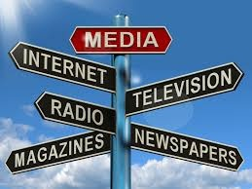
Human Communication

Slide 2
Presented By:
Dr. Sheikh Shafiul Islam
Associate Professor
Department of Journalism and Mass Communication
Daffodil International University
01704 320 110

Slide 3
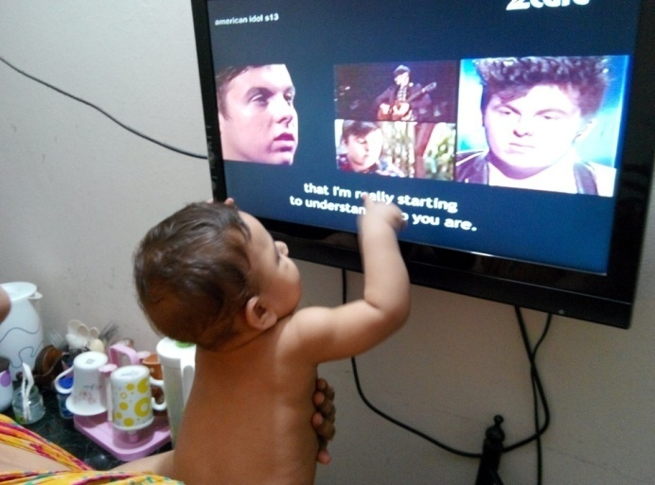
Why is communication?
Removes uncertainty through sharing of information
Education and Training:
Socialization:
Infotainment:
Motivation through Persuasion
Transmission of culture and heritage
Solving problems
Minimizing myths and misunderstanding:
Facilitate in decision-making
Developing mutual understanding and relationship
Integrating and Coordinating:
Implementing activities:
Developing image

Slide 4
Why?
Developing Commonness
Transparency and ensuring accountability
Facilitating participation

Slide 5
Scope of Communication
In personal life
In social life
In national life
In corporate world
In international affairs
In religion and culture
Connecting the unconnected

Slide 6
Thank for Your Patient Participation

