Slide 1
Relational Model in DBMS
Presented By
Rubel Sheikh
rubel.cse@diu.edu.bd

Slide 2
Lesson Outcomes
What is Relational Model?
Relational Model Concepts
Relational Integrity Constraints
Operation in Relational Model

Slide 3
What is Relational Model?
RELATIONAL MODEL (RM) represents the database as a collection of relations. A relation is nothing but a table of values. Every row in the table represents a collection of related data values. These rows in the table denote a real-world entity or relationship.
Relational data model is the primary data model, which is used widely around the world for data
storage and processing. This model is simple and it has all the properties and capabilities required
to process data with storage efficiency.
Some popular Relational Database management systems are:
DB2 and Informix Dynamic Server - IBM
Oracle and RDB – Oracle
SQL Server and Access - Microsoft

Slide 4
Relational Model Concepts
Attribute: Each column in a Table. Attributes are the properties which define a relation. e.g., Student_Rollno, NAME,etc.
Tables – In the Relational model the, relations are saved in the table format. It is stored along with its entities. A table has two properties rows and columns. Rows represent records and columns represent attributes.
Tuple – It is nothing but a single row of a table, which contains a single record.
Relation Schema: A relation schema represents the name of the relation with its attributes.
student(student_ID, name, dob, semester)

Slide 5
Relational Model Concepts
Degree: The total number of attributes which in the relation is called the degree of the relation.
Cardinality: Total number of rows present in the Table.
Column: The column represents the set of values for a specific attribute.
Relation instance – Relation instance is a finite set of tuples in the RDBMS system. Relation instances never have duplicate tuples.
Relation key - Every row has one, two or multiple attributes, which is called relation key.
Attribute domain – Every attribute has some pre-defined value and scope which is known as attribute domain

Slide 6
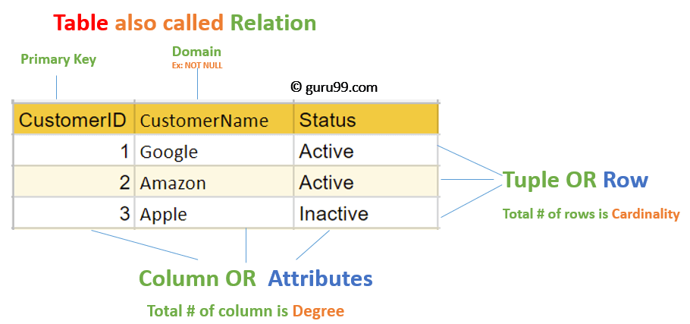
Relational Model Concepts

Slide 7
Properties of Relations
Name of the relation is distinct from all other relations.
Each relation cell contains exactly one atomic (single) value
Each attribute contains a distinct name
Attribute domain has no significance
tuple has no duplicate value
Order of tuple can have a different sequence

Slide 8
Relational Integrity constraints
Relational Integrity constraints is referred to conditions which must be present for a valid relation.
There are many types of integrity constraints. Constraints on the Relational database management system is mostly divided into three main categories are:
Domain constraints
Key constraints
Referential integrity constraints

Slide 9
Domain Constraints
Domain constraints can be violated if an attribute value is not appearing in the corresponding domain or it is not of the appropriate data type.
This is specified as data types which include standard data types integers, real numbers, characters, Booleans, variable length strings, etc.
Example:
Create DOMAIN CustomerName CHECK (value not NULL)
The example shown demonstrates creating a domain constraint such that CustomerName is not NULL
If a constrains AGE>0 is applied on STUDENT relation, inserting negative value of AGE will result in failure.

Slide 10
Key constraints
Every relation in the database should have atleast one set of attributes which defines a tuple uniquely. Those set of attributes is called key. e.g.; ROLL_NO in STUDENT is a key. No two students can have same roll number. So a key has two properties:
It should be unique for all tuples.
It can’t have NULL values.
In the given table, CustomerID is a key attribute of Customer Table. It is most likely to have a single key for one customer, CustomerID =1 is only for the CustomerName =" Google".

Slide 11
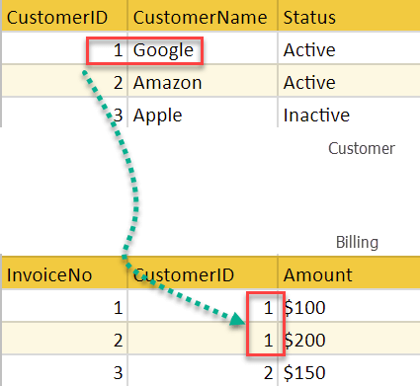
Referential integrity constraints
Referential integrity constraints is base on the concept of Foreign Keys.
A foreign key is an important attribute of a relation which should be referred to in other relationships.
In the above example, we have 2 relations, Customer and Billing.
Tuple for CustomerID =1 is referenced twice in the relation Billing. So we know CustomerName=Google has billing amount $300

Slide 12
Insert Operation
The insert operation gives values of the attribute for a new tuple which should be inserted into a relation.

Slide 13
Update Operation
You can see that in the below-given relation table CustomerName= 'Apple' is updated from Inactive to Active.

Slide 14
Delete Operation
You can see that in the below-given relation table CustomerName= 'Apple' is updated from Inactive to Active.

Slide 15
Select Operation
You can see that in the below-given relation table CustomerName= 'Apple' is updated from Inactive to Active.

Slide 16
Advantages of Relational Model
Simplicity: A Relational data model in DBMS is simpler than the hierarchical and network model.
Structural Independence: The relational database is only concerned with data and not with a structure. This can improve the performance of the model.
Easy to use: The Relational model in DBMS is easy as tables consisting of rows and columns are quite natural and simple to understand
Query capability: It makes possible for a high-level query language like SQL to avoid complex database navigation.
Data independence: The Structure of Relational database can be changed without having to change any application.
Scalable: Regarding a number of records, or rows, and the number of fields, a database should be enlarged to enhance its usability.

Slide 17
Disadvantages of Relational Model
Few relational databases have limits on field lengths which can't be exceeded.
Relational databases can sometimes become complex as the amount of data grows, and the relations between pieces of data become more complicated.
Complex relational database systems may lead to isolated databases where the information cannot be shared from one system to another.

Slide 18
Thank You

