Slide 1
Database Architecture
Presented By
Rubel Sheikh
rubel.cse@diu.edu.bd

Slide 2
Lesson Outcomes
What is Database Architecture?
One Tier Architecture
Two tier Architecture
Three tier Architecture

Slide 3
Database Architecture
The DBMS design depends upon its architecture. The basic client/server architecture is used to deal with a large number of PCs, web servers, database servers and other components that are connected with networks.
The client/server architecture consists of many PCs and a workstation which are connected via the network.
DBMS architecture depends upon how users are connected to the database to get their request done.

Slide 4
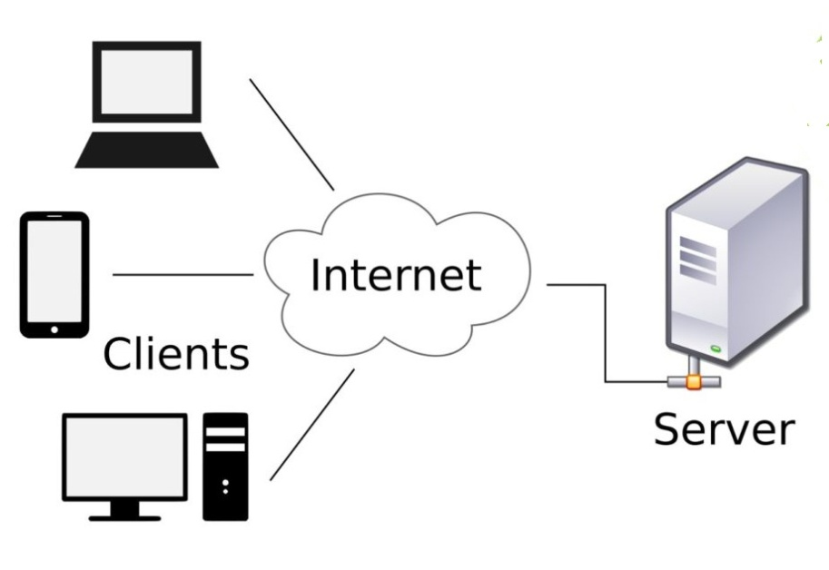
Client and Server Model
Client: When we talk the word Client, it mean to talk of a person or an organization using a particular service. Similarly in the digital world a Client is a computer (Host) i.e. capable of receiving information or using a particular service from the service providers (Servers).
Servers: Similarly, when we talk the word Servers, It mean a person or medium that serves something. Similarly in this digital world a Server is a remote computer which provides information (data) or access to particular services.

Slide 5
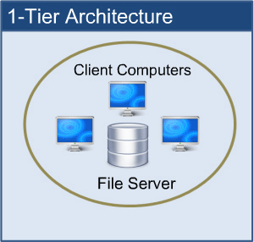
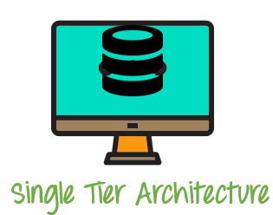
One Tier Architecture
The simplest of Database Architecture are 1 tier where the Client, Server, and Database all reside on the same machine. Anytime you install a DB in your system and access it to practice SQL queries it is 1 tier architecture. But such architecture is rarely used in production.

Slide 6
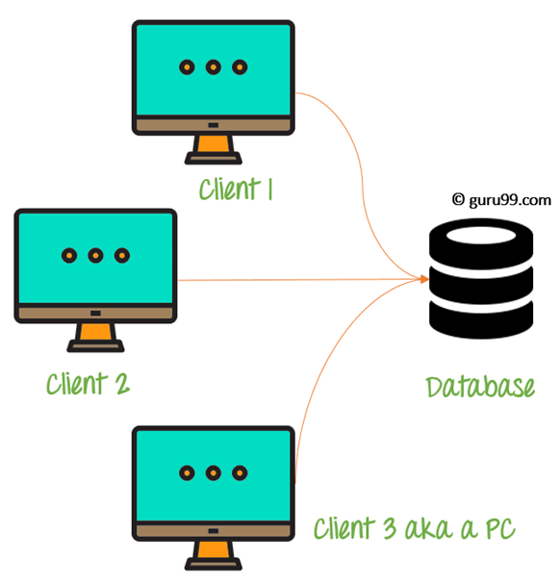
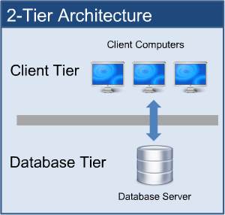
Two Tier Architecture
Two tier architecture is similar to a basic client-server model.
The application at the client end directly communicates with the database at the server side.
API’s like ODBC,JDBC are used for this interaction.
The user interfaces and application programs are run on the client-side.
The server side is responsible to provide the functionalities like: query processing and transaction management.
To communicate with the DBMS, client-side application establishes a connection with the server side.

Slide 7
Advantage of Two Tier Architecture
Such an architecture provides the DBMS extra security as it is not exposed to the End User directly. Also, security can be improved by adding security and authentication checks in the Application layer too.
An advantage of this type is that maintenance and understanding is easier, compatible with existing systems.
However this model gives poor performance when there are a large number of users.
Example – Contact Management System created using MS-Access or Railway Reservation System, etc.

Slide 8
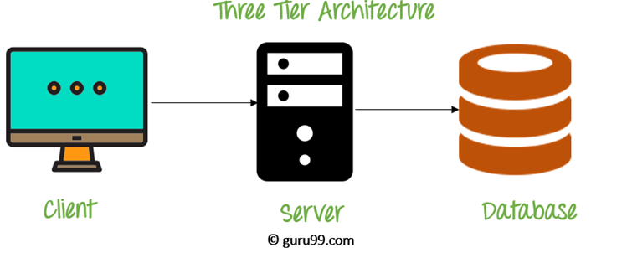
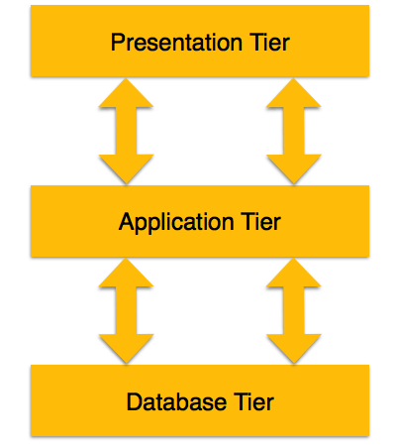
Three Tier Architecture
In this type, there is another layer between the client and the server. The client does not directly communicate with the server.
Instead, it interacts with an application server which further communicates with the database system and then the query processing and transaction management takes place.
3-tier schema is an extension of the 2-tier architecture. 3-tier architecture has following layers
Presentation layer (your PC, Tablet, Mobile, etc.)
Application layer (server)
Database Server

Slide 9
Three Tier Architecture (Cont’d)
This intermediate layer acts as a medium for exchange of partially processed data between server and client. This type of architecture is used in case of large web applications.
If you have used MySQL, then you must have seen PHPMyAdmin, it is the best example of a 3-tier DBMS architecture.
Applications
E-commerce Websites
Database related Websites
Any large Website

Slide 10
Advantage of Three Tier Architecture
Enhanced scalability due to distributed deployment of application servers. Now, individual connections need not be made between client and server.
Data Integrity is maintained. Since there is a middle layer between client and server, data corruption can be avoided/removed.
Security is improved. This type of model prevents direct interaction of the client with the server thereby reducing access to unauthorized data.
Flexibility - Because each tier can be managed or scaled independently, flexibility is increased.

Slide 11
Disadvantage of Three Tier Architecture
High installation cost.
Structure is more complex as compare to 1 & 2 tier architectures.

Slide 12
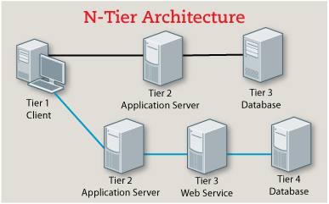
N Tier Architecture
N-tier architecture would involve dividing an application into three different tiers. These would be the
logic tier,
the presentation tier, and
the data tier.
Provides security and integrity
But it is more complex to design
And implementation is costly.

Slide 13
Thank You

