Slide 1
Entity Relationship (ER) Model in DBMS
Presented By
Rubel Sheikh
rubel.cse@diu.edu.bd

Slide 2
Learning Outcome
Data Model
Entity Relationship Model?
Symbols for Entity Type
Relationship Type and Relationship Set

Slide 3
Data Model
Model: an abstraction of a real-world object or event
  Useful in understanding complexities of the real-world environment
Data model
  A diagram that displays a set of tables and the relationships between them

Slide 4
Importance of Data Model
Blue print: official documentation
  Blue print of house
Employee’s w/o DB knowledge can understand
  a data model diagram vs. a list of tables
  Used as an effective Communication Tool
  Improve interaction among the managers, the designers, and the end users
Independence from a particular DBMS
  Network DB, Object-oriented DB, etc.

Slide 5
Steps in developing a Database
Requirements analysis →
Conceptual Database design →
Logical Database design →
Schema refinement →
Physical Database design
Applications and security

Slide 6
Conceptual design: (ER Model is used at this stage.)
The ER data mode was developed to facilitate database design by allowing specification of an enterprise schema that represents the overall logical structure of a database.
The ER data model employs three basic concepts:
  entity sets,
  relationship sets,
  attributes.
The ER model also has an associated diagrammatic representation, the ER diagram, which can express the overall logical structure of a database graphically.

Slide 7
ERD
ERD is a data modeling technique used in software engineering to produce a conceptual data model of an information system.
So, ERDs illustrate the logical structure of databases.

Slide 8
How to find entities?
Entity:
  "...anything (people, places, objects, events, etc.) about which we store information (e.g. supplier, machine tool, employee, utility pole, airline seat, etc.).”
  Tangible: customer, product
  Intangible: order, accounting receivable
  Look for singular nouns (beginner)
  BUT a proper noun is not a good candidate….

Slide 9
Entity Instance
Entity instance: a single occurrence of an entity.
  6 instances
Entity: student
Student ID | Last Name | First Name
2144 | Arnold | Betty
3122 | Taylor | John
3843 | Simmons | Lisa
9844 | Macy | Bill
2837 | Leath | Heather
2293 | Wrench | Tim
instance

Slide 10
How to find attributes?
Attribute:
  Attributes are data objects that either identify or describe entities (property of an entity).
  In other words, it is a descriptor whose values are associated with individual entities of a specific entity type
    The process for identifying attributes is similar except now you want to look for and extract those names that appear to be descriptive noun phrases.

Slide 11
How to find relationships?
Relationship:
  Relationships are associations between entities.
  Typically, a relationship is indicated by a verb connecting two or more entities.
  Employees are assigned to projects
  Relationships should be classified in terms of cardinality.
    One-to-one, one-to-many, etc.

Slide 12
How to find cardinalities?
Cardinality:
  The cardinality is the number of occurrences in one entity which are associated to the number of occurrences in another.
  There are three basic cardinalities (degrees of relationship).
  one-to-one (1:1), one-to-many (1:M), and many-to-many (M:N)

Slide 13
Identifier
“attributes that uniquely identify entity instances”
Becomes a PK in RDS
Composite identifiers are identifiers that consist of two or more attributes
Identifiers are represented by underlying the name of the attribute(s)
  Employee (Employee_ID), student (Student_ID)
Notes:
18

Slide 14
E-R MODEL
A basic ER model is composed of entity types (which classify the things of interest) and specifies relationships that can exist between entities (instances of those entity types).
ER MODEL
Entity
Attribute
Relationship
Weak Entity
Key (Simple & Single) valued)
One to One
Composite
One to Many
Strong
Entity
Multivalued
Many to One
Derived
Many to Many

Slide 15
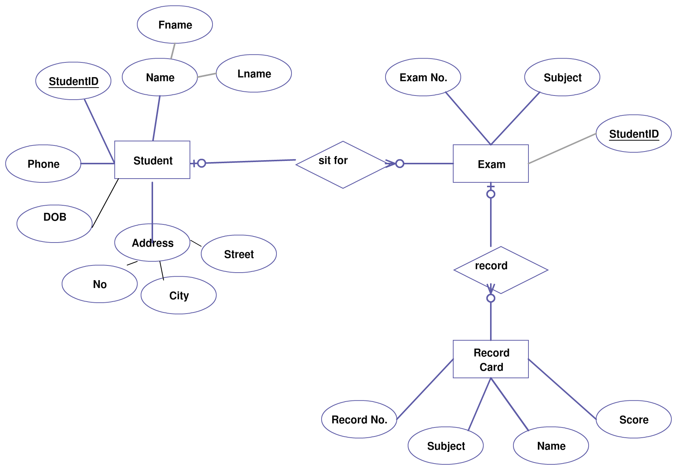
E-R MODEL (Cont’d)

Slide 16
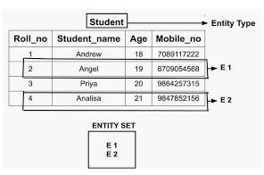
ENTITY
An entity is an object that exists and is distinguishable from other objects.
Example: specific person, company, event, plant
Entities have attributes
Example: people have names and addresses

Slide 17
Entity Notations
Entity represents in Rectangle shape
Student
Exam

Slide 18

ATTRIBUTE
Attributes are the properties which define the entity type.
Example: Roll_No, Name, DOB, Age, Address, Mobile_No are the attributes which defines entity type Student
In ER diagram, attribute is represented by an oval.

Slide 19

KEY ATTRIBUTE
The attribute which uniquely identifies each entity in the entity set is called key attribute.
Example: Roll_No will be unique for each student
In ER diagram, key attribute is represented by an oval with underlying lines.

Slide 20
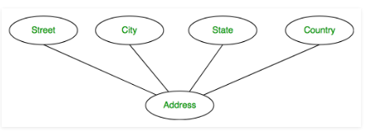
COMPOSITE ATTRIBUTE
An attribute composed of many other attribute is called as composite attribute.
Example: Address attribute of student Entity type consists of Street, City, State, and Country.
In ER diagram, composite attribute is represented by an oval comprising of ovals.

Slide 21
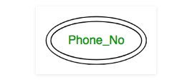
MULTIVALUED ATTRIBUTE
An attribute consisting more than one value for a given entity.
Example: Phone_No (can be more than one for a given student).
In ER diagram, multivalued attribute is represented by double oval.

Slide 22
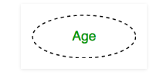
Derived Attribute Notations
An attribute which can be derived from other attributes of the entity type is known as derived attribute.
Example: Age (can be derived from DOB)
In ER diagram, derived attribute is represented by dashed oval.

Slide 23
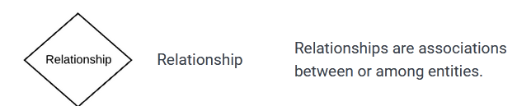
Relation Notations
Student
Sit for
Exam

Slide 24
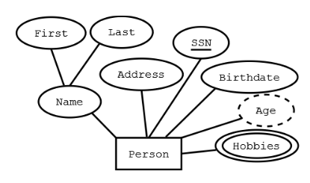
SUMMARY OF SYMBOLS USED IN E-R NOTATION(CONT’D)
Rectangle – Entity
Ellipses -- Attribute (underlined attributes are [part of] the primary key)
Double ellipses -- multi-valued attribute
Dashed ellipses-- derived attribute,
Example: age is derivable from birthdate and current
date.

Slide 25
Helps to give name for particular relation
Representing entities
we represent an entity by a named rectangle
use a singular noun, or adjective + noun
refer to one instance in naming
CUSTOMER
PART TIME EMPLOYEE

Slide 26
Types of Relationships in ER Model
Types of Relationships
Three types of relationships can exist between entities
One-to-one relationship One-to-one relationship (1:1): One instance in an entity (parent) refers to one and only one instance in the related entity (child).
One-to-many relationship One-to-many relationship (1:M): One instance in an entity (parent) refers to one or more instances in the related entity (child)
Many-to-many relationship Many-to-many relationship (M:N): exists when one instance of the first entity (parent) can relate to many instances of the second entity (child), and one instance of the second entity can relate to many instances of the first entity.

Slide 27
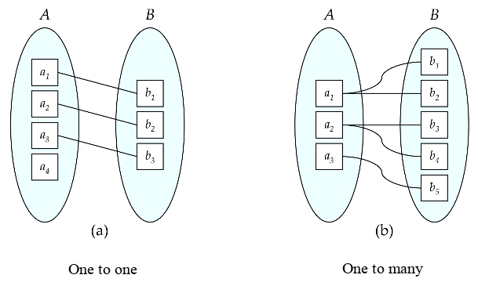
ENTITY-RELATIONSHIP DIAGRAMS(CONT’D)

Slide 28
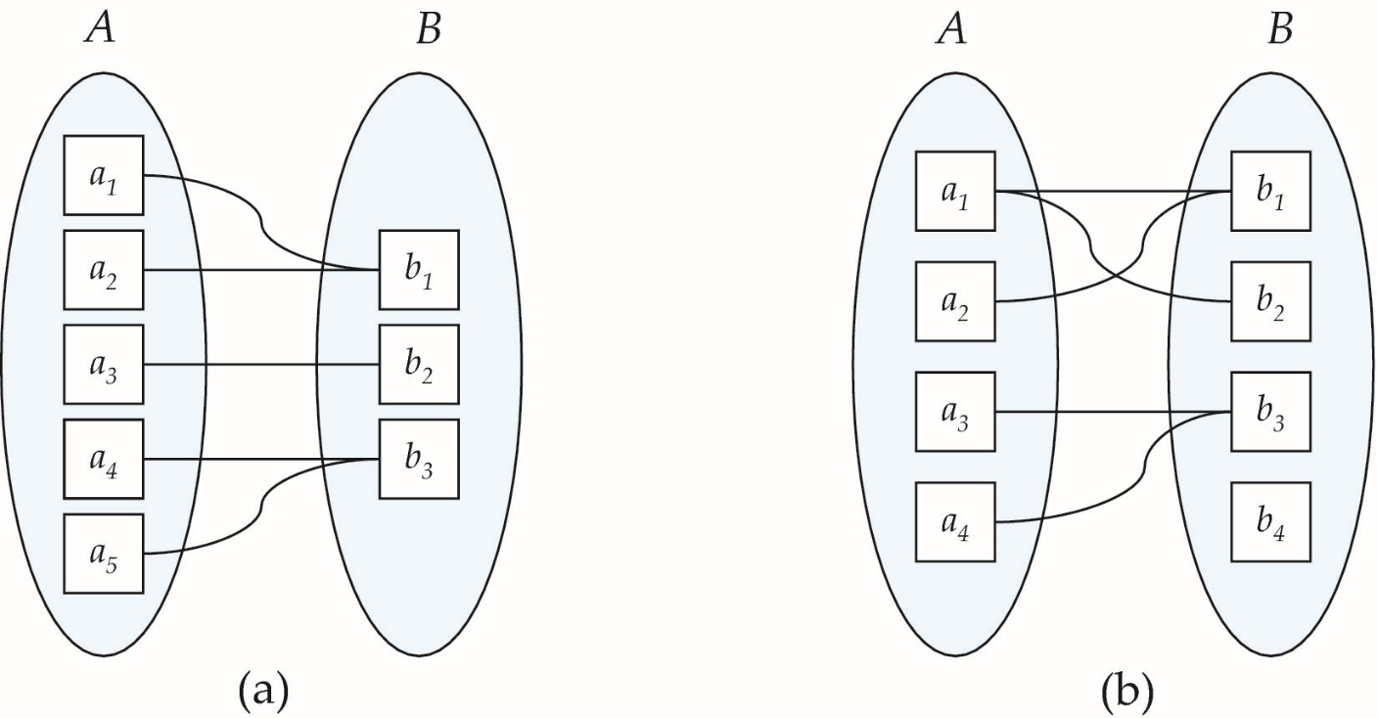
ENTITY-RELATIONSHIP DIAGRAMS(CONT’D)
Types of Relationships
Many-to-many relationship Many-to-many relationship (M:N): exists when one instance of the first entity (parent) can relate to many instances of the second entity (child), and one instance of the second entity can relate to many instances of the first entity.
Many to one
Many to many

Slide 29
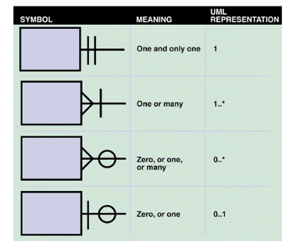
Notations for Relationships in ER Model (CONT’D)
Crow's foot notation is a common method of indicating cardinality. The four examples show how you can use various symbols to describe the relationships between entities.

Slide 30
E-R MODEL (Example)

Slide 31
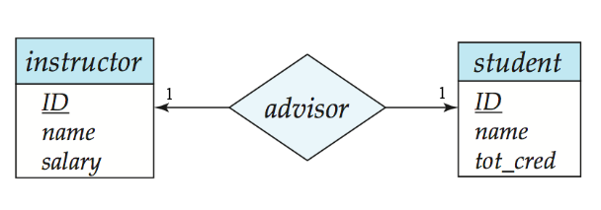
Notations for Relationships in ER Model (CONT’D)
We express cardinality constraints by drawing either a directed line (→),signifying “one,” or an undirected line (—), signifying “many,” between the relationship set and the entity set.
Or, by numbering each entity. * or, m for many.
One-to-one relationship:
A student is associated with at most one instructor via the relationship advisor
A student is associated with at most one department via stud_dept

Slide 32
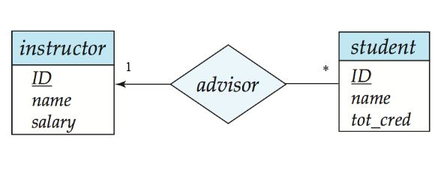
ONE-TO-MANY RELATIONSHIP
one-to-many relationship between an instructor and a student
an instructor is associated with several (including 0) students via advisor
a student is associated with at most one instructor via advisor,

Slide 33
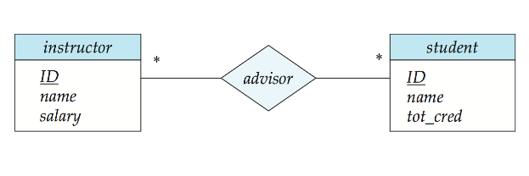
MANY-TO-MANY RELATIONSHIP
An instructor is associated with several (possibly 0) students via advisor
A student is associated with several (possibly 0) instructors via advisor

Slide 34
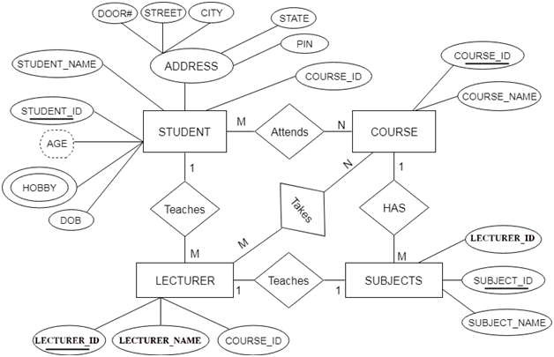
ENTITY-RELATIONSHIP (Example)

Slide 35
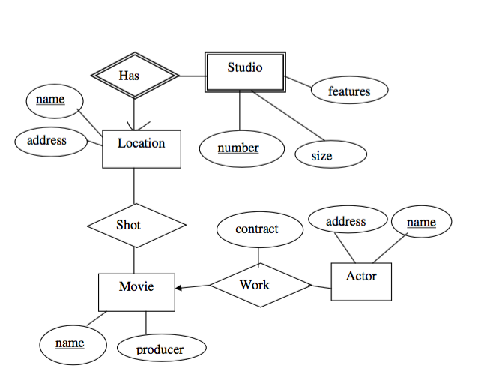
ENTITY-RELATIONSHIP (Example)

Slide 36
PARTICIPATION CONSTRAINT
Participation Constraint is applied on the entity participating in the relationship set.
Total Participation – Each entity in the entity set must participate in the relationship. If each student must enroll in a course, the participation of student will be total. Total participation is shown by double line in ER diagram.
Partial Participation – The entity in the entity set may or may NOT participate in the relationship. If some courses are not enrolled by any of the student, the participation of course will be partial. The diagram depicts the ‘Enrolled in’ relationship set with Student Entity set having total participation and Course Entity set having partial participation.

Slide 37
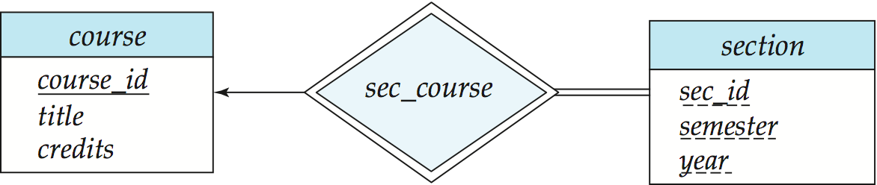
WEAK ENTITY SETS
An entity set that does not have a primary key is referred to as a weak entity set
We underline the discriminator of a weak entity set with a dashed line.
We put the identifying relationship of a weak entity in a double diamond.
Primary key for section – (course_id, sec_id, semester, year)

Slide 38
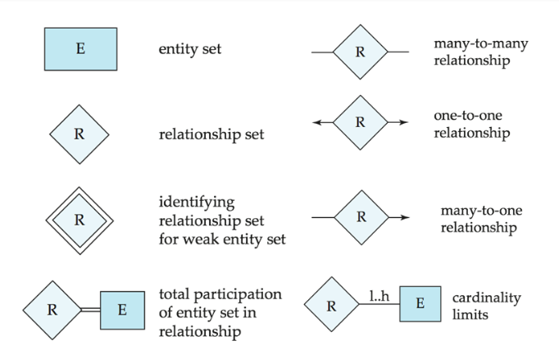
SUMMARY OF SYMBOLS USED IN E-R NOTATION

Slide 39
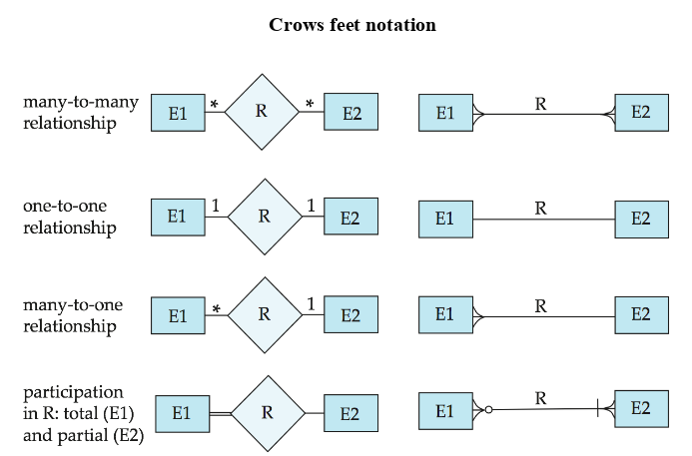
SUMMARY OF SYMBOLS USED IN E-R NOTATION(CONT’D)

Slide 40
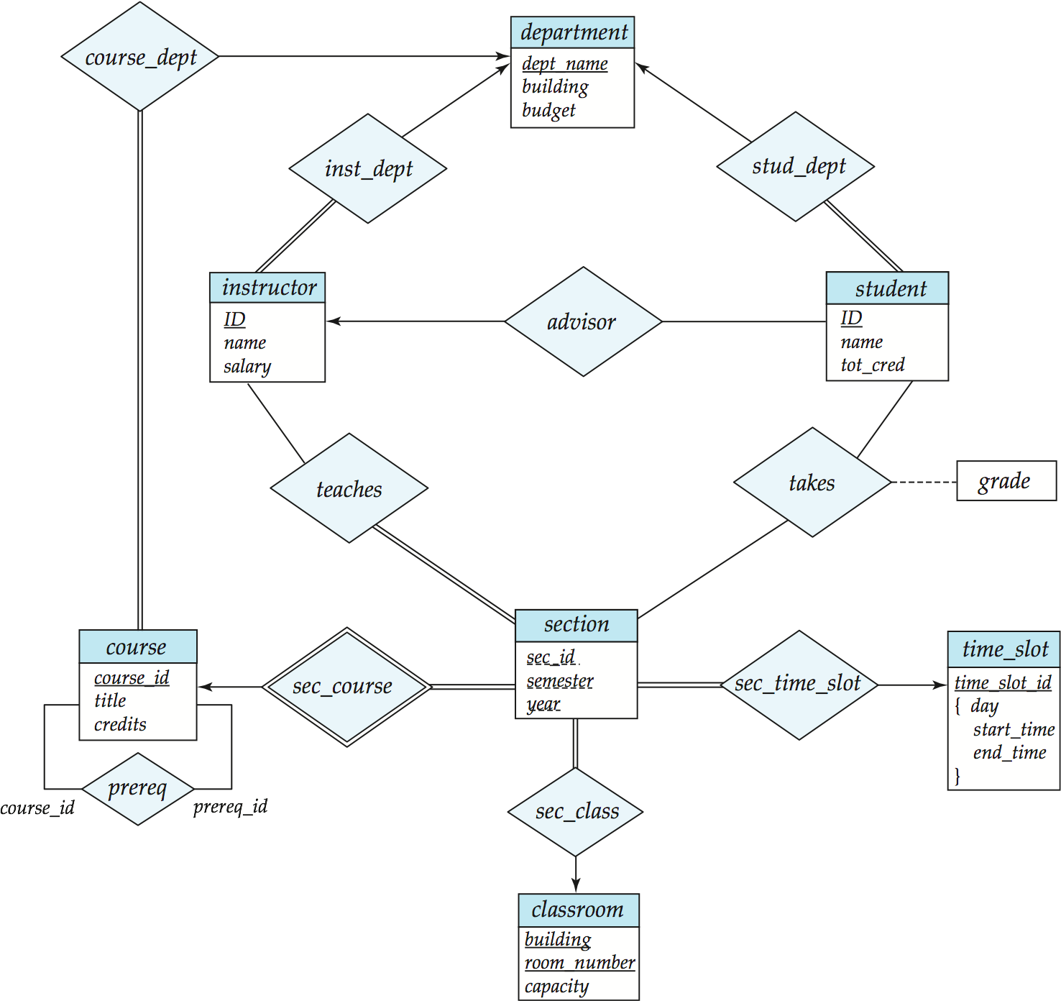
E-R DIAGRAM FOR A UNIVERSITY

Slide 41
Thank You

