Slide 1
Database Management System Lab
Rubaiya Hafiz
Summer 2020

Slide 2

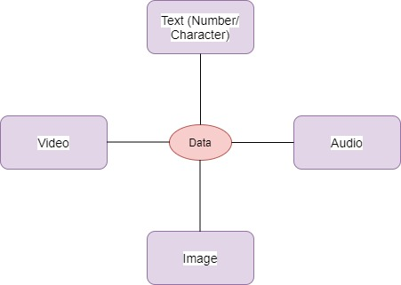
What is Data ?
Data: Raw material
Any raw fact that can be recorded
Data collection costs money
Collect only necessary and sufficient data
Data is generally used by machines
Data is useless unless it is processed to create INFORMATION

Slide 3

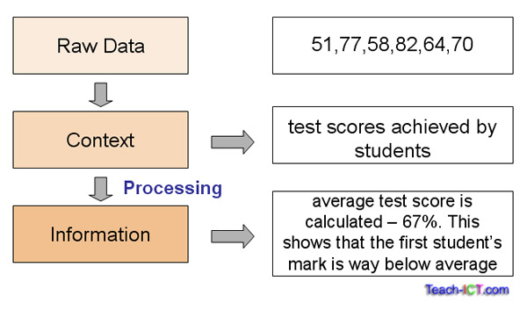
What is Information?
Systematic and meaningful form of data.
Knowledge acquired through study or experience.
Information helps human beings in their decision
making.

Slide 4

What is DBMS ?
A DBMS is a software package designed to store and manage databases
Computerized record keeping system.
A DBMS provides generic functionality that otherwise would have to be implemented over and over again.Reduced application development time
Several brands, e.g., Oracle Xi/Yg (Oracle), DB2 (IBM), SQL Server, Access (Microsoft), MySQL, PostgreSQL, HSQLDB, SQLite(open source)

Slide 5
Data Representation Model
- Representation of data stored inside a database.
- Describes the physical structure of the database.
- It uses the concepts which are close to the end-users.
- Classification:
a. Hierarchical
b. Relational
c. Network

Slide 6
a. Hierarchical Database Model
Developed by IBM, is the Oldest database model.
Represented using a tree-diagram.
(Parent-child relationship)
Each box is called a ‘Node’
The nodes represent a record type.
A line connecting nodes represents
the link.
Director
Manager(HR)
Manager (Sales)
Manager (Market.)
Area Manager
1
Area Manager 2
Area Manager 3
Sales Exe. 1
Sales Exe. 2
Sales Representative

Slide 7
Cont…
Parent-child type is suited for One-to-many relationship between two entities.
But difficult to implement
many-to-many relationship.
e.g.:
IMS system from IBM.
Director
Manager(HR)
Manager (Sales)
Manager (Market.)
Area Manager
1
Area Manager 2
Area Manager 3
Sales Exe. 1
Sales Exe. 2
Sales Representative

Slide 8
b. Relational Database Model
Simplest and the most common model.
Developed in 1970 by E.F. Codd, it became commercial
in the 80s.
Data elements are stored in
different tables made up of
rows and columns.
Roll No | Name | Surname | Section
1001 | Rajkumar | Tomar | D
1002 | Rajkumar | Singh | D

Slide 9
Cont…
Terminologies:
-Data Values: alphanumeric raw data (Rajkumar)
-Columns: fields (item or object that holds the data)
-Rows: record (a group of data for related field)
-Table: collection (all records & fields)
-Key: identifier (uniquely identifies a row in the
table. It can be value of a single or multiple column.
e.g.:
DB2, ORACLE, SQL Server.
Roll No | Name | Surname | Section
1001 | Rajkumar | Tomar | D
1002 | Rajkumar | Singh | D

Slide 10
c. Network Database Model
Represented using a Data-Structure Diagram.
Boxes represents the records & lines the links.
Based on
‘owner-member relationship.’
Members of an owner may
be many but for many members
owner is one.
Can represent one-to-one
and many-to-many as well.
Teacher 1
Teacher 2
Teacher 3
Course A
Course B
Course C
Student 1
Student 2
Student 3

Slide 11
Cont…
One-to-many relationship is converted into a set of one-to-one.
Also, many-to-many is
converted into 2 or more
one-to-many
relationship.
e.g.:
IDMS, IMAGE.
Teacher 1
Teacher 2
Teacher 3
Course A
Course B
Course C
Student 1
Student 2
Student 3

Slide 12

Database Languages
Once data is filled, manipulation is required
(insertion, deletion, modification of data)
For these, a set of languages is provided by
DBMS:
1. Data Definition Language.
2. Data Manipulation Language.
3. Data Control Language.

Slide 13
Cont…
1. Data Definition Language (DDL):
Used by DB designers to define schema.
DDL compiler converts DDL statements and generate a set of tables which are stored in.
  CREATE – Creates objects in the database
  ALTER – Alters objects of the database
  DROP – Deletes objects of the database
  TRUNCATE – Deletes all records from a table and resets table identity to initial value.
e.g.: SQL
2. Data Manipulation Language (DML):
-For accessing and manipulating the data.
SELECT – Retrieves data from a table
INSERT - Inserts data into a table
UPDATE – Updates existing data into a table
DELETE
e.g.: SQL

Slide 14
Cont…
3. Data Control Language (DCL):
-Similar to a computer programming language used to control
access to data stored in a database.
-operations like:
GRANT – Gives user's access privileges to database
REVOKE – Withdraws user's access privileges to database given with the GRANT command
e.g.: SQL

Slide 15
Thank you

