Slide 1
Good Governance and Development : Communication & Media Perspective - A focus on Bangladesh
Professor Md. Golam Rahman, PhD
[Former Chief Information Commissioner
Information Commission, Bangladesh]
E-mail: gr@daffodilvarsity.edu.bd, golamr07@hotmail.com

Slide 2
Good Governance
As a term “good governance” is still unsettled in meaning.
[Nanda, Ved. P., 2006]
Through the 1980s and 1990s, donor countries and institutions trended to make aid conditional upon reforms in the recipient country, which was found largely ineffective in encouraging real policy changes.
Donors, such as IMF, the World Bank, and the United States, are increasingly insisting upon performance and good governance as a prerequisite for aid
This becomes a commitment to economic and social reforms for the recipient country.

Slide 3
Governance
Governance consists of the traditions and institutions by which authority in a country is exercised.
This includes the process by which governments are selected, monitored and replaced; the capacity of the government to effectively formulate and implement sound policies; and the respect of citizens and the state for the institutions that govern economic and social interactions among them.

Slide 4
Governance Indicators
The Worldwide Governance Indicators (WGI) project reports aggregate and individual governance indicators for over 200 countries and territories over the period 1996–2015, for six dimensions of governance:

Slide 5
The Indicators….1
Voice and Accountability
Voice and accountability captures perceptions of the extent to which a country's citizens are able to participate in selecting their government, as well as freedom of expression, freedom of association, and a free media.

Slide 6
The Indicators…2
    Political Stability and Absence of Violence
Political Stability and Absence of Violence/Terrorism measures perceptions of the likelihood of political instability and/or politically motivated violence, including terrorism.

Slide 7
The Indicators…3
Government Effectiveness
Government effectiveness captures perceptions of the quality of public services, the quality of the civil service and the degree of its independence from political pressures, the quality of policy formulation and implementation, and the credibility of the government's commitment to such policies.

Slide 8
The Indicators…4
Regulatory Quality
Regulatory quality captures perceptions of the ability of the government to formulate and implement sound policies and regulations that permit and promote private sector development.

Slide 9
The Indicators…5
Rule of Law
Rule of law captures perceptions of the extent to which agents have confidence in and abide by the rules of society, and in particular the quality of contract enforcement, property rights, the police, and the courts, as well as the likelihood of crime and violence.

Slide 10
The Indicators…6
Control of Corruption
Control of corruption captures perceptions of the extent to which public power is exercised for private gain, including both petty and grand forms of corruption, as well as "capture" of the state by elites and private interests.
(Daniel Kaufmann, Natural Resource Governance Institute (NRGI) and Brookings Institution & Aart Kraay, World Bank Development Research Group)
[http://info.worldbank.org/governance/wgi/#home (14-08-2017)]

Slide 11
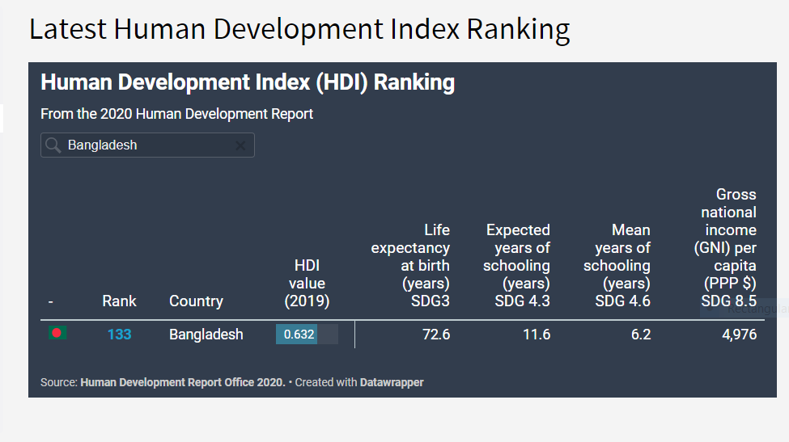
Latest Human Development Index 2020

Slide 12
Human Development Index | Index 0.632 | Rank 133
Health | Life expectancy at birth | 72.6 | years
Education | Expected years of schooling | 11.6 | years
Income/Composition of Resources | Gross National Income | 4,976 | 2017 PPPS
Inequality | Inequality adjusted HDI | 0.478
Gender | Gender Development Index | 0.904
Poverty | Multidimensional Poverty Index | 24.6
Work, employment & vulnerability | Employment to population ratio | 56.5 | % ages 15 & older
Human Security | Homicide rate | 2.4 | Per 100,000 people
Trade & Financial flows | Exports & imports | 36.8 | % of GDP
Mobility & Communication | Internet users | 15 | % of population
Environmental sustainability | Carbon dioxide emissions per capita | 0.5 | tonnes
Demography | Population, total | 179 | millions
*Human Development Report 2020

Slide 13
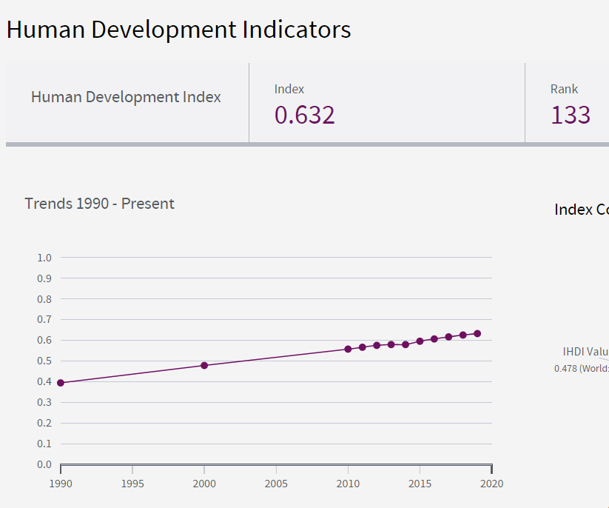
HDI Index 0.632 Rank 133 in 2020

Slide 14
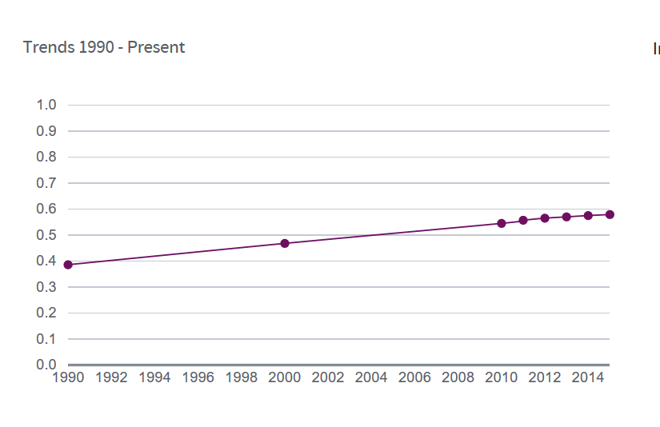
HDI – Index 0.579 - Rank 139

Slide 15
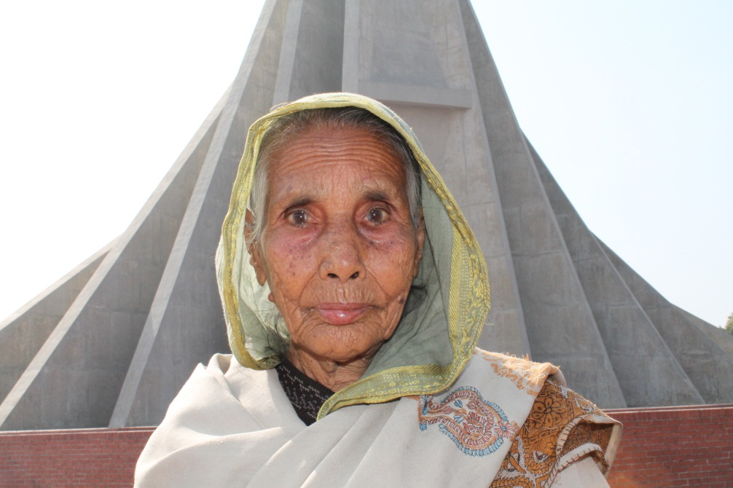
Dynamics of Development & Media

Slide 16
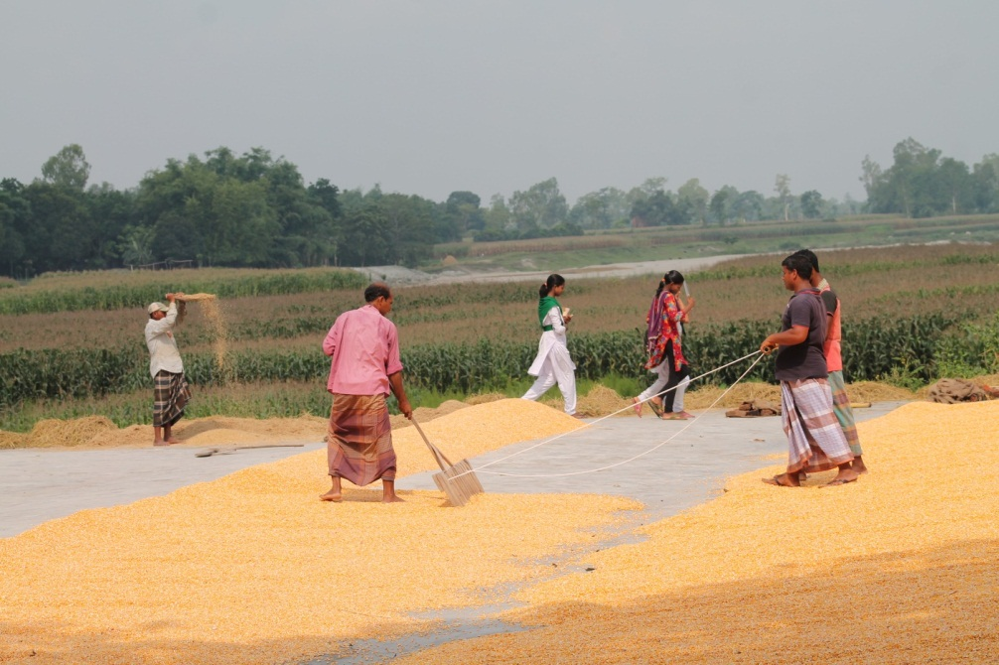
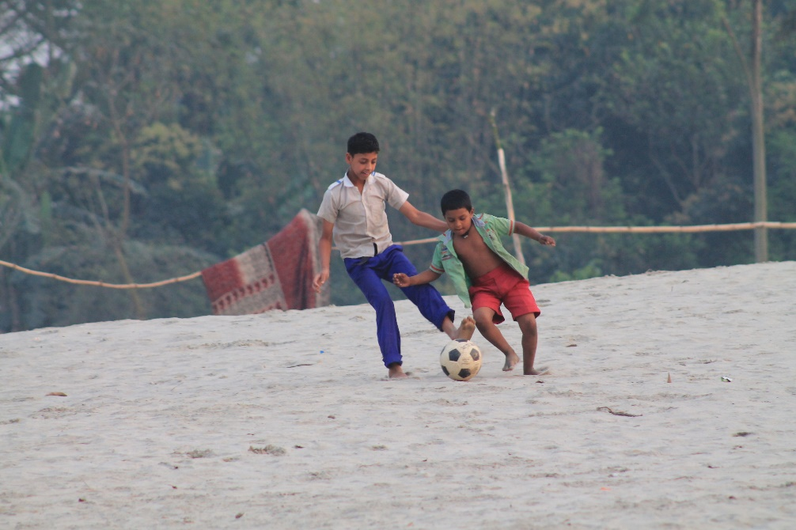
Dynamics of Development & Media

Slide 17
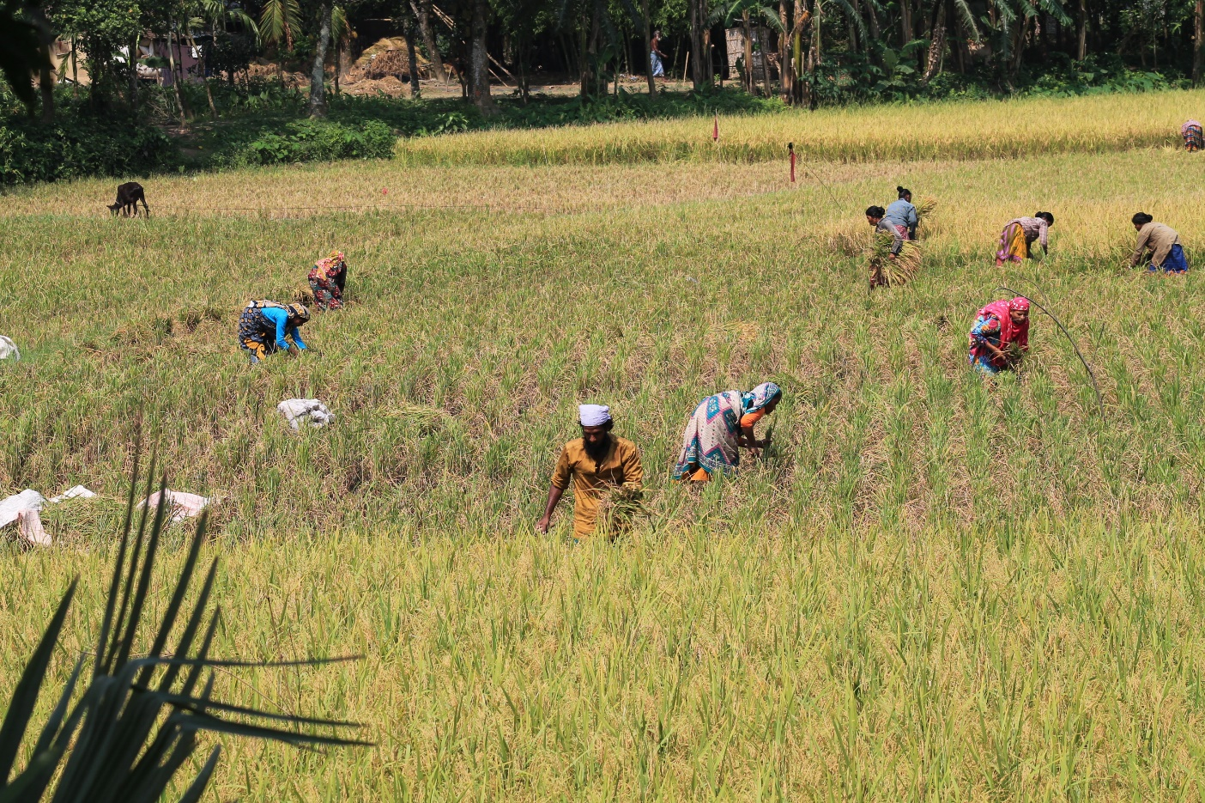
Dynamics of Development & Media

Slide 18
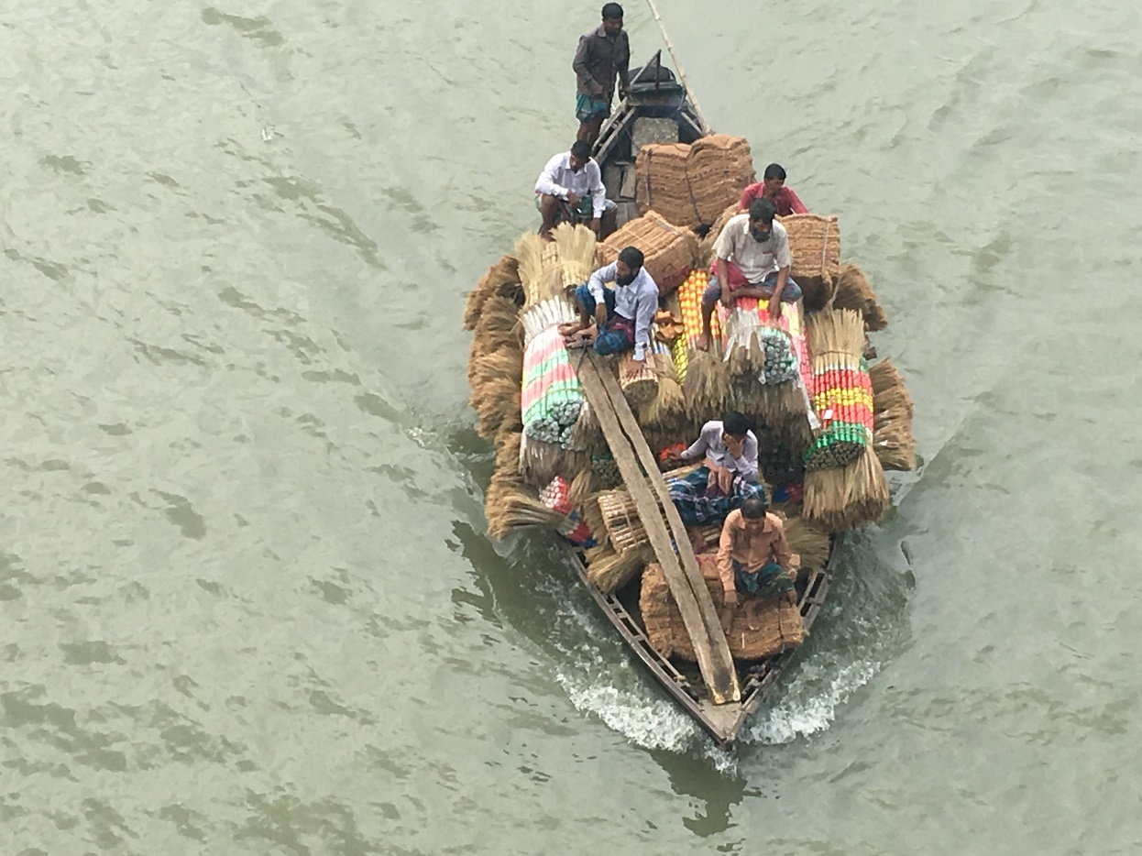
Dynamics of Development & Media

Slide 19
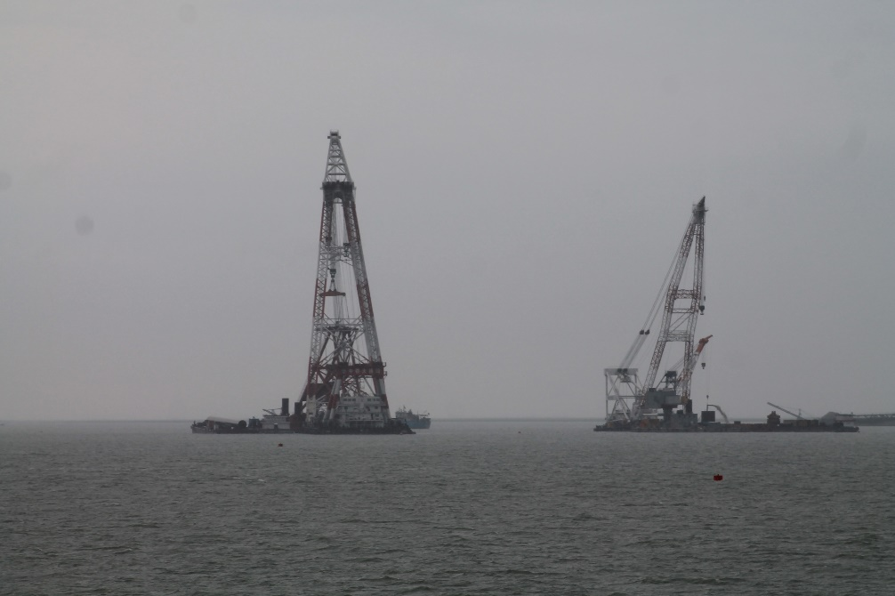
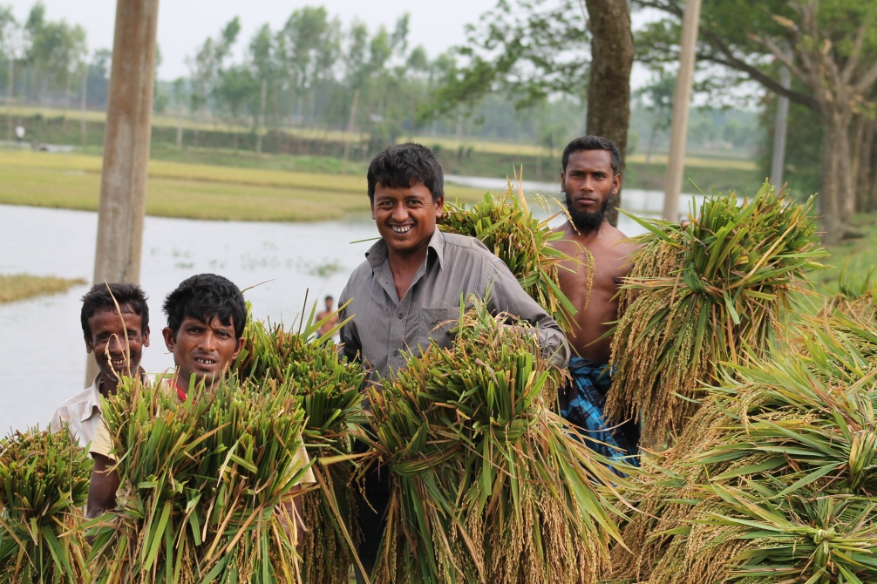
Dynamics of Development & Media

Slide 20
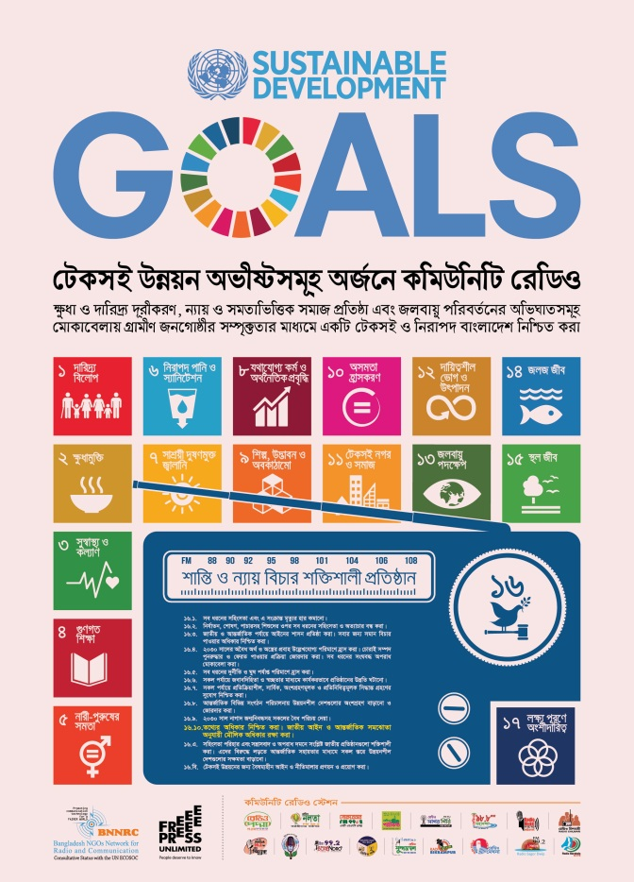
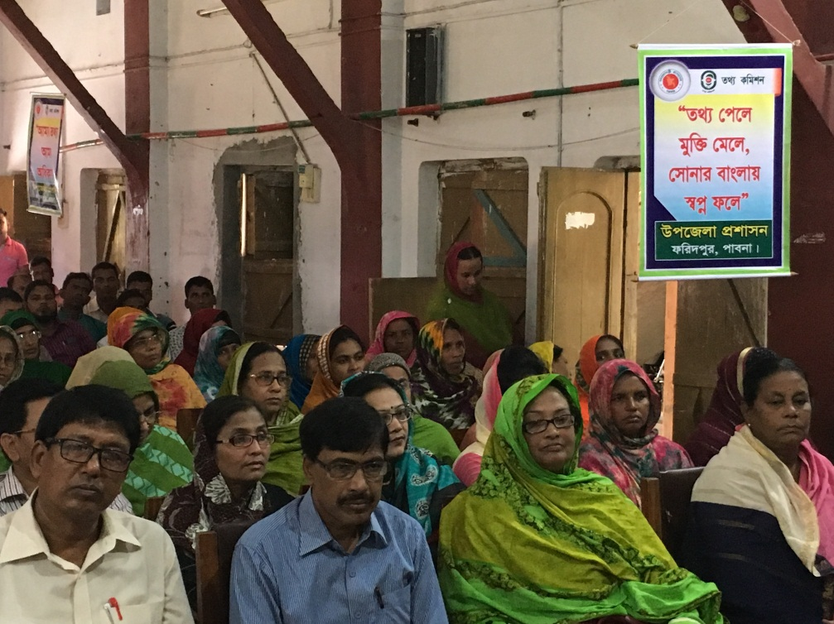
Dynamics of Development & Media

Slide 21
Democracy and Governance
Media as catalyst of governance
  Communication & Power: Inter-relations
Media as an agent of development
Media as a part of transmission of social heritage
Media as technological determinism

Slide 22
Addressing Major Development Challenges
  Governance (Administration) [Mass media bridge-up gaps between people and government and people]
  Rule of Law [Mas media help smooth functioning of legal system]
  Corruption [Mass media not only expose corruption but show accountibilty to be practiced]
  Exposure of Culture, Heritage, Values [Documentation & promotion of local cultures to extended audience]
  Right to information [Inculcate the culture of sharing of information and removing digital divide]

Slide 23
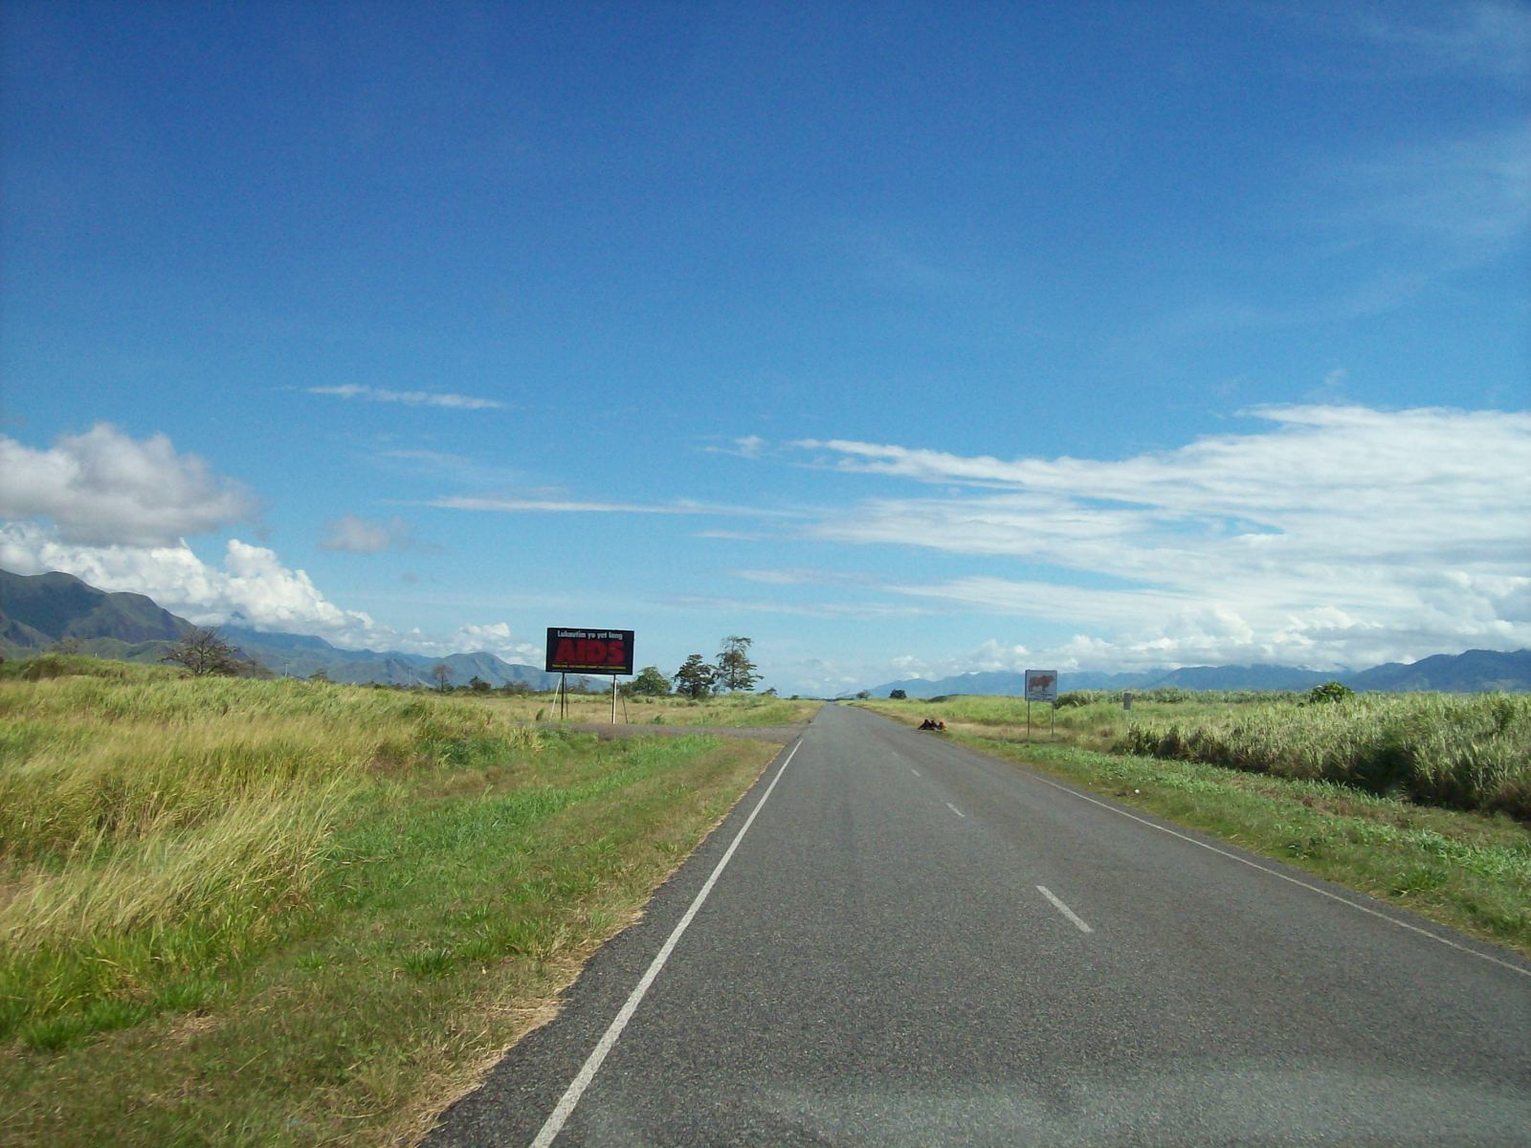
Long way to go…

Slide 24
Communication Perspectives
Enlarge horizons
Brings information of experiences of others
Raise aspirations
Help provide motivation with fulfillment of cultural objectives & values

Slide 25
Broad areas of economic, social and political role of communication and how these components qualify our life
Communication
  helps a person find alternative ways of making a living
  reduces the pressure on land
  helps raise a family’s economic status
  creates demand for goods
  motivates local initiative to meet rising demands
  broadens the entrepreneurial base
  helps economic development become a self-perpetuating process

Slide 26
Economic, social and political role..
Communication:
  aids in the process of status change from heredity to achievement
  forces the traditional leaders to compete for status retention and motivates them to acquire knowledge and adapt to change
  helps people find new norms and achieve a balance during a period of rapid change
  helps bring about greater equality and greater respect for human dignity

Slide 27
Economic, social and political role..
Communication:
  helps in inducing parents to send their children to schools
  motivates the illiterate to become literate
  helps shift influence from age and traditional status to knowledge and ability
  helps in the process of power change from heredity to achievement
  helps in getting medical services and aids

Slide 28
Economic, social and political role..
Communication
  helps the mass recognize their own importance in the power structure and acts as a stimulus to political participation
  helps the government learn of the needs of the public and plan its programs
  helps the public know of government plans and programs
  helps bring about greater equality and respect for human dignity in the political arena

Slide 29
Democracy & Role of Media
Mass media:
  inform people
  instruct people
  guide people
  pursue people
  construct people’s opinion
  channelize people’s opinion to government
  maintain two-way communication

Slide 30
Media Independence
Ownership: how pluralistic?
How representative of different opinions?
How accessible by different sections?
How effective are media in investigating government and powerful corporations/ organizations?
How free are journalists from restrictive laws, harassment and intimidations?

Slide 31

Media and Business
Audience/consumer rights
Interests Triangle: Whose rights? Who’s right?
Advertisements
?
Contents of media
Audience

Slide 32
Media Independence and Citizen
How free are private citizens from intrusion and harassment by the media?
  blackmailed / disturbed
  irresponsible role while publishing on rape, assault, social issues
  correction of incorrect news/information [Plight of the people]
  political bias, hidden pressure, etc

Slide 33
Citizen Journalism
  Social media
  Irresponsibility, because of no institutional commitment
  Its consequences
Online media:
  Parallel of traditional version

Slide 34
Media Ethics
Conflict of interests when media run as only to earn profit in a developing country
Disinformation and misinformation
“… a society without the right to free speech and expression is not a democratic society, it is equally true that unless all citizens have the capacity to exercise the right, the mere existence of the right and of the means to exercise it, does not make it a democratic society.”
- Justice P. B. Sawant, “Freedom of Media and Ethics” International Conference: World Association of Press Councils, 2001, p. 35.

Slide 35
Responsible Media
The complexity of modern life and our inability to make sense of what is going on around us might be threatening the media what Walter Lippmann thought more than 80 years ago.
The degree of democracy of a nation may be measured by the ‘quality’ of freedom exercised by the media in general

Slide 36
Conclusion
Socially responsible media
Socially committed media
  Because, we take democracy as a commonplace but its familiarity is still a trap and its logic is still flawed.
  Do we have ‘better’ choice?
  … Perhaps, not.

Slide 37
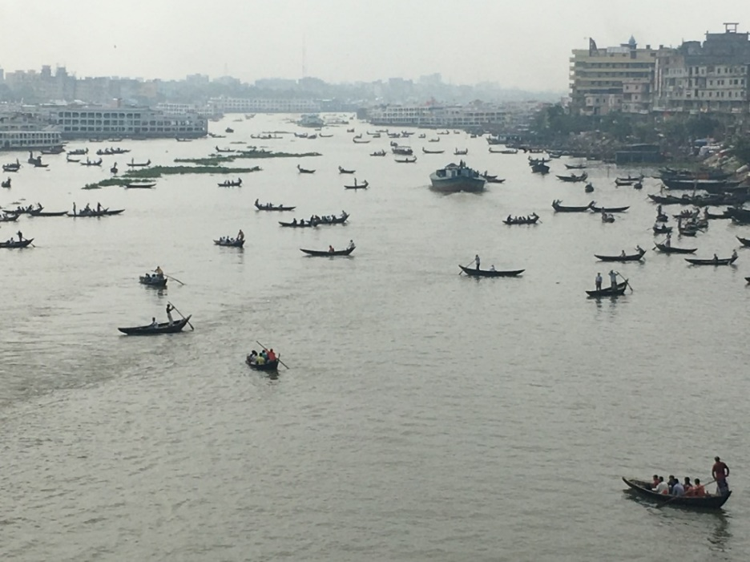
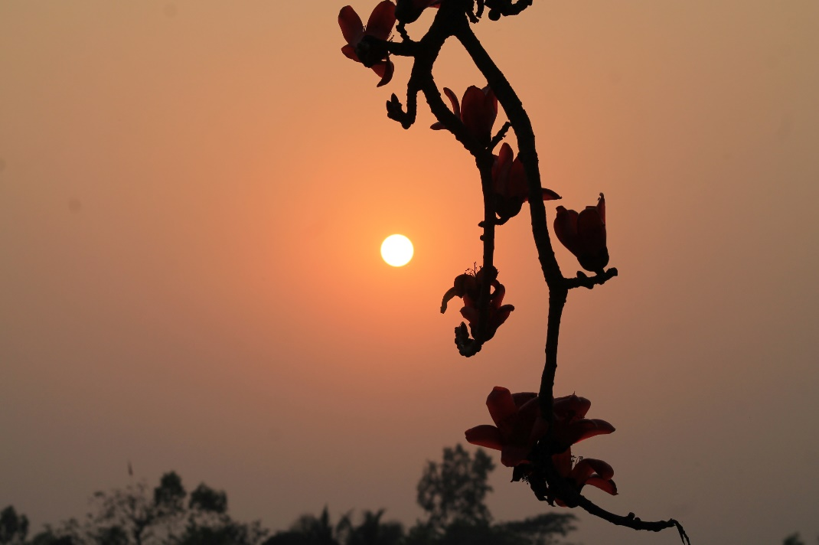
Clarifications…Comments…
Thank you all…

Slide 38
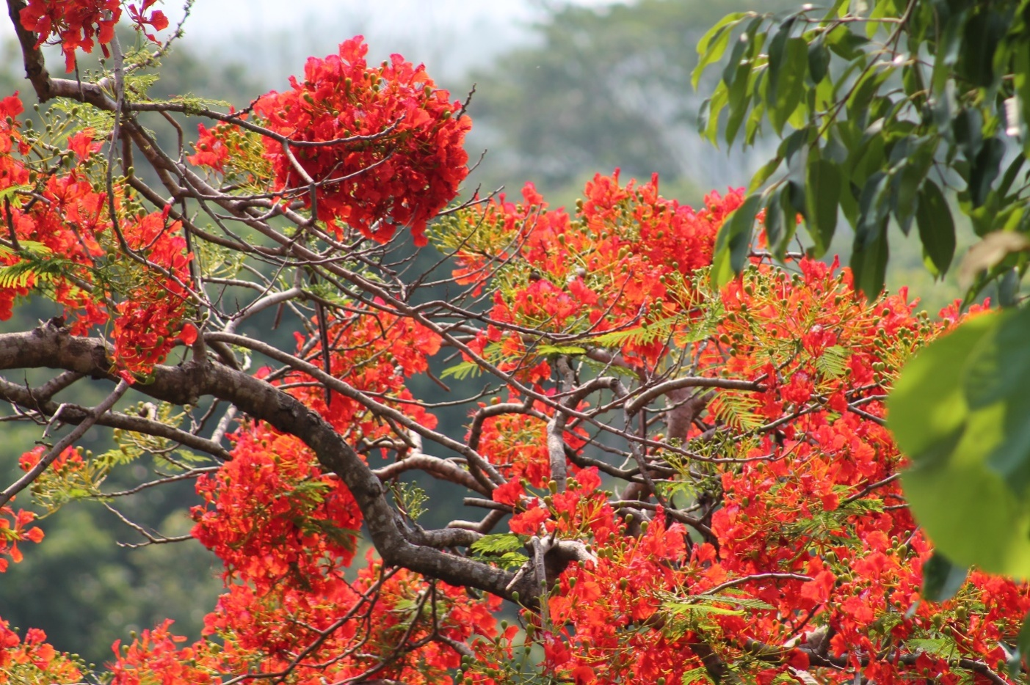
Thank you all…

