Slide 1


Human Communication

Slide 2
Presented By:
Dr. Sheikh Shafiul Islam
Associate Professor
Department of Journalism and Mass Communication
Daffodil International University
01704 320 110

Slide 3
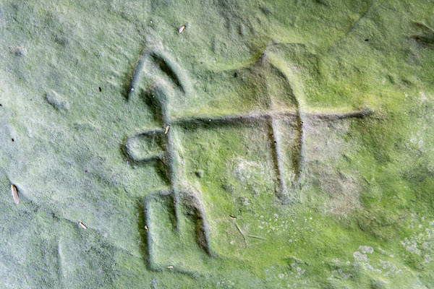
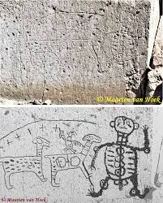
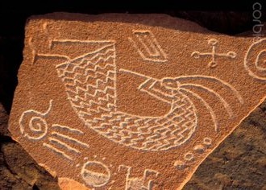
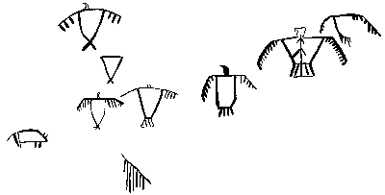
Pics

Slide 4
Emergence
Watching from a high place like valleys
Symbols invented 30,000 years ago….assumed
Writing system originated 5000 years ago
Different groups communicated differently
with their respective symbols
Cave paintings
Petro-glyphs—carving into a rock surface
Writing emerged from Sumer civilization
Combination of writing and drawing

Slide 5
Thank for Your Patient Participation

