Slide 1

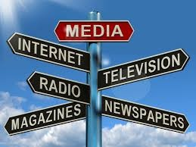
Human Communication

Slide 2
Presented By:
Dr. Sheikh Shafiul Islam
Associate Professor
Department of Journalism and Mass Communication
Daffodil International University
01704 320 110

Slide 3
Definition
Lakshman Rao defined communication as “Communication is a social process - the flow of information, the circulation of knowledge, and ideas in human society, the propagation and internalization of thoughts”.
Emery et.al said, “Communication is the art of transmitting information, ideas, and attitudes from one person to another”.
Newstrom and Davis stated, ‘Communication is the process of transferring from one person to another person. It is a way of reaching others by transmitting ideas, facts, thoughts, feelings and values.”
Baskin and Aronoff told,” Communication is the exchange of messages between people for the purpose of achieving common meanings.”
DeVito (1988) states, “Communication refers to act, by one or more persons, of sending and receiving messages that are distorted by noise, occur within a context, have some effect and provide some opportunity for feedback”.

Slide 4
Definition
Due to nature of the subject, it is also called ‘multi-disciplinary’ faculty of knowledge which is not possible to define in a simple proposition. Different communication scholars have defined human communication in their own ways. Some of the experts have described communication as 'the transfer of meaning', while some of them perceived communication as 'transmission of stimuli', 'one mind affecting other' or 'sharing of experiences on the basis of commonness'.

Slide 5
Nature of human communication
A transactional process
Interrelated components
Communicators act as whole

Slide 6
Thank for Your Patient Participation

