Slide 1

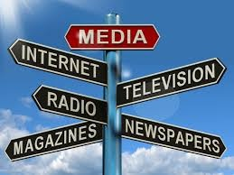
Human Communication

Slide 2
Presented By:
Dr. Sheikh Shafiul Islam
Associate Professor
Department of Journalism and Mass Communication
Daffodil International University
01704 320 110

Slide 3
Types and Levels of Comm.
Communication can be categorized primarily in two ways:
Verbal communication and
Non-verbal communication
Verbal communication means communicating with the people face-to-face. Some of the key components of verbal communication are sound, words, speaking, and language.

Slide 4

Continues
Nonverbal communication is carried out without words. People usually communicate nonverbally when they gesture, smile or frown, widen eyes, move chair closer to someone, wear jewelry, touch someone, or raise your vocal volume—and when someone receives these signals.

Slide 5
Levels of Human Comm.
Intrapersonal Communication: ‘Intra’ means within ‘self’. So, intrapersonal communication denotes communication activities of a person even with him/herself. It is the fundamental and intrinsic among an ‘individual’.

Slide 6
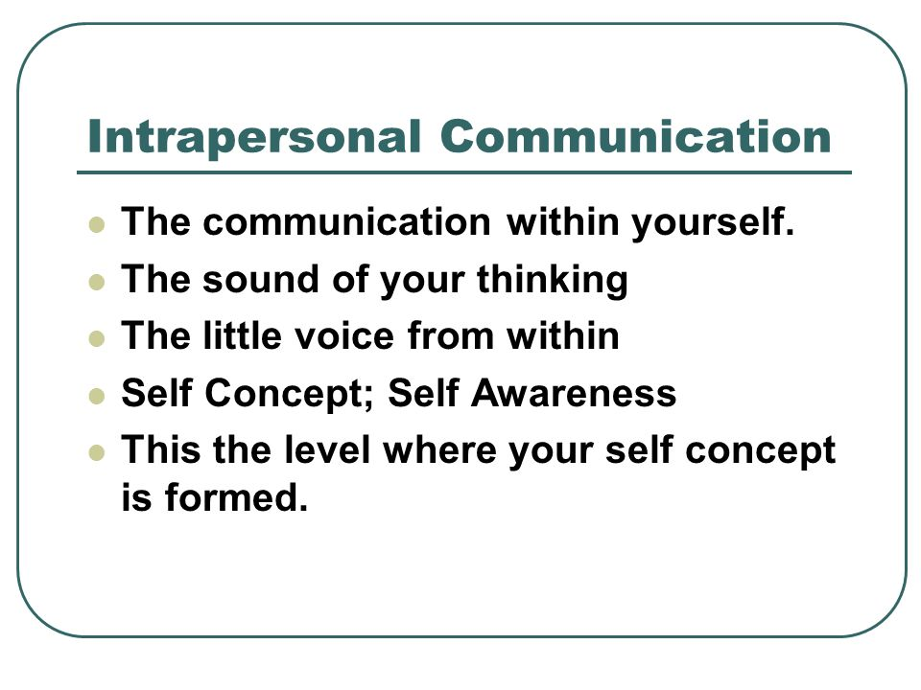

Intrapersonal communication

Slide 7
Interpersonal Communication
‘Inter’ means ‘between’ or middle’. So, interpersonal communication denotes the communication activities and experiences between two individuals or more in any social settings. An interpersonal communication is carried out in two way-dyadic communication and small group communication.

Slide 8
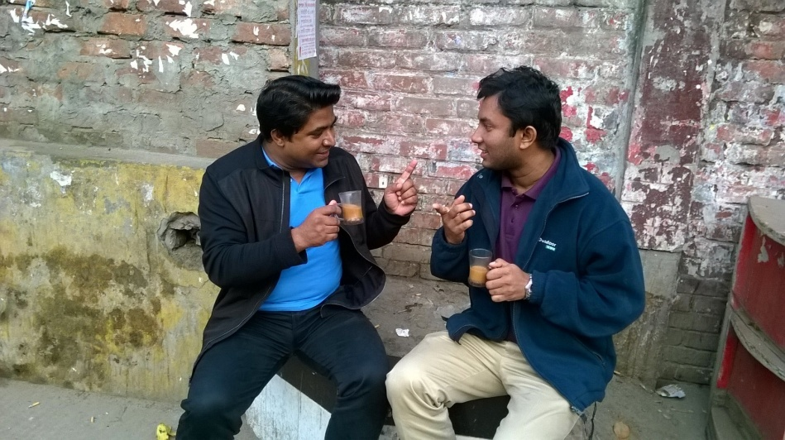
Dyadic communication
Triadic communication

Slide 9
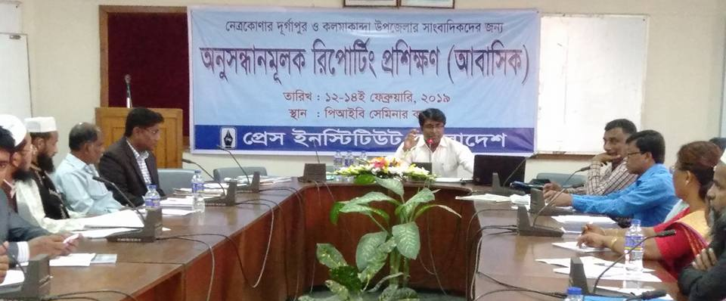


Small Group Communication

Slide 10

Large Group Communication

Slide 11
Public Communication
Public Communication: Public communication means sending of a message to a larger audience, the public. In public communication, the audience functions primarily as receivers and responders. It is also called speaker-audience communication. Means of public communications developed over time with the advancement of communication technologies. Public opinions, policies and ideas are constantly changing in line with the demand of the days.

Slide 12
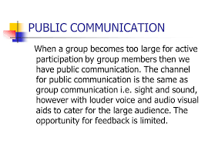
Public communication

Slide 13

pix

Slide 14


pix

Slide 15

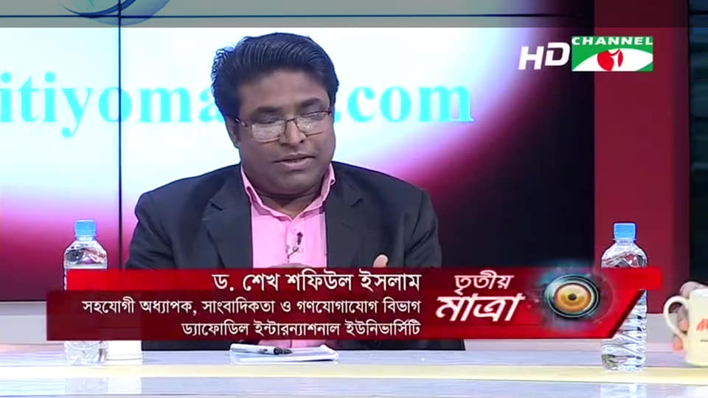
Mass communication
Mass Communication: sharing of messages with the anonymous, heterogeneous and unknown audience with the use of mass media with immediate or delayed feedback. It refers to the mass distribution of identical message to person or receivers mostly unknown to the sender.
The mass media are mainly machine-assisted channel including the print, electronic and new media i.e. the newspapers, television, radio, motion pictures, books, billboards, internet, mobile phones etc.

Slide 16
Thank for Your Patient Participation

