Slide 1
Digital Bangladesh: Concept, Changes and Prospects
Md. Golam Rahman, PhD
[Former Chief Information Commissioner]
Professor
Daffodil International University
E-mail: golamr07@hotmail.com , gr@daffodilvarsity.edu.bd

Slide 2
Digital Technology
Digital technology is a base two process. Digitized information is recorded in binary code of combinations of the digits 0 and 1, also called bits, which represent words and images.
Example:
Digital technologies are electronic tools, systems, devices and resources that generate, store or process data. Well known examples include social media, online games, multimedia and mobile phones.
Source: https://www.google.com/search?source=hp&ei=5pWnXIyZG6Laz7sPipKfiAI&q=digital+technology+concept&btnK=Google+Search (03-04-2019)

Slide 3
Digital Bangladesh
Digital Bangladesh implies the broad use of computers, and embodies the modern philosophy of effective and useful use of technology in terms of implementing the promises in education, health, job placement and poverty reduction. The party (Awami League, 2008) underscored a changing attitude, positive thinking and innovative ideas for the successes of “Digital Bangladesh”.^{1, 2}
1. "Digital Bangladesh a reality now". Dhaka Tribune. 2018-07-10. Retrieved 2019-01-03.
2. "Digital Bangladesh: Dreams and reality". The Daily Star. 2015-03-10. Retrieved 2019-01-03.
Source: https://en.wikipedia.org/wiki/Vision_2021 (04-04-2019)

Slide 4
Concept Digital Bangladesh 2009
a2i states:
Information and Communication Technologies (ICTs) are recognized as a powerful tool for socio-economic development. With appropriate policies, supplemented by realistic strategies, ICTs are known to have brought tremendous welfare to people in terms of better access to information
[https://a2i.gov.bd/publication/concept-digital-bangladesh-2009/ (04-04-2019)]

Slide 5
Digital Bangladesh: Concepts of Development…1
The phrase “Digital Bangladesh”, although is composed of the catching word “Digital”, stands for a concept which benefits the country as a whole by using Information and Communication Technology for management, administration and governance in order to ensure transparency, accountability and answerability at all levels of society and state.

Slide 6
Digital Bangladesh: Concepts of Development… 2
Digital Bangladesh will provide us an ICT driven knowledge-based society where information will be readily available on line and where all possible tasks of the government, semi-government and also private spheres will be processed using the state of the art technology.
[Presented by Md. Abdul Karim Principal Secretary Prime Minister’s Office The Government of the People’s Republic of Bangladesh, 15-16 February 2010.]
https://www.ukessays.com/essays/information-technology/digital-bangladesh-concept-of-development.php (04-04-2019)

Slide 7
Backbone of Digital Bangladesh
ICT is the backbone of any digital initiative. It covers the vast area of information ensuring connectivity through the information technology, communication technology and of course the telecommunication technology. Without the development of the ICT sector, the dream of a Digital Bangladesh would not be possible. The main factors of ICT are the physical backbone and the intellect. Computer Systems, Network Machineries, Software, Wire and Wireless Connectivity Systems, Broadcast Hardware and many other Hardware and Accessories are the physical backbone.

Slide 8
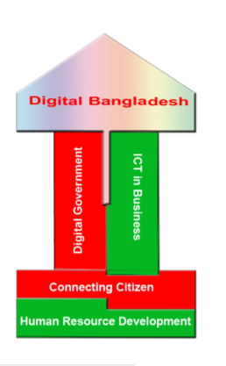
Relationship between development and digitization
Information technology reduces costs, saves time, improves efficiency, raises comfort levels and increases the confidence of citizens. Hence, developing countries such as Bangladesh should leverage the power of IT to leapfrog poverty barriers, and promote economic and social development. … It is important to understand that ICT facilities Good Governance but ICT itself do not guarantee Good Governance.

Slide 9
Status of our country
Telecommunication and Internet: backbone of communication
Until recently, International Telecommunication System of Bangladesh has been dependent on satellite which was slow and had narrow band width. According to Telecommunication Policy of the government, International Telecommunication Network system is being regulated now by BTCL.

Slide 10
Mobile phone: media of communication
Over last few years, a great revolution has taken place in the cellular phone usage in Bangladesh.
This digital revolution has created a brand new economic sector that simply did not exist before. Computers, modern telecommunication and the Internet all reduce communication costs and break down geographical borders. In addition, ICT can be an important driver in poverty reduction and assure sustained economic growth, better public welfare, and strong social solidity and democratic forms of government

Slide 11
Mobile phone
As per the Bangladesh Telecommunication Regulatory Commission data, the number of total mobile phone subscribers increased to 15.84 crore at the end of February from 15.75 crore in January this year (2019).
[New Age, 25 March 2019]
Grameenphone tops the list among the four mobile phone operators with more than 70 million subscribers.
Robi was behind it with 46.1 million.
Banglalink has nearly 33.5 million subscribers and state-owned Teletalk around 3.8 million. [bdnews24.com 04-04-2019]

Slide 12
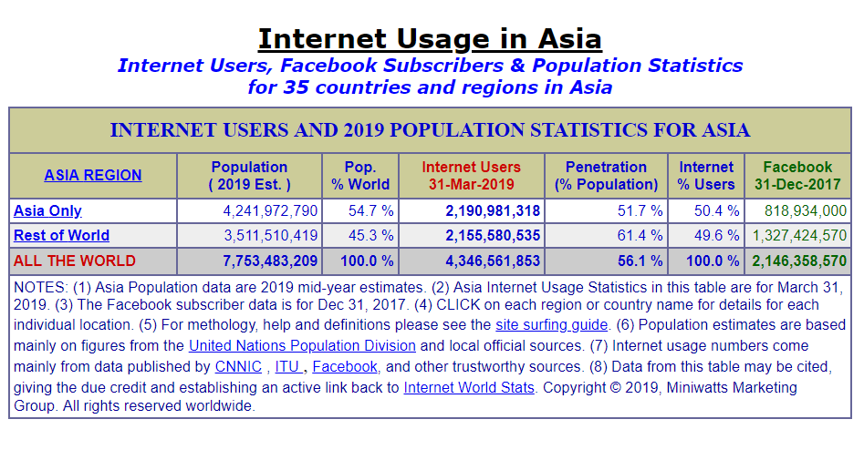

Slide 13
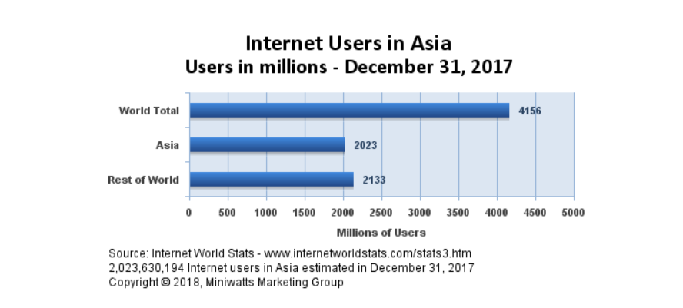

Slide 14
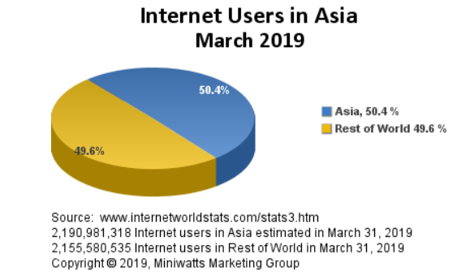

Slide 15
Country | Population (2018 Est.) | Internet Users 30 June 2018 | Internet Users 31 March 2019 | Penetra-tion (% Popn.) | Facebook 31 Dec 2017 | Users % Asia
Afghanistan | 36,373,176 | 6,003,183 | 6,538,124 | 17.6% | 3,200,000 | 0.3%
Bangladesh | 166,368,149 | 88,687,000 | 92,061,000 | 54.8% | 28,000,000 | 4.2%
Bhutan | 817,054 | 370,423 | 370,423 | 44.8 % | 350,000 | 0.0%
India | 1,354,051,854 | 462,124,989 | 560,000,000 | 40.9 % | 251,000,000 | 25.6%
Maldives | 444,259 | 2,000,000 | 340,000 | 75.3 % | 1,900,000 | 0.0%
Nepal | 29,624,035 | 16,190,000 | 18,000,000 | 54.1 % | 8,700,000 | 0.7%
Pakistan | 200,813,818 | 44,608,065 | 44,608,065 | 21.8 % | 32,000,000 | 2.0%
Sri Lanka | 20,950,041 | 6,710,160 | 6,710,160 | 31.9 % | 5,500,000 | 0.3%
Source: Internet World Stats, https://www.internetworldstats.com/stats3.htm (03-04-2019)

Slide 16
Population, Annual GDP, GDP per capita, and Human Development Index (HDI) of SAARC Countries
Countryeconomy.com https://countryeconomy.com/countries/groups/south-asian-association-regional-cooperation (13-01-2021)
Countries | Population | Annual GDP | GDP per capita | HDI
Afghanistan [+] | 37,172,386 | 19,630M.$ | 528$ | 0.498
Bangladesh [+] | 161,356,039 | 288,424M.$ | 1,788$ | 0.608
Bhutan [+] | 754,394 | 2,582M.$ | 3,423$ | 0.612
India [+] | 1,352,617,328 | 2,718,732M.$ | 2,010$ | 0.640
Maldives [+] | 515,696 | 5,328M.$ | 10,332$ | 0.717
Nepal [+] | 28,087,871 | 29,040M.$ | 1,034$ | 0.574
Pakistan [+] | 200,960,000 | 314,588M.$ | 1,565$ | 0.562
Sri Lanka [+] | 21,670,000 | 88,901M.$ | 4,102$ | 0.770
TOTAL: SAARC | 1,803,133,714 | 3,467,225M.$ | 1,923$

Slide 17
Country | Primary School Enrollment | Human Dev Index
Afghanistan | N/A | 0.465 (171)
Bangladesh | 92% | 0.570 (142)
Bhutan | 91% | 0.605 (132)
India | 94% | 0.609 (130)
Maldives | N/A | 0.706 (104)
Nepal | 98% | 0.548 (145)
Pakistan | 72% | 0.538 (147)
Sri Lanka | 94% | 0.756 (73)
Source:https://en.wikipedia.org/wiki/South_Asian_Association_for_Regional_Cooperation (22-09-2018)

Slide 18
Our shortcomings … 1
Access to the Technology
Inadequate technical and policy capacity is a fundamental barrier to digital Bangladesh.
Economic Barriers
The economic condition of the people is one of the vital issues for computer use and internet connectivity
Literacy Barrier
The Bangladesh is facing acute crisis of skilled computer user due to literacy problem. Lack of skilled manpower in public and private sectors is created. Cont…

Slide 19
Our shortcomings …2
Language Barrier
Language problem is another vital issue for the local user of the internet/web. There are very few web sites available in local language i.e. in Bengali. Local people are not very much frequent / efficient in English as language.
Content Barrier
Lack of Local & Social Issues in the Net Contents in the web is not sufficiently enriched with information and services required by the local user. Still, local webs are concentrated with their product & service promotion.

Slide 20
Our shortcomings … 3
Social & Cultural Environment
As male group of the society can avail the web access facility from commercial centers or outside the home but the local women community of Bangladesh has limited access due to some social and cultural environment.
The high cost of IT equipment
The high cost of IT equipment accessories which acts a barrier towards proliferation of IT access needs to be lowered.

Slide 21
NGOs & Social Media
A study on “How Global NGOs Use Social Media” showed that 52 percent of global NGOs have used social media to report live. Of those, the top three live reporting tools are facebook 79%, Twitter 56%, and Instagram 23%. The data found in the survey that was conducted in 153 countries globally among 4,908 NGOs mentioned citing Tech Report. [smartinsights.com]
Facebook is the most popular social media channel for global NGOs with 92% having a facebook page. Instagram, which was taken over by Facebook in 2012, only has 39% of NGOs creating a profile account. [smartinsights.com]

Slide 22
Global South in Internet Governance
“According to the International Telecommunications Union (ITU), over 70% of the 3.6 trillion Internet users are now located in developing countries (ITU, 2017). However, while most Internet users are in the Global South, actors from this part of the world do not exert a major influence over the global governance of the network.” [p.42]

Slide 23
Global South in Internet Governance…2
“… one of the factors that motivate the participation of the Global South in the dispute regarding Internet governance is the digital gap between the Global South and the Global North. This gap can be quantified in terms of Internet infrastructure, access to new technology, broadband, Internet speed, Internet eXchange Points (IXP), access to digital markets, new developments, digital entrepreneurship and the gap in terms of the many companies in the North, that lead the world of the Internet and the few companies in the South, that struggle for a space on the web. ” [p.49]
[Jean-Marie Chenou, Juan Sebastián Rojas Fuerte, The Difficult Path to the Insertion of the Global South in Internet Governance, Edited by Daniel Oppermann, Published in 2018 by International Relations Research Center]

Slide 24
Social Media
Of those, 1.2 billion are adolescents, with 23% of them in Africa, 19% in Latin America and Caribbean, and 18% in Asia. And for those youth and adolescents who have access, social media is an important part of their daily lives.

Slide 25
Social Media..2
Social media are multidirectional.
As participants in social media, all are senders and receivers at the same time. Using this new way of communication requires literacy and connectivity. It also requires access to equipment and funds for connection time.

Slide 26
Youth and Use of ICT
Millions of youth and adolescents across the world are connected with ICTs, particularly mobile telephony and social media.
It is estimated that there are nearly 2 billion youth and adolescents in the world (UNFPA, 2011).
In an article endorsed by the American Academy of Pediatrics, O’Keefe and Clarke-Pearson (2011) stated that 22% of teenagers in the U.S.A. log on to a social media site about ten times a day, and at least 50% of teenagers log on at least once a day.

Slide 27
The youth of our country, between ages of 18-35 years is about one-third of total population which is about 5.30 crores
জাতীয যুবনীতি অনুসারে বাংলাদেশের ১৮-৩৫ বছর বয়সী জনগোষ্ঠিকে যুব হিসেবে অভিহিত করা হয়। এ বয়সসীমার জনসংখ্যা দেশের মোট জনসংখ্যার এক-তৃতীয়াংশ, যা প্রায় ৫ কোটি ৩০ লক্ষ। শ্রমশক্তির যোগান ও সংখ্যার বিবেচনায়ও আমাদের দেশের উন্নয়নের জন্য যুবসমাজের সম্পৃক্ততা অত্যন্ত গুরুত্বপূর্ণ। [http://www.dyd.gov.bd/site/page/57f039b0-3112-4b5c-a071-2b300e8317af/- (04-04-2019)

Slide 28
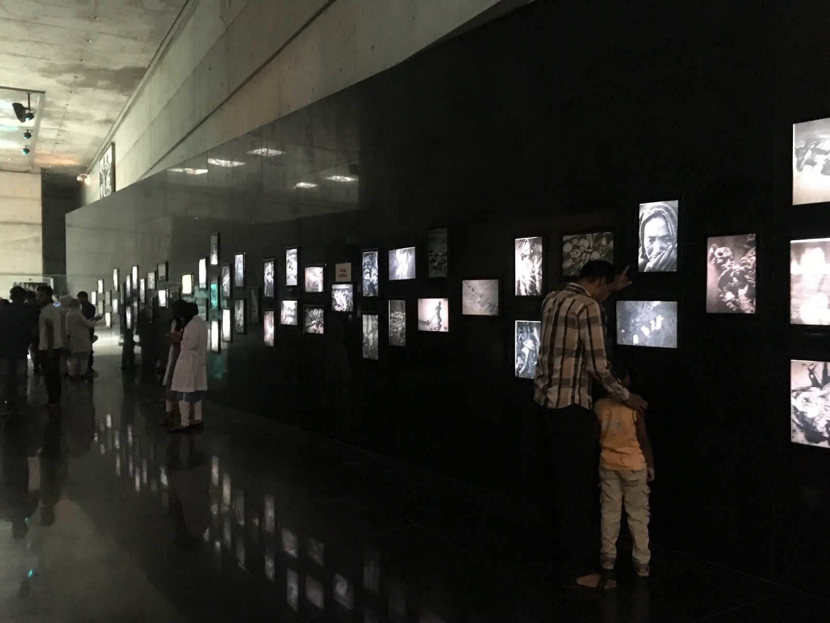
Question, Clarifications, Comments…

Slide 29
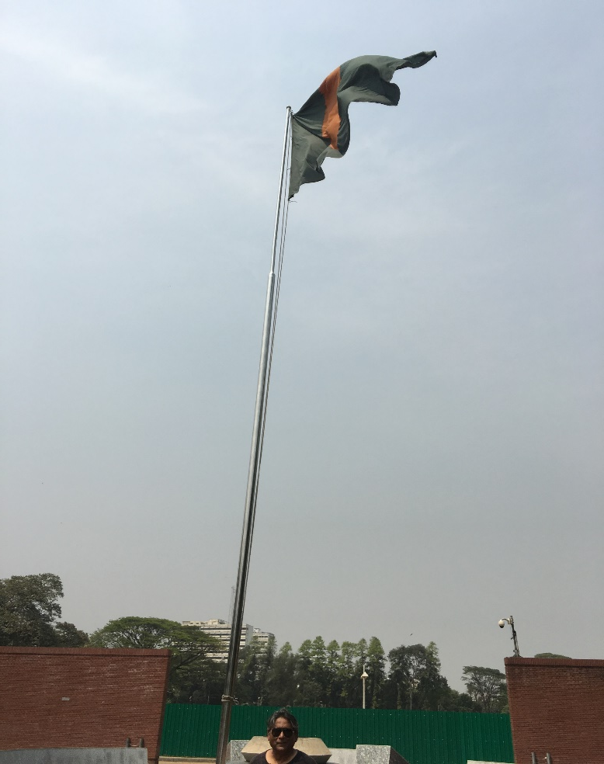
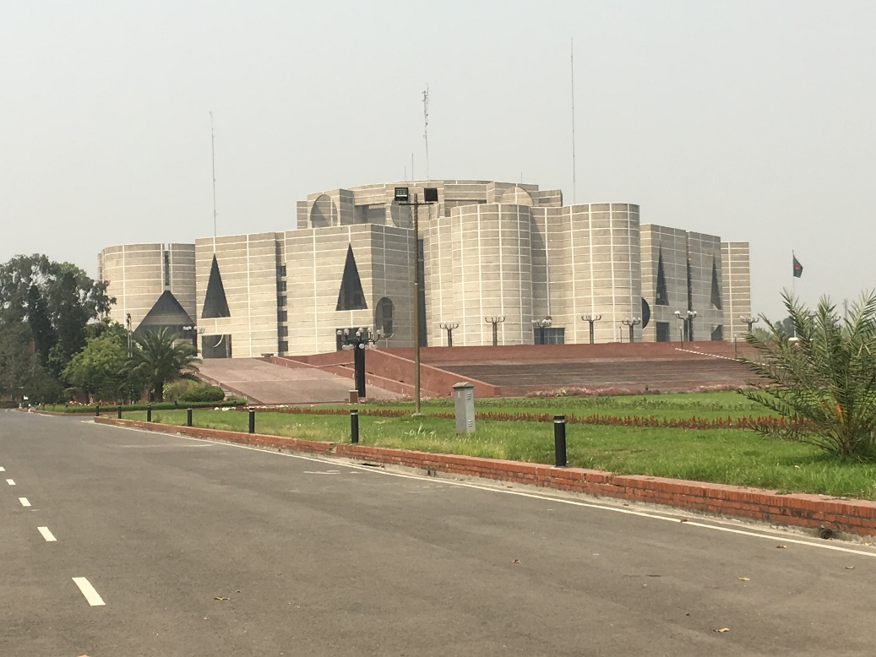
Thank you all…

