Slide 1
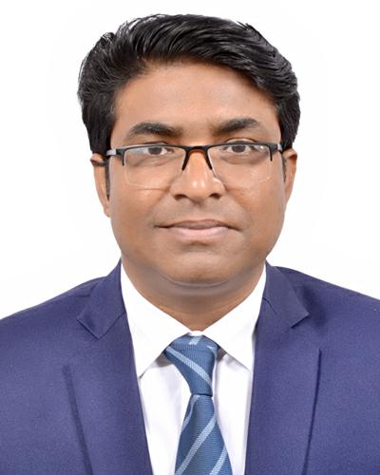
Presented By:
Dr. Sheikh Shafiul Islam
Associate Professor
Department of Journalism and Mass Communication
Daffodil International University
01704 320 110
Communication process

Slide 2
Presented By:
Dr. Sheikh Shafiul Islam
Associate Professor
Department of Journalism and Mass Communication
Daffodil International University
01704 320 110

Slide 3
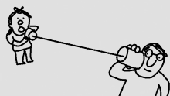
Communication is a process

Slide 4
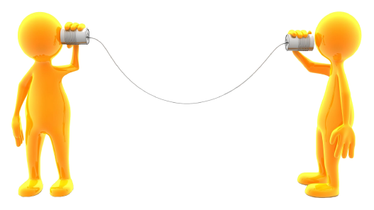
Process:

Slide 5
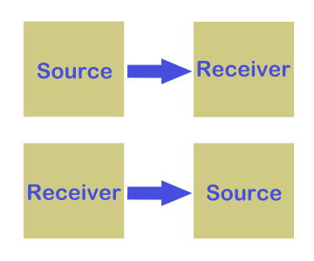
Process

Slide 6
Process of Comm.
Process of Human Communication
Components of Human Communication
By this time we have learnt that human communication is a process of exchanging verbal and non verbal messages. It is a two-way traffic and continuous process involving some obvious components:
a. Source
b. Message
c. Channel
d. Receiver
e. Feedback
f. Noise
g. Encoder
h. Decoder
Context

Slide 7
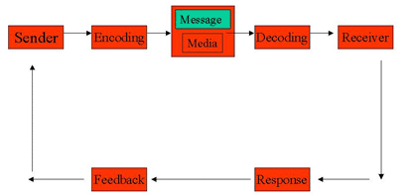
Process

Slide 8
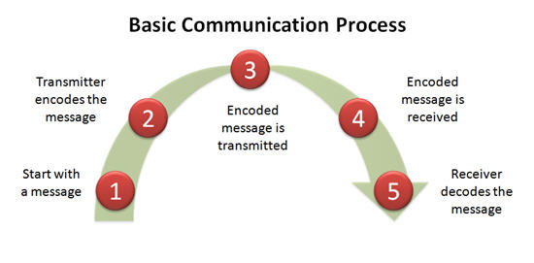
Process of Communication

Slide 9
Aristotle’s Model
The Greek philosopher Aristotle was the first to take an initiative and design the communication model. He viewed communication from the rhetorical perspective i.e. speaking to the masses to influence them and thus persuade them. Aristotle provides a model with three elements:
Speaker
Speech
Audience
According to Aristotle, the basic function of communication is to persuade the audience. Many scholars recognized the model as the first initiative of thinking of a ‘communication model’.
Speaker
Speech
Audeince

Slide 10
Shannon and Weaver’s Model of Communication
The first formal model of communication was contributed in 1949 by Claude Elwood Shannon and Warren Weaver. In 1948, Shannon was an American mathematician, Electronic engineer and Weaver was an American scientist. They joined together to write an article in “Bell System Technical Journal” called “A Mathematical Theory of Communication” and also called as “Shannon-Weaver model of communication”.
Source
Transmitter
Receiver
Channel
Destination

Slide 11
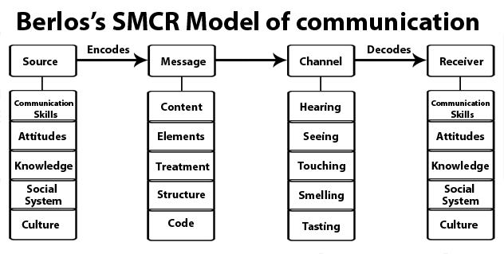
Berlo’s Model
In 1960, David K. Berlo expanded Shannon and Weaver’s linear model of communication. He proposed a revised model popularly known as ‘Source-Message-Channel-Receiver (SMCR)’ Model of communication.

Slide 12
Harold D. Lasswell’s Verbal Model of Communication
Harold D. Lasswell, a professor of Yale University, was an American Political Scientist and Communication Theorist
In his 1948 article, The Structure and Function of Communication in Society, Lasswell wrote that "a convenient way to describe an act of communication is to answer the following questions:
Who
Says What
In Which Channel
To Whom
With What Effect?"

Slide 13
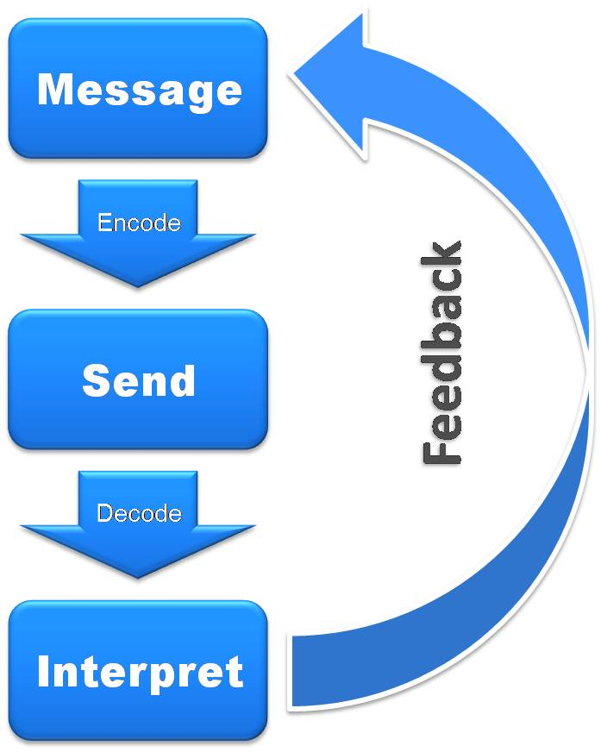
Process: Feedback

Slide 14
Thank for Your Patient Participation

