Slide 1
Managing Leadership and Influence Processes
Khadiza Rahman Tanchi, PhD
Assistant Professor
Department of Business Administration

Slide 2
Learning Objectives
Describe the nature of leadership and relate leadership to management.
Discuss and evaluate the two generic approaches to leadership.
Identify and describe the major situational approaches to leadership.
Identify and describe three related approaches to leadership.
Describe three emerging approaches to leadership.

Slide 3
The Nature of Leadership
The Meaning of Leadership
Leadership as a Process: what leaders actually do.
Using noncoercive influence to shape the group’s or organization’s goals.
Motivating others’ behavior toward goals.
Helping to define organizational culture.
Leaders are people who can influence the behaviors of others without having to rely on force.
Leadership as a Property: who leaders are.
Characteristics attributed to individuals perceived as leaders.
Leaders are people who are accepted as leaders by others.

Slide 4
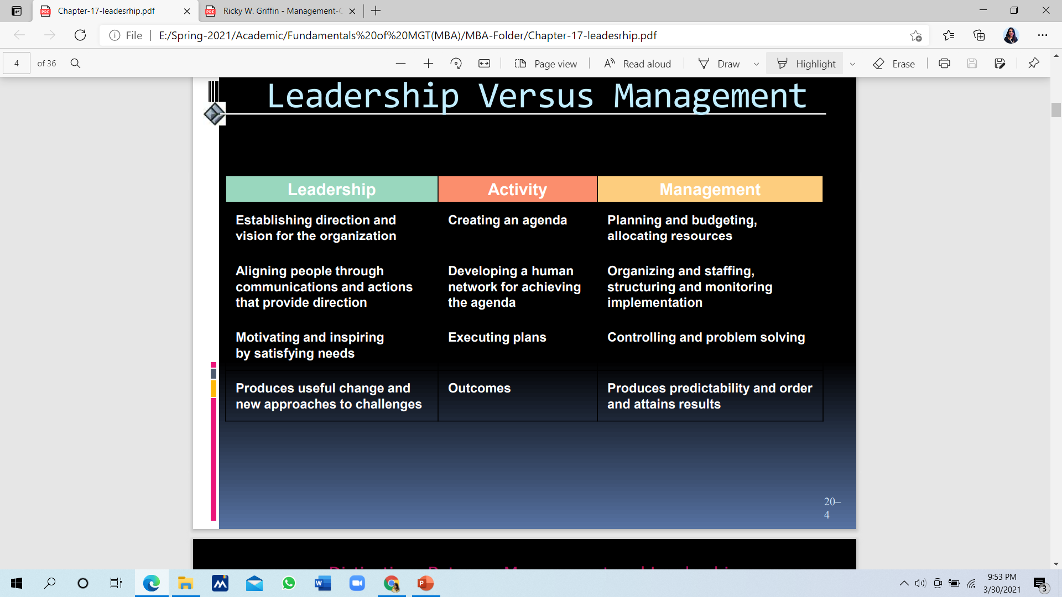

Slide 5
Types of Power
Legitimate Power
Reward Power
Coercive Power
Referent Power
Expert Power

Slide 6
Leadership and Power
Power is the ability to affect the behavior of others.
Legitimate power is granted through the organizational hierarchy.
Reward power is the power to give or withhold rewards.
Coercive power is the capability to force compliance by means of psychological, emotional, or physical threat.
Referent power is the personal power that accrues to someone based on identification, imitation, loyalty, or charisma.
Expert power is derived from the possession of information or expertise.

Slide 7
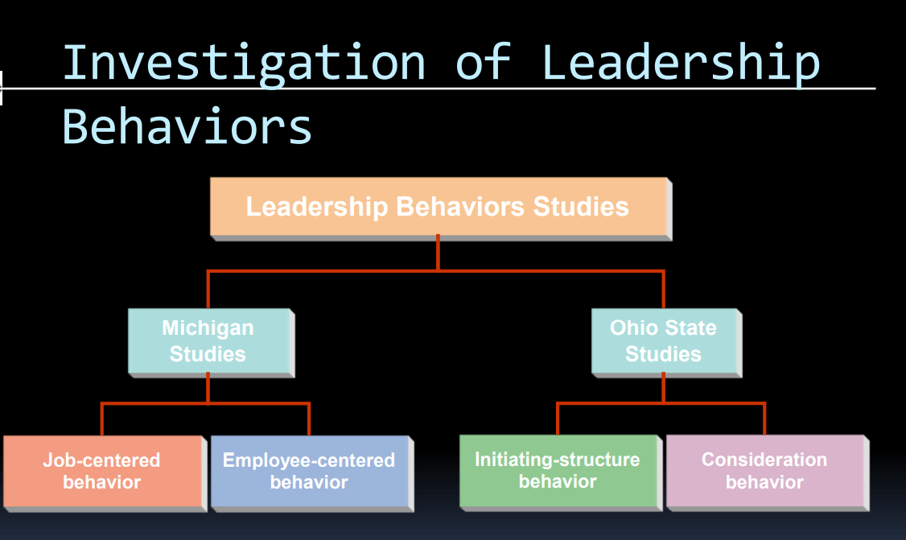

Slide 8
Situational Approaches to Leadership
Situational Models of Leader Behavior
Assume that:
Appropriate leader behavior depends on the situation.
Situational factors that determine appropriate leader behavior can be identified.
Situational Leadership Theories:
Leadership behavior continuum
Least preferred coworker theory
Path-goal theory
Decision tree approach
Leader-member exchange approach

Slide 9
Situational Approaches to Leadership
Leadership Continuum (Tannenbaum and Schmidt)
Continuum identifies a range of levels of leadership from boss-centered to subordinate-centered leadership
Variables influencing the decision-making continuum:
Leader’s characteristics
Subordinates’ characteristics
Situational characteristics

Slide 10
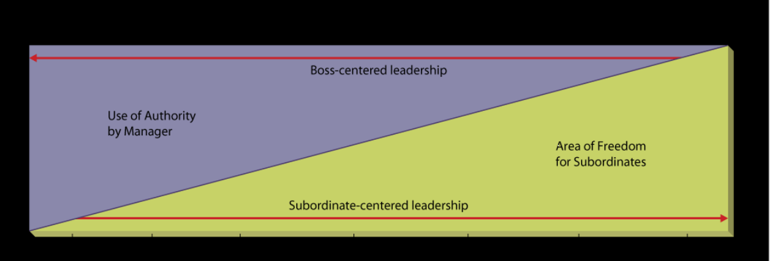
Tannenbaum and Schmidt’s Leadership Continuum

Slide 11
Situational Approaches to Leadership
Least Preferred Coworker (LPC) Theory (Fiedler)
Assumed that leadership style is fixed and situation must be changed to favor the leader.
Appropriate leadership style varies with situational favorableness (from the leader’s viewpoint).
LPC scale asks leaders to describe the person with whom they are least able to work well.
High scale scores indicate a relationship orientation; low scores indicate a task orientation on the part of the leader.
Situational favorableness is determined by:
Quality of leader-member relations
Degree to which the structure of the group’s task is defined
Position power of the leader

Slide 12
Situational Approaches to Leadership
Path-Goal Theory (Evans and House)
The primary functions of a leader are:
To make valued or desired rewards available in the workplace
To clarify for the subordinate the kinds of behavior that will lead to goal accomplishment or rewards
Leader Behaviors:
Directive leader behavior
Supportive leader behavior
Participative leader behavior
Achievement-oriented leader behavior

Slide 13
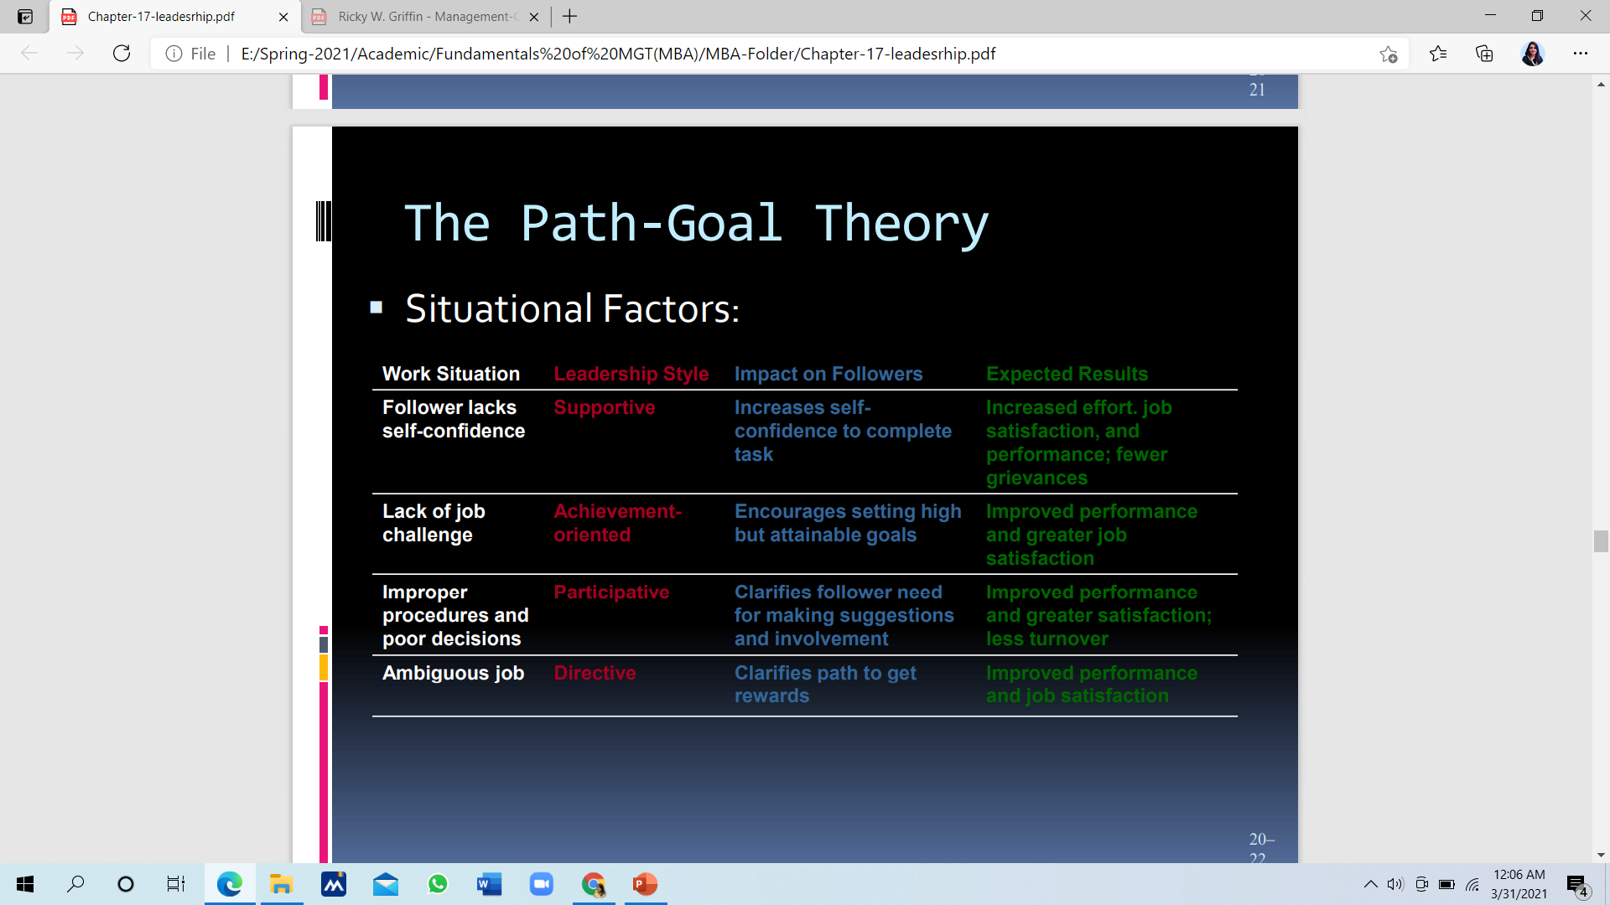

Slide 14
Situational Approaches to Leadership
Vroom’s Decision Tree Approach
Attempts to prescribe a leadership style appropriate to a given situation.
Basic premises:
Subordinate participation in decision making depends on the characteristics of the situation.
No one decision-making process is best for all situations.
After evaluating problem attributes, a leader chooses a path on the decision trees that determines the decision style and specifies the amount of employee participation.
Decision significance
Decision timeliness

Slide 15
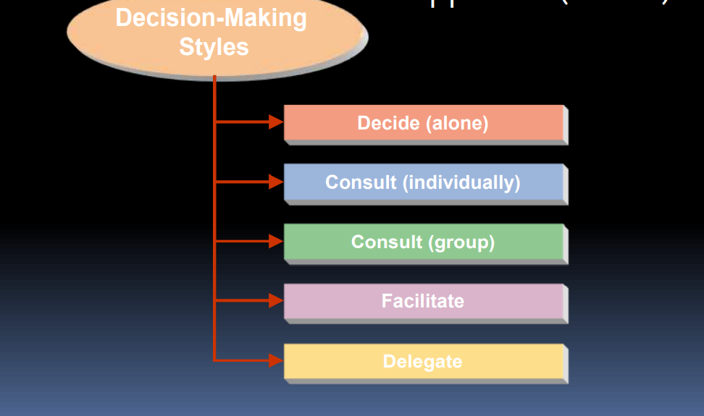

Slide 16
Situational Approaches to Leadership
The Leader-Member Exchange (LMX) Approach
Stresses the importance of variable relationships between supervisors and each of their subordinates.
Vertical dyads
Leaders form unique independent relationships with each subordinate (dyads) in which the subordinate becomes a member of the leader’s out-group or ingroup

Slide 17
In group members:
Interactions between leader and follower result in high quality, negotiated, reciprocal relationships, where the follower assumes responsibilities beyond the job description, they are known as the “in-group.”
Out group members:
When the interactions result in a one-way.

Slide 18
Leadership Style
Coaching Leadership Style
Visionary Leadership Style
Servant Leadership Style
Autocratic Leadership Style
Democratic or Participative Leadership Style
Laisses-Fair or Hands off Leadership Style
Pacesetting Leadership Style
Transaction Leadership Style
Transformational Leadership Style
Bureaucratic Leadership Style
Charismatic Leadership Style

Slide 19
Coaching Style
Someone who can quickly recognize their team members’ strengths, weaknesses and motivations to help each individual improve
Assists team members in setting smart goals and then provides regular feedback with challenging projects to promote growth
Setting clear expectations and creating a positive, motivating environment.
Are supportive
Offer guidance instead of giving commands
Value learning as a way of growing
Balance relaying knowledge and helping others find it themselves
Are self-aware

Slide 20
Visionary Style
Ability to drive progress
Inspiring employees and earning trust for new ideas
Establish a strong organizational bond
Persistent and bold
Strategic
Risk-taking
Inspirational
Optimistic
Innovative
Magnetic

Slide 21
Servant Style
Emphasis on employee satisfaction and collaboration
Motivate your team
Have excellent communication skills
Personally care about your team
Encourage collaboration and engagement
Commit to growing your team professionally

Slide 22
Autocratic Style
Someone who is focused almost entirely on results and efficiency.
Make decisions alone or with a small, trusted group and expect employees to do exactly what they’re asked
Have self-confidence
Are self-motivated
Communicate clearly and consistently
Follow the rules
Are dependable
Value highly structured environments
Believe in supervised work environments

Slide 23
Laisses- Fair Style
Focusing mostly on delegating many tasks to team members and providing little to no supervision.
Effectively delegate
Believe in freedom of choice
Provide sufficient resources and tools
Will take control if needed
Offer constructive criticism
Foster leadership qualities in your team
Promote an autonomous work environment

Slide 24
Democratic Style
Combination of the autocratic and laissez-faire types of leaders
Someone who asks for input and considers feedback from their team before making a decision
Value group discussions
Provide all information to team when making decisions
Promote a work environment where everyone shares their ideas
Are rational
Are flexible
Are good at mediation

Slide 25
Pacesetting Style
Primarily focused on performance
Set high standards and hold their team members accountable for hitting their goals.
Focus on goals
Are slow to praise
Will jump in to hit goals if needed
Are highly competent
Value performance over soft skills

Slide 26
Transactional Style
Someone who is laser-focused on performance, similar to a pacesetter.
Focused on mentorship, instruction and training to achieve goals and enjoy the rewards.
Value corporate structure
Micromanage
Don’t question authority
Are practical and pragmatic
Value goal-hitting
Are reactionary

Slide 27
Transformational Style
Similar to the coach-style in that it focuses on clear communication, goal-setting and employee motivation
Driven by a commitment to organizational objectives.
Have mutual respect with your team
Provide encouragement
Inspires others to achieve their goals
Think of the big picture
Places value on intellectually challenging your team
Are creative
Have a good understanding of organizational needs

Slide 28
Bureaucratic leadership style
Similar to autocratic leaders in that they expect their team members to follow the rules and procedures precisely as written.
Focuses on fixed duties within a hierarchy where each employee has a set list of responsibilities
Are detail-oriented and task-focused
Value rules and structure
Have a great work ethic
Are strong-willed
Have a commitment to your organization
Are self-disciplined

Slide 29
Charismatic leadership style
Is an interpersonal attraction that inspires support and acceptance
Is an individual characteristic of a leader.
Self-confident
Have a firm conviction in their belief and ideals
Possess a strong need to influence people
Envision the future, set high expectations, and model behaviors consistent with expectations.
Energize others through a demonstration of excitement, personal confidence, and patterns of success.
Enable others by supporting them, by empathizing with them, and by expressing confidence in them

Slide 30
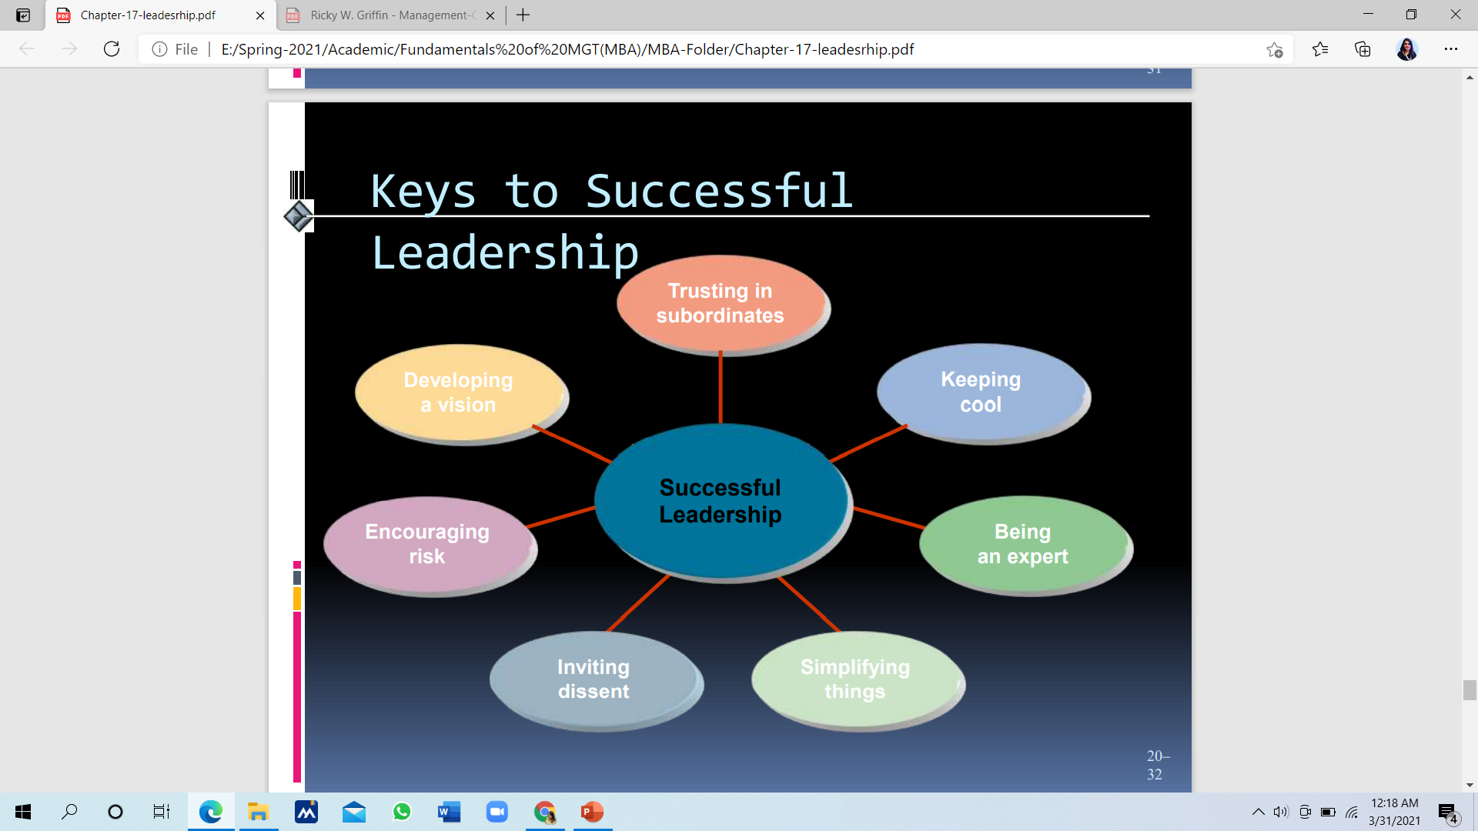

Slide 31
Strategic leadership
Strategic leadership refers to a manager's potential to express a strategic vision for the organization, or a part of the organization, and to motivate and persuade others to acquire that vision. Strategic leadership can also be defined as utilizing strategy in the management of employees.

Slide 32
Cross-cultural leadership
Cross-cultural leadership is the way to understand leaders who work in the newly globalized market. Cross-cultural leadership involves the ability to influence and motivate people's attitudes and behaviors in the global community to reach a common organizational goal.

Slide 33
Ethical leadership
Ethical leadership is leadership that is directed by respect for ethical beliefs and values and for the dignity and rights of others. It is thus related to concepts such as trust, honesty, consideration, charisma, and fairness.

Slide 34
Thank You

