Slide 1
Lecture-2: Classification of Signals
Multichannel and Multidimensional signals
Continuous-time versus Discrete-time signals
Deterministic versus Random signals

Slide 2
Multichannel and Multidimensional signals
Multichannel Signals:
Signals which are generated by multiple sources or multiple sensors are called multichannel signals.
These signals are represented by vector
S(t) = [(S1(t) S2(t) S3 (t)]
Above signal represents a 3-channel signal.
Multidimensional signals:
A signal is called multidimensional signal if it is a function of M independent variables.
For example : Speech signal is a one dimensional signal because amplitude of signal depends upon single independent variable, namely, time.

Slide 3
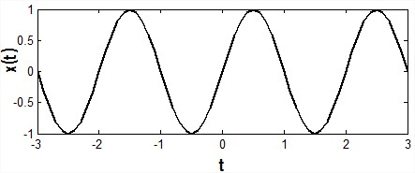
Continuous Signals
Defined for every values of time.
Take on values in the continuous interval ( a, b)
where, a can be -∞ and b can be ∞
Function of a continuous variable
Example: x (t) = sinπt

Slide 4
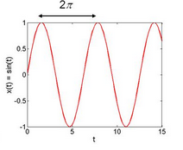
Periodic & Non-Periodic Signal
Periodic Signal: A signal which completes a pattern within a measurable time frame, called a period and repeats that pattern over identical subsequent periods.
The completion of a full pattern is called a cycle. A period is defined as the amount of time (expressed in seconds) required to complete one full cycle. The duration of a period represented by T.
Also called deterministic signal.

Slide 5
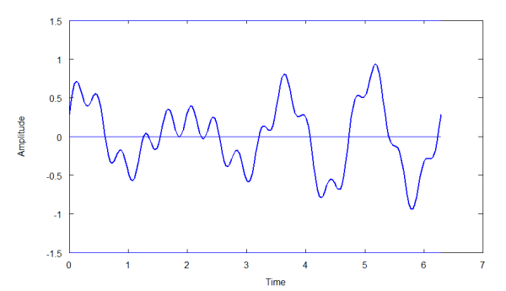
Non-Periodic Signal
Does not repeats its pattern over a period
Can not represented by any mathematical equations
Values can not be determined with certainty at any given point of time.
Also called random signal.

Slide 6
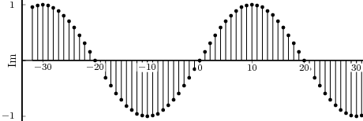
Discrete Signal
Defined only at discrete instants of time.
A discrete-time sinusoidal signal may be expressed as,
X(n) =$Acos\left(ωn+θ\right), −∞<n<∞$ --------------(1)
where, n = Integer variable, A= Amplitude,
$ω$= Frequency in radians/sample, $θ$= Phase in radian.
$$But ω=2πf$$
So the equation (1) becomes,
X(n) =$Acos\left(2πfn+θ\right)$, $−∞<n<∞$

Slide 7
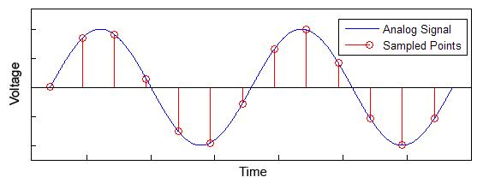
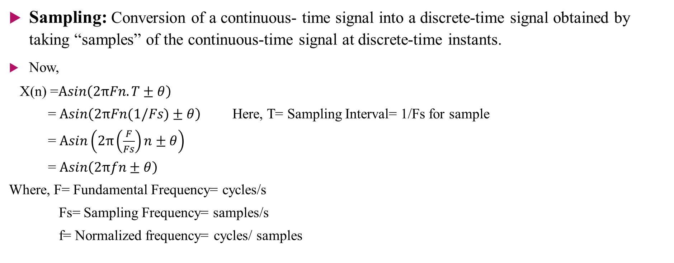
Sampling of Analog Signal
Sampling: Conversion of a continuous- time signal into a discrete-time signal obtained by taking “samples” of the continuous-time signal at discrete-time instants.
Now,
X(n) =$Asin\left(2πFn.T±θ\right)$
= $Asin\left(2πFn(1/Fs)±θ\right)$ Here, T= Sampling Interval= 1/Fs for sample
= $Asin\left(2π\left(\frac{F}{Fs}\right)n±θ\right)$
= $Asin\left(2πfn±θ\right)$
Where, F= Fundamental Frequency= cycles/s
Fs= Sampling Frequency= samples/s
f= Normalized frequency= cycles/ samples

Slide 8
Digital Signal
Quantization: Conversion of a discrete-time continuous-valued signal into a discrete-time, discrete-valued (Digital) signal.
5.6 7.2 8.3 9.6
6 7 8 10 → sampling, quantized value
5.6-6= -0.4 7.2-7= 0.2 8.3-8= 0.3 9.6-10= -0.4
Quantization Error Quantization Error

Slide 9
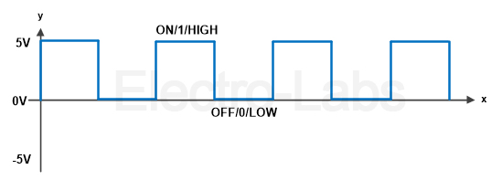

6 7 8 10
0110 0111 1000 1010
-$π≤2πf≤π$
= -$\frac{π}{2π}≤2πf≤\frac{π}{2π}$
= $−\frac{1}{2}≤f≤\frac{1}{2}$
so, f$≤\frac{1}{2}$
Or, F/Fs $≤\frac{1}{2}$
Or, Fs$≥2F$
F$s≥2F$Nyquist Rate/ Sampling Theorem

Slide 10
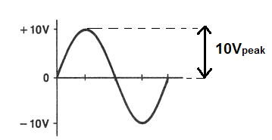
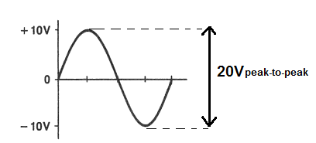
Peak and Peak to Peak Voltage
10 volt Peak
20 volt peak to peak

