Slide 1
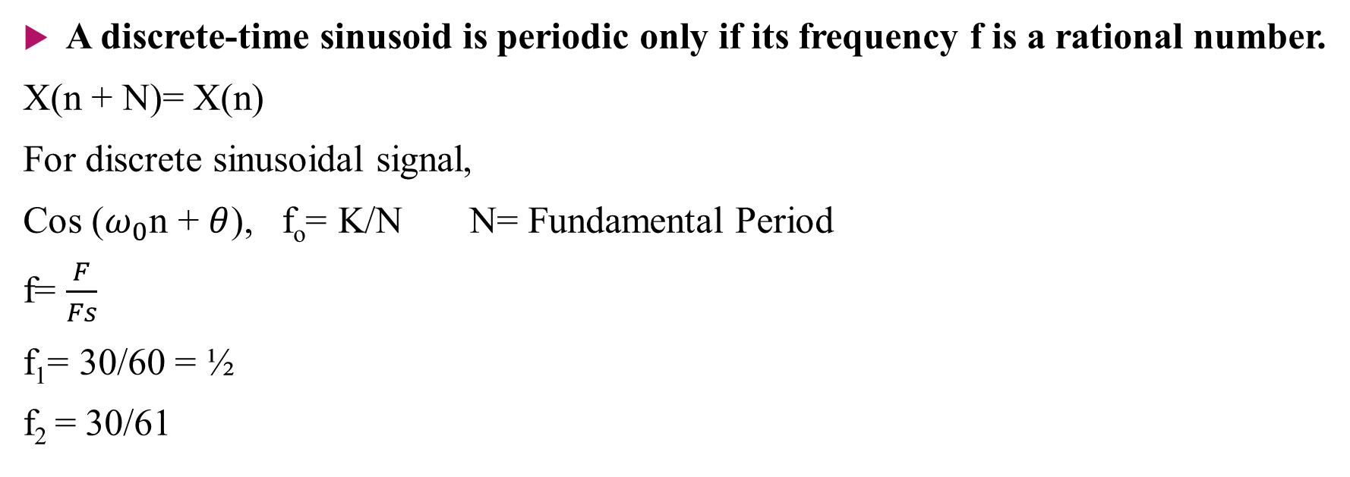
Lecture-3: Discrete Time Sinusoidal Signal
A discrete-time sinusoid is periodic only if its frequency f is a rational number.
X(n + N)= X(n)
For discrete sinusoidal signal,
Cos ($ω_{0}$n + $θ$), f_{o}= K/N N= Fundamental Period
f= $\frac{F}{Fs}$
f₁= 30/60 = ½
f₂ = 30/61

Slide 2
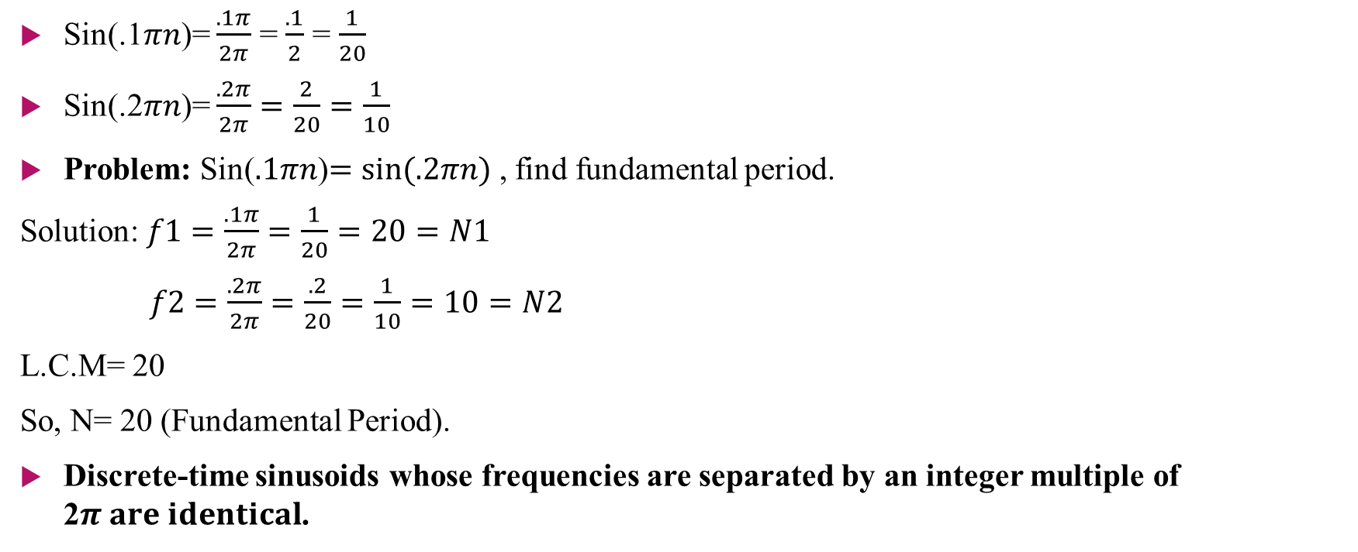
Sin(.1$πn$)= $\frac{.1π}{2π}$ = $\frac{.1}{2}$ = $\frac{1}{20}$
Sin(.2$πn$)= $\frac{.2π}{2π}=\frac{2}{20}=\frac{1}{10}$
Problem: Sin($.1πn$)$=\sin{(.2πn)}$ , find fundamental period.
Solution: $f1=\frac{.1π}{2π}=\frac{1}{20}=20=N1$
$f2=\frac{.2π}{2π}=\frac{.2}{20}=\frac{1}{10}=10=N2$
L.C.M= 20
So, N= 20 (Fundamental Period).
Discrete-time sinusoids whose frequencies are separated by an integer multiple of 2$π are identical$.

Slide 3
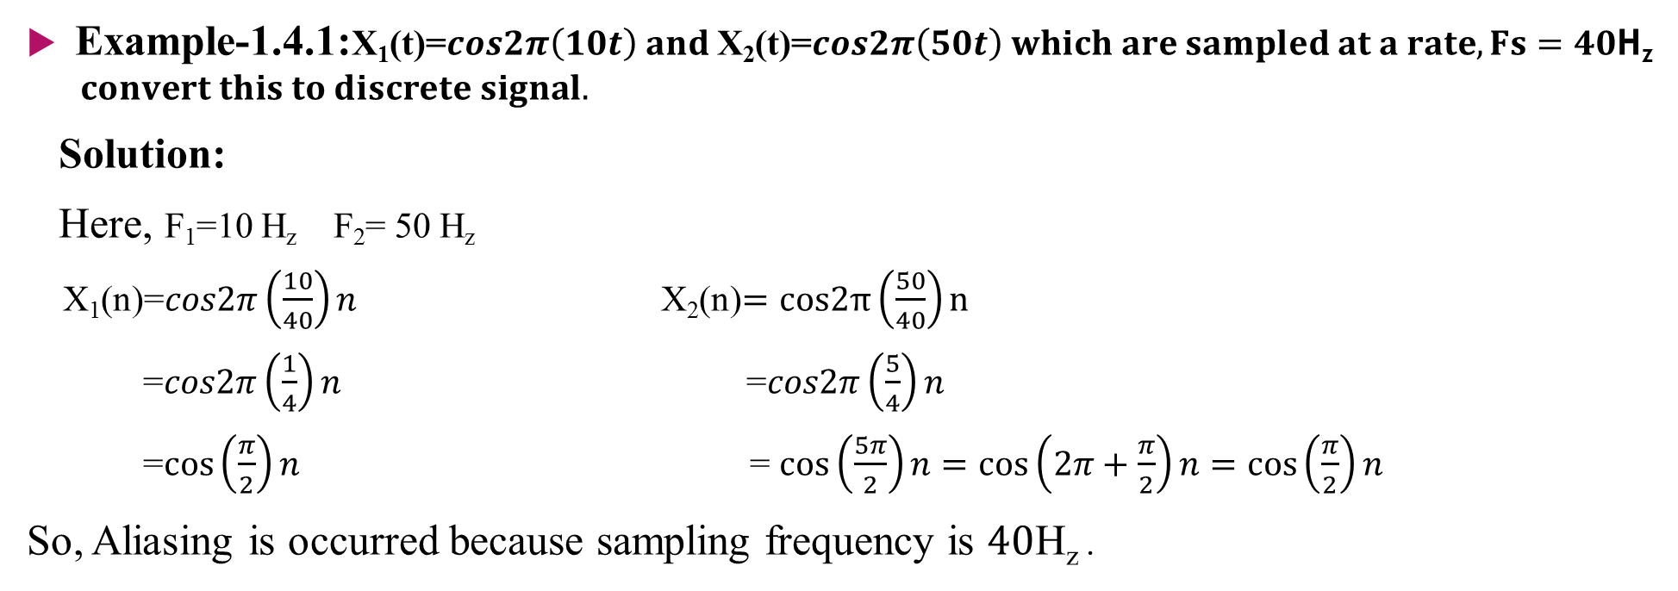
Problems
Example-1.4.1:X₁(t)=$cos2π\left(10t\right) and$X₂(t)=$cos2π\left(50t\right) which are sampled at a rate, Fs=40\text{H}\text{z} convert this to discrete signal.$
Solution:
Here, F₁=10 H_{z} F₂= 50 H_{z}
X₁(n)=$cos2π\left(\frac{10}{40}\right)n$ X₂(n)$=cos2π\left(\frac{50}{40}\right)n$
=$cos2π\left(\frac{1}{4}\right)n$ =$cos2π\left(\frac{5}{4}\right)n$
=$\cos\left(\frac{π}{2}\right)n$ = $\cos\left(\frac{5π}{2}\right)n=\cos\left(2π+\frac{π}{2}\right)n=\cos\left(\frac{π}{2}\right)n$
So, Aliasing is occurred because sampling frequency is $40\text{H}\text{z}$.

Slide 4
Problems
Example-1.4.2: Consider the analog signal, X_{a}(t)=$3cos100πt$
(a) Determine the minimum sampling rate required to avoid aliasing
(b) Suppose that the signal is sampled at the rate Fs= 200 Hz. What is the discrete-time signal obtained after sampling?
(c) Suppose that the signal is sampled at the rate Fs= 75 Hz. What is the discrete-time signal obtained after sampling?
(d) What is the frequency 0<F<Fs/2 of a sinusoid that yields samples identical to those obtained in part (c)?

Slide 5
Problems
Example-1.4.3: Consider the analog signal X_{a}(t)=$3cos50πt+10sin300πt−cos100πt$
What is the Nyquist rate for the signal?
Example-1.4.4: Consider the analog signal X_{a}(t)=$3cos2000πt+5sin6000πt+10cos12000πt$
What is the Nyquist rate for the signal?
Assume now that we sample this signal using a sampling rate Fs= 5000 samples/s. what is the discrete-time signal obtained after sampling?
What is the analog signal Ya(t) we can reconstruct from the samples if we use ideal interpolation?

