Slide 1
Digital Signal Processing
Lecture-4

Slide 2
Overview
Filters
Common Filter Types
Analog vs. Digital Filters
Difference Equation
Difference Equation Diagram Elements
Nonrecursive Difference Equation Diagrams
Recursive Difference Equation Diagrams
Impulse Response
Step Response

Slide 3
Filters
Filters change a signal’s characteristics by selectively removing some of its frequency elements.
A low pass filter, for example, removes the high frequency components of a signal, but passes low frequency components.
It does this because the filter’s gain, the amplification factor it applies to an input, varies with frequency.

Slide 4
Filters
For a low pass filter, the gains are highest at low frequency and much lower at high frequency.
A high pass filter has exactly the opposite shape: its gains are highest at high frequency and lowest at low frequency.
The pass band of a filter determines the range of frequencies that are passed.
The stop band of the filter determines the range of frequencies that are strongly attenuated.

Slide 5
Filters
Cutoff Frequency
A filter is considered to pass signals at frequencies where the filter’s gain exceeds 0.707 of its maximum gain.
The frequency or frequencies where the gain equals 0.707 of the maximum gain are called the cut-off frequencies of the filter.
Since 20log0.707 = -3 dB, they are also called –3 dB frequencies.

Slide 6
Filters
Bandwidth
The bandwidth of a low pass filter is the range of frequencies from 0 to the –3 dB frequency.
For a high pass filter, the bandwidth is the range of frequencies from the –3 dB frequency to half the sampling frequency.
For band pass filters, the bandwidth is the distance in Hz between the cut-off frequencies.

Slide 7
Common Filter Types
Low Pass Filter
_____ Real Filter
….... Ideal Filter

Slide 8
Common Filter Types
High Pass Filter
_____ Real Filter
….... Ideal Filter

Slide 9
Common Filter Types
Band Pass Filter
_____ Real Filter
….... Ideal Filter

Slide 10
Common Filter Types
Band Stop or Notch Filter
_____ Real Filter
….... Ideal Filter

Slide 11
Filters
Roll-Off
Another important feature of a filter is its roll-off.
This characteristic determines how quickly the gain drops outside the pass band.
The higher the order of a digital filter, defined by the number of coefficients needed to specify it, the steeper the slope, and the higher the quality of the filter is said to be.

Slide 12
Filters
Gain
A filter’s gain at a certain frequency determines the amplification factor that the filter applies to an input at this frequency.
A gain may have any value.
In the pass band region, filter’s gain is high.
In the stop band region, filter’s gain is low.

Slide 13

Filters
Gain
The cutoff frequency of the filter occurs when the gain is $\frac{1}{\sqrt{2}}\sim 0.707 or 70.7\%$
A gain in dB is calculated as $Gain\left(dB\right)=20log\left(Gain\right)$

Slide 14
Filters
Bandwidth
Example-1: Find the bandwidth of the band pass filter.
The edges of the pass
Band occur where the
Gain equals 0.707.
The bandwidth of the
Filter is
BW = F_{H} - F_{L}
BW = 4000 - 2000
BW = 2000 Hz

Slide 15
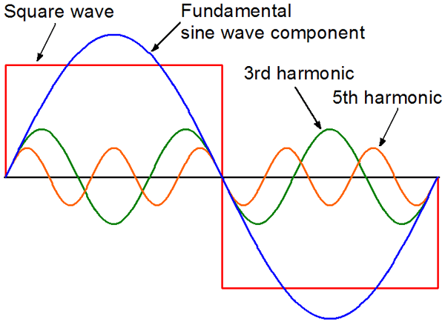
Square Wave
A square wave can be constructed from multiple sine waves at different frequencies.
The sine waves added in addition to the fundamental frequency are called harmonics.
A square wave has harmonics at odd multiples of the fundamental frequency.

Slide 16
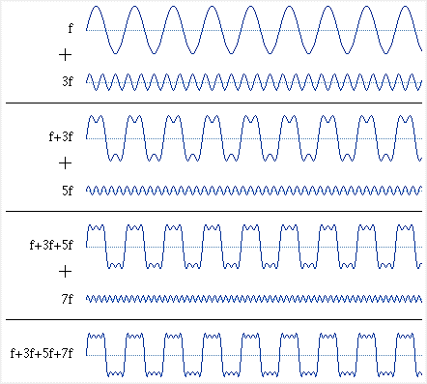
Square Wave
As higher harmonics are added, the result gets closer to an ideal square wave, which contains infinite harmonics.
sin(angle) + sin(3*angle)/3 + sin(5*angle)/5 + sin(7*angle)/7 + ...

Slide 17
Effects of Low Pass Filters
Each filter type has a unique effect on an input signal.
Low pass filters tend to smooth signals by averaging out sudden changes.

Slide 18
Effects of High Pass Filters
Each filter type has a unique effect on an input signal.
High pass filters tend emphasize sharp transition.

Slide 19
Antialiasing Filter

Slide 20
Analog vs. Digital Filters
Filters may be implemented in either analog or digital form.
Analog filters are defined in hardware, while digital filters are defined in software.
In general, digital filters are much less susceptible to noise and component variation than are analog filters.
Furthermore, digital filter re-design is simply a matter of editing a list of coefficients, while analog re-design requires building an entirely new circuit.

Slide 21
Difference Equation
A difference equation is one way to specify a filter or system.
It may be presented in equation or diagram form.
The general form of a difference equation is
a₀y[n] + a₁y[n-1] + a₂y[n-2] + … + a_{N}y[n-N]
= b₀x[n] + b₁x[n-1] + b₂x[n-2] + … + b_{M}x[n-M]
The a_{k} and b_{k} weightings are called filter coefficients.
Generally difference equation has N+1 a_{k} coefficients and M+1 b_{k} coefficients.
N is the past output required, also referred as a filter order.
M is the number of past input required.
The equation defines how each new output y[n] is obtained.
In general, a₀ is assumed to be one.

Slide 22
Difference Equation
The general form of a difference equation is
a₀y[n] + a₁y[n-1] + a₂y[n-2] + … + a_{N}y[n-N]
= b₀x[n] + b₁x[n-1] + b₂x[n-2] + … + b_{M}x[n-M]
The compact form of the recursive difference equation is
In the above equation, both inputs and outputs are needed to compute a new output, so the difference equation is said to be recursive.

Slide 23
Difference Equation
When only inputs are needed to compute a new output, the difference equation is said to be non-recursive, that is,
y[n] = b₀x[n] + b₁x[n-1] + b₂x[n-2] + … + b_{M}x[n-M]
The compact form of the non-recursive difference equation is

Slide 24
Difference Equation
Example-2: A filter has a difference equation y[n] = 0.5y[n-1] + x[n]
Is this a recursive or non-recursive difference equation?
Identify all a_{k} and b_{k} coefficients.
If the input x[n] is u[n], find 5 samples of the output y[n].
Solution
a. The equation is recursive as it depends on a past output y[n-1]
b. Since y[n] – 0.5y[n-1] = x[n], therefore a₀ = 1, a₁ = -0.5, b₀ = 1
c. y[n] = 0.5y[n-1] + x[n]
When n = 0, y[0] = 0.5y[0-1] + x[0] = 0.5(0) + 1 = 1
When n = 1, y[1] = 0.5y[1-1] + x[1] = 0.5(1) + 1 = 1.5
When n = 2, y[2] = 0.5y[2-1] + x[2] = 0.5(1.5) + 1 = 1.75
When n = 3, y[3] = 0.5y[3-1] + x[3] = 0.5(1.75) + 1 = 1.875
When n = 4, y[4] = 0.5y[4-1] + x[4] = 0.5(1.875) + 1 = 1.9375
Y[n] = {1, 1.5, 1.75, 1.875, 1.9375}

Slide 25
Difference Equation
Y[n] = {1, 1.5, 1.75, 1.875, 1.9375}

Slide 26
Difference Equation Diagram Elements
Delay Element

Slide 27
Difference Equation Diagram Elements
Coefficient Multiplier Element

Slide 28
Difference Equation Diagram Elements
Summer Element

Slide 29
Nonrecursive Difference Equation Diagram
The general form of the nonrecursive difference equation is
y[n] = b₀x[n] + b₁x[n-1] + b₂x[n-2] + … + b_{M}x[n-M]
It can be schematically presented as

Slide 30
Finite Word Length Effects
When difference equations are implemented by a computer, quantization means that filter coefficients cannot be represented perfectly.
This means that filter behavior will not match the design exactly.
Furthermore, computer arithmetic is always subject to rounding and truncation errors, again due to the limited number of bits available.
All of these effects are called finite word length effects.

Slide 31
Nonrecursive Difference Equation Diagram
In order to reduce quantization error of filter’s coefficient one strategy is to break higher order filter into second order chunks
Figure: Cascaded second order nonrecursive filter sections

Slide 32
Nonrecursive Difference Equation Diagram
Example-3: Draw a diagram for the difference equation
y[n] = 0.5x[n] + 0.4x[n-1] - 0.2x[n-2]
Solution

Slide 33
Nonrecursive Difference Equation Diagram
Example-4: Write the difference equation of the following diagram.
Solution
y[n] = x[n] - 0.3x[n-2] + 0.7x[n-3]

Slide 34
Recursive Difference Equation Diagram
The general form of a recursive difference equation is
a₀y[n] + a₁y[n-1] + a₂y[n-2] + … + a_{N}y[n-N]
= b₀x[n] + b₁x[n-1] + b₂x[n-2] + … + b_{M}x[n-M]

Slide 35
Recursive Difference Equation Diagram
Example-5: Draw a direct form I diagram for the following recursive difference equation
y[n] + 0.5y[n-2] = 0.8x[n] + 0.1x[n-1] - 0.3x[n-2]
Solution

Slide 36
Recursive Difference Equation Diagram
Example-6: Write the difference equation of the following diagram.
Solution
y[n] + 0.5y[n-2] = 0.8x[n] + 0.1x[n-1] - 0.3x[n-2]

Slide 37
Recursive Difference Equation Diagram
In direct form I realization, calculation for output y[n] require
M + 1 input states
N output states
M + N + 1 coefficient multiplications
M + N additions
When more than 2 or 3 delays are needed, this realization is very sensitive to the finite word length effects.

Slide 38
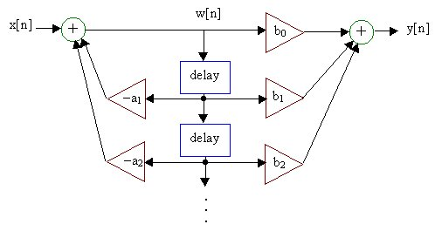
Recursive Difference Equation Diagram
Recursive filters have an alternative representation, called direct form 2, that has certain advantages for implementation.
This representation is defined by the pair of equations
w[n] = x[n] – a₁w[n-1] – a₂w[n-2] – … – a_{N}w[n-N]
y[n] = b₀w[n] + b₁w[n-1] + b₂w[n-2] + … + b_{M}w[n-M]

Slide 39
Recursive Difference Equation Diagram
Transpose of the direct form 2 realization is an another popular implementation model.

Slide 40
Recursive Difference Equation Diagram
Example-7: Write the difference equation of the following diagram.
The output of the bottom summer is 0.1x[n] – 0.3y[n]
The output of the middle summer is 0.1x[n-1] – 0.3y[n-1] + 0.2x[n] – 0.2y[n]
The final out top summer is y[n] = 0.1x[n-2] – 0.3y[n-2] + 0.2x[n-1] – 0.2y[n-1] + 0.8x[n]

Slide 41
Impulse Response
The impulse response h[n] is an important way of characterizing a filter or system.
By definition, it is the system’s response to an impulse function input δ[n].

Slide 42
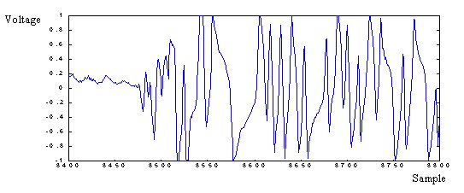
Impulse Response
For a musical instrument like a piano, an impulse response corresponds to the note obtained by striking a single key.

Slide 43
Impulse Response
The impulse response may be calculated from a system’s difference equation.
The impulse function δ[n] substitutes for the input x[n]
The impulse response h[n] substitutes for the output y[n]

Slide 44
Impulse Response
For a non-recursive system, the impulse response is
h[n] = b₀δ[n] + b₁δ[n-1] + b₂δ[n-2] + … + b_{M}δ[n-M]
For a recursive system, the impulse response is
h[n] = – a₁h[n-1] – a₂h[n-2] – … – a_{N}h[n-N]
+ b₀δ[n] + b₁δ[n-1] + b₂δ[n-2] + … + b_{M}δ[n-M]

Slide 45
Impulse Response
Because non-recursive systems do not rely on past outputs, they have finite impulse responses, which return to zero after a finite number of samples have elapsed.
Recursive systems, on the other hand, have infinite impulse responses, because each new output depends on past outputs as well as inputs.
For causal systems, both non-recursive and recursive, the impulse response h[n] is zero for n < 0.

Slide 46
Impulse Response
Example-8: Find the first six samples of the impulse response h[n] for the difference equation
Y[n] – 0.4y[n-1] = x[n] – x[n-1]
Solution
The impulse response of the difference equation is
h[n] – 0.4h[n-1] = δ[n] – δ[n-1]
So the first six samples of the impulse response are
h[0] = 1 h[3] = -0.096
h[1] = -0.6 h[4] = -0.0384
h[2] = -0.24 h[5] = -0.01536

Slide 47
Impulse Response
So the first six samples of the impulse response are
h[0] = 1 h[3] = -0.096
h[1] = -0.6 h[4] = -0.0384
h[2] = -0.24 h[5] = -0.01536
h[n] = [1, 0.6, -0.24, -0.096, -0.0384, -0.01536]

Slide 48
Impulse Response
Example-9: write the difference equation whose impulse response is shown in the figure.
Solution
The impulse response can be written as a sum of impulse functions.
h[n] = δ[n] + 0.8δ[n-1] + 0.2δ[n-2]
The difference equation is y[n] = x[n] + 0.8x[n-1] + 0.2x[n-2]

Slide 49
Impulse Response
Example-10: The input signal x[n] and impulse response h[n] are shown in the figures. Find the output y[n] by breaking the input signal into impulse functions and finding the response to each.

Slide 50
Impulse Response
Y[n] = 3h[n] + 2h[n-1] + h[n-2]

Slide 51
Step Response
The step response s[n] for a filter is its response to a step input u[n].
It records the response of the system to a change in level, and may be calculated in two ways.
The first way mimics that for the impulse response, but with s[n] replacing y[n] and u[n] replacing x[n].

Slide 52
Step Response
For non-recursive systems,
s[n] = b₀u[n] + b₁u[n-1] + b₂u[n-2] + … + b_{M}u[n-M]
For recursive systems,
s[n] = – a₁s[n-1] – a₂s[n-2] – … – a_{N}s[n-N]
+ b₀u[n] + b₁u[n-1] + b₂u[n-2] + … + b_{M}u[n-M]

Slide 53
Step Response
The step function u[n] is equivalent to a sum of impulse functions:
u[n] = δ[n] + δ[n-1] + δ[n-2] + …
The step response s[n] is the same sum of impulse responses:
s[n] = h[n] + h[n-1] + h[n-2] + …

Slide 54
Step Response
The second way to compute the step response s[n] relies on the impulse response.
each step response sample is a cumulative sum of the impulse response samples.
For example
s[4] = h[4] + h[3] + h[2] + h[1] + h[0]

Slide 55
Step Response
Example-11: Find the first eight samples of the step response s[n] for the difference equation
Y[n] – 0.2y[n-1] = 0.5x[n] + 0.3x[n-1]
Solution
The step response s[n] of the difference equation is
s[n] – 0.4s[n-1] = u[n] – u[n-1]
So the first eight samples of the step response are
s[0] = 0.5 s[3] = 0.96 s[6] = 0.996
s[1] = 0.8 s[4] = 0.98 s[7] = 0.9984
s[2] = 0.9 s[5] = 0.992

Slide 56
Step Response
So the first eight samples of the step response are
s[0] = 0.5 s[3] = 0.96 s[6] = 0.996
s[1] = 0.8 s[4] = 0.98 s[7] = 0.9984
s[2] = 0.9 s[5] = 0.992
S[n] = [0.5, 0.8, 0.9, 0.96, 0.98, 0.992, 0.996, 0.9984]

