Slide 1

Lecture-10: Discrete Fourier transform(DFT)
Synthesis Equation:
$x\left(n\right)= \sum_{k=0}^{N−1}{\text{C}\text{k} }e^{j2πkn/N}$
Analysis Equation:
$\text{C}\text{k}$ = $\frac{1}{N}$ $\sum_{n=0}^{N−1}{\text{C}\text{k} }e^{−j2πkn/N}$

Slide 2
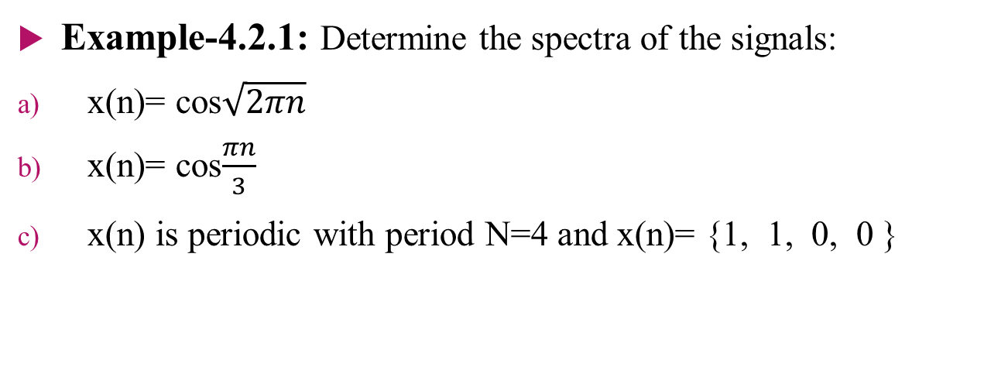
Problems
Example-4.2.1: Determine the spectra of the signals:
x(n)= cos$\sqrt{2πn}$
x(n)= cos$\frac{πn}{3}$
x(n) is periodic with period N=4 and x(n)= {1, 1, 0, 0 }

Slide 3

Solution:
N= 4, 4 point DFT,
x(n)= {1, 1, 0, 0 }
$\text{C}\text{k}$ = $\frac{1}{N}$ $\sum_{n=0}^{N−1}{ \text{x}\text{(}\text{n}\text{)}e^{−j2πkn/N}}$
= $\frac{1}{4 }$ $\sum_{n=0}^{3}{x(n)}e^{−j2πkn/4}$
= $\frac{1}{4 }$ (1. $e^{0}$+ 1. $e^{−\frac{jπk}{2}}$)
= $\frac{1}{4 }$ (1+ $e^{−\frac{jπk}{2}}$)
So, C₀ =$\frac{1}{4 }$ (1+1)= 2/4= ½ Here, k=0
C₁ =$\frac{1}{4 }$ (1+ $e^{−\frac{jπ}{2}}$)
= $\frac{1}{4 }$(1+cos$\frac{π}{2} −jsin\frac{π}{2}$)
= $\frac{1}{4 }\left(1−0−j\right)$ k=1
= $\frac{1}{4 }$(1-j)= $\frac{1}{4 } −j\frac{1}{4 }$

Slide 4
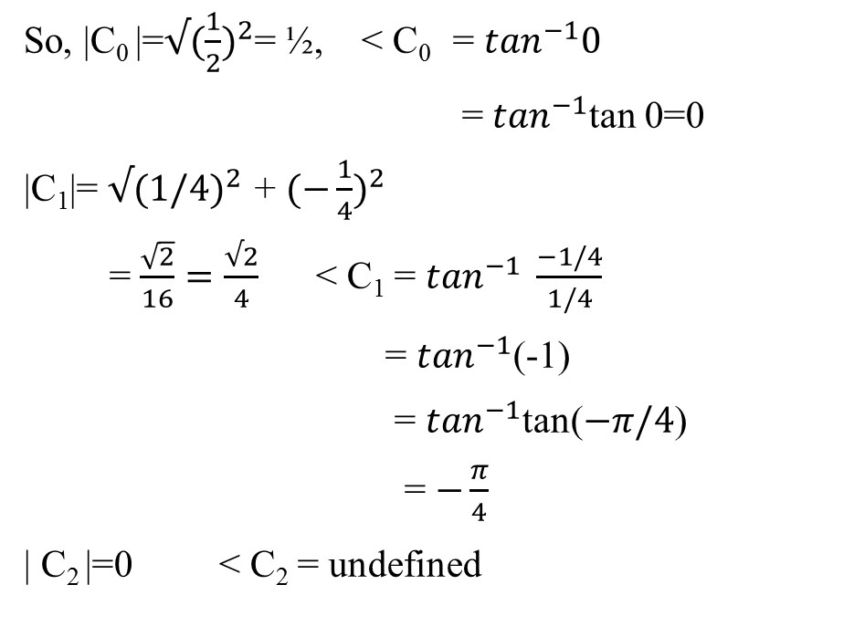

C₂ = $\frac{1}{4 }$(1+ $e^{−jπ}$)
= $\frac{1}{4 }$(1+cos $π−jsinπ$)
= $\frac{1}{4 }$(1-1)=0
C₃ = $\frac{1}{4 }$(1+ $e^{−jπ3/2}$)
=$\frac{1}{4 }$(1+$cos3π/2−jsin3π/2$)
=$\frac{1}{4 }$(1+j)
So, |C₀ |=$√{(\frac{1}{2})}^{2}$= ½, < C₀ = $\tan^{−1}0$
= $\tan^{−1}$tan 0=0
|C₁|= $√{(1/4)}^{2 }$+ ${(−\frac{1}{4})}^{2}$
= $\frac{\sqrt{2}}{16}=\frac{√2}{4}$ < C₁ = $\tan^{−1} \frac{−1/4}{1/4}$
= $\tan^{−1}$(-1)
= $\tan^{−1}$tan($−π/4$)
= $−\frac{π}{4}$
| C₂ |=0 < C₂ = undefined

Slide 5


|C₃|= $√{(1/4)}^{2}+{(1/4)}^{2}$
= $\frac{√2}{4}$ < C₃ = $\tan^{−1}\frac{1/4}{1/4}$
= $\tan^{−1}$1
= $\tan^{−1}$tan $\frac{π}{4}$= $\frac{π}{4}$
So, | C₀ | = ½ , < C₀ =0
|C₁| = $\frac{√2}{4}$ , < C₁ = $−\frac{π}{4}$
| C₂ | = 0 , < C₂ = undefined
|C₃|= $\frac{√2}{4}$ , < C₃ = $\frac{π}{4}$

Slide 6
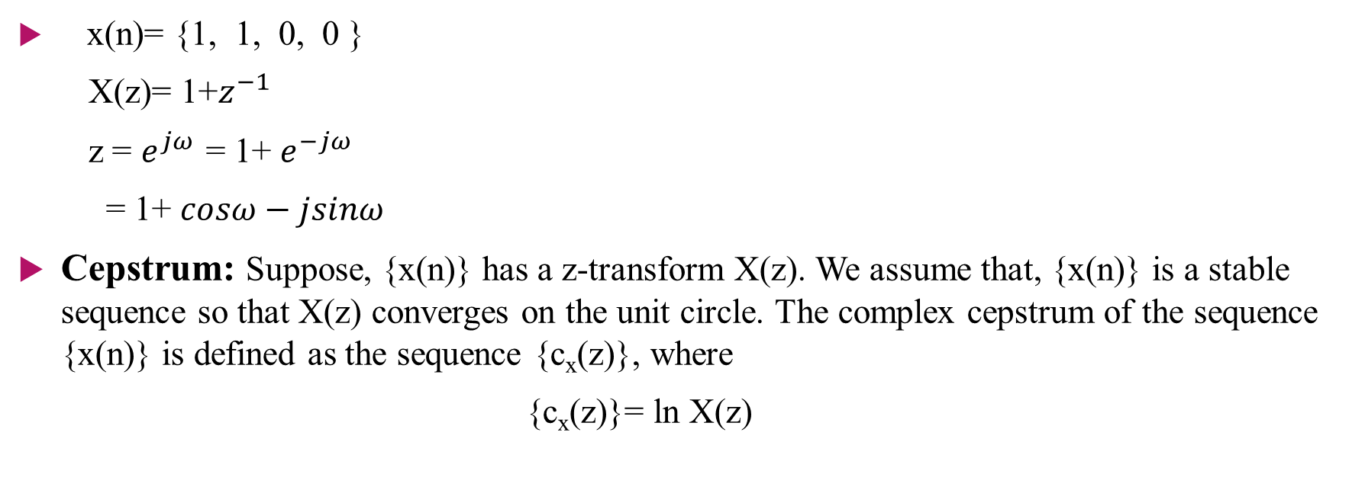
Relationship of the Fourier Transform to Z-Transform
x(n)= {1, 1, 0, 0 }
X(z)= 1+$z^{−1}$
z = $e^{jω }$= 1+ $e^{−jω }$
= 1+ $cosω−jsinω$
Cepstrum: Suppose, {x(n)} has a z-transform X(z). We assume that, {x(n)} is a stable sequence so that X(z) converges on the unit circle. The complex cepstrum of the sequence {x(n)} is defined as the sequence {c_{x}(z)}, where
{c_{x}(z)}= ln X(z)

Slide 7
Problem
Example-4.2.5: Determine the Fourier transform of the following signals,
x₁ (n)= u(n)
x₂ (n)= ${(−1)}^{n}$ u(n)
x₃ (n)= (cos $ω$₀n) u(n)

