Slide 1
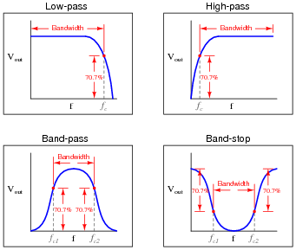
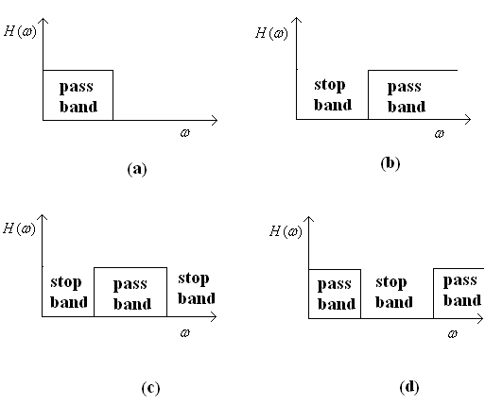
Lecture-11: Filters
Ideal Filter Characteristics:
Low pass filter
High pass filter
Band pass filter
Band stop filter

Slide 2
Chapter-7: Implementation of discrete-time system
Finite Impulse Response (FIR) filters: The filters which have an impulse response containing only a finite number of values are commonly called finite impulse response(FIR) filters.
Structure For Finite Impulse Response (FIR) Systems:
Direct-form structure
Cascade-form structure

Slide 3
Direct-Form Structure of FIR Filters
The direct-form realization follows from the convolution summation:
$y\left(n\right)=\sum_{k=0}^{L−1}{h\left(k\right)x(n−k)}$
The structure is illustrated below:
Figure: Direct-form realization of FIR system

Slide 4
Here, the structure requires L-1 memory locations for storing the L-1 previous inputs and has a complexity of L multiplications and L-1 additions per output point. Since the output consists of a weighted linear combination of L-1 past values of the input and weighted current value of the input, the structure resembles a tapped delay line or a transversal system. So, the direct-form realization is often called a transversal or tapped-delay-line filter.

Slide 5
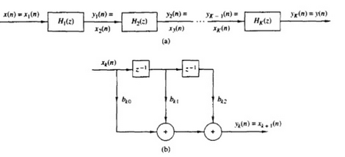
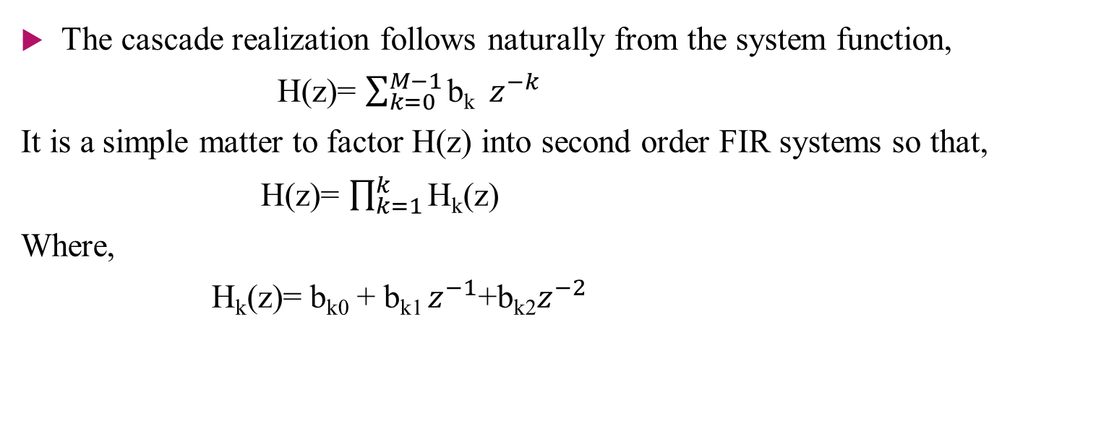
Cascade-form structure of FIR system
The cascade realization follows naturally from the system function,
H(z)= $\sum_{k=0}^{M−1}{\text{b}\text{k} }z^{−k}$
It is a simple matter to factor H(z) into second order FIR systems so that,
H(z)= $\prod_{k=1}^{k}{\text{H}\text{k}\text{(}\text{z}\text{)}}$
Where,
$\text{H}\text{k}\text{(}\text{z}\text{)}$= b_{k0} + b_{k1} $z^{−1}$+b_{k2}$z^{−2 }$

Slide 6
Infinite Impulse Response (IIR)
Infinite Impulse Response (FIR) filters: The filters which have an impulse response of infinite length are called infinite impulse response(IIR) filters.
Structure For Infinite Impulse Response (IIR) Systems:
Direct-form structure
Cascade-form structure

Slide 7
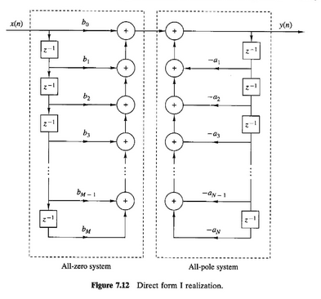
Direct-Form Structure of IIR Filters

