Slide 1
EEE-315
Communication Engineering-I
Course Teacher
Md.Sohel Rana
Lecturer,Dept. of EEE
Email:sohel.eee@diu.edu.bd
Phone:01736723130

Slide 2
Course Contents
Credit(s): 3.0
Pre-requisite(s): EEE 227 (Signal and System)
Overview of communication systems: basic principles, fundamental elements, system limitations, message source, bandwidth requirements, transmission media types, transmission capacity.
Noise: sources of noise, characteristics of various types of noise and SNR, mathematical representation of noise: spectral components of noise, superposition of noise, linear filtering, noise bandwidth
Continuous wave modulation: baseband transmission, carrier transmission;
Amplitude modulation(AM): SSB,VSB, spectral analysis, envelope and synchronous detection.
Frequency modulation(FM): frequency modulation(FM),phase modulation, spectral analysis, demodulation of FM and PM signals, noise in amplitude modulation systems, noise in frequency modulation systems.
Sampling : sampling theorem, Nyquist criteria, frequency aliasing, instantaneous and natural sampling.
Analog-to-digital conversion: pulse-amplitude modulation, quantization of signals, pulse-code modulation, non-uniform quantization, multiplexing PCM signals, differential PCM, delta modulation, adaptive delta modulation, noise in pulse code and delta modulation systems.
Course Contents

Slide 3
Digital modulation technique: ASK, FSK, BPSK, differential PSK, QPSK, M-ary PSK, M-ary PSK, minimum shift keying (MSK).
Multiplexing: Time-division multiplexing (TDM)- principle, receiver synchronization, frame synchronization, TDM of multiple bit rate systems; frequency-division multiplexing (FDM)- principle, demultiplexing. PDH, SONET/SDH.
Multiple-access techniques: Time-division multiple-access (TDMA), frequency-division multiple access (FDMA); code-division multiple access (CDMA) - spread spectrum multiplexing, coding techniques and constraints of CDMA.
Ref. Book:
1.Modern Digital ad Analog Communication Systems. B.P. Lathi
2.Electronic Communication System . Kennedy and Davis

Slide 4
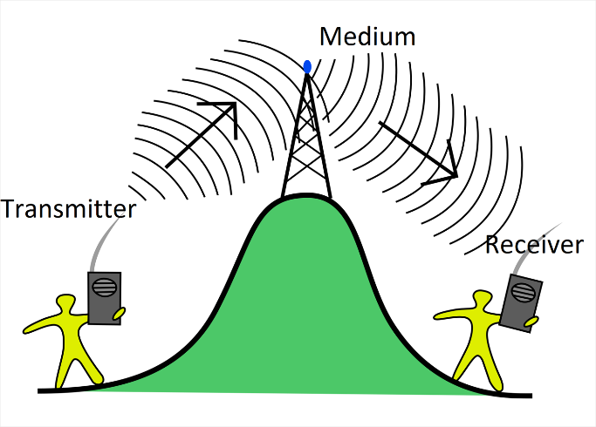
Communication Engineering concerned with the sending and receiving of signals especially by means of electrical devices and electromagnetic waves.

Slide 5
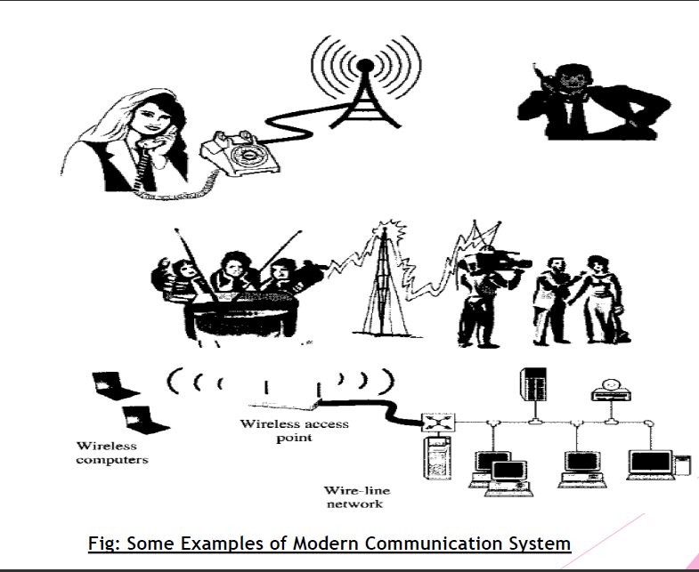

Slide 6
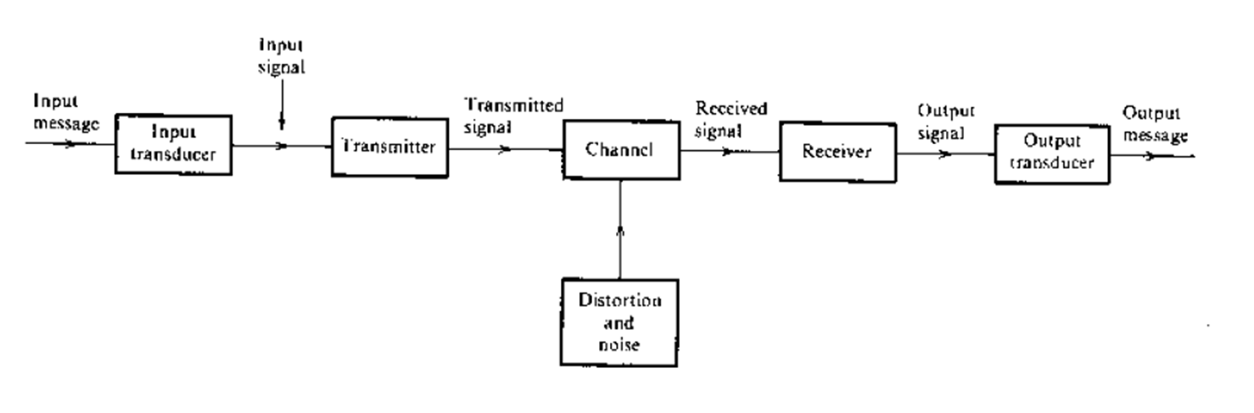
Modern Communication System

Slide 7
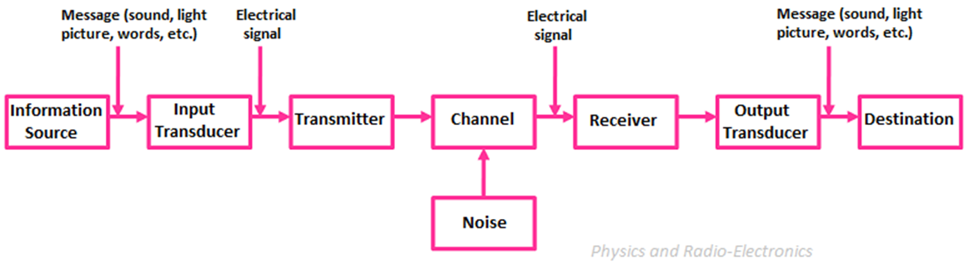
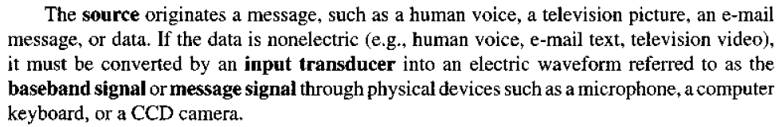
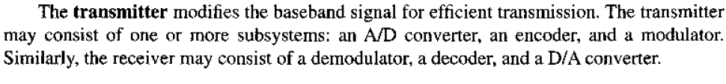
Modern Communication System
Source & Input Transducer
Transmitter

Slide 8
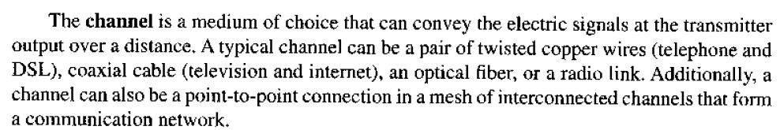
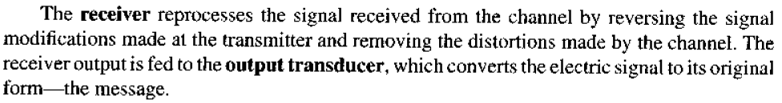
Channel
Receiver & Output Transducer

Slide 9
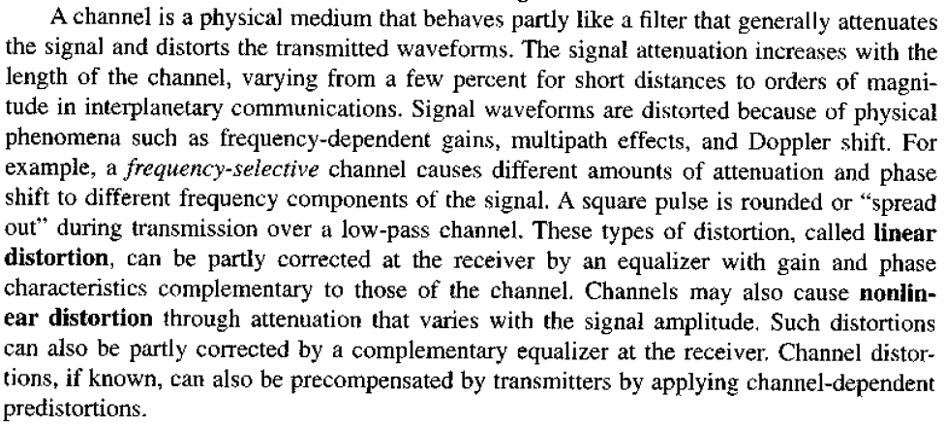
Distortion

Slide 10
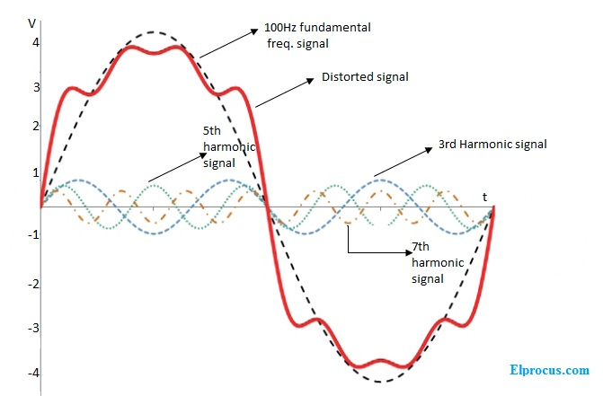

Slide 11
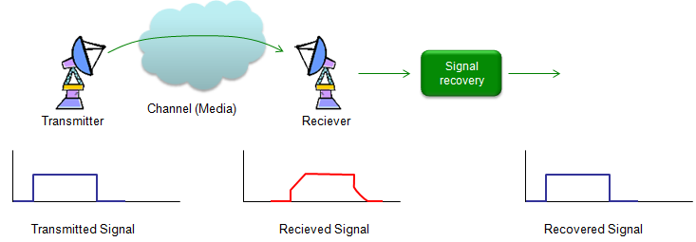

Slide 12
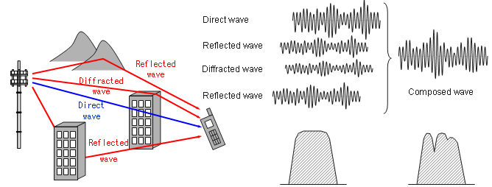

Slide 13
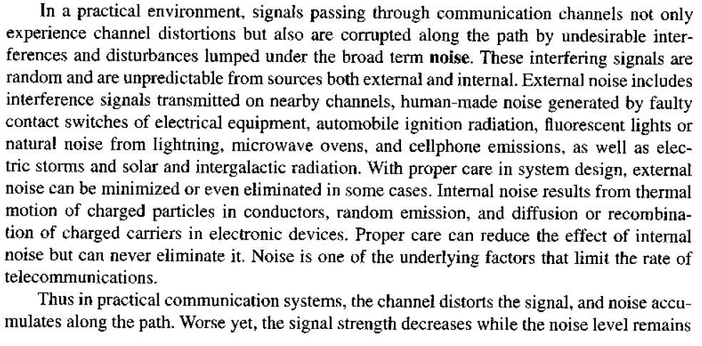
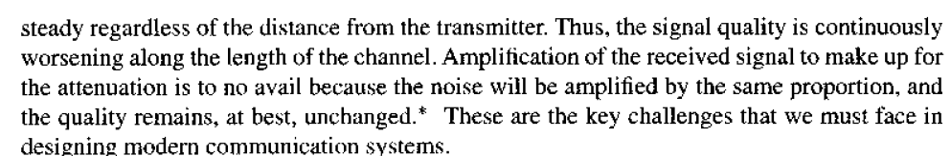
Noise

Slide 14
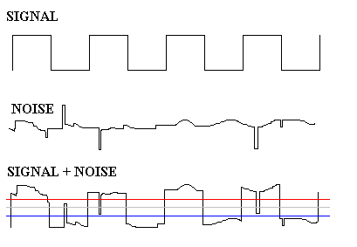

Slide 15
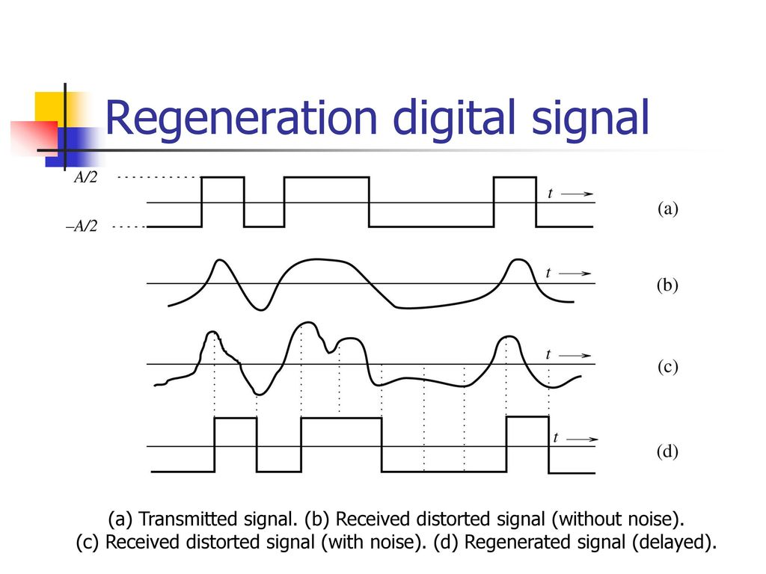

Slide 16
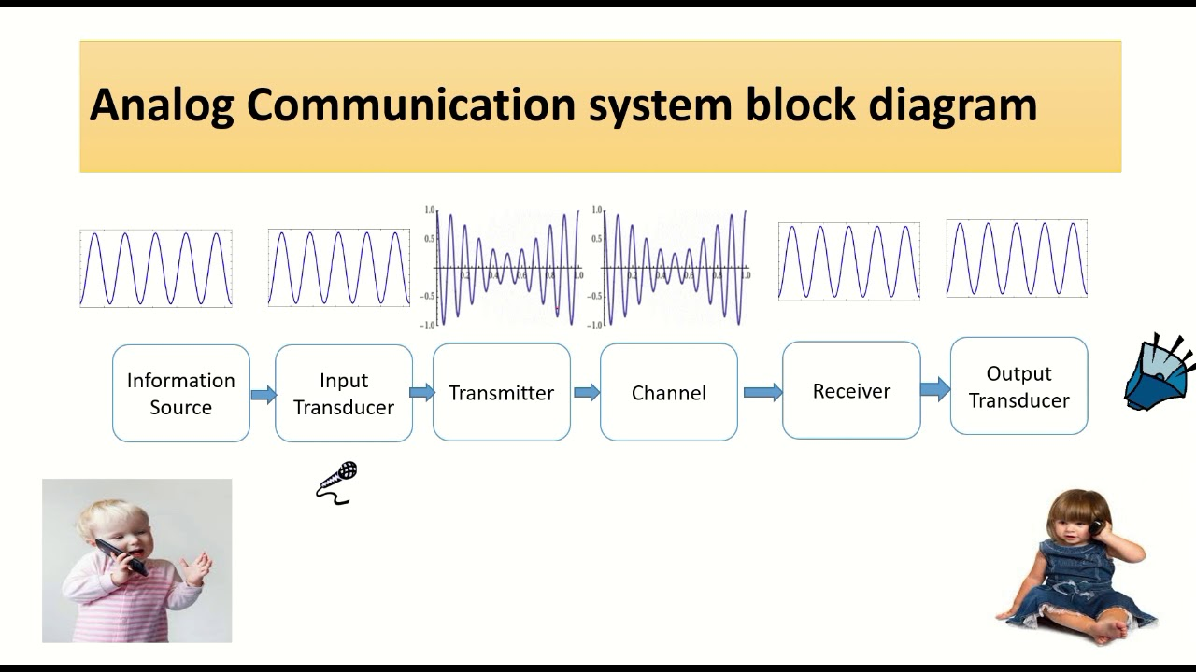

Slide 17
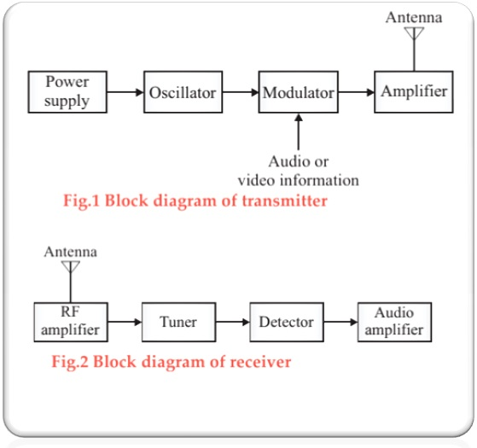

Slide 18
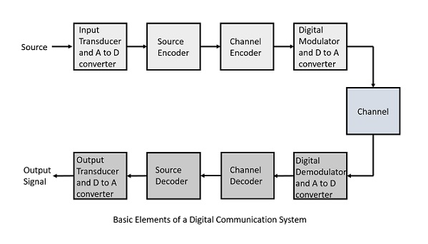
Digital Communication System
A/D Converter: Analog to Digital Converter
D/A Converter: Digital to Analog Converter

Slide 19
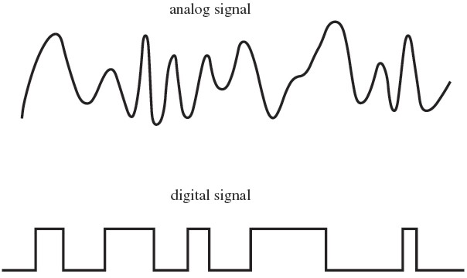

Slide 20
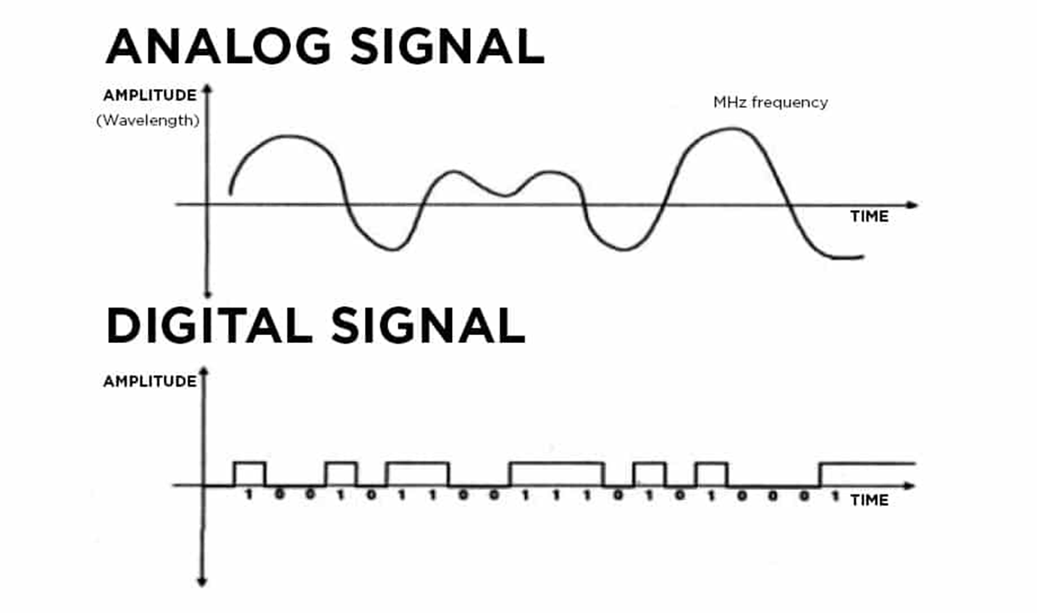

Slide 21
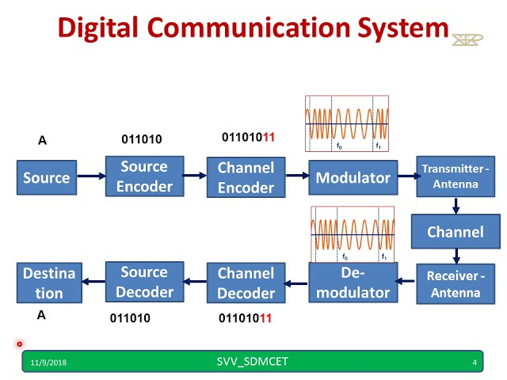

Slide 22

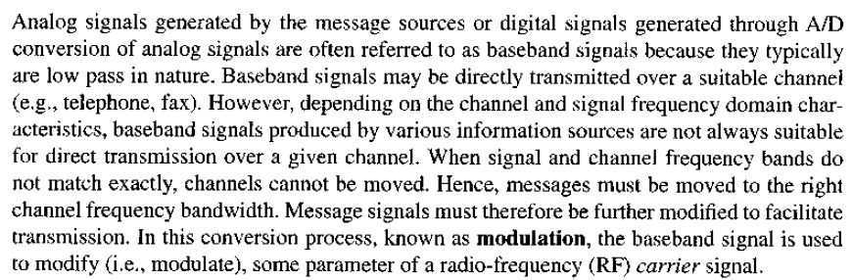
Modulation is a part of Transmission which is done in Transmitter before Message Signal Transmission through Communication Channel

Slide 23
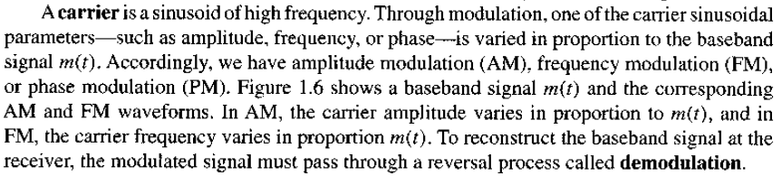

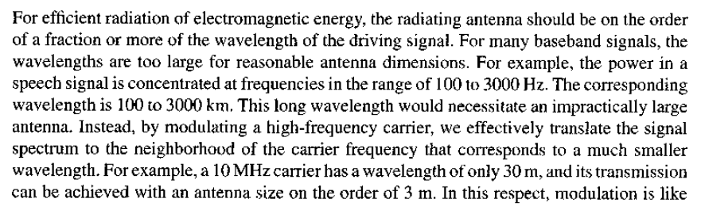
Carrier
Reason For Modulation

Slide 24
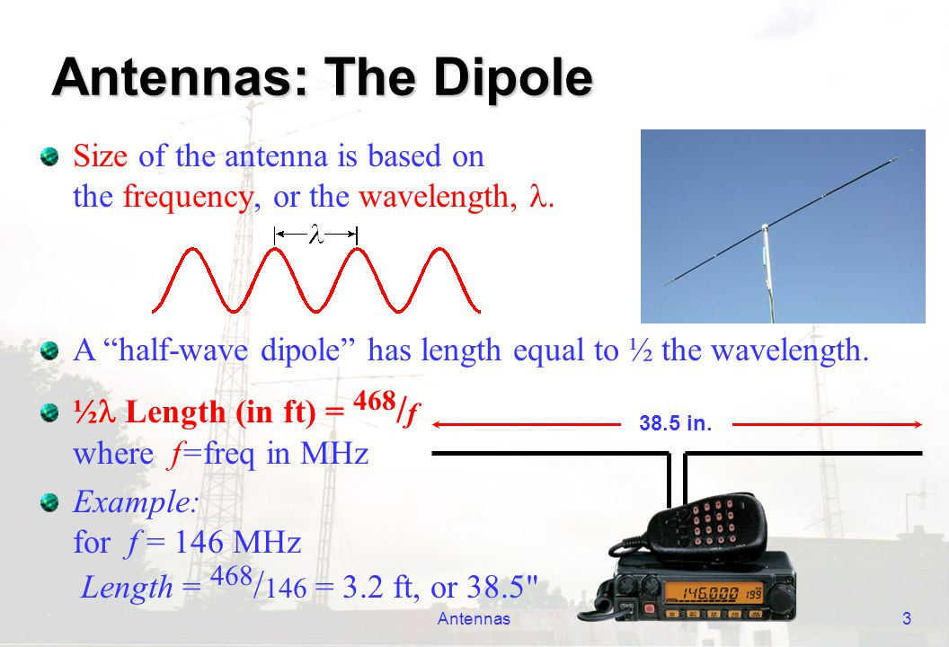

Slide 25
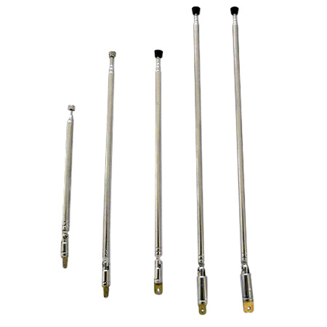
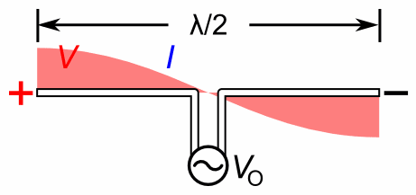

Slide 26
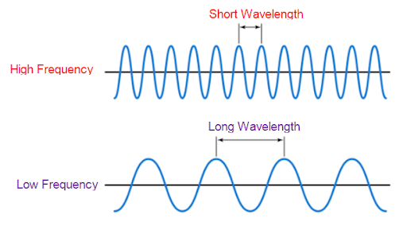
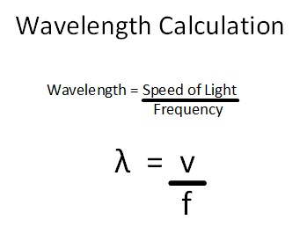

Slide 27
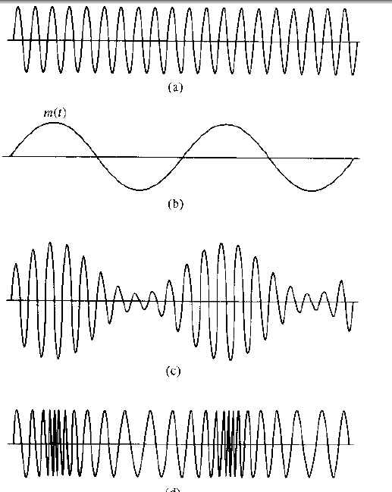
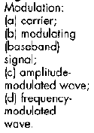
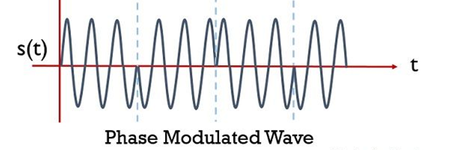
Modulated Signal

Slide 28
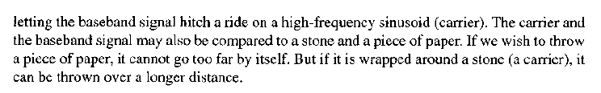

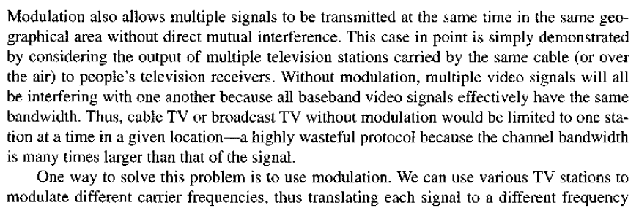

Slide 29
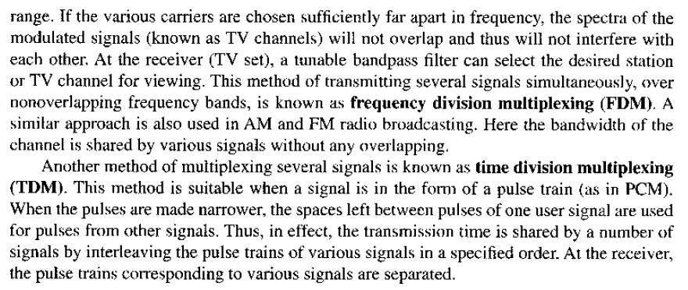

Slide 30
Frequency division multiplexing (FDM)
Frequency division multiplexing (FDM) is an analog technique that can be applied when the bandwidth of a link is greater than the combined bandwidth of the signals to be transmitted. In FDM, signals generated by each sending device is modulated with different carrier frequencies. These modulated signals are then combined into a single composite signal that can be transported by the link.
Carrier frequencies are separated by sufficient bandwidth to accommodate the modulated signal. Channels can be separated by unused bandwidth guard bands to prevent signals from overlapping. In the demodulator, the original signals are separated from the composite signal through filtering. In addition carrier frequencies must not interfere with the original data frequencies. We consider FDM to be an analog multiplexing technique; however, this does not mean that FDM cannot be used to combine sources sending digital signals. A digital signal can be converted to an analog signal before FDM is used to multiplex them.

Slide 31
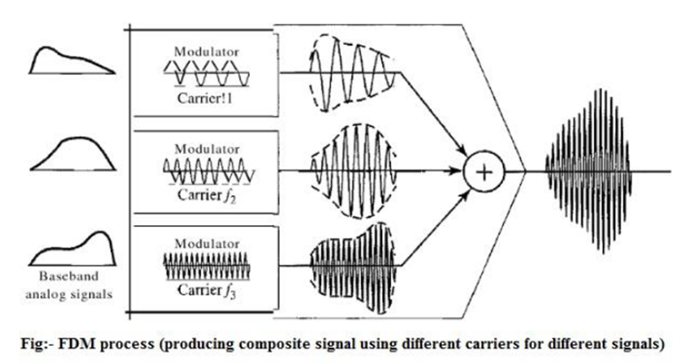

Slide 32
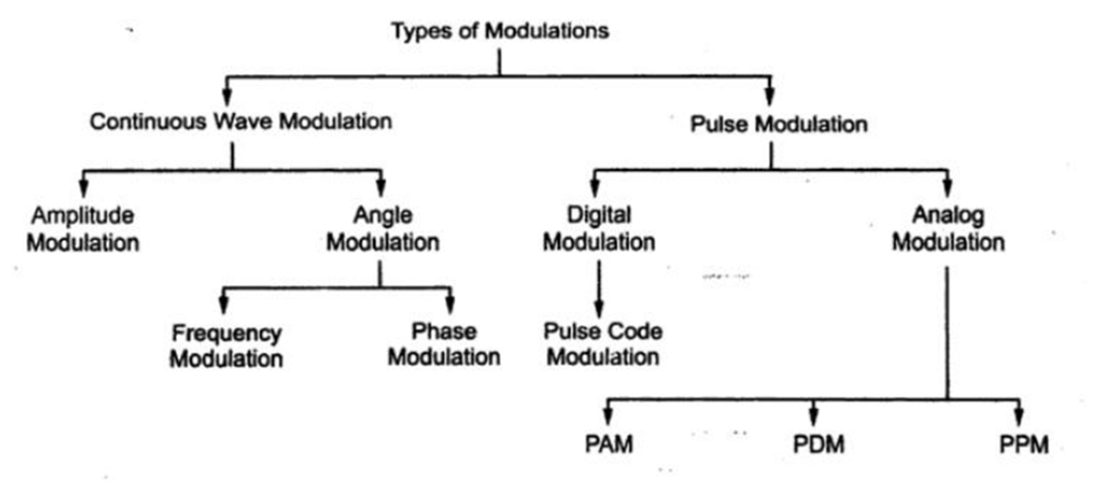

Slide 33
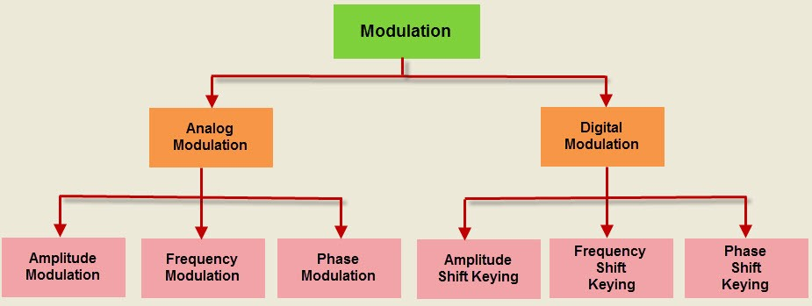

Slide 34
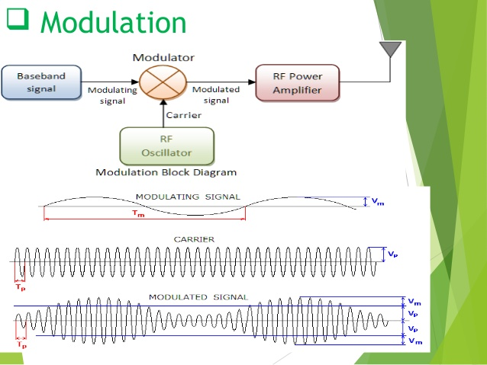

Slide 35
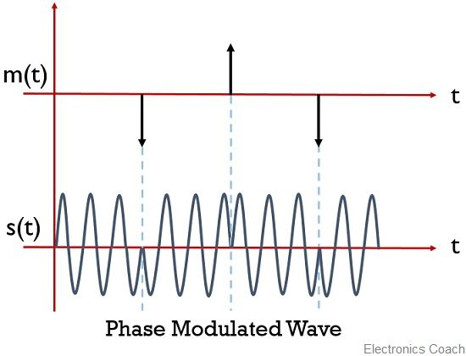

Slide 36

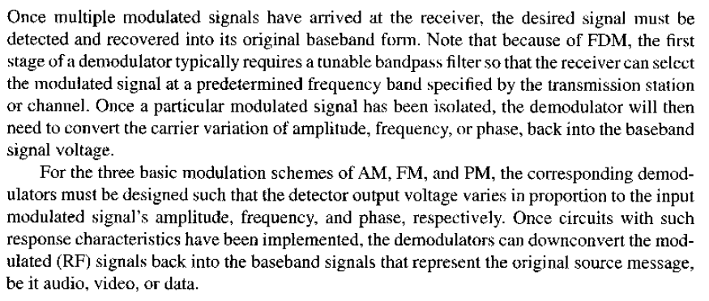

Slide 38
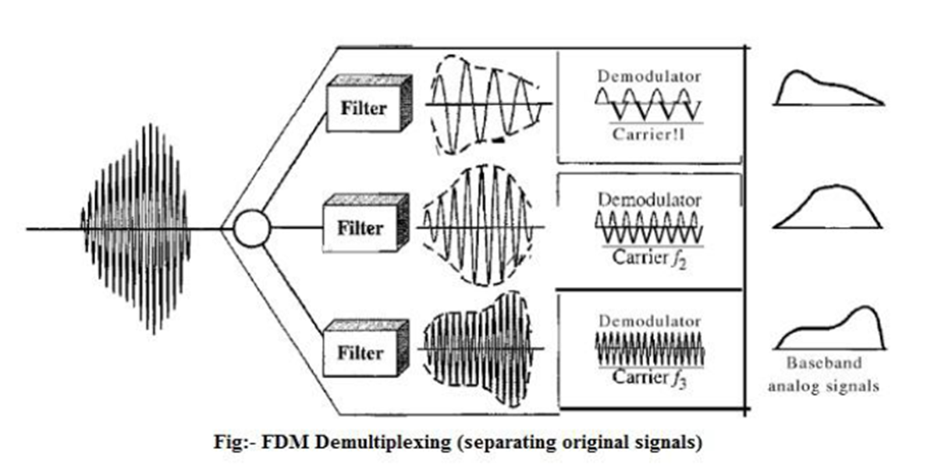

Slide 39
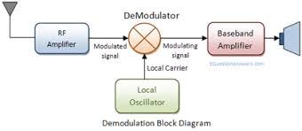

Slide 40
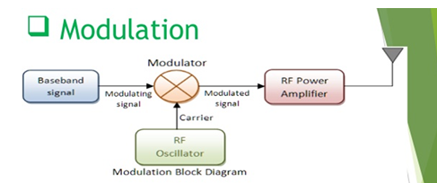

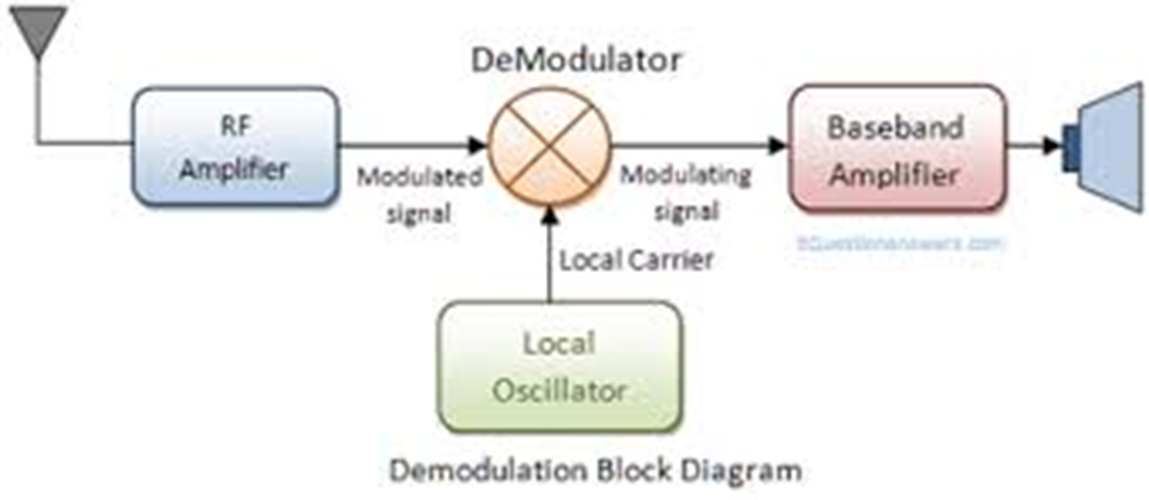

Slide 41
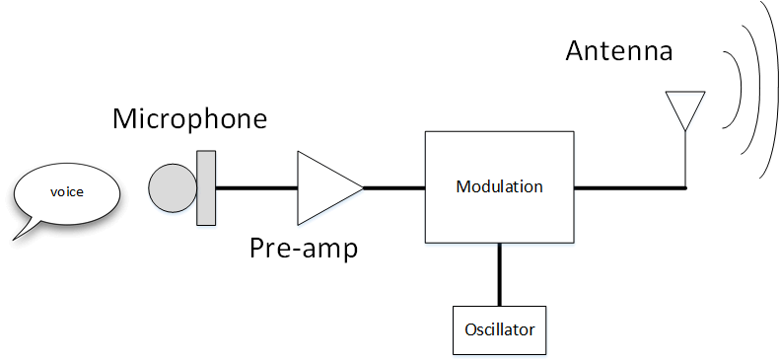

Slide 42
