Slide 1
EEE 333
Power System Analysis
Power Flow Analysis
Prepared by
Dr. Md. Rezwanul Ahsan
Assistant Professor, Dept. of EEE

Slide 2
Lecture Contents
Power Flow Analysis
Gauss-Seidel method of power flow solution

Slide 3
Learning Outcomes
The students will be able to…
Identify type of buses in power system
Develop general equation of power flow solution

Slide 4
Introduction to Power Flow/ Load Flow
Power Flow Studies (Load Flow) is an important part of power system analysis
Necessary for planning, economic scheduling and control of an existing system as well as planning its future expansion
The problem consists of determining the magnitudes and phase angle of voltages at each bus and active and reactive power flow in each line
In solving power flow problem, the system is assumed to be operating under balanced conditions and a single-phase model is used
Four quantities are associated with each bus: voltage magnitude |V|, phase angle θ, real power P and reactive power Q

Slide 5
Introduction to Power Flow/ Load Flow
The system buses are generally classified into three types:-
Slack bus (Swing bus or Reference bus) – one generator at slack bus - is taken as reference where the magnitude voltage (V) and phase angle of the voltage (θ) are specified. This bus makes up the difference between scheduled loads and generated power that caused by the losses in the network
Load buses (P-Q buses) – the reactive and active powers are specified at these buses. The magnitude and the phase angle of the bus voltages are unknown
Regulated buses (Generator buses or P-V buses) – known as voltage-controlled buses. The real power and voltage magnitude are specified. The phase angles of the voltages and reactive power to be determined

Slide 6
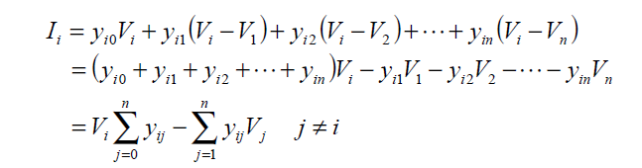
Power Flow Equation
Consider bus of a power system network as shown in figure below. Transmission lines are represented by equivalent π models where impedances have been converted to per unit admittances on a common MVA base
Applying KCL to this bus (bus i) results in
V_{i}
V₁
y_{i1}
V₂
y_{i2}
I_{i}
y_{i3}
V_{n}
y_{i0}

Slide 7
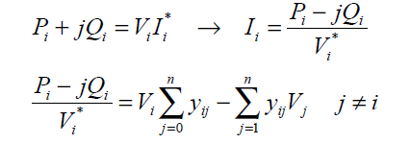
Power Flow Equation
The real and reactive power at bus i is
From this relationship, the mathematical formulation of the power flow problem results in a system of algebraic non-linear equations which must be solved by iterative techniques (like Gauss-Seidel, Newton-Raphson etc.)

Slide 8

Gauss-Seidel Power Flow Solution
In power flow study, it is essential to solve the set of non-linear equations for two unknown variables at each node
In Gauss-Seidel method, V_{i} is solved and the iterative sequences become:
where, y_{ij} shown in lowercase letters is the actual admittance in per unit
P_{i}^{sch} and Q_{i}^{sch} are the net real and reactive powers in per unit

Slide 9


Gauss-Seidel Power Flow Solution
In KCL, current entering bus i was assumed positive. Thus, for buses where real and reactive powers are injected into the bus, such as generator buses, P_{i}^{sch} and Q_{i}^{sch} have positive values
For load buses where real and reactive powers are flowing away from the bus, Pisch and Qisch have negative values

Slide 10
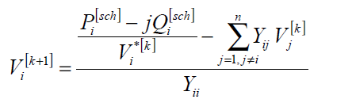
Gauss-Seidel Power Flow Solution
Rewriting the power flow equation in terms of the bus admittance matrix (Y-bus)
Since the off-diagonal elements of the bus admittance matrix Y_{bus} shown by uppercase letters, Y_{ij} = -y_{ij} and the diagonal elements are Y_{ii} = -y_{ij} and the diagonal elements are Y_{ii} = Σy_{ij} becomes

Slide 11
Gauss-Seidel Power Flow Solution
Y_{ii} includes the admittance to ground of life charging susceptance and any other fixed admittance to ground
Since both components (V and θ) are specified for slack bus, there are 2(n-1) equations which must be solved iteratively
Under normal operating conditions, |V| of buses are in neighborhood of 1.0 per unit or close to the |V| of the slack buses
|V| of load buses are lower than the slack bus value, depending on reactive power demand whereas the scheduled voltage at the generator buses are higher
The θ of the load buses are below the reference angle in accordance to power demand whereas θ of the generator buses may be above the reference value depending on the amount of real power flowing into the bus
Thus, for Gauss-Seidel method, an initial voltage estimate of 1.0 +j 0.0 for unknown voltage is satisfactory and the converged solution correlates with actual operating states

Slide 12

Gauss-Seidel Power Flow Solution
For P-Q buses, P_{i}^{sch} and Q_{i}^{sch} are known. Starting with an initial estimate, Vi(k+1) is solved for the real and imaginary components of voltage
For P-V buses, P_{i}^{sch} and |V_{i}| are specified, Q_{i}^{(k+1)}, then used in V_{i}^{(k+1)}
Since |V_{i}| is specified, only imaginary part of V_{i}^{(k+1)} is retained. And its real part is selected in order to satisfy
where e_{i}^{(k+1)} and f_{i}^{(k+1)} are the real and imaginary components of the voltage V_{i}^{(k+1)} in the iterative sequence

Slide 13
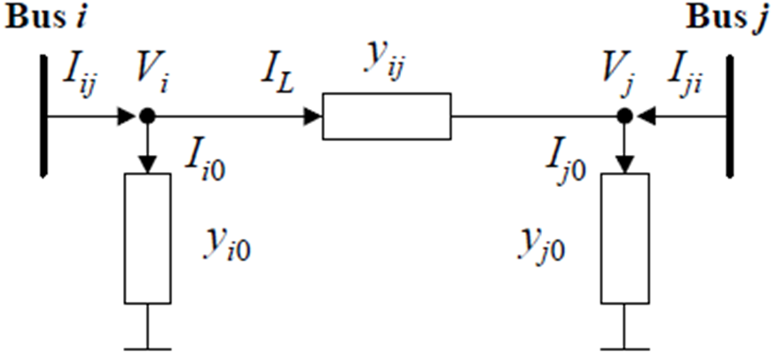

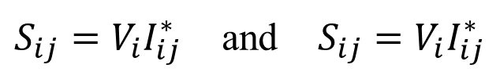
Line Flows and Losses
Consider the line connecting the two buses i and j in Transmission line model below. The line current I_{ij} measured at bus i and defined positive in the direction
i → j given by : $I_{ij}=I_{l}+I_{i0}$= $y_{ij}$($V_{i}$- $V_{j}$)+ $y_{i0}$ $V_{i}$
and, j → i given by : $I_{ji}={−I}_{l}+I_{j0}$= $y_{ij}$($V_{j}$- $V_{i}$)+ $y_{j0}$ $V_{j}$
Then, the complex power S_{ij} from bus i to j and S_{ji} from bus j to i are:
$S_{ij}=V_{i}I_{ij}^{∗}$ and $S_{ij}=V_{i}I_{ij}^{∗}$
The power loss in the line i – j is the algebraic sum of the power flows.
$$S_{L, ij}=S_{ij}+S_{ji}$$

Slide 14
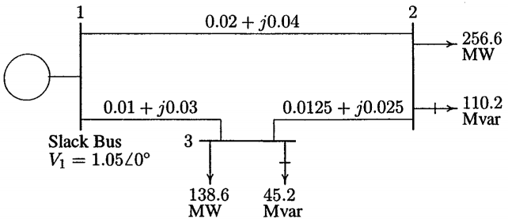
Example 6.7:
Figure below shows the single-line diagram of three-bus power system with generation at bus 1. The scheduled loads at buses 2 and 3 are as marked on the diagram. Line impedances are marked in per unit on 100 MVA base and the line charging susceptances are neglected
Using Gauss-Seidel method, determine the phasor values of the voltage at load buses 2 and 3 (P-Q buses) to 4 decimal places
Find slack bus real and reactive power
Determine the line flows and line losses
Construct a power flow diagram showing the direction of line flow

Slide 15
Example 6.7: Solution
a) Line impedances are converted to admittances

Slide 16
Example 6.7: Solution
Bus 1 is taken as reference bus (slack bus). Starting from an initial estimate of

Slide 17
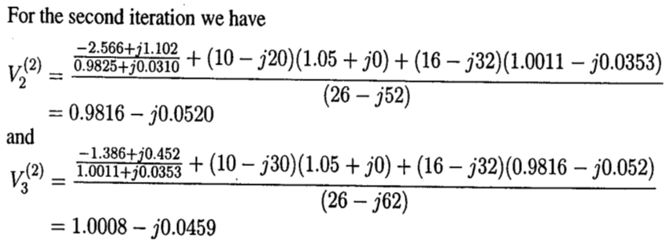
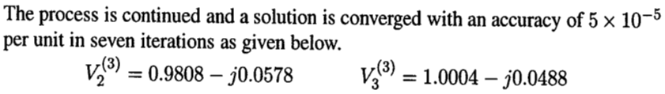
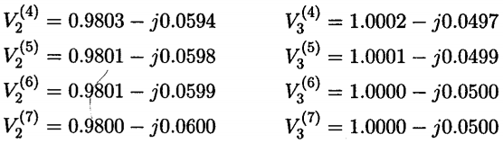
Example 6.7: Solution

Slide 18
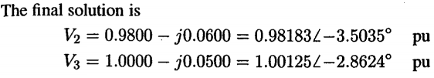
Example 6.7: Solution
(b) The slack bus is:

Slide 19
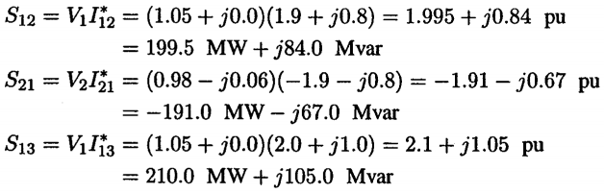
Example 6.7: Solution
(c) To find the line flows, first find the line currents are computed. With the line charging capacitors neglected, the line currents are:
The line flows are:

Slide 20
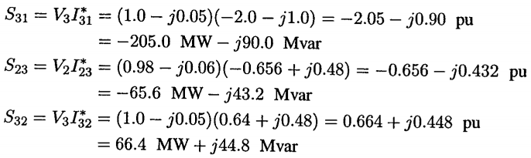
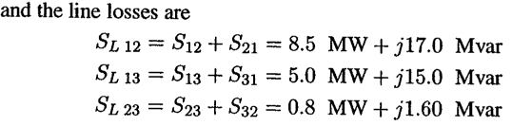
Example 6.7: Solution

Slide 21
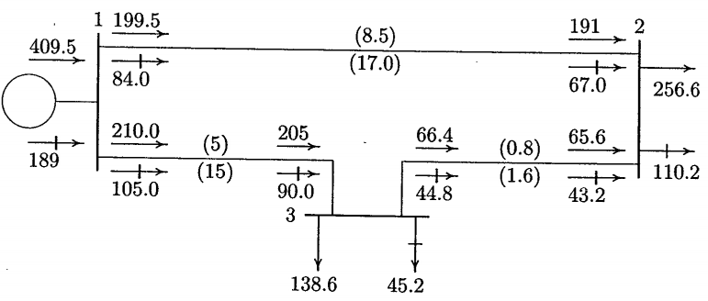
Example 6.7: Solution
(d) The line flows are:

Slide 22
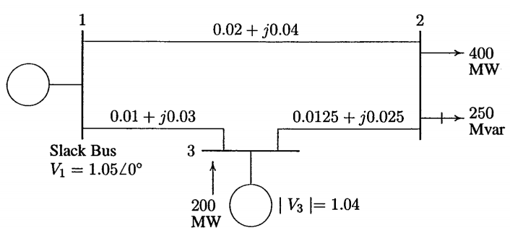
Example 6.8:
Figure below shows the single-line diagram of three-bus power system with generator at buses 1 and 3. The magnitude of voltage at bus 1 is adjusted to 1.05 pu. Voltage magnitude at bus 3 is fixed at 1.04 pu with a real power generation at 200 MW. A load consisting of 400 MW and 250 Mvar is taken from bus 2. Line impedances are marked in per unit on a 100 MVA base and the line charging susceptances are neglected. Obtain the power flow solution by Gauss-Seidel method including line flows and line losses.

Slide 23
Example 6.8: Solution
Line impedances are converted to admittances
Bus 1 is taken as reference bus (slack bus). Starting from an initial estimate of

Slide 24
Example 6.8: Solution
Bus 3 is a regulated bus where voltage magnitude and real power are specified. For the voltage-controlled bus, the first reactive power is:

Slide 25
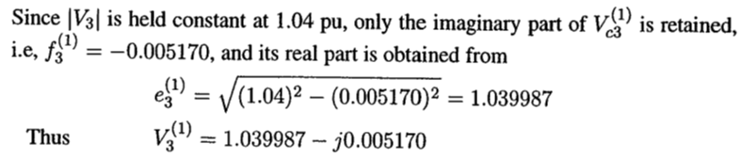
Example 6.8: Solution

Slide 26
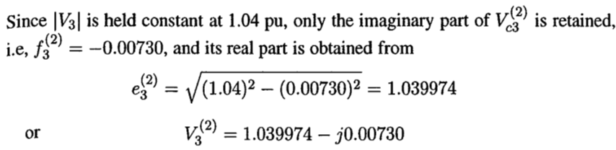
Example 6.8: Solution

Slide 27
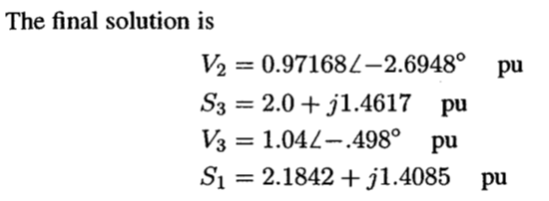
Example 6.8: Solution
Line flows and line losses are computed as below:-

Slide 28
Example 6.8: Solution
The power flow diagram is as below:-

Slide 29
Exercise 1:
Figure 1 shows the single-line diagram of a three-bus power system with generation at bus 1. The voltage at bus 1 is V₁ = 1.025∠0° per unit. The scheduled loads on bus 2 and bus 3 are marked on the diagram. Line impedances are marked in per unit on a 100 MVA base. Line resistances and line charging susceptances are neglected.
a) By using Gauss-Seidel method and initial estimates of V₂⁽⁰⁾=1.0∠0° and V₃⁽⁰⁾=1.3285∠19.8°, find V₂ and V₃. Perform calculation for two iterations.
b) After several iterations, the bus voltages converge to
V₂ = 0.9346 – j0.1159 pu
V₃ = 0.9724 – j0.0604 pu
Determine the line flows and losses and the slack bus real and reactive power.
Figure 1:

Slide 30
Exercise 2:
Figure 2 shows the single-line diagram of three-bus power system with generation at bus 1 and bus 3. The voltage at bus 1 is V1 = 1.0250 p.u. The voltage magnitude at bus 3 is fixed at 1.05 p.u with a real power generation of 250 MW. The scheduled load on bus 2 is marked on the diagram. Line impedances are marked in p.u on a 100-MVA base. Line resistances and line charging susceptances are neglected.
By using Gauss-Seidel method and initial estimates of V₂⁽⁰⁾ = 1.0∠0° and V₃⁽⁰⁾ = 1.05∠0°, determine V₂ and V₃. Perform calculation for one iteration.
Figure 2:

Slide 31


