Slide 1
Chapter 01:
Overview of Emergency Management
Topic to Cover:
Definition of Emergency Management
Four Phases of Emergency Management
Mitigation
Preparedness
Response
Recovery
Emergency Management Cycle
Emergencies and Disasters and the Livestock Industry

Slide 2
A. Definition of Emergency Management
Definition:
At one end of the spectrum, emergencies are usually small scale, localized incidents which are resolved quickly using local resources. However, small-scale emergencies can escalate into disasters when there has been inadequate planning and wasteful use of resources.

Slide 3
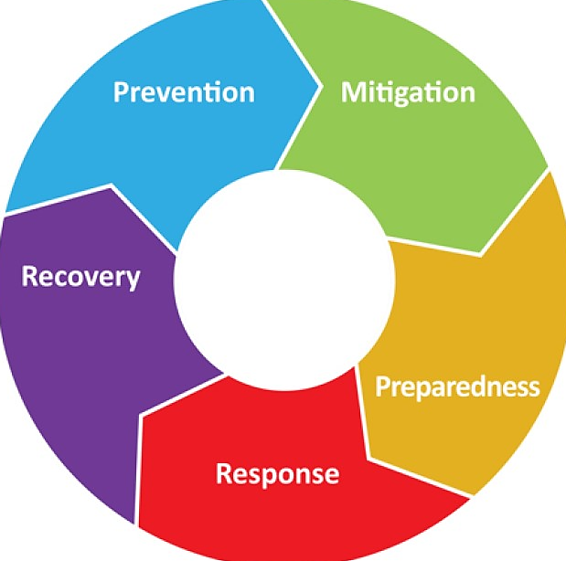
B. Four Phases of Emergency Management

Slide 4
C. Mitigation
This phase includes actions taken to prevent or reduce the cause, impact, and consequences of disasters.
Examples of hazard mitigation include:
Tying down homes or barns with ground anchors to withstand wind damage
Digging water channels to redirect water and planting vegetation to absorb water
Constructing levees or permanent barriers to control flooding
Reinforcing fencing to prevent animal escapes
Buying insurance policiesDevelopment Industry

Slide 5
D. Preparedness
This phase includes planning, training, and educational activities for events that cannot be mitigated.
Examples include:
Developing disaster preparedness plans for what to do, where to go, or who to call for help in a disaster
Exercising plans through drills, tabletop exercises, and full-scale exercises
Creating a supply list of items that are useful in a disaster
Walking around a farm and identifying possible vulnerabilities to high winds

Slide 6
E. Response
The response phase occurs in the immediate aftermath of a disaster. During the response phase, business and other operations do not function normally. Personal safety and wellbeing in an emergency and the duration of the response phase depend on the level of preparedness.
Examples of response activities include:
Implementing disaster response plans
Conducting search and rescue missions
Taking actions to protect yourself, your family, your animals, and others
Addressing public perceptions about food safety

Slide 7
F. Recovery
During the recovery period, restoration efforts occur concurrently with regular operations and activities. The recovery period from a disaster can be prolonged.
Examples of recovery activities include:
Preventing or reducing stress-related illnesses and excessive financial burdens
Rebuilding damaged structures based on advanced knowledge obtained from the preceding disaster
Reducing vulnerability to future disasters

Slide 8
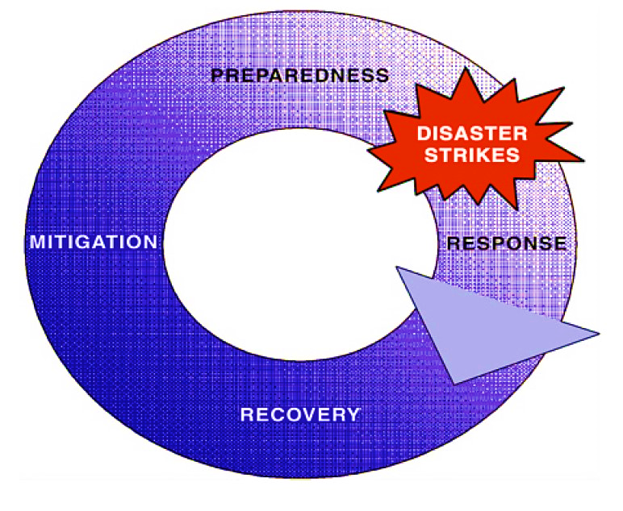
G. Emergency Management Cycle

Slide 9
H. Emergencies and Disasters and the Livestock Industry
Emergencies and disasters involving livestock also vary in degree, depending on the amount and availability of needed resources. The degree to which an incident results in a disaster depends on the size of the event and local response and recovery capabilities. In many cases, levels of preparedness, response, and recovery capabilities go hand-in-hand. For example, in the 1998 ice storm in the northeastern U.S., the most critical agricultural need was for electrical generators. Dairy farms suffering power outages depended on electricity to milk their cows. Farmers who had adequate-sized generators and who knew how to operate them faced an emergency because they were only temporarily prevented from milking their cows. In contrast, farmers without generators, or with generators that failed due to lack of adequate maintenance or fuel, were faced with disastrous consequences. They could not milk their cows and suffered great production losses. Their cows became ill and, in some cases, died.

