Slide 1
Chapter 03:
Disaster Scenario in Bangladesh
Topics to Cover:
Floods
Cyclone Devastated Area
Risk
Context
A Land of Natural Disasters
River
Climate Change Impact: Observed in Bangladesh
Earthquake
Disaster Management Regulative Framework
Legislation and policy
Disaster Management Institutions
Products/Services
Community-based Early Warning

Slide 2
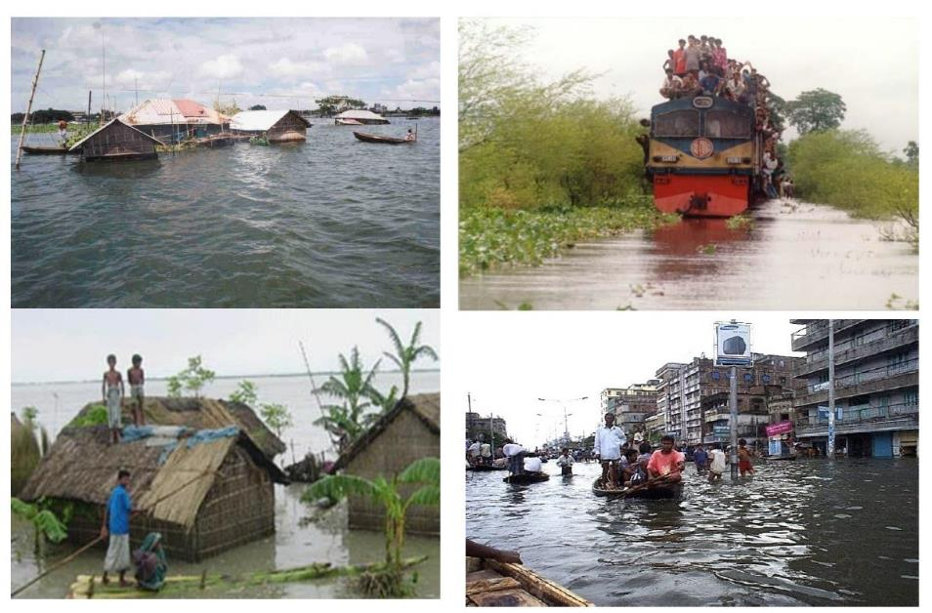
A. Floods

Slide 3
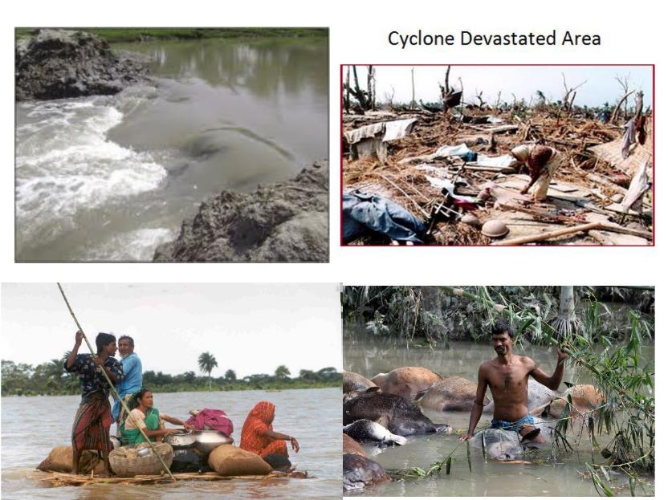
B. Cyclone Devastated Area

Slide 4
C. Risk

Slide 5
D. Context

Slide 6
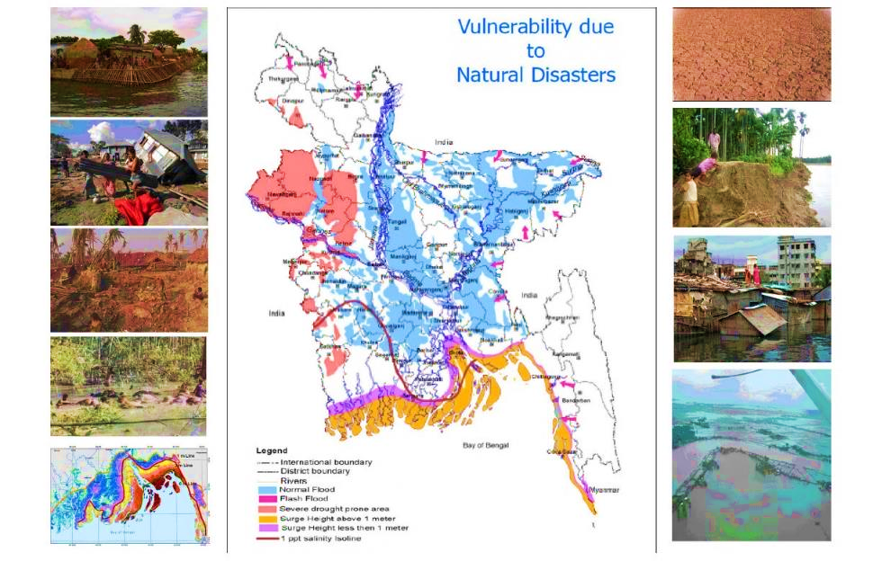
E. A Land of Natural Disasters

Slide 7
F. River

Slide 8
G. Climate Change Impact: Observed in Bangladesh

Slide 9
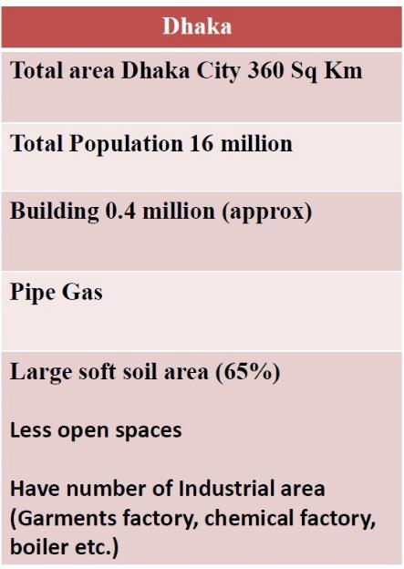
H. Earthquake

Slide 10
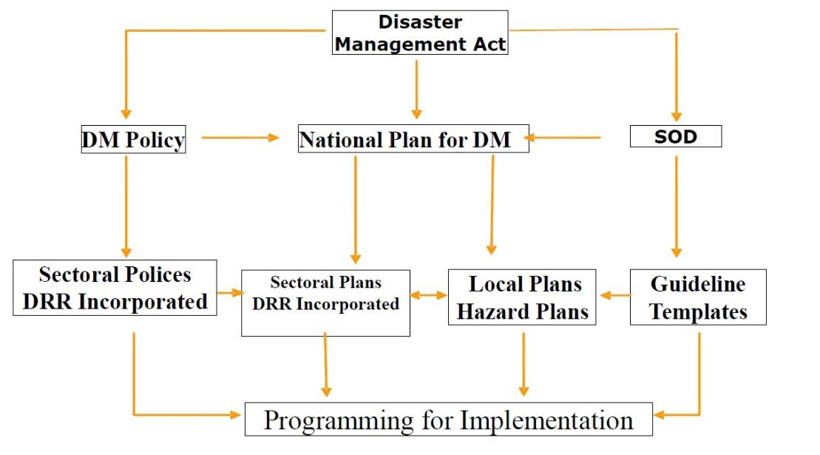
I. Disaster Management Regulative Framework

Slide 11
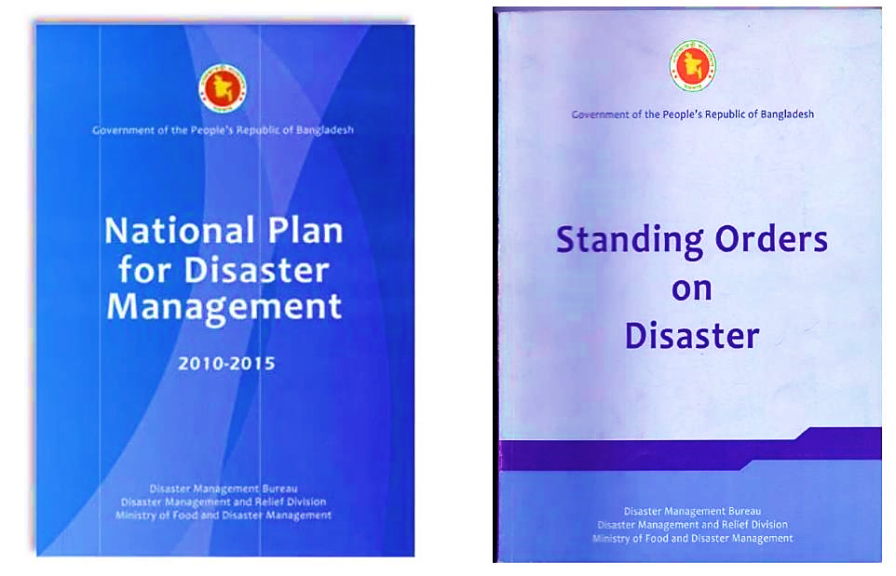
J. Legislation and policy

Slide 12
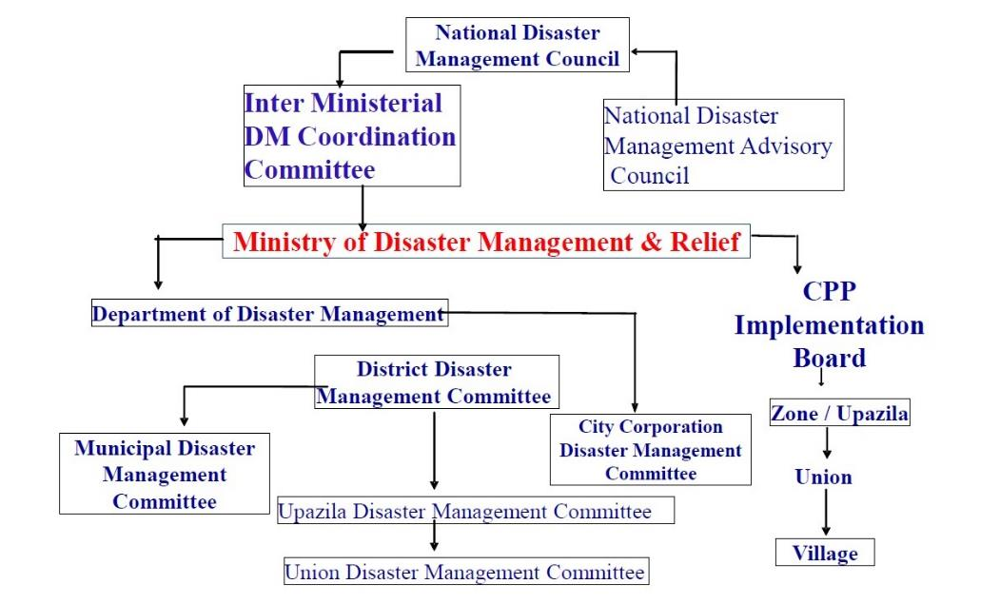
K. Disaster Management Institutions

Slide 13
L. Products/Services

Slide 14
M. Community-based Early Warning
To be Continued

Slide 15
M. Community-based Early Warning
To be Continued

Slide 16
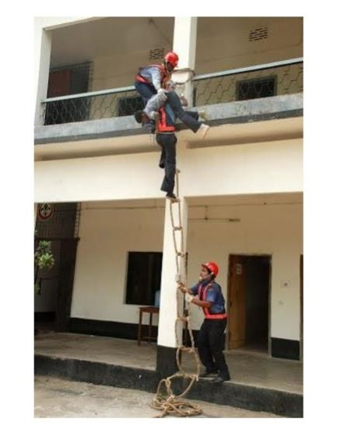
M. Community-based Early Warning

