Slide 1
Chapter 04:
Disaster Management : Bangladesh Perspective
Topics to Cover:
Bangladesh
Country Profile: Bangladesh
River
Disasters And Bangladesh
Disasters
Bangladesh Disasters Management History
Key Factors Of Vulnerability
Affects Of Climate Change
National Disaster Context
Flood, River Erosion, Cyclone And Earthquake Hazard Maps
Hazards Bangladesh Faces
Poverty - Disaster Interface
Cyclone Sidr, November 15, 2007: Damage And Loss
Cyclone Aila, May 25, 2009: Damage And Loss

Slide 2
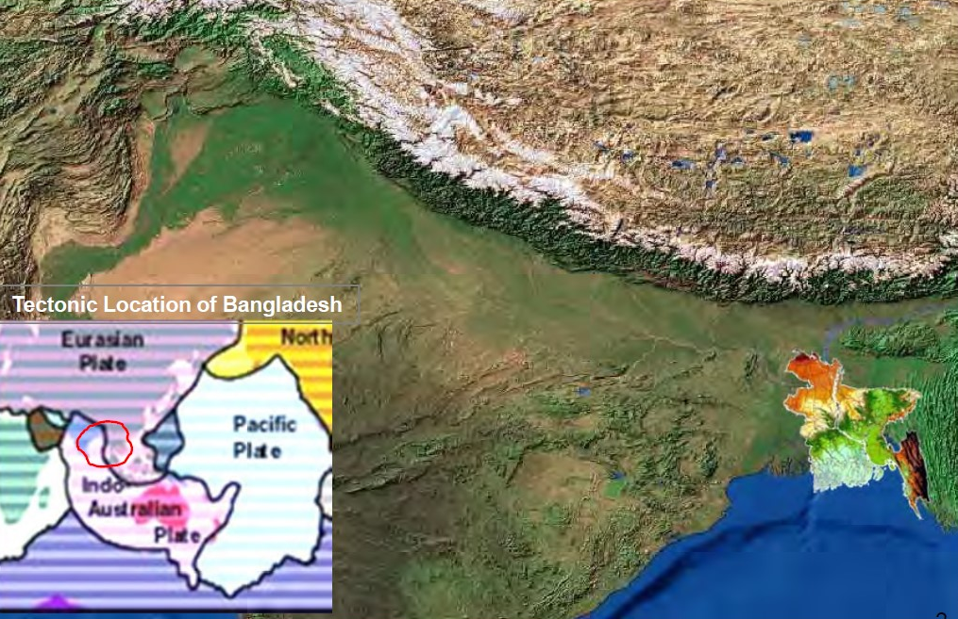
A. BANGLADESH

Slide 3
B. COUNTRY PROFILE: BANGLADESH
Population : 155 million
Geographic Area : 144,000 sqkm
Population density in coastal areas : 1000/sqkm
Floodplains: 80% of total areas
Located at fragile deltaic flood-plain
More than 300 rivers (57 Trans boundary rivers)
High-risk country to recurrent natural disasters

Slide 4
C. RIVER

Slide 5
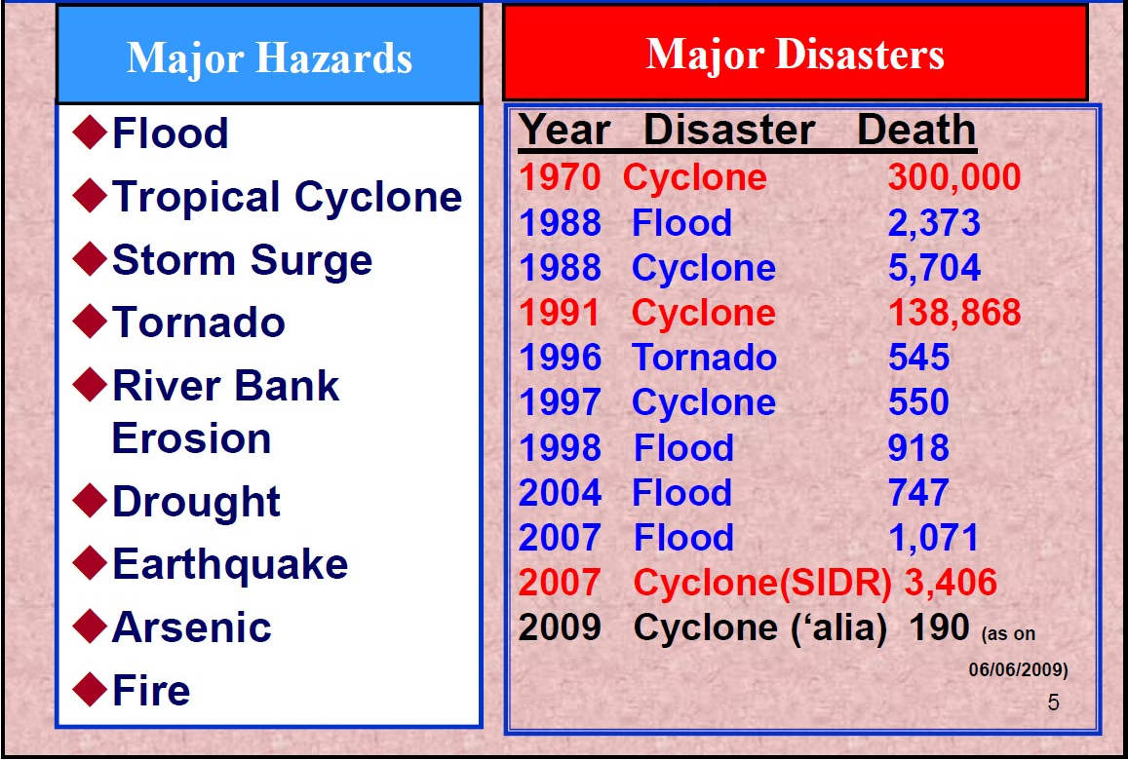
D. DISASTERS AND BANGLADESH

Slide 6
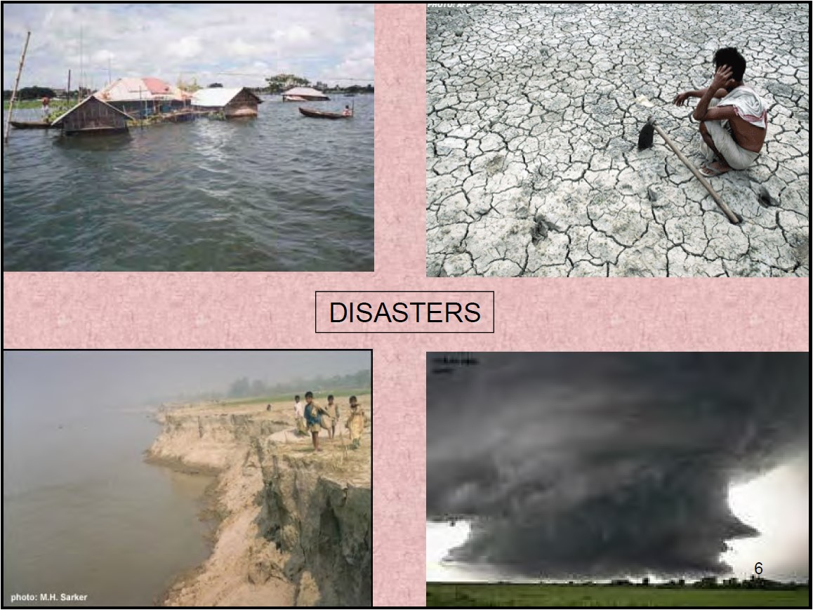
E. DISASTERS
To be Continued

Slide 7
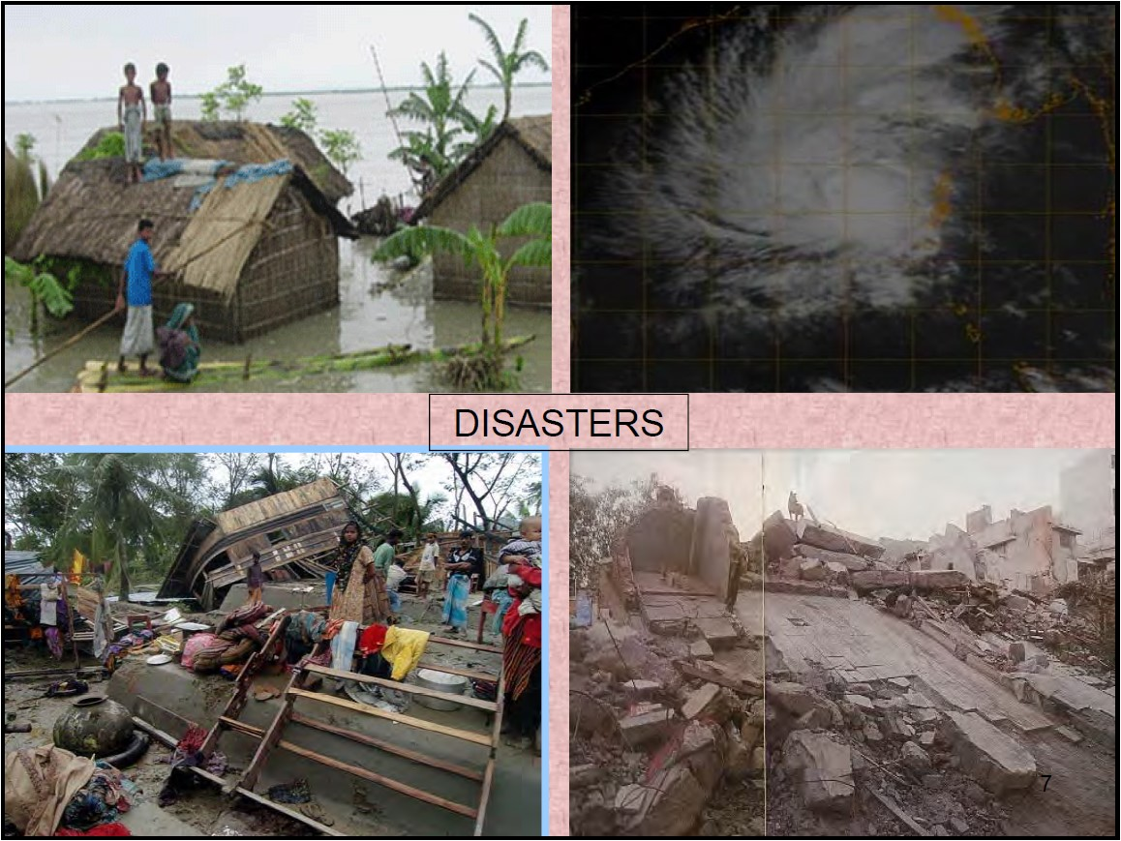
E. DISASTERS
To be Continued

Slide 8
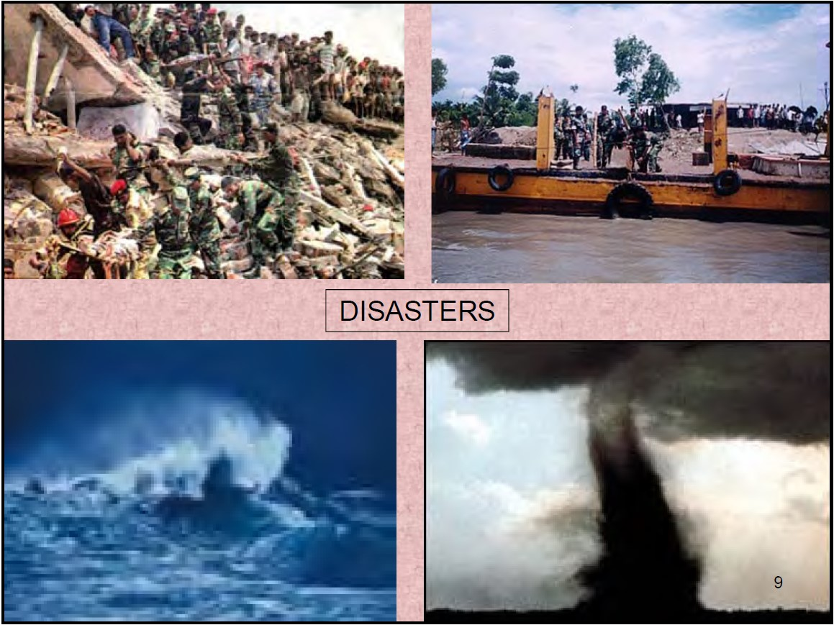
E. DISASTERS
To be Continued

Slide 9
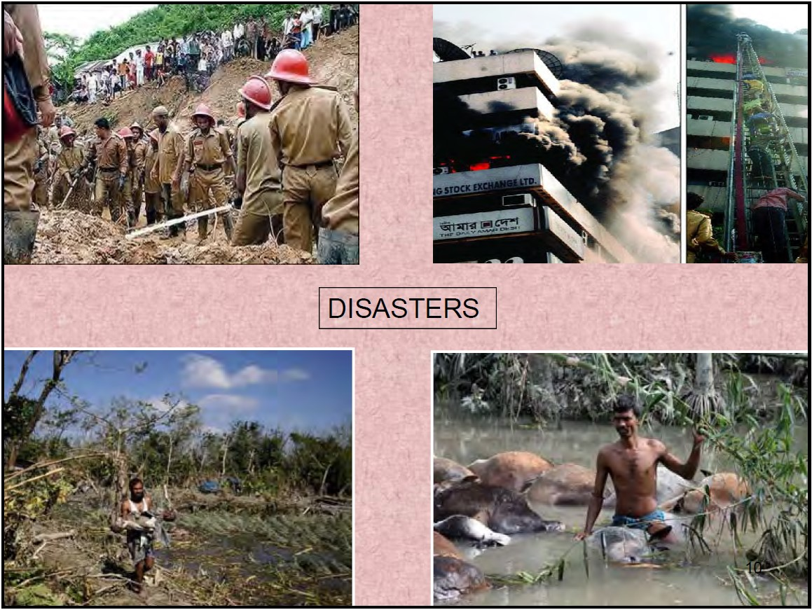
E. DISASTERS

Slide 10
F. BANGLADESH DISASTERS MANAGEMENT HISTORY
Soon after 1991 cyclone which caused huge of lives and damages to the properties the country has realized that the reactive
response to disaster is no longer an option for Bangladesh.
The country has adopted a paradigm shift from reactive response to comprehensive DM approach that includes a number of strategies and mechanism/policy decision.
Disaster Management Bureau (DMB) was created in 1993.
Standing Orders on Disasters (SOD) formulated in 1997 – SOD recognized every bodies’ roles and responsibilities in DM and those are clearly spelt out in the document. SOD also revised in 2010.
CDMP (Comprehensive Disaster Management Program) was formulated in 2000 and launched in 2004.
Ministry of Food & Disaster Management was established in 2005.
Government also adopted a new DM vision.
A Bangladesh DM model has been created/developed and adopted – the model gave main emphasis on disaster risk reduction.

Slide 11
G. KEY FACTORS OF VULNERABILITY
Global Warming and Climate Change.
Geographic location.
Dominance of floodplains.
Low elevation from the sea.
High population density.
High level of poverty.
Funnel shape of the Bay of Bengal.

Slide 12
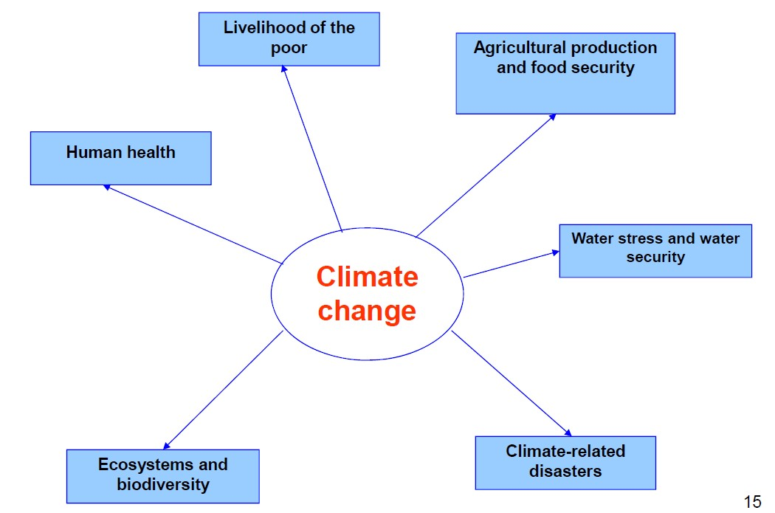
H. AFFECTS OF CLIMATE CHANGE

Slide 13
I. NATIONAL DISASTER CONTEXT
Frequently hit by various natural disasters like Cyclones, Storm surges, Floods, Tornadoes, Droughts and other calamities.
Monsoon flooding is an annual occurrence shaping lives and livelihoods.
Almost 200 disaster events have occurred causing more than 500,000 deaths and leaving prolonged damage to livelihoods, infrastructure and the economy.
Climate change is likely to cause significant impact in the form of severe floods, cyclones, droughts, sea level rise and salinity affecting agriculture, livelihoods, natural orders, water supply, health etc.
The disaster vulnerable people demonstrates strong resilience and enduring capacity to face the disaster challenges.

Slide 14
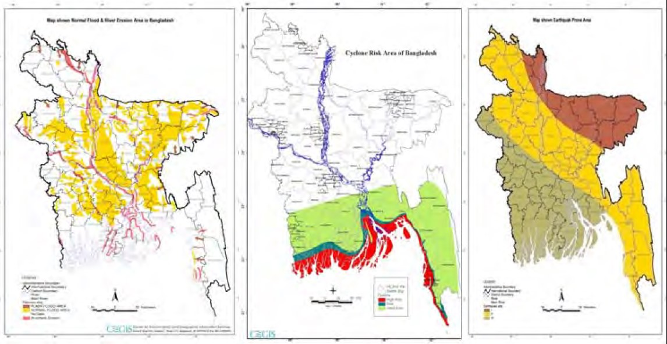
J. FLOOD, RIVER EROSION, CYCLONE AND EARTHQUAKE HAZARD MAPS

Slide 15
K. HAZARDS BANGLADESH FACES

Slide 16
L. POVERTY - DISASTER INTERFACE
Adverse long-term impact on economic and social activities.
The poor are more vulnerable to any kind of disaster.
Depletion of their assets.
Income reduction due to loss of employment.
Increase indebtedness.
Increase migration toward urban centers.
Cost to cope with disaster disproportionately higher for the poor.

Slide 17
M. CYCLONE SIDR, NOVEMBER 15, 2007: DAMAGE AND LOSS

Slide 18
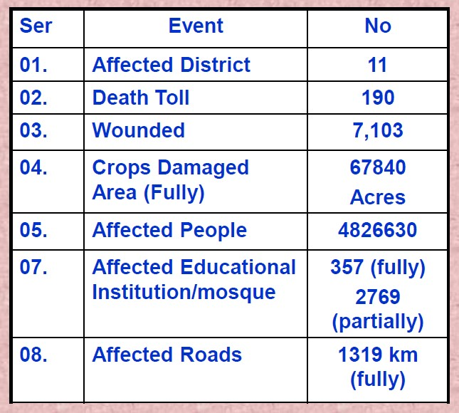
N. CYCLONE AILA, MAY 25, 2009: DAMAGE AND LOSS

