Slide 1
Chapter 06:
Disaster Management & Government
Topics to Cover:
GoB Vision On Disaster Management
Mission Of The MOFDM
What Made The Difference
GoB Capacity In Disaster Management
CDMP
Disaster Management Institutions In Bangladesh
Standing Orders On Disaster
Committees Under SOD
DRR Institutions

Slide 2
A. GOB VISION ON DISASTER MANAGEMENT
To reduce the vulnerability of people, especially the poor, to the effects of natural, environmental and human induced hazards to a manageable and acceptable humanitarian level.

Slide 3
B. MISSION OF THE MOFDM
To bring a paradigm shift in disaster management from conventional response and relief to a more comprehensive risk reduction culture and to promote food security as an important factor in ensuring the resilience of the community to hazards.

Slide 4
C. WHAT MADE THE DIFFERENCE
Improvement of disaster risk reduction measures including early warning system.
Active leadership role in the field level Disaster Management Committees.
Coastal afforestation projects.
Cyclone and Flood shelters.
Embankments in Coastal Belts (3433 KM)
Cyclone Preparedness Program (CPP) having 60,000 volunteers.
Paradigm shift from a relief centric approach to a more holistic, multidisciplinary DRR approach.
Community based disaster preparedness.
Disaster Management Committees are playing active and leadership role in the national, district, upazilla and union level.
Increased resilience of the vulnerable communities.

Slide 5
D. GOB CAPACITY IN DISASTER MANAGEMENT
Specialized Ministry for Food and Disaster Management
Creation of Disaster Management Bureau (DMB): Shifting focus from relief to disaster management specially to risk reduction culture.
ECNEC Decision as part of Mainstreaming of Disaster Risk Reduction.
Issuance of SOD (Standing Order on Disaster): Establishing mechanisms and procedures for effective response at all levels during disaster emergency.
Initiate formulation of ‘Comprehensive Disaster Management Framework’ involving all disaster stakeholders including donor community.
From 2000 onwards – introduction and mainstreaming of risk reduction.

Slide 6
E. CDMP
CDMP is a strategic institutional and programming approach that is designed to optimize the reduction of long term risk and to strengthen the operational capacities for responding to emergencies and disaster situations including actions to improve recovery from these events.
CDMP is now implementing programs:
Capacity building
Partnership development
Community empowerment
Response management through its 12 components

Slide 7
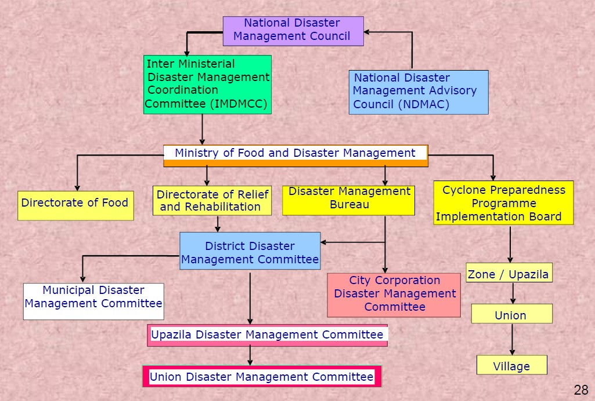
F. DISASTER MANAGEMENT INSTITUTIONS IN BANGLADESH

Slide 8
G. STANDING ORDERS ON DISASTER

Slide 9
H. COMMITTEES UNDER SOD
NDMC : National Disaster Management Council
IMDMCC : Inter-Ministerial Disaster Management Co-ordination Committee
NDMAC : National Disaster Management Advisory Committee
CPPIB : Cyclone Preparedness Program Implementation Board
DMTATF : Disaster Management Training and Public Awareness Building Task Force
FPOCG : Focal Point Operation Coordination Group of Disaster Management
NGOCC : NGO Coordination Committee on Disaster Management
CSDDWS : Committee for Speedy Dissemination of Disaster Related Warning/ Signals

Slide 10
I. DRR INSTITUTIONS
DMRD : Disaster Management & Relief Division
DMB : Disaster Management Bureau
DRR : Directorate of Relief and Rehabilitation
DOE : Department of Environment
BMD : Bangladesh Metrological Department
CPP : Cyclone Preparedness program
FFWC : Flood Forecasting and warning Center
IWM : Institute of Water Modeling
SPARRSO : Space Research & Remote Sensing Organization
SOB : Survey of Bangladesh
BARC : Bangladesh Rural Advancement Committee
DAE : Department of Agriculture Extension
CEGIS : Center for Environmental and Geographical Information Services
AFD : Armed Forces Division

