Slide 1
Chapter 07:
National plan for disaster management
Topic to Cover:
Objectives
DMIC
Information Flow During Emergency Response
Cyclone Preparedness Program – CPP
The Main Activities Of Cyclone Preparedness Program
Unit Committee
Early Warning Dissemination
Lines Of Defense
Evacuation And Rescue Operation
Immediate Assistance Needs
Resource Mobilization System

Slide 2
A. OBJECTIVES
Enhance disaster management coordination through improved facilities and information sharing capacities of DMIC during normal and emergency periods.
Improved capacity of information sharing during normal (non-emergency) periods.
Emergency Operation Centre more effectively and efficiently coordinated during disasters.

Slide 3
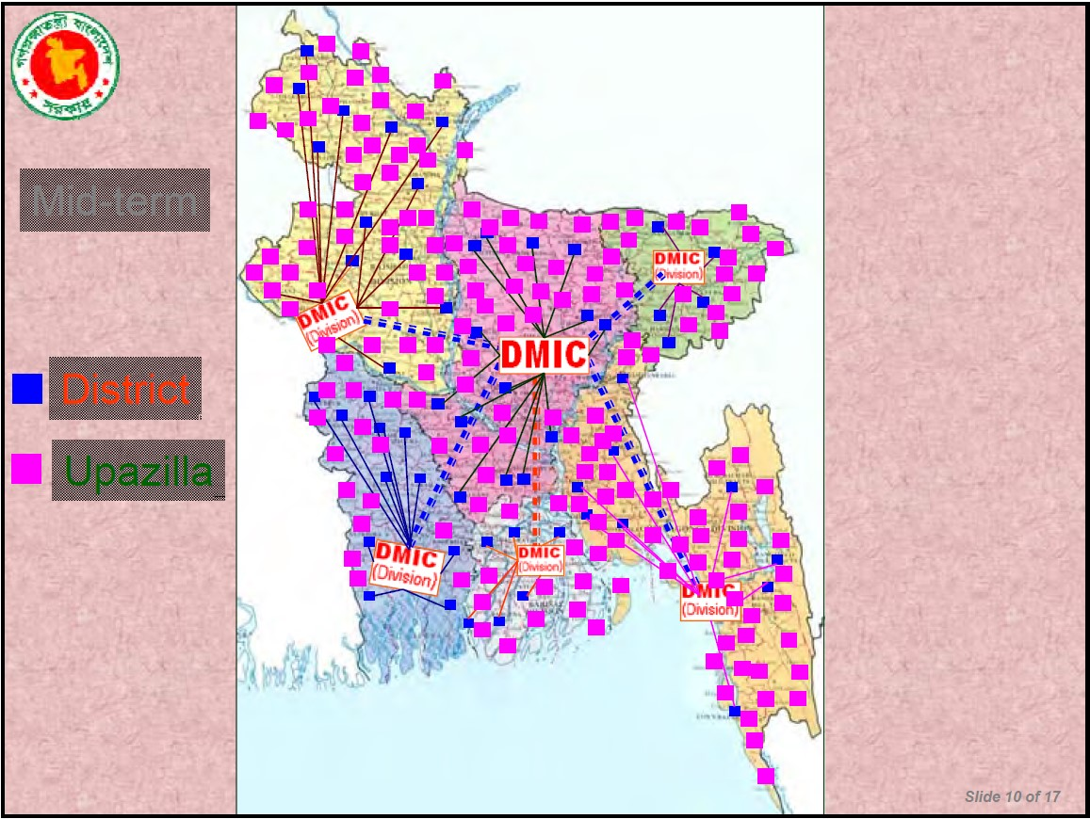
B. DMIC

Slide 4
C. INFORMATION FLOW DURING EMERGENCY RESPONSE

Slide 5
D. CYCLONE PREPAREDNESS PROGRAM – CPP

Slide 6
E. THE MAIN ACTIVITIES OF CYCLONE PREPAREDNESS PROGRAM
Disseminate cyclone warning signals to local residents.
Assist people in taking shelter.
Rescue victims affected by a cyclone.
Provide first aid to people injured by a cyclone.

Slide 7
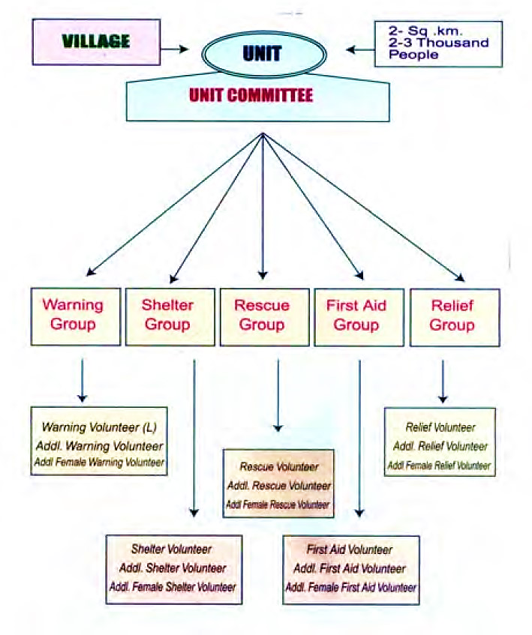
F. UNIT COMMITTEE

Slide 8
G. EARLY WARNING DISSEMINATION
BMD (Bangladesh Metrological Department) and FFWC(Flood Forecasting and Warning Center) generates Early warnings.
Ensure receipt of warning signals of imminent disasters by all concerned officials, agencies and mass communication media.
Publish daily bulletins during disaster period for foreign embassies and UN Missions
CPP plays vital roles disseminating EW to community level

Slide 9
H. LINES OF DEFENSE
Structural:
Cyclone shelters
Embankments
Polders, evacuation routes, killahs ( Earth mound)
Houses and building retrofitting (cyclone resilient)
Non structural
Institutional preparedness
Warning system
Response preparedness
Community & civil society mobilization

Slide 10
I. EVACUATION AND RESCUE OPERATION
Instruction to local authorities for evacuation and rescue operations.
Undertaking evacuation measures in risk areas by Local DM Committees.
42000 CPP Volunteers and the Community Leaders in the risk areas play important roles in evacuation to shelters.
AFD, CPP and DMC members take part in rescue operation.
Emergency Responses by GO, NGOs and Others.

Slide 11
J. IMMEDIATE ASSISTANCE NEEDS
Search and rescue operation.
Supply of instant food.
Medicare.
Water and sanitation.
Temporary shelter for displaced people.
Restoration of livelihoods.

Slide 12
K. RESOURCE MOBILIZATION SYSTEM

