Slide 1


Health Economics:
Health Care Financing
Professor Zafar Ullah, MBBS, MPH (UK), Ph.D (UK)
Associate Dean, Faculty of Allied Health Sciences
Daffodil International University (DIU)
http://ph.daffodilvarsity.edu.bd/activities/73-internationally-renowned-faculty-joined-diu
https://www.linkedin.com/in/abu-naser-zafar-ullah-mbbs-dha-pgclthe-mph-uk-phd-uk-b42b5190/

Slide 2
Definition of healthcare financing
Health financing refers to the “function of a health system concerned with the mobilization, allocation and mechanism of money to cover the health needs of the people, individually and collectively, in the health system.

Slide 3
Why health care financing
Good health is essential to human welfare and to sustained economic and social development.
Health financing is fundamental to the ability of health systems to maintain and improve human welfare.
Without the necessary funds no health workers would be employed, no medicines would be available and no health promotion or prevention would take place.

Slide 4
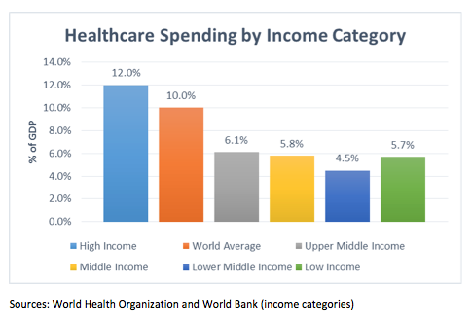

Slide 5
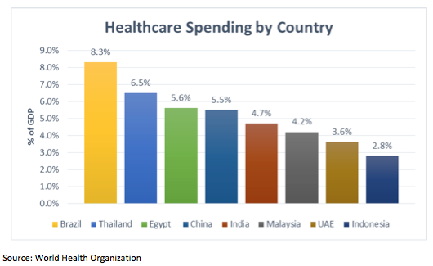

Slide 6
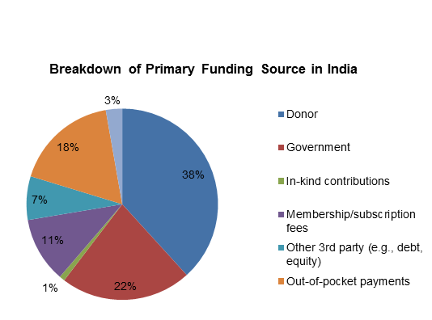

Slide 7
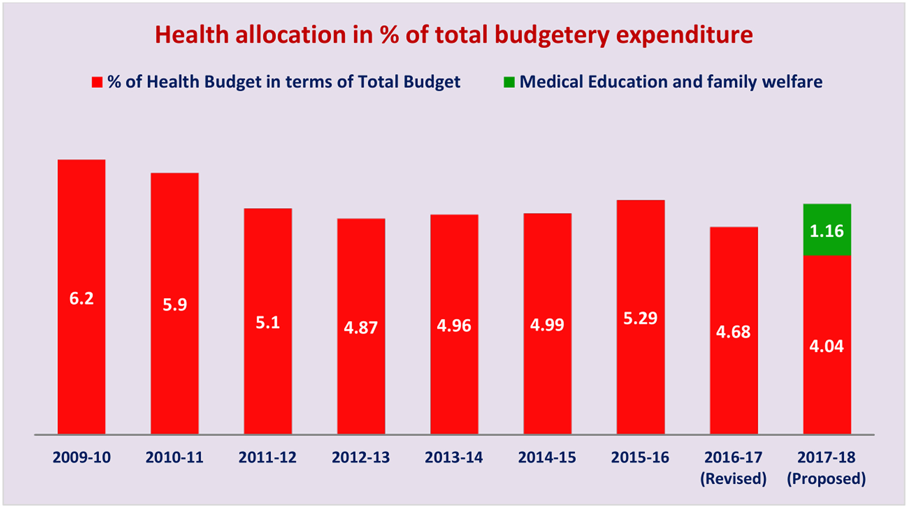

Slide 8
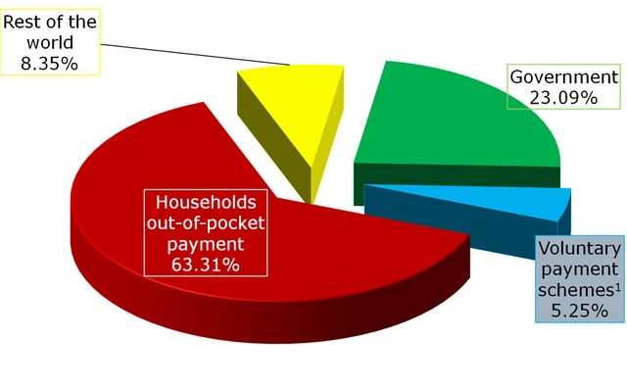
Per Capita Health Expenditure in Bangladesh

Slide 9
Healthcare financing
Mobilization of funds for health care
Allocation of funds to the regions and population groups and for specific types of health care
Mechanisms for paying health care

Slide 10
The purpose of health financing
To make funding available
to set the right financial incentives to providers
to ensure that all individuals have access to effective public health and personal health care” (WHO 2000).

Slide 11
Three basic principles of finance:
1) Raise enough revenues to provide individuals with the intended packages of health services that assure health and financial protection against catastrophic medical expenses caused by illness and injury in an equitable, efficient and financially sustainable manner;
Contd.

Slide 12
Three basic principles of finance:
2) Manage these revenues to pool health risks equitably and efficiently; and
3) Ensure the payment for or purchase of health services is carried out in ways that are allocative and technically efficient.

Slide 13
Mechanism: Health service financing source
Health services financed broadly through public expenditure or private expenditure or external aid
Public expenditure includes all expenditure on health services by
  central and local government funds spent by state owned
  where services are paid for by taxes, or compulsory health insurance contributions either by employers or insured persons or both this counts as public expenditure.

Slide 14
Health service financing source
Voluntary payments by individuals or employers are private expenditure.
External sources refer to the external aid which comes through bilateral aid programme or international non governmental organizations

Slide 15
General revenue
The most traditional way of financing health care
General revenue is the income a government receives primarily from its taxing authority
Finance a major portion of the health care (especially in low income countries)
Example: income taxes, sales taxes

Slide 16
Private insurance
private contract offered by an insurer to exchange a set of benefits for a payment of a specified premium.
marketed either by nonprofit or for profit insurance companies
consumers voluntarily choose to purchase an insurance package that best matches their preference.
offered on individual and group basis. Under individual insurance the premium is based on that individuals risk characteristics.
major concern in private insurance is buyer’s adverse selection
Under group insurance, the premium is calculated on a group basis. risk is pooled across age, gender and health status.

Slide 17
Social Insurance Programs
Social insurance helps vulnerable populations get access to health care.
Governments run compulsory social insurance programs as a way to manage risk, such as the risk of getting sick or becoming unemployed, and provide a safety net for citizens. Citizens pay for social insurance programs through taxes such as Medicare and Social Security payroll taxes, and fees such as Medicare premiums and co-pays.

Slide 18
Definition
  "Encyclopedia Britannica" defines social insurance as a compulsory public insurance program that provides protection from economic risks, such as loss of income due to sickness, old age or unemployment.

Slide 19
Difference from Private Insurance Programs
  Social insurance programs differ from private insurance programs in two important ways.
  Firstly, participation in social insurance program is almost always compulsory. For example, you cannot opt out of Social Security taxes.
  Secondly, private insurance operates to generate profit by charging premiums and minimizing payouts, whereas social insurance programs act as a safety net to provide citizens with income security.

Slide 20
Community based financing
Factors for success of community based financing
Technical strength and institutional capacity of the local group
Financial control as part of the broader strategy in local management and control of health care services
Support received from outside organizations and individuals
Links with other local organizations
Diversity of funding
Responding to other (non health) development needs of the community
Ability to adapt to a changing environment

Slide 21
Changing government role in health care
Health is considered a public goods
Government needs to actively participate to avoid market failures
A market failure is a situation where free markets fail to allocate resources efficiently.

Slide 22
Question?

Slide 23

Thank You

