Slide 1
Project Management

Slide 2
Project, Program and Portfolio

Slide 3
Project
Project: A Project is a temporary endeavor undertaken to create a unique product, service, or result.
A project can create:
A unique product that can be either component of another item or an item in itself,
A unique service or a capability to perform a service ( e.g., a business function that supports production or distribution),
A unique result, such as an outcome or document (e.g., a research project that develops knowledge that can be used to determine whether a trend exists or a new process will benefit society).
A unique combination of one or more products, services, or results ( e.g., a software application, its associated documentation, and help desk services).
- PMBOK, 6th edition

Slide 4
Project
Temporary Endeavor
Project drive change
Projects enable business value creation
  Net quantifiable benefit ( tangible, intangible, or both)
Project Initiation Context
  Meet regulatory, legal, or social requirements;
  Satisfy stakeholder requests or needs;
  Implement or change business or technological strategies; and
  Create, improve, or fix products, processes, or services.
- PMBOK, 6th edition

Slide 5
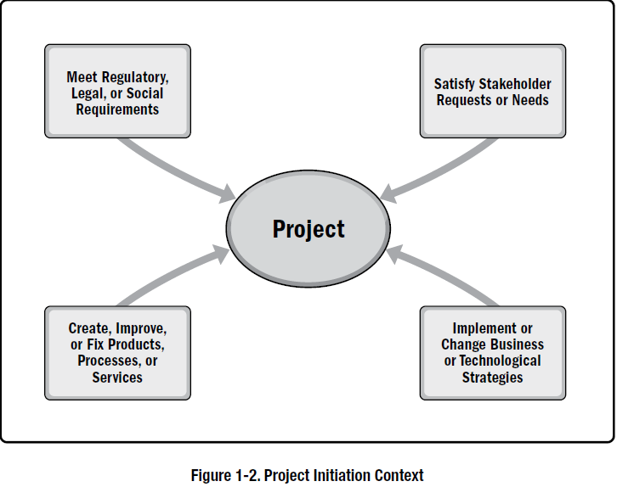
Project Initiation Context

Slide 6
Factors that Lead to the Creation of a Project
New Technology Competitive Forces Material Issues Political Changes Market Demand Economic Changes Customer Request | Stakeholder Demands Legal Requirement Business Process Improvement Strategic Opportunity or Business Need Social Needs Environmental Considerations

Slide 7
Project Management
Project management is the application of knowledge, skills, tools, and techniques to project activities to meet the project requirements.
Project management is accomplished through the appropriate application and integration of the project management processes identified for the project.
Project management enables organizations to execute projects effectively and efficiently.

Slide 8
Importance of Project Management
Effective project Management helps:
Meet business objectives; Satisfy stakeholder expectations; Be more predictable; Increase chances of success; Deliver the right products at the right time; Resolve problems and issues; Respond to risks in a timely manner; Optimize the use of organizational resources; | Identify, recover, or terminate failing projects; Manage constraints (e.g., scope, quality, schedule, costs, resources); Balance the influence of constraints on the project (e.g., increased scope may increase cost or schedule); and Manage change in a better manner.

Slide 9
Importance of Project Management
Poorly managed projects:
Missed deadlines, Cost overruns, Poor quality, Rework, Uncontrolled expansion of the project | Loss of reputation for the organization, Unsatisfied stakeholders, and Failure in achieving the objectives for which the project was undertaken.

Slide 10
Program Management
A program is defined as a group of related projects, subsidiary programs, and program activities managed in a coordinated manner to obtain benefits not available from managing them individually.
Program management is defined as the application of knowledge, skills, and principles to a program to achieve the program objectives and to obtain benefits and control not available by managing program components individually.
PMBOK, 6th edition

Slide 11
Program Management
Aligning with the organizational or strategic direction that affects program and project goals and objectives;
Allocating the program scope into program components;
Managing interdependencies among the components of the program to best serve the program;
Managing program risks that may impact multiple projects in the program;
PMBOK, 6th edition

Slide 12
Program Management
Resolving constraints and conflicts that affect multiple projects within the program;
Resolving issues between component projects and the program level;
Managing change requests within a shared governance framework;
Allocating budgets across multiple projects within the program; and
Assuring benefits realization from the program and component projects.
PMBOK, 6th edition

Slide 13
Portfolio Management
A portfolio is defined as projects, programs, subsidiary portfolios, and operations managed as a group to achieve strategic objectives.
Portfolio management refers to the centralized management of one or more portfolios to achieve strategic objectives.
- PMBOK, 6th edition

Slide 14
Portfolio Management
Guide organizational investment decisions.
Select the optimal mix of programs and projects to meet strategic objectives.
Provide decision-making transparency.
Prioritize team and physical resource allocation.
Increase the likelihood of realizing the desired return on investment.
Centralize the management of the aggregate risk profile of all components.

Slide 15
Project Management
Project management is accomplished through the appropriate application and integration of 49 logically grouped project management processes, which are categorized into following five Process groups:
  Initiating
  Planning,
  Executing,
  Monitoring and Controlling, and
  Closing

Slide 16
Operations Management
Operations management is concerned with the ongoing production of goods and/or services. It ensures that business operations continue efficiently by using the optimal resources needed to meet customer demands. It is concerned with managing processes that transform inputs (e.g., materials, components, energy, and labor) into outputs (e.g., products, goods, and/or services).

Slide 17
Projects vs. Operations
Projects | Operations
Create own charter, organization, and goals Purpose of change Unique product or service Heterogeneous teams Definite start- definite end Progressively elaborated process deliverables | Semi-permanent charter, organization, and goals Purpose of status quo Pre defined & approved product or service Homogeneous teams Ongoing Fully known process deliverables

Slide 18
Project Life Cycle
A project life cycle is the series of phases that a project passes through from its start to its completion. It provides the basic framework for managing the project. This basic framework applies regardless of the specific project work involved.
The phases may be sequential, iterative, or overlapping.
Project life cycles can be predictive or adaptive.
Within a project life cycle, there are generally one or more phases that are associated with the development of the product, service, or result.

Slide 19
Project Life Cycle
A project life cycle is the series of phases that a project passes through from its initiation to its closure.
The phases are generally sequential
All projects can be mapped to the following generic life cycle structures:
  Starting the project
  Organizing and preparing
  Carrying out the project work, and
  Closing the project

Slide 20
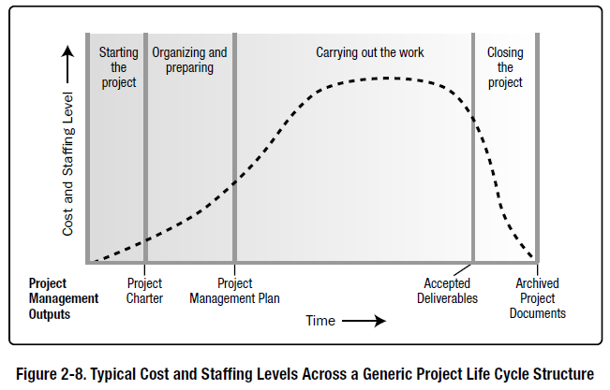
Typical Cost and Staffing Levels Across a Generic Project Life Cycle

Slide 21
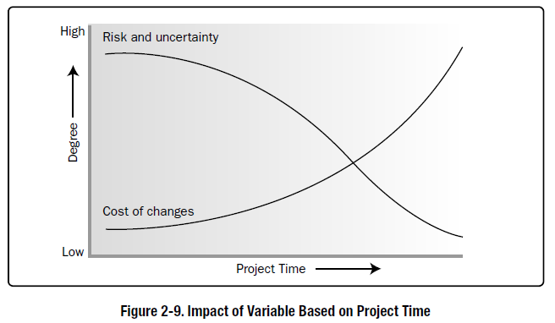
Impact of Variable Based on Project Time

Slide 22
Project Life Cycle
Predictive life cycle
Iterative life cycle
Incremental life cycle
Adaptive Life Cycle
Hybrid life cycle

Slide 23
Project Phase
A project phase is a collection of logically related project activities that culminates in the completion of one or more deliverables.

Slide 24
Project Phase
Projects may be separated into distinct phases or subcomponents. These phases or subcomponents are generally given names that indicate the type of work done in that phase:
Concept development,
Feasibility study,
Customer requirements,
Solution development,
Design,
Prototype,
Build,
Test,
Transition,
Commissioning,
Milestone review, and
Lessons learned.

Slide 25
Project Management Processes

Slide 26
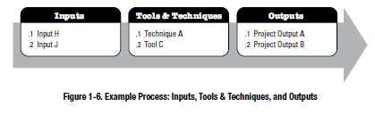
Project Management Processes

Slide 27
PMI- PMBOK
5 Process Groups
10 Knowledge Areas
49 processes
Project Management Process Groups and Knowledge Areas Mapping

Slide 28

Initiation Process Group
1 | Develop Project Charter
2 | Identify stakeholders

Slide 29
Planning Process Group
1 | Develop Project Management Plan | 13 | Determine Budget
2 | Plan Scope Management | 14 | Plan Quality Management
3 | Collect Requirements | 15 | Plan Resource Management
4 | Define Scope | 16 | Estimate Activity Resources
5 | Create WBS | 17 | Plan Communications Management
6 | Plan Schedule Management | 18 | Plan Risk Management
7 | Define Activities | 19 | Identify Risks
8 | Sequence Activities | 20 | Perform qualitative risk analysis
9 | Estimate Activity Durations | 21 | Perform quantitative risk analysis
10 | Develop schedule | 22 | Plan Risk Response
11 | Plan Cost Management | 23 | Plan Procurement Management
12 | Estimate Costs | 24 | Plan Stakeholder management

Slide 30
Executing Process Group
1 | Direct and Manage Project Work
2 | Manage Project Knowledge
3 | Manage Quality
4 | Acquire Resources
5 | Develop Team
6 | Manage Team
7 | Manage Communications
8 | Implement Risk Responses
9 | Conduct Procurements
10 | Manage Stakeholders Engagement

Slide 31
Monitoring and Controlling Process Group
1 | Monitor and Control Project Work
2 | Perform Integrated Change Control
3 | Validate Scope
4 | Control Scope
5 | Control Schedule
6 | Control Costs
7 | Control Quality
8 | Control Resources
9 | Manage Communications
10 | Monitor risks
11 | Control Procurements
11 | Monitor Stakeholder Engagement

Slide 32
Closing
1 | Close Project or Phase

Slide 33
Process Groups : Distribution of Process
Total 49 Processes
1
Closing
2
Initiating
10
Executing
12
Monitoring
&
Controlling
24
Planning

Slide 34
Project Management Data and Information
Work Performance data
Work Performance information
Work performance reports

Slide 35
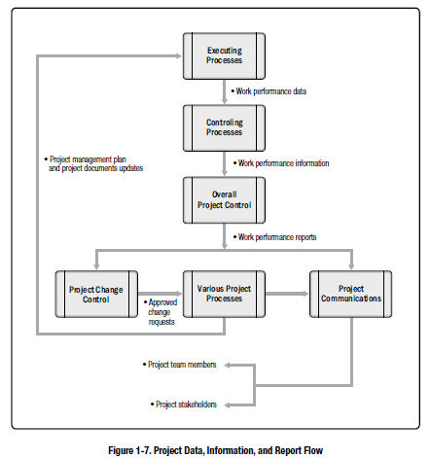
Data , Information, and Report Flow

Slide 36
Project Business case
The project business case is a documented economic feasibility study used to establish the validity of the benefits of a selected component lacking sufficient definition and that is used as a basis for the authorization of further project management activities.

Slide 37
Project Business case
The business case lists the objectives and reasons for project initiation. It helps measure the project success at the end of the project against the project objectives.
The business case is a project business document that is used throughout the project life cycle.
The business case may be used before the project initiation and may result in a go/no-go decision for the project.

Slide 38
Benefits Management Plan
The project benefits management plan is the document that describes how and when the benefits of the project will be delivered, and describes the mechanisms that should be in place to measure those benefits.
Target benefits
Strategic alignment
Timeframe for realizing benefits
Benefits owner
Metrics
Assumptions
Risks

Slide 39
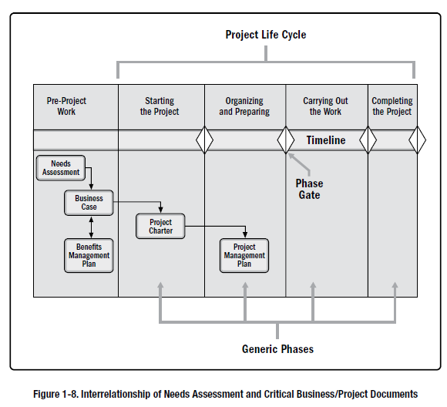
Project Life Cycle

Slide 40
Project Charter and Project Management Plan
The project charter is defined as a document issued by the project sponsor that formally authorizes the existence of a project and provides the project manager with the authority to apply organizational resources to project activities.
The project management plan is defined as the document that describes how the project will be executed, monitored, and controlled.

Slide 41
Project Success Measures
Traditionally, the project management metrics of time, cost, scope, and quality have been the most important factors in defining the success of a project.
More recently, practitioners and scholars have determined that project success should also be measured with consideration toward achievement of the project objectives.

Slide 42
Project Success Measures
Additional Criterion:
Completing the project benefits management plan; Meeting the agreed-upon financial measures Net present value (NPV), Return on investment (ROI), Internal rate of return (IRR), Payback period (PBP), and Benefit-cost ratio (BCR). Meeting business case nonfinancial objectives; From its current state to the desired future state; | Fulfilling contract terms and conditions; Meeting organizational strategy, goals, and objectives; Achieving stakeholder satisfaction; Acceptable customer/end-user adoption; Integration of deliverables into the organization’s operating environment; Achieving agreed-upon quality of delivery; Meeting governance criteria; and

Slide 43

Project Environment

Slide 44
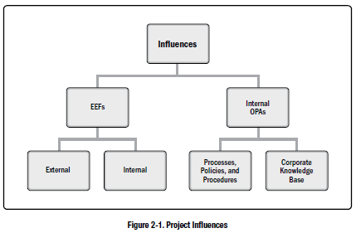
Project Influences

Slide 45
Enterprise Environmental Factors
Enterprise environmental factors (EEFs) refer to conditions, not under the control of the project team, that influence, constrain, or direct the project. These conditions can be internal and/or external to the organization.
EEFs are considered as inputs to many project management processes, specifically for most planning processes. These factors may enhance or constrain project management options. In addition, these factors may have a positive or negative influence on the outcome.

Slide 46
Project Management Office
A project management office (PMO) is an organizational structure that standardizes the project-related governance processes and facilitates the sharing of resources, methodologies, tools, and techniques.
The responsibilities of a PMO can range from providing project management support functions to the direct management of one or more projects.
PMO Roles:
Supportive
Controlling
Directive

