Slide 1
Lecture : Health System Models and provision of healthcare under different health systems
BakiBillah
Lecturer
DPH, DIU

Slide 2
Overview of the presentation
Health care models
International comparisons
U.S.A
U.K.
Canada
France
Germany
Japan

Slide 3
Different health care models
Each nation’s health care system is a reflection of its:
History
Politics
Economy
National values
They all vary to some degree
However, they all share common principles
There are four basic health acre models around the world

Slide 4
Four different healthcare models
The Bismarck model
The Beveridge model
The National Health Insurance model
The out-of-pocket model

Slide 5
1. The Bismarck Model
Germany, Japan, France, Belgium, Switzerland, Central and South East European (CSEE) countries, Former Soviet Union (FSU) countries and several countries in Latin America
Named for Prussian Chancellor Otto von Bismarck, father of the Welfare state (1883)
“Mixed Model”, “Sickness Funds”
Characteristics:
Providers and payers are private
Private insurance plan- financed jointly by employers and employees through payroll deduction
The plans cover everyone and do not make a profit
Tight regulation of medical services and fees (cost control)

Slide 6
2. The Beveridge Model
Named after Sir William Beveridge (1942) – inspired Britain’s NHS
Also known as “Public Model”, “Socialized Medicine Model”
Great Britain, Italy, Spain, Cuba, Chile (until 1973)
Characteristics:
Healthcare is provided and financed by the State through tax payments
There are no medical bills
Medical treatment is a public service
Providers can be government employees
The government controls cost as the sole payer

Slide 7
3. The National Health Insurance Model
Canada, Taiwan, South Korea
Characteristics:
Providers are private
Payer is a State-run insurance program that every citizen pays into
National insurance collects monthly premiums and pays medical bills
Can control costs by:
limiting the medical services they will pay for or
making patients wait to be treated

Slide 8
4. The Out-of-Pocket Model
Rural regions of Africa, India, China, and some countries in South America
Characteristics:
Only the rich get medical care; the poor stay sick or receive minimal services by public and humanitarian institutions
Most medical care is paid for by the patient, out-of-pocket
No insurance or government plan

Slide 9
What is the best system?
All models of health care systems are imperfect and there is no model which is the best and broadly accepted and recommended. There are big differences among countries in relation to the goals, structure, organization, finance and the other characteristics of the health care systems.

Slide 10
Mixed health system
According to Oxfam in 2009:
‘Centrally planned government health services that operate side by side with private markets for similar or complementary products and services’
Mixed health system syndrome:
According to WHO bulletin in 2010,
‘When a public and private mix of health care delivery shows symptoms of compromised quality and equity it can be diagnosed as having mixed health system syndrome’

Slide 11
Characteristics of mixed health system
Diversity in health care provision
Dominant, poorly organized private markets
Compromised public services
Blurred public-private distinction

Slide 12
Mixed health systems syndrome: summary of characteristics
Diversity in provision
Ownership or payment type: Public - private
Recognition: Formal - informal
System of knowledge: Western - indigenous
Cadre: Professional – nonprofessional
Large corporatized hospitals – solo / family-run establishments
Compromised public services
Low public expenditure
Inefficiencies in public spending
Poor management, oversight and services in public sector
Dominant, poorly organized private markets
OOP payments predominate
Private provision outnumbers public
Exploitative practices common
Blurred public-private distinction
Private doctors linked to government facilities
Informal payments
Dual practice
Formal PPPs

Slide 13
What does this mean for users of care?
Unnecessarily high costs of health care
Variable quality of care provided
Irregular ethical conduct of health care providers
Unavailability / unequal distribution of health care providers

Slide 14
Comparison between different International Health Systems

Slide 15
Financing and delivery mechanisms of a Health System
Source: Besley & Gouveia, Organisation for Economic Consumables – Operation & Development (OECD – 1994)

Slide 16
Financing and delivery mechanisms of a Health System (Contd.)
Financing | Delivery system of country
Public/ private mix | Public | Private
Mainly public provision, public finance | Denmark | Norway
 | Finland | Portugal
 | Greece | Spain
 | Iceland | Sweden
 | Ireland | United Kingdom
 | Italy | -
Mixed provision, public finance | Australia | Germany
 | Austria | Japan
 | Belgium | Luxembourg
 | France | New Zealand
Mainly private provision, public finance | Canada | -
Mixed provision, mixed finance | Netherlands | -
Mainly private provision, private finance | Switzerland | -

Slide 17
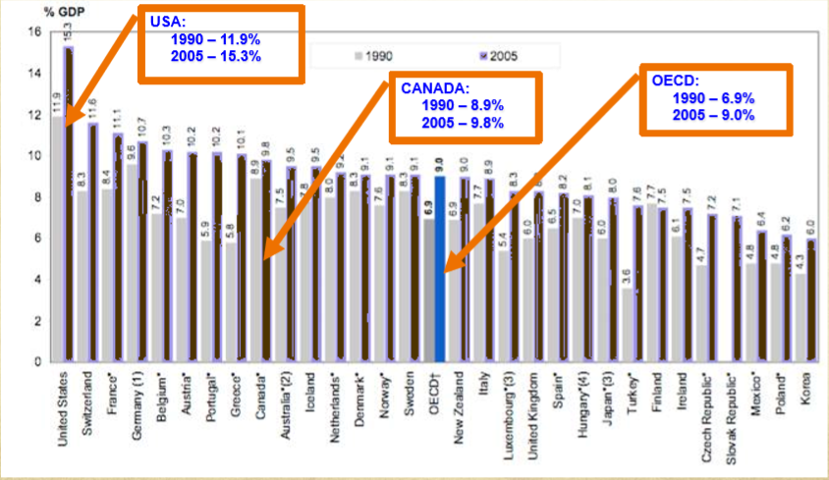
Costs comparisons (% of GDP) for OECD countries (1990-2005)

Slide 18
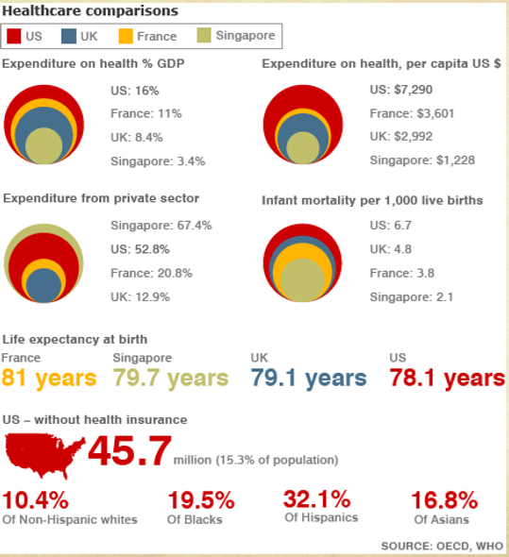

Slide 19
United States Health System costs
WHO ranking for health attainment: 24
WHO overall ranking: 37
Largest spender on health care health care
15% of GDP (OECD median 8.6%)
2.3 trillion in 2007
Why so high?
Providers make more money
High malpractice insurance
“The way we manage health insurance and the complexity of the health system”
Only country that relies on profit-making health insurance companies
Private insurance industry has the world’s highest administrative costs of any health care payer in the world
Most fragmented health care system in the world
Only industrialized country in the world without UHC

Slide 20
United States: benefits and problems
Insured
62% employer-sponsored
15% Medicaid/ other
5% private non-group
18% uninsured (45 million)
Quality
Depends on plan- often gaps for prescription drugs, dental, vision
Physician choice
Restricted choice of providers
Waiting time
Waiting lines relatively rare
Significant health disparities by race and income

Slide 21
Great Britain costs
WHO ranking for health attainment: 14
WHO overall ranking: 18
Insured
100% of population insured
Spending
7.5% of GDP
Funding
Single payer system funded by general revenues (National Health System); operates on huge deficit
Private Insurance
10% of Britons have private health insurance
Similar to coverage by NHS, but gives patients access to higher quality of care and reduce waiting times
Physician Compensations
Most providers are government employees, paid under salary and according to number of listed patients

Slide 22
Great Britain: benefits and problems
Physician choice
Patients have very little provider choice
Co-payment/ deductibles
No deductibles
Almost no co-payments (prescription drugs)
Waiting times
Huge problem (on an average 2.5 months to consult a Specialist, 3 months for elective procedure)
Benefit covered
Offers comprehensive coverage, except dental and eye
Terminally ill patients may be denied treatment

Slide 23
Canada costs
WHO ranking for health attainment: 12
WHO overall ranking: 30
Insured
Single payer system, 100% insured
13 provincial/ territorial governments administer provincial/ territorial health care plans (Medicare)
Each provide must make insurance:
Universal (available to all)
Comprehensive (covers all necessary hospital visits)
Portable (individuals remain covered when moving to another province)
Accessible (no financial barriers, such as deductible or co-payments)
Funding
Federal government uses revenue to provide a block grant to the provinces (finances 16% of healthcare)
The remainder is funded by provincial taxes (personal and corporate income taxes)
Spending
9.9% of GDP
Private insurance
At one time all private insurance was prohibited; changed in 2005
Many private clinics now offer services

Slide 24
Canada: benefits and problems
Physician Compensation
Physicians work in private practice
Paid on a fee-for-service basis
These fees are set by a centralized agency; makes wages fairly low
Physician Choice
Referrals are required for all specialist services
Great difficulties for a family doctor
Co-payment/Deductibles
Generally no co-payments or deductibles
Some provinces do charge insurance premiums
Waiting Times
Long waiting lists
Many travel to the U.S. for healthcare
Gaps in coverage
Tension between provincial and central governments

Slide 25
France costs
WHO ranking for health attainment: 3
WHO overall ranking: 1
Insured
About 99% of population covered
Cost
11% of GDP
Funding
Multi-payer system
13.55% payroll tax (employers pay 12.8%, individuals pay 0.75%)
5.25% general social contribution tax on income
Taxes on tobacco, alcohol and pharmaceutical company revenues
Private insurance
“more than 92% of French residents have complementary private insurance”
These funds are loosely regulated; the only requirement is renewability
These benefits are not equally distributed (creates a two-tiered system)

Slide 26
France: benefits and problems
3rd most expensive health care system
Physician Compensation
Providers paid by national health insurance system based on a centrally planned fee schedule – fees are based on an upfront treatment lump sum
However, doctors can charge whatever they want
The patient or the private insurance makes up the difference
Medical school is free
Physician Choice
Fair amount of choice in the doctors they choose
Co-payment/Deductible
10% to 40% copayments
Waiting Times
Very little waiting lists/times
Technology
Government does not reimburse new technologies very generously
Little incentive to make capital investments in medical technology
Nursing and physician shortage

Slide 27
Germany costs
WHO ranking for health attainment: 22
WHO overall ranking: 25
Insured
99.6% of population – sickness funds
11.1% of GDP
Funding
Multi-payer system
Those with higher incomes can buy private insurance
The federal Gov. decides the global budget and which procedures to include in the benefit package
Sickness funds are financed through a payroll tax (avg. 15% of income)
The tax is split between the employer and employee
Private insurance
9% of Germans have supplemental insurance; covers items not paid for by the sickness funds
Only middle- and upper-class can opt out of sickness funds

Slide 28
Germany: benefits and problems
Physician Compensation
Reimbursement set through negotiation with the sickness funds
Providers have little negotiating power
Very low compensation
Significant reimbursement caps and budget restrictions
Physician choice
Free choice of GP and Specialists, must use the closest hospital
Co-payment/Deductibles
Almost no co-payments or deductibles
Waiting Times
WHO reported that “waiting lists and explicit rationing decisions are virtually unknown”
Benefits Covered
There is an extensive benefit package which even includes sick pay (70% to 90% of pay) for up to 78 weeks
Excessive numbers of physician

Slide 29
Japan: Organization of Health System
Japanese health care system
Employee health insurance
Elderly (Roken)
Self-employed, retired, others (Kokuho)
1800 Kenpo Association (large companies)
Seikan (small-mid companies)
Kyosai
(public employees and private school teachers)

Slide 30
Japan costs
WHO ranking for health attainment: 1
WHO overall ranking: 10
Insured
Universal health insurance based around a mandatory, employment-based insurance
“The Employee Health Insurance Program” requires that all companies with 700 or more employees to provide workers with health insurance, small business workers join a government-run small business national health insurance plan, the self-employed and the retired are covered by Citizens Insurance Program administered by municipal governments
Costs
8% of GDP
Average household spends $2300 per year on out-of-pocket costs
Japans have a healthy lifestyle – lower incidence of disease
Funding
8.5% (large business) or an 8.2% (small business) payroll tax
Payroll taxes are split almost evenly between employer and employee
Those who are self-employed or retired must pay a self-employment tax
Private Insurance
Very rare for Japanese to use this; less than 1%

Slide 31
Japan: benefits and problems
Physician Compensation
Hospital physicians are salaried
Non-hospital physicians are paid on a fee-for-service basis
Hospitals and clinics are privately owned but the government sets the fee schedule
Physician Choice
No restrictions on physician or hospital choice
No referral requirements
Co-payment/Deductibles
Co-payments are 10% to 30%
Capped at $677 per month for the average family
Technology
High levels of technology; comparable to U.S.
Waiting Times
Significant problem at the best hospitals b/c they cannot charge higher prices
High cost-sharing
Over-prescription of drugs
Kenpo associations in debt

Slide 32
Thank you

