Slide 1
Lecture-03:
Determinants of Health
BakiBillah
Lecturer
Department of Public Health
Daffodil International University
Email: bakibillahihedu@gmail.com Cell: 01775050285
Date: February 26, 2021

Slide 2

Determinants of Health
“The range of personal, social, economic, and environmental factors that influence health status are known as determinants of health.”

Slide 3

….Determinants of Health
These are often complex and interrelating factors that contribute to a person’s current state of health and their chances of maintaining good health or becoming ill or injured.

Slide 4
Determinants of Health
Determinants of health fall under several broad categories:
Policymaking
Social factors
Health services
Individual behavior
Biology and genetics

Slide 5
Policymaking
Policies at the local, state, and federal level affect individual and population health. Increasing taxes on tobacco sales, for example, can improve population health by reducing the number of people using tobacco products.
Some policies affect entire populations over extended periods of time while simultaneously helping to change individual behavior.
For example:
High-way Act
Seat-belt Regulation

Slide 6
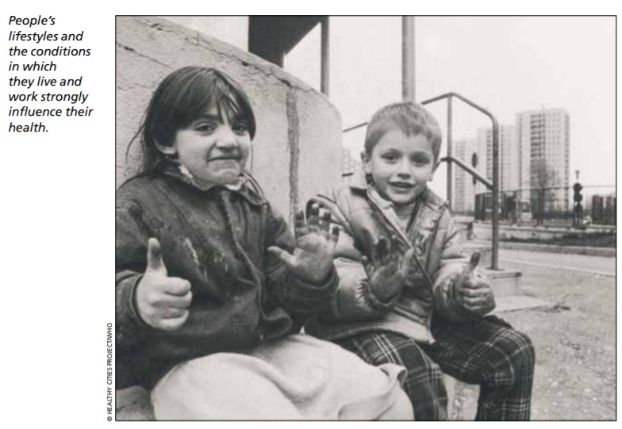
Social Factors

Slide 7
Social Factors
Social determinants of health reflect the social factors and physical conditions of the environment in which people are born, live, learn, play, work, and age.
Also known as social and physical determinants of health, they impact a wide range of health, functioning, and quality-of-life outcomes.

Slide 8
Examples of Social Determinants
Availability of resources to meet daily needs, such as educational and job opportunities, living wages, or healthful foods
Social norms and attitudes, such as discrimination
Exposure to crime, violence, and social disorder, such as the presence of trash
Social support and social interactions
Exposure to mass media and emerging technologies, such as the Internet or cell phones
Socioeconomic conditions, such as concentrated poverty
Quality schools
Transportation options
Public safety
Residential segregation

Slide 9
Examples of Physical Determinants
Natural environment, such as plants, weather, or climate change
Built environment, such as buildings or transportation
Worksites, schools, and recreational settings
Housing, homes, and neighborhoods
Exposure to toxic substances and other physical hazards
Physical barriers, especially for people with disabilities
Aesthetic elements, such as good lighting, trees, or benches

Slide 10
……Continued
Poor health outcomes are often made worse by the interaction between individuals and their social and physical environment.
For example, millions of people in the United States live in places that have unhealthy levels of ozone or other air pollutants. In counties where ozone pollution is high, there is often a higher prevalence of asthma in both adults and children compared with state and national averages. Poor air quality can worsen asthma symptoms, especially in children

Slide 11
Health Services
Both access to health services and the quality of health services can impact health. Healthy People 2020 directly addresses access to health services as a topic area and incorporates quality of health services throughout a number of topic areas.
Lack of access, or limited access, to health services greatly impacts an individual’s health status. For example, when individuals do not have health insurance, they are less likely to participate in preventive care and are more likely to delay medical treatment

Slide 12
…Health Services
Barriers to accessing health services include:
Lack of availability
High cost
Lack of insurance coverage
Limited language access
These barriers to accessing health services lead to:
Unmet health needs
Delays in receiving appropriate care
Inability to get preventive services
Hospitalizations that could have been prevented

Slide 13
Individual Behavior
Individual behavior also plays a role in health outcomes. For example, if an individual quits smoking, his or her risk of developing heart disease is greatly reduced.
Many public health and health care interventions focus on changing individual behaviors such as substance abuse, diet, and physical activity. Positive changes in individual behavior can reduce the rates of chronic disease nationally.

Slide 14
Examples of Individual Behavior
Diet
Physical activity
Alcohol, cigarette, and other drug use
Hand washing

Slide 15
Biology & Genetics
Some biological and genetic factors affect specific populations more than others. For example, older adults are biologically prone to being in poorer health than adolescents due to the physical and cognitive effects of aging.
Sickle cell disease is a common example of a genetic determinant of health. Sickle cell is a condition that people inherit when both parents carry the gene for sickle cell. The gene is most common in people with ancestors from West African countries, Mediterranean countries, South or Central American countries, Caribbean islands, India, and Saudi Arabia.

Slide 16
….Examples of Biology & Genetics
Age
Sex
HIV status
Inherited conditions, such as sickle-cell anemia, hemophilia, and cystic fibrosis
Carrying the BRCA1 or BRCA2 gene, which increases risk for breast and ovarian cancer
Family history of heart disease

Slide 17
Determinants of health reach beyond the boundaries of traditional health care and public health sectors; sectors such as education, housing, transportation, agriculture, and environment can be important allies in improving population health.

Slide 18

Thanks!

